Slide 1

OpenStack
Definition, Architecture & Status
Bruno Cornec, HPE WW Open Source and Linux Strategist
November 2017

Slide 2
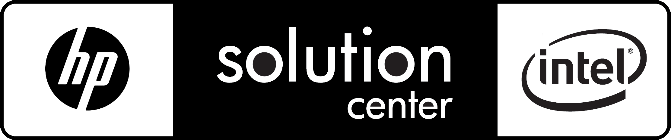


Introducing myself
Software engineering and Unices since 1988:
  Mostly Configuration Management Systems (CMS), Build systems, quality tools, on multiple commercial Unix systems
  Discovered Open Source & Linux (OSL) & made first contributions in 1993
  Full time on OSL since 1995, first as HP reseller then @HP
Currently:
  OSL Technology Strategist, EMEA EG Innovation Solution Center aka HP/Intel Solution Center, Grenoble
  HP OSL Advocate and Converged Infrastructure Ambassador
  WW Linux Community Lead for the HP Open Source Profession
  POSS conference, OpenStack.fr and AFUL board member. Conferences at WW level at LinuxCon, Linux.conf.au, ...
  MondoRescue, Project-Builder.org, UUWL and PUSK Project Lead
  LinuxCOE, mrepo, tellico, rinse, fossology, collectl, Ironic contributor
  FOSSBazaar/SPDX and OSL Governance enthusiast
  Mandriva, Mageia, Fedora packager
Notes:
Risks grow with every new opportunity in the market.
The New Style of Business requires the integration of security tools into every aspect of IT and operations.
With HP’s end-to-end approach, your business can focus on innovating and growth without compromise—and proactively handle security.
No matter your needs or size, Hewlett Packard Enterprise has the scale and market-leading suite of services and solutions to help, solidifying IT as the key driver of value.
Leading companies throughout the world rely on HPE to redefine security and protect their organization.
We know what it takes to transform. We’ve done it for the world’s leading companies, and we’d be honored to do it for you.

Slide 3



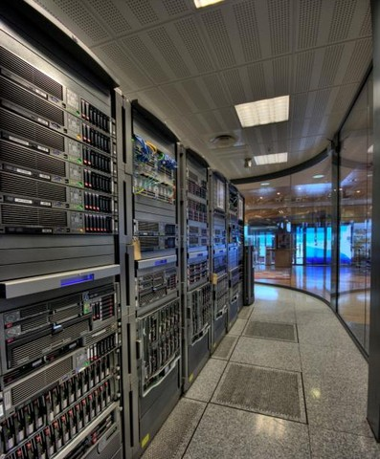

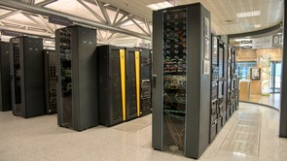
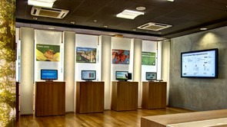

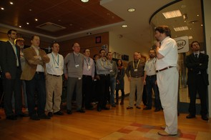

WW Customer Innovation Center
Grenoble
Making the new style of IT a reality
CoE
17+ years of success, world wide programs, including Cloud Center of Excellence, Big Data Center of Excellence, Open Source Solutions Initiative, RISC to HP Intel Architecture Migrations, NFV Center of Excellence and more
Complete IT (400+ systems, 3000+ network ports, 500+ TB storage)
Portfolio of 40+ ready to demo solutions with access to our ecosystem of Partners
Complete test & validation environment
Strategic partnerships with Intel, Red Hat, SUSE, Docker, Mesosphere, Microsoft, Vmware,
A unique proof point in the industry with a proven service offering
PoC
Live demo
Mission: Accelerate the adoption of new and innovative solutions by creating simple and rewarding end-to-end customer experiences that benefit our customers and partners, in a compelling and engaging collaborative environment.
…more information available at https://www.hpe.com/us/en/about/executive-briefing-centers/geneva.html
Workshop
Notes:
To remove the worry and risk from your migration, you can take advantage of a customer-ready infrastructure for running proof of concepts at the HP Intel Solution Centers. You can come to the center and migrate your database environment with assistance from HP, Intel and EDB experts.

Slide 4
Introducing HPE Solution Architect colleagues
René Ribaud – Training Development – OpenStack and DevOps specialist
Vincent Misson - OpenStack specialist – Reference Infrastructure specialist
Christophe Larsonneur – Training Development - DevOps specialist

Slide 5
Getting help
Support Mailing-list for the Reference IaaS managed by IT: ensimag-internal@lists.osp.hpe.com
Support Mailing-list for the Customer application and setup related questions: ensimag-customer@lists.osp.hpe.com
Provide your e-mail address to bruno.cornec@hpe.com be subscribed.

Slide 6
The OpenStack® project

Slide 7









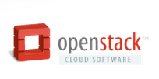
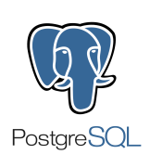






Open Source is the Infrastructure of the Cloud
Notes:
==============
KEY TALK TRACK
==============
For evidence on the rise and importance of open source in cloud infrastructure, we point to the broad ecosystem efforts across the entire infrastructure stack.
OpenStack technology at the IaaS layer
Cloud Foundry at the PaaS layer
MySQL & PostGres database
Hadoop for big data
Orchestration and configuration management tools such as Ansible, Salt, Puppet, and Chef.
With newcomers like Docker (containerization technology), there’s continuing evidence that the trend towards open is strong and vibrant.

Slide 8
Back to basics: *aaS ?
Managed by :
Client
Cloud Vendor
Traditional / on premises
IaaS
PaaS
SaaS
Apps
Apps
Apps
Apps
Data
Data
Data
Data
Runtime
Runtime
Runtime
Runtime
SW Middleware
Middle
ware
SW Middleware
SW Middleware
SW Middleware
Guest OS
Guest OS
Guest OS
Guest OS
Virtualiz.
Virtualiz.
Virtualiz.
Virtualiz.
Server
Server
Server
Server
Storage
Infra
structure
Storage
Storage
Storage
Network
Network
Network
Network
IT team
Sysadmin / Ops
Application Builder / Dev
Business User

Slide 9

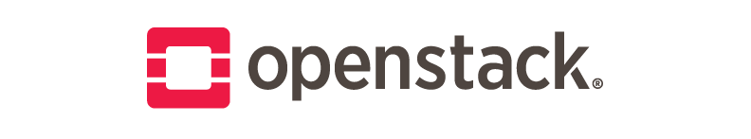


Bare-Metal vs VM vs Container
Bare metal
application layer
Virtualized
application layer
Containerized
application layer
Apps
Apps
Apps
Apps
Guest OS
Apps
Apps
Container
Host-OS
Hypervisor
Host-OS
Server
Server
Server
Storage
Infra
structure
Storage
Storage
Network
Network
Network

Slide 10
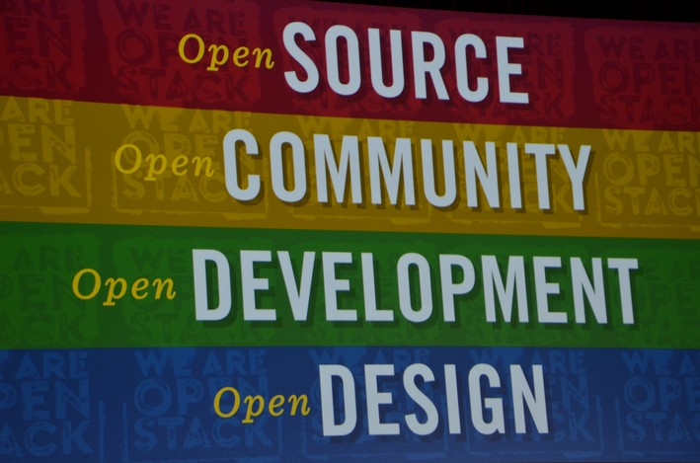
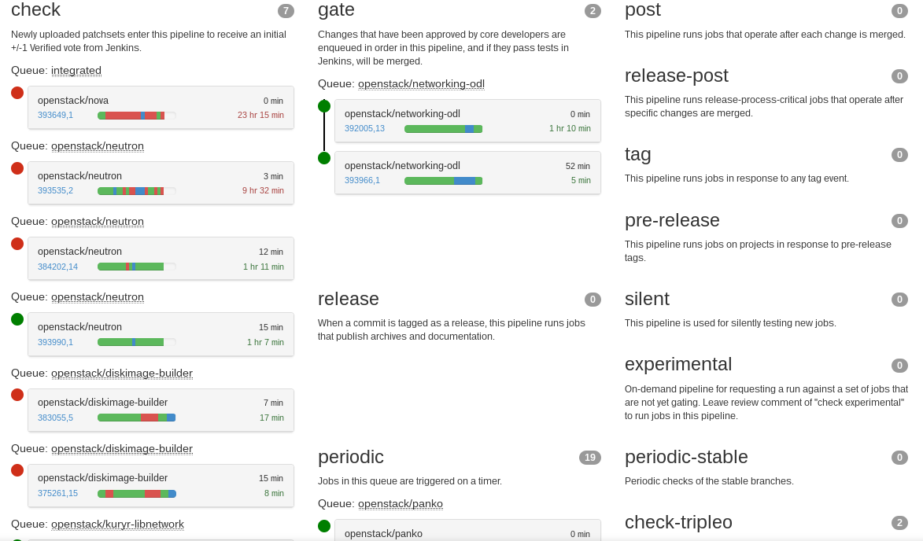
OpenStack Governance
  Open Source software -> not be limited in functionality or scalability
  Design summits -> open to the public
  Publicly available source code repository
  Community participation processes -> open and transparent

Slide 11





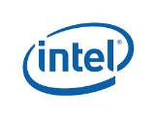
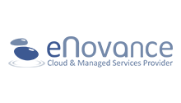



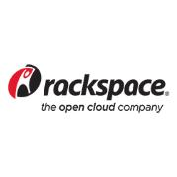
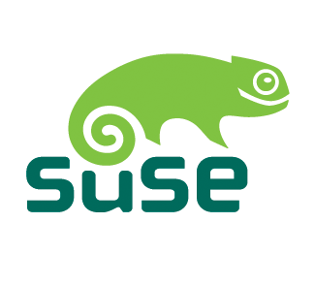







Who is using OpenStack® today ?
Source: http://www.openstack.org/user-stories/
Notes:
Information Technology

Slide 12
OpenStack Architecture

Slide 13




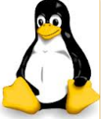


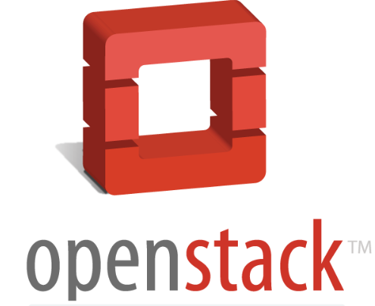
Back to basics: What is OpenStack®
“Open Source Cloud Computing platform that will meet the needs of public and private clouds”
Open Architecture – connect your own tools, leverage ecosystem, customize dashboard through a REST API
Open Source Infrastructure as a Service (IaaS) cloud computing platform
A series of interrelated projects that control pools of compute, storage and networking resources exposed as a consistent and open layer (API) for a heterogeneous infrastructure environment
Allocate Computing Resources to users
  Computing Power (CPU, Memory)
  Storage Space (Disk)
  Networking (Subnets)
Users manage their Cloud Infrastructure
  Create / Terminate instances (VMs), Networks, Storage and deployment images
http://www.openstack.org
  New release every 6 months
  Previous : February 2017 Ocata
  Stable :August 2017 Pike
  Next : February 2018 Queen
  Delivered under the Apache 2.0 license
Your applications
OpenStack
OpenStack dashboard
Cloud Operating System
COMPUTE
NETWORK
STORAGE
Infrastructure control layer above virtualized components + plugins infrastructure
OpenStack shared services
Heterogeneous infrastructure, different hypervisors, different vendors, different versions
Standard hardware
Notes:
OpenStack is a cloud operating system that controls large pools of compute, storage, and networking resources throughout a datacenter, all managed through a dashboard that gives administrators control while empowering their users to provision resources through a web interface. OpenStack is architected to provide flexibility as you design your cloud, with no proprietary hardware or software requirements and the ability to integrate with legacy systems and third party technologies. It is designed to manage and automate pools of compute resources and can work with widely available virtualization technologies, as well as bare metal and high-performance computing (HPC) configurations.
Compute
Administrators often deploy OpenStack Compute using one of multiple supported hypervisors in a virtualized environment. KVM and XenServer are popular choices for hypervisor technology and recommended for most use cases. Linux container technology such as LXC is also supported for scenarios where users wish to minimize virtualization overhead and achieve greater efficiency and performance. In addition to different hypervisors, OpenStack supports ARM and alternative hardware architectures.
Storage
In addition to traditional enterprise-class storage technology, many organizations now have a variety of storage needs with varying performance and price requirements. OpenStack has support for both Object Storage and Block Storage, with many deployment options for each depending on the use case. Object Storage is ideal for cost effective, scale-out storage. It provides a fully distributed, API-accessible storage platform that can be integrated directly into applications or used for backup, archiving and data retention. Block Storage allows block devices to be exposed and connected to compute instances for expanded storage, better performance and integration with enterprise storage platforms.
Network
Today's datacenter networks contain more devices than ever before including servers, network equipment, storage systems and security appliances many of which are further divided into virtual machines and virtual networks. The number of IP addresses, routing configurations and security rules can quickly grow into the millions. Traditional network management techniques fall short of providing a truly scalable, automated approach to managing these next-generation networks. At the same time, users expect more control and flexibility with quicker provisioning. OpenStack Networking is a pluggable, scalable and API-driven system for managing networks and IP addresses. Like other aspects of the cloud operating system, it can be used by administrators and users to increase the value of existing datacenter assets. OpenStack Networking ensures the network will not be the bottleneck or limiting factor in a cloud deployment and gives users real self service, even over their network configurations.
Dashboard
The OpenStack dashboard provides administrators and users a graphical interface to access, provision and automate cloud-based resources. The extensible design makes it easy to plug in and expose third party products and services, such as billing, monitoring and additional management tools. The dashboard is also brandable for service providers and other commercial vendors who want to make use of it.
The dashboard is just one way to interact with OpenStack resources. Developers can automate access or build tools to manage their resources using the native OpenStack API or the EC2 compatibility API.

Slide 14
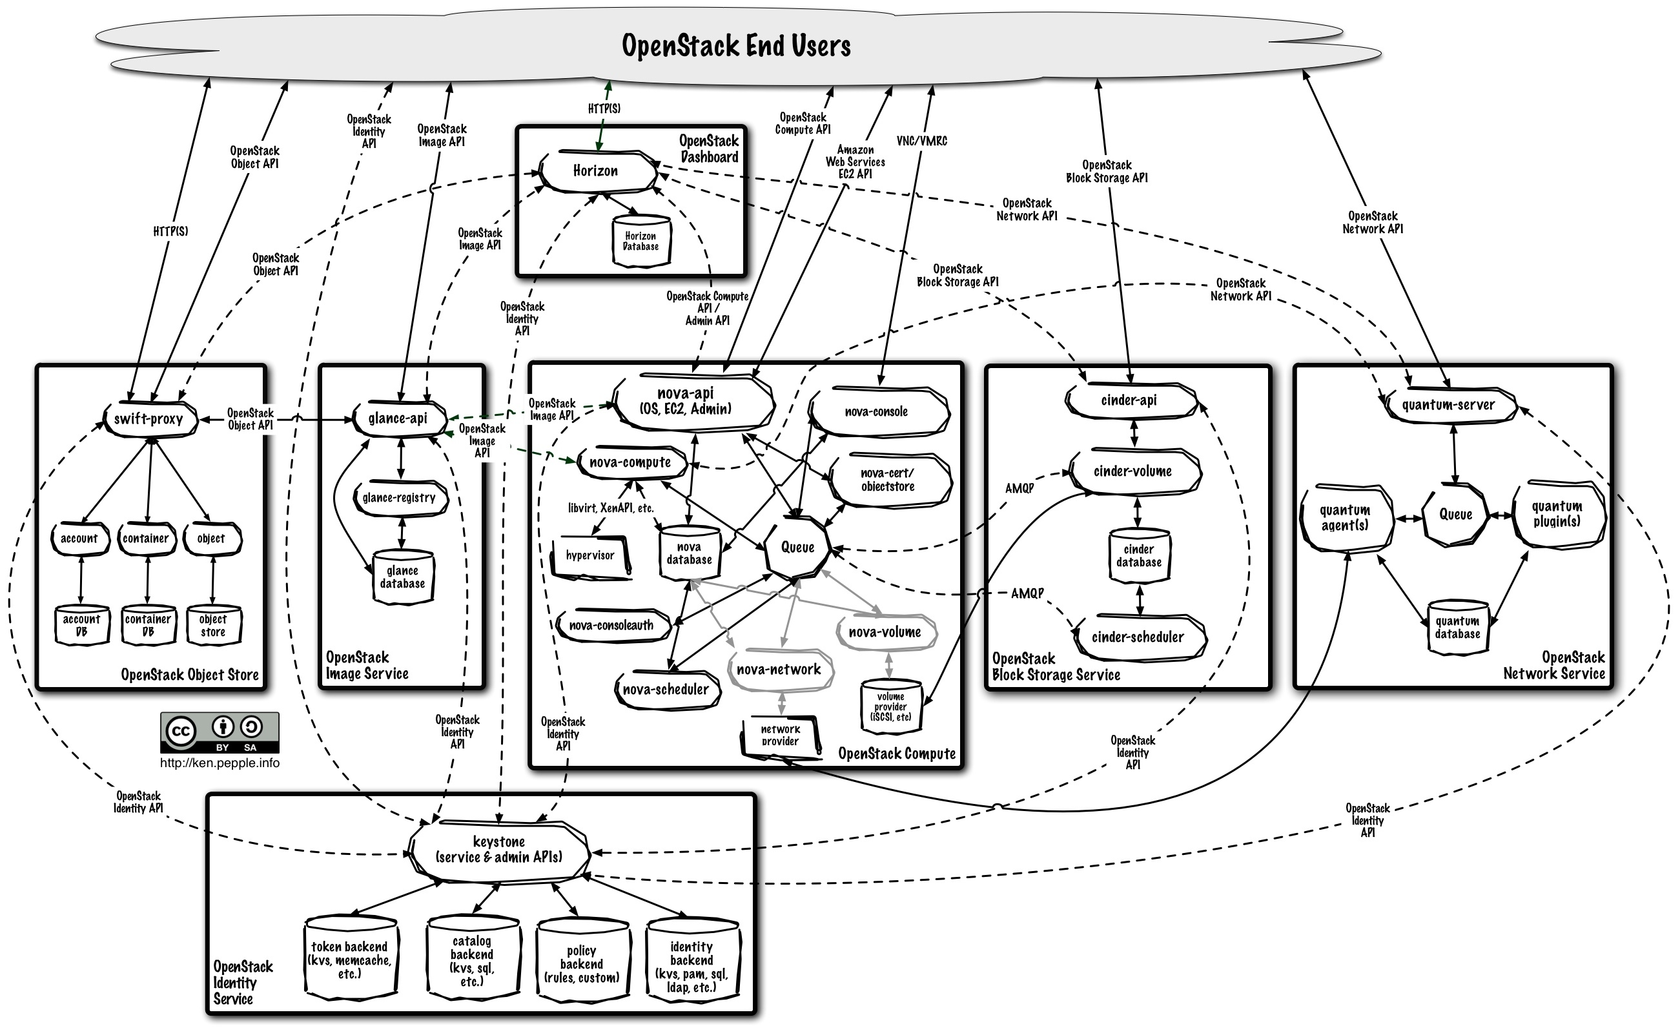




OpenStack® is simple. Well !
Dashboard
(Horizon)
Compute
(Nova)
Network
(Neutron)
Object Storage
(Swift)
Block Storage
(Cinder)
Usage Metrics
(Ceilometer)
Orchestration
(Heat)
Image
(Glance)
Bare metal
(Ironic)
Heat api
Heat api-cfn
Ceilometer api
data store
collector
Identity
(Keystone)
glance
poll
Templates
Heat Engine
Agent
queue
Templates
cinder
Compute agent
swift
quantum
nova
glance
quantum
cinder
nova

Slide 15
OpenStack® Project Teams
Bare metal (Ironic)
Queue service (Zaqar)
Key Management (Barbican)
DNS Services (Designate)
Shared File Systems (Manila)
Management (Monasca)
Common Libraries (Oslo)
Infrastructure
Documentation
Quality Assurance (QA)
Deployment (TripleO)
Standalone deployment (Devstack)
Release cycle management
Compute (Nova)
Object Storage (Swift)
Image Service (Glance)
Identity (Keystone)
Dashboard (Horizon)
Networking (Neutron)
Block Storage (Cinder)
Metering/Monitoring (Ceilometer)
Orchestration (Heat)
Database Service (Trove)
Data processing (Sahara)
Containers (Magnum)
+ the Big Tent approach
Source: http://git.openstack.org/cgit/openstack/governance/tree/reference/programs.yaml

Slide 16
OpenStack Architecture step by step

Slide 17
OpenStack Architecture step by step
Toolkit & API: libvirt
Domains support :
Virtual machines, (KVM, XEN, ESX, Hyper-V)
Containers (LXC, OVZ)
Networks support :
virtual private networks
NAT virtual network
bridges to physical networks
Storage support:
ISCSI/SCSI
Local/network FS
LVM, multipath, RBD
OpenSource Hypervisor: KVM
Part of the standard Linux kernel since version 2.6.20 (Feb 2007) - Production ready
Benefits from the latest kernel optimizations
Benefits from HW assisted technology (VT-d aka I/O MMU virtualization aka PCI pass-through, VT-c aka Network Virtualization, VMDQ aka Virtual Machine Device Queue, SRIOV aka Single Root I/O Virtualization, NPIV aka N_Port ID Virtualization...)
  Provides flexibility by supporting multiple guest OSes (Linux, Windows, Solaris, ...)
Supported by the 3 main commercial Linux distributions:
Red Hat Enterprise Linux, Novell SUSE Linux Enterprise Server, Canonical Ubuntu => no specific certification required
KVM HyperVisor
Libvirt
VM1
ethX
VM2
ethX
VMn
ethX
DATA
OpenSource Cmpnt

Slide 18
OpenStack Architecture step by step
Nova Ctrl
Compute Ctrl
OpenStack Compute: nova
Scheduler Receives user requests
API driven
console
Nova Compute
Manages instances lifecycle
Hypervisor agnostic
Asynchronous communication
Scale out architecture
Hardware agnostic
MGT
KVM HyperVisor
Nova Compute
Libvirt
Compute Node
VM1
ethX
VM2
ethX
VMn
ethX
DATA
OpenStack Cmpnt
OpenSource Cmpnt

Slide 19
OpenStack Architecture step by step
Nova Ctrl
Compute Ctrl
OpenStack Network: neutron
Software Defined Network Controller
Manages public, private Net, extended Net, floating Ips, Multi-tenancy
Net, subnet, ports, routers, DVR
Neutron Agent
on the compute node
Manages OpenVswitch configurations up to the VMs
Creates end to end tunnels for each network
MGT
KVM HyperVisor
Nova Compute
Libvirt
Compute Node
Neutron Agent
Open Vswitch
Network Node
VM1
ethX
VM2
ethX
MGT
VMn
EXT
Neutron
DATA
ethX
Network Ctrl
DATA
OpenStack Cmpnt
OpenSource Cmpnt
Note that the network topology shown here is purely theoritical and for supporting the global explanations
A real OpenStack network topology is much more comprehensive and complex in reality

Slide 20
OpenStack Architecture step by step
Nova Ctrl
Compute Ctrl
OpenStack Identity: keystone
Shared service providing:
Concepts managemrnt : Region / User / Tenant / Role
Service catalog
  Available services
  Service endpoints (APIs)
Common authentication (AuthN) and authorization (AuthZ)
Support many authenticaton:
  Forms : Username/passwd, tokens
  Backends : SQL, LDAP,
  AD, PAM, Key
Cloud Ctrl
MGT
MGT
KVM HyperVisor
Nova Compute
Libvirt
Compute Node
Neutron Agent
Open Vswitch
Network Node
Keystone
VM1
ethX
VM2
ethX
MGT
VMn
EXT
Neutron
DATA
ethX
Network Ctrl
DATA
OpenStack Cmpnt
OpenSource Cmpnt

Slide 21
OpenStack Architecture step by step
Nova Ctrl
Compute Ctrl
OpenStack Images: glance
System disk image repository
Supports different disk image format:
  VMDK (VMware),
  QCOW2 (Qemu/KVM)
  OVF (VMware/others),
  VDI (VirtualBox)
  VHD (Hyper-V)
Metadata support (for filtering)
Manages Snapshots
Able to stream images from an object store up to the VM
Cloud Ctrl
MGT
MGT
KVM HyperVisor
Nova Compute
Libvirt
Compute Node
Neutron Agent
Open Vswitch
Network Node
Keystone
VM1
Glance
ethX
VM2
ethX
MGT
VMn
EXT
Neutron
DATA
ethX
Network Ctrl
DATA
OpenStack Cmpnt
OpenSource Cmpnt

Slide 22
OpenStack Architecture step by step
Nova Ctrl
Compute Ctrl
OpenStack Block Storage: cinder
Manages persistant File System Storage
Access associated to a VM
Works on top of LVM
Single attachment
ISCSI or FC based mounted FS (drivers for MSA, Lefthand and 3PAR managing volumes & snapshots)
Note : local VM storage
is ephemeral
Cloud Ctrl
MGT
MGT
KVM HyperVisor
Nova Compute
Libvirt
Compute Node
Neutron Agent
Open Vswitch
Network Node
Keystone
VM1
Glance
ethX
VM2
ethX
MGT
VMn
EXT
Neutron
DATA
ethX
Network Ctrl
DATA
Cinder
MGT
OpenStack Cmpnt
Storage Ctrl
OpenSource Cmpnt
Storage

Slide 23
OpenStack Architecture step by step
Nova Ctrl
Compute Ctrl
OpenStack Object Storage: swift
Put / Get objects through HTTPS
(no filesystem, UUID based)
Access from everywhere
Data distributed with replication
Erasure coding
Scalable to PB
May be used with Glance
Hardware agnostic (no RAID required)
Cloud Ctrl
MGT
MGT
KVM HyperVisor
Nova Compute
Libvirt
Compute Node
Neutron Agent
Open Vswitch
Network Node
Keystone
VM1
Glance
ethX
VM2
ethX
MGT
VMn
EXT
Neutron
DATA
ethX
Network Ctrl
DATA
Cinder
MGT
OpenStack Cmpnt
Storage Ctrl
Swift
OpenSource Cmpnt
Storage

Slide 24
OpenStack Architecture step by step
Nova Ctrl
Compute Ctrl
OpenStack Dashboard: horizon
- The Admin dashboard
Web based UI to manage the infrastructure & controllers
Support all OpenStack concepts
Overall view of size and state of the cloud.
Creation of all resources, assignment of users to projects, and limits on the resources
- The User dashboard
self-service portal to provision resources planned by the admin
Cloud Ctrl
MGT
MGT
Horizon
KVM HyperVisor
Nova Compute
Libvirt
Compute Node
Neutron Agent
Open Vswitch
Network Node
Keystone
VM1
Glance
ethX
VM2
ethX
MGT
VMn
EXT
Neutron
DATA
ethX
DATA
Cinder
MGT
OpenStack Cmpnt
Storage Ctrl
Swift
OpenSource Cmpnt
Storage

Slide 25
OpenStack Architecture step by step
Nova Ctrl
Compute Ctrl
OpenStack Measurement: ceilometer
Collection of metering data (on nova, neutron, cinder, glance)
Push or pull interface
Manages the full chain : collect, transform, publish and store info
Data metered available through a REST API
Type of data collected configurable
CloudKitty extension for billing
Cloud Ctrl
MGT
MGT
Horizon
KVM HyperVisor
Nova Compute
Libvirt
Compute Node
Neutron Agent
Ceilometer
Open Vswitch
Network Node
Keystone
VM1
Glance
ethX
VM2
ethX
MGT
VMn
EXT
Neutron
DATA
ethX
Network Ctrl
DATA
Cinder
MGT
OpenStack Cmpnt
Storage Ctrl
Swift
OpenSource Cmpnt
Storage

Slide 26
OpenStack Architecture step by step
Nova Ctrl
Compute Ctrl
OpenStack Orchestration: heat
Template based orchestration
Describe a cloud application
Execute appropriate OpenStack API calls to generate applications
Most OpenStack resources are available (instances, floating Ips, volumes, users, security groups, ...)
Supports custom plugins
Cloud Ctrl
MGT
MGT
Horizon
KVM HyperVisor
Nova Compute
Libvirt
Compute Node
Heat
Neutron Agent
Ceilometer
Open Vswitch
Network Node
Keystone
VM1
Glance
ethX
VM2
ethX
MGT
VMn
EXT
Neutron
DATA
ethX
Network Ctrl
DATA
Cinder
MGT
OpenStack Cmpnt
Storage Ctrl
Swift
OpenSource Cmpnt
Storage

Slide 27
OpenStack Architecture step by step
Nova Ctrl
Compute Ctrl
OpenStack Monitoring: monasca
Monitoring at scale
Extended with Elastic Search, Logstash, Kibana
Cloud Ctrl
MGT
MGT
Horizon
KVM HyperVisor
Nova Compute
Monasca
Libvirt
Compute Node
Heat
Neutron Agent
Ceilometer
Open Vswitch
Network Node
Keystone
VM1
Glance
ethX
VM2
ethX
MGT
VMn
EXT
Neutron
DATA
ethX
Network Ctrl
DATA
Cinder
MGT
OpenStack Cmpnt
Storage Ctrl
Swift
OpenSource Cmpnt
Storage

Slide 28
OpenStack Architecture step by step
Nova Ctrl
Compute Ctrl
OpenStack Project
Managed by a single nova compute controller
Span across Hypervisors
Cloud Ctrl
MGT
MGT
MGT
Horizon
KVM HyperVisor
KVM HyperVisor
Nova Compute
Nova Compute
Project 1
Monasca
Libvirt
Libvirt
Heat
Neutron Agent
Neutron Agent
Project n
Ceilometer
Open Vswitch
Open Vswitch
Keystone
VM1
VM1
Glance
ethX
ethX
VM2
VM2
ethX
ethX
MGT
VMn
VMn
EXT
Neutron
DATA
ethX
ethX
Network Ctrl
DATA
Cinder
MGT
OpenStack Cmpnt
Storage Ctrl
Swift
DATA
OpenSource Cmpnt
Storage

Slide 29
OpenStack Architecture step by step
Nova Ctrl
Compute Ctrl
OpenStack Availability Zone
Creates nova compute node groups sharing common features
e.g: HDD vs SDD Compute nodes
Cloud Ctrl
MGT
MGT
MGT
Horizon
KVM HyperVisor
KVM HyperVisor
Nova Compute
Nova Compute
Availability Zone 1
Monasca
Libvirt
Libvirt
Heat
Neutron Agent
Neutron Agent
Availability Zone n
Ceilometer
Open Vswitch
Open Vswitch
Keystone
Glance
MGT
MGT
MGT
KVM HyperVisor
KVM HyperVisor
EXT
Neutron
DATA
Nova Compute
Nova Compute
Network Ctrl
Libvirt
Libvirt
Cinder
Neutron Agent
Neutron Agent
MGT
OpenStack Cmpnt
Storage Ctrl
Swift
Open Vswitch
Open Vswitch
OpenSource Cmpnt
Storage

Slide 30
OpenStack Architecture step by step
OpenStack Region
Managed by its own nova compute controller – Central Auth + Mngt
MGT
Horizon
MGT
MGT
Cloud Ctrl
Keystone
Cloud Ctrl
KVM HyperVisor
MGT
MGT
KVM HyperVisor
Nova Compute
Nova Compute
Nova Ctrl
Nova Ctrl
Libvirt
Libvirt
Neutron Agent
Monasca
Monasca
Neutron Agent
Open Vswitch
Heat
Heat
Open Vswitch
Ceilometer
Ceilometer
MGT
MGT
KVM HyperVisor
Glance
Glance
KVM HyperVisor
Nova Compute
Nova Compute
Libvirt
Neutron
Neutron
Libvirt
Neutron Agent
Neutron Agent
Open Vswitch
Cinder
Cinder
Open Vswitch
Swift
Swift
Region 1
Region n

Slide 31
Where to learn more
OpenStack web page
http://www.openstack.org
OpenStack documentation
http://docs.openstack.org
HP Helion OpenStack web page
http://www.hpe.com/helion
OpenStack Technology
https://www.youtube.com/watch?v=HQN0_dLchmk

Slide 32
Linux Containers and Docker

Slide 33
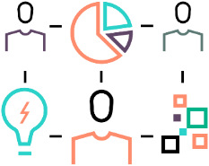
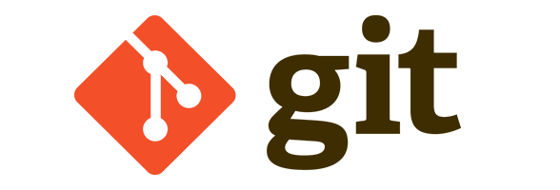


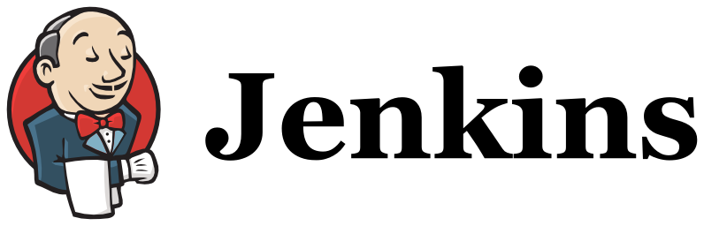
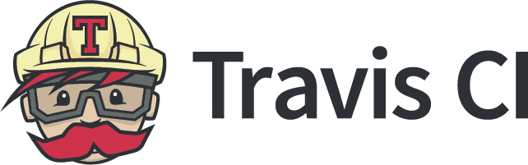
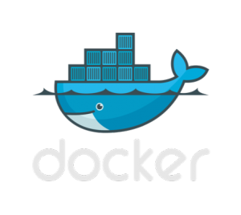
Container-as-a-Service enabling IT transformation
Container-as-a-Service for CI/CD Composability use case
Communities enablement
Developpers
QA/Test
Operations
From infrastructure to the cloud
Cloud native & monolith Applications
Composable Infrastructure
+
+
Hybrid Cloud
Build
Ship
Run
Agile development environment :
Tested. Integrated. Portable. Optimized. Secured
Notes:
HPE Tested, Supported, Guaranteed—HPE IT’s Docker in the Datacenter (DiDC) showcases HPE’s own internal Docker Data center based CaaS running enterprise scale IT workloads for Hewlett Packard Enterprise. This CaaS blueprint enables organizations to build, ship, and run distributed applications and deliver a platform to deploy micro services with optimized core systems, accelerated application development, and reduced costs.

Slide 34
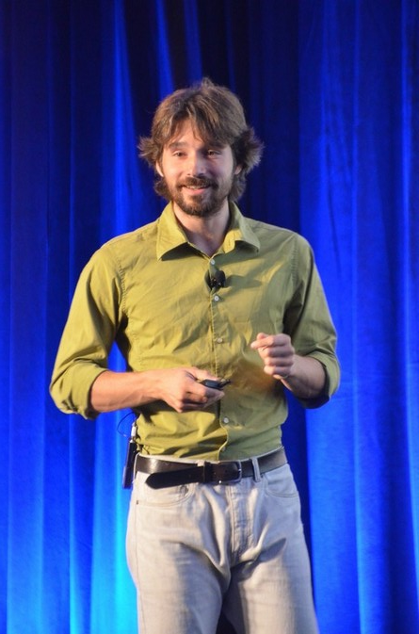
What is Docker value-add ?
Run applications in a neutral, lightweight and portable way
  Bundle: Everything packed together
  Layers: Images (ro) & containers (rw) using a union FS
  Registry: public/private registry of shared images
  Dockerfile: descriptive build of an image
  Volumes: loopback mounting host FS into container
  Ports: expose container services port to the host
  Portable: created once, run everywhere (on a given OS)
  Management: REST API/CLI
  Enterprise: Docker Enterprise (formerly DDC)
Solomon Hykes, Docker Inc.

Slide 35
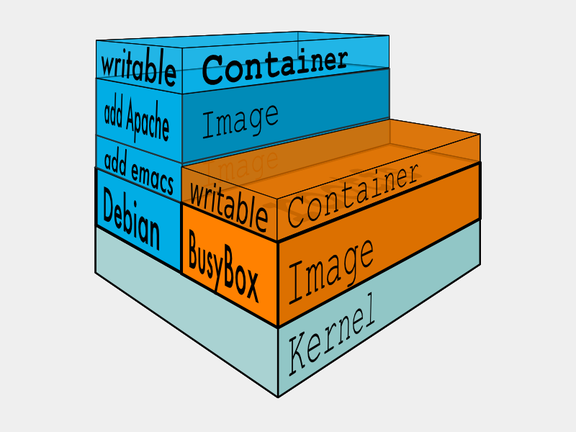
A layered approach
Images
  Local or remote reference content to initiate a container
  Multiple images can be layered adding content at each time using Copy on Write FS
  Cache to speed up repeated operations
Containers
  Last layer providing rw access to the cumulated set of images
1 application + its deps == 1 container

Slide 36

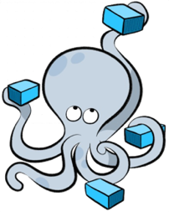
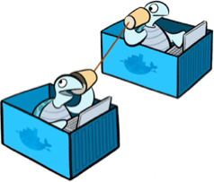
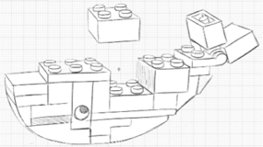
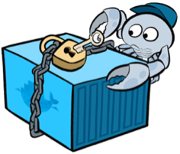
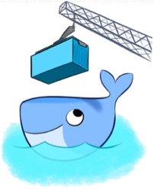
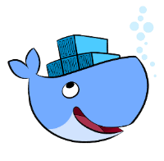
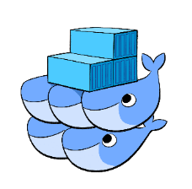
Docker’s world
Docker solutions and plumbling tools
Docker Machine
Automated Provisioning
Docker Compose
Service Composition
Notary
Security
Docker Libnetwork
Networking
Plugin
Extensibility
Docker Engine
Creates & Runs
containers
Docker UCP
Deploy & Manage
Docker Swarm
Native Host
Clustering
Docker Hub/Registry
Package & Distribution

Slide 37
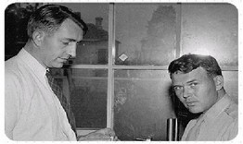
THANK YOU
Bruno.Cornec@hpe.com
(Open Source and Linux Technology Strategist
at the HP/Intel Solution Center)
http://downloads.linux.hpe.com/
Linus Torvalds, Richard Stallman, Eric Raymond, Nat Makarevitch, René Cougnenc, Eric Dumas, Rémy Card, Bdale Garbee, Bryan Gartner, Craig Lamparter, Lee Mayes, Gallig Renaud, Andree Leidenfrost, Phil Robb, Bob Gobeille, Martin Michlmayr among others, for their work and devotion to the Open Source Software cause... and my family for their patience :-)
”Changes are never easy to make.
There is comfort and safety in tradition, but change must come, no matter how painful or expensive it may be.”
Bill Hewlett

