Slide 1

Ensimag Project - 2017/2018
Bruno Cornec
Christophe Larsonneur
Vincent Misson
René Ribaud

Slide 2
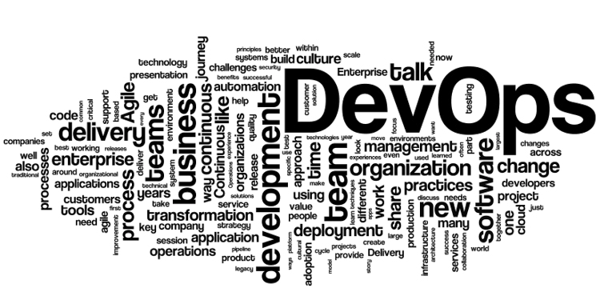
DevOps Project
Productize an Open Source project
Adopt a DevOps mindset to deliver quickly your project with quality
Explore and apply technologies
Contribute to Open Source Community

Slide 3
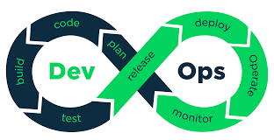


DevOps Project
A lottery for e-Commerce
Public
Uggla/
cloud_native_app
Your Company
Fork
YourOrg/
cloud_native_app
Infra repository
Software
Factory
Your Customer
Packstack
Monitoring
Application
Instance

Slide 4
Planning sessions
Nov | December |  |  |  | January
S1 | S2 | S3 | S4 | Christmas | New year | S5 | S6 | S7 | S8
Mar 28 | Mar 5 | Mar 12 | Mar 19 |  |  | Mar 9 | Mar 16 | mar 23 | mar 30
Presentations + setup |  | Development |  |  |  |  |  | Pre-eval | Evaluation

Slide 5
Planning sessions
Session 1 – 28 November 2017 – 14:00-17:00
Welcome – This presentation – René & Christophe
Openstack architecture & example – Bruno
Introduction to Docker – Bruno
Your company Openstack environment – Vincent
Reference Environment
Open VPN setup & Waystation creation

Slide 6
Planning sessions
Session 2 – 05 December 2017 – 14:00-17:00
DevOps fundamentals – Christophe
Application overview - René
IaC – Openstack API as TD - Bruno
Project explanation – Christophe - René
(spec/design/constraints & goals)

Slide 7
Planning sessions
Session 3 to 6: 12 dec, 19 dec, 09 jan, 16 jan - 15:30-18:30
Session open for discussion & follow-up
Session 7 – Pre-evaluation – 23 January 2018
Synthesis
Group presentation
Integrate a customer request in your factory.
Session 8 – Evaluation – 30 January 2018 (25‘ per group)
Architecture, roles, tasks done, code, commits, deployment flow, Process used

Slide 8
Evaluation criterias
Dev team - 5 points
Github, design, automation, ...
Factory team - 5 points
Github, design, automation, services, support, maintenance, ...
Production services - 5 points
Application, services, cloud, ...
Project life - 5 points
Maintenance, agile, chatops, issues tracking, support, upstream relationship, ...

Slide 9
Q/A & References
https://github.com/uggla/cloud_native_app

