Slide 1
AAVAIL revenue predictor
Exploratory Data Analysis

Slide 2
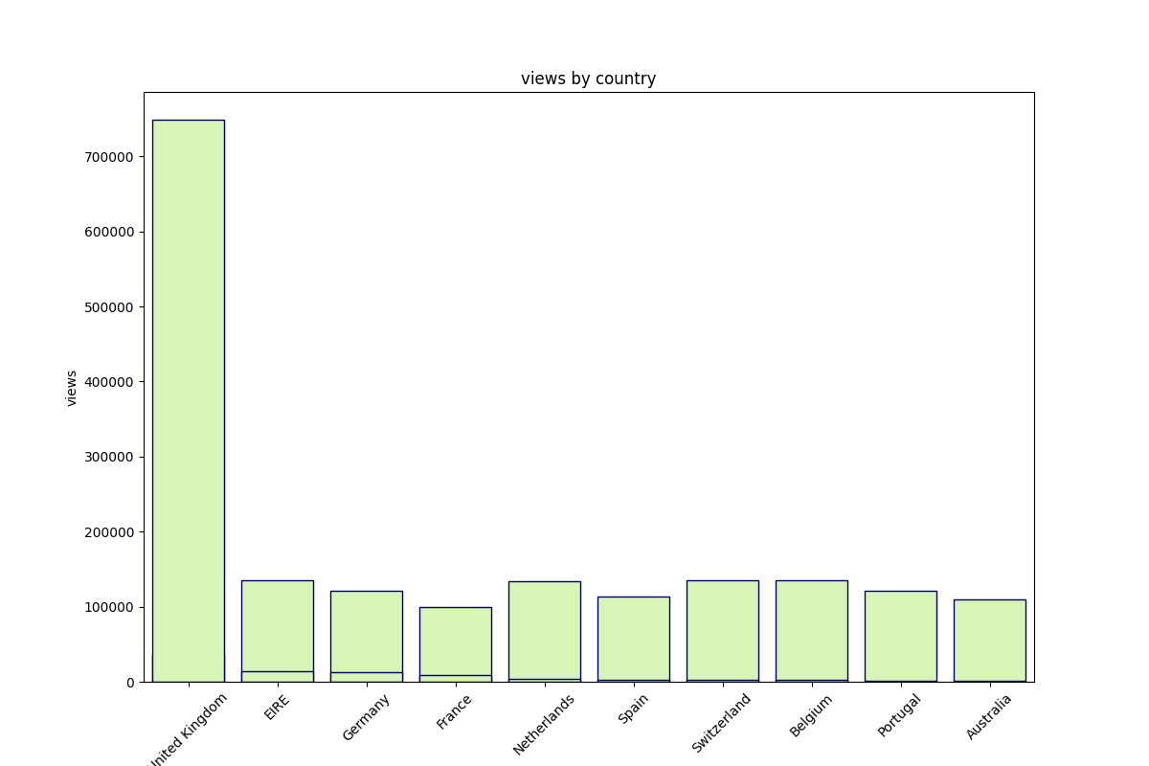
Revenues are concentrated mainly in one country : UK
All other countries have a revenue that is relatively balanced

Slide 3
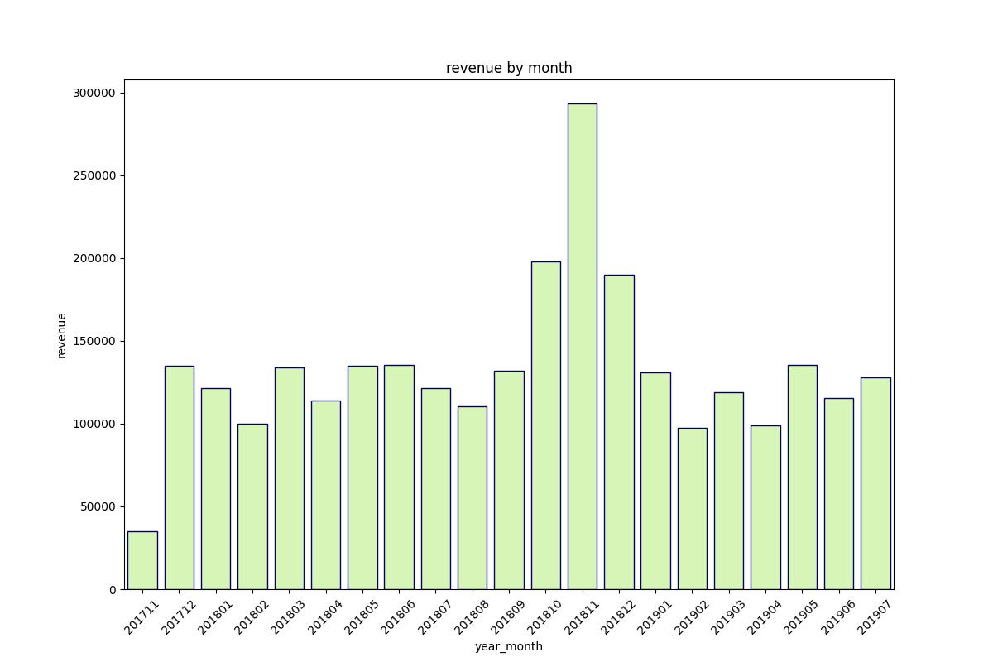
It is not sure if revenue has some kind of seasonality. We can see a major peak on 2018 November but we have not enough data to confirm this. On 2017 November and December such peak is not present. This could be due to the fact that the business was ramping up at the time but revenue has not growth much since then

Slide 4
The conclusion is that the revenue seems to have a regular distribution among time. It is also regularly distributed among countries (except for UK).

