Slide 1
AAVAIL model evaluation
Evaluation of models performances against golden source

Slide 2
We created three models using different algorithms . Trained them and then checked the error on both the training set and the test set.
Then we also run each model on the full set of data available and plot the error ( abs(y_pred – y)) distribution .
The code to perform this task is placed in the file: model_selection.py
Running it will create a selection folder in which there are for each algorithm:
An image of the graph of the error distribution
A csv with the error for each date in the sample data used for evaluation
The three model where created with these algorithms:
Random Forest
MLP
SVM

Slide 3
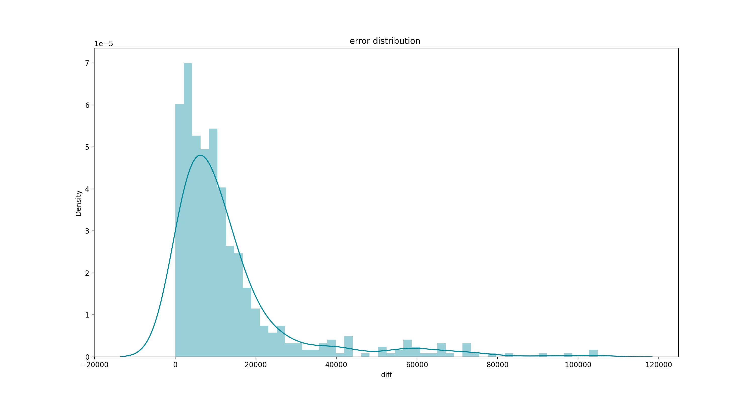
Random Forest
Rmse on test set: 8134
Rmse on training set: 3891

Slide 4
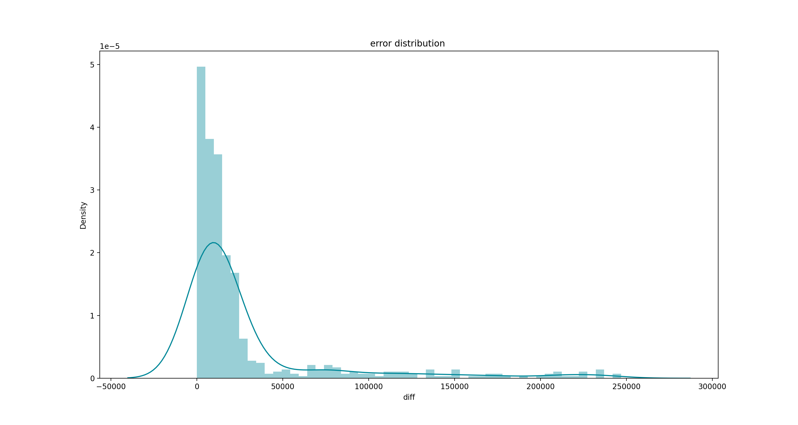
MLP
Rmse on test set: 9957
Rmse on training set: 9272

Slide 5
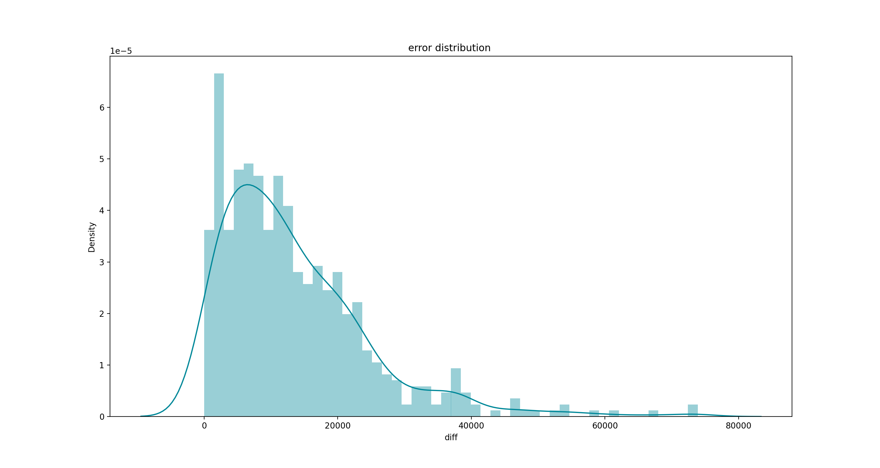
SVM
Rmse on test set: 47893
Rmse on training set: 50798

Slide 6
Both the Random Forest model and the MLP model performed similarly regarding the values of the error mean (rmse) on the training test. While the SVM had a much higher error mean . All three models generalized quite well from the training to the test set. Only the Random Forest shown a little sign of overfitting.
Considering the performances and the fact that the MLP consumes much more resources (both RAM and CPU) to train we have decided to use the Random Forest model for production.
Also the MLP had a distribution of errors that was more spread with significative percentage of samples in which the prediction was wrong for a quantity of the same order of magnitude of the prediction. So Random Forest model seems more stable

