Slide 1
AAVAIL
Analysis of Pay per View Data

Slide 2
Table of contents
Distribution of revenue by time
Distribution of revenue by country

Slide 4
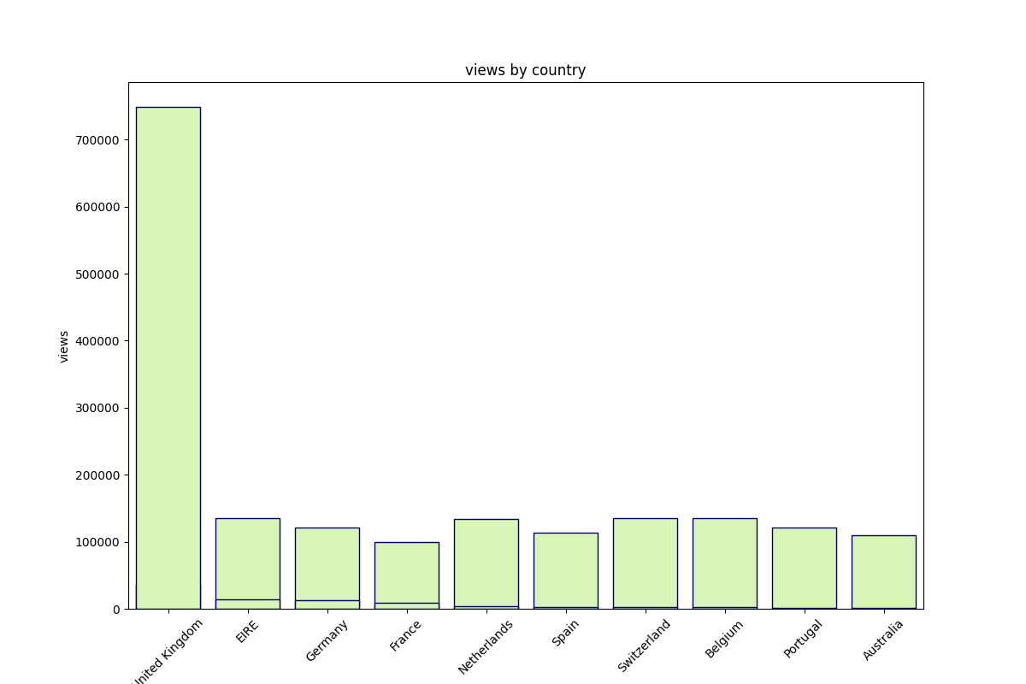
Views By Country

Slide 5
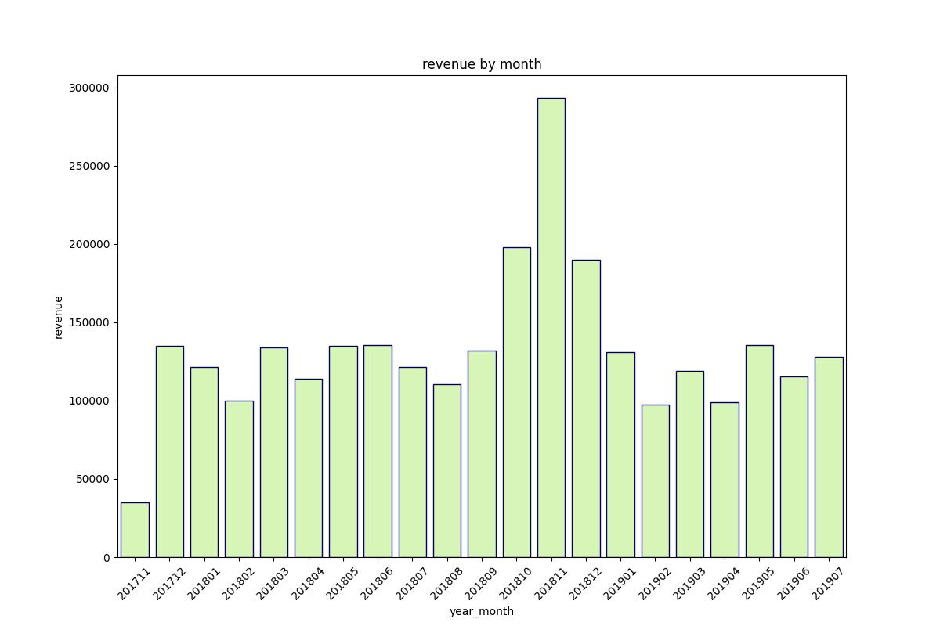
Revenue by Month

