Slide 1
Title: Breast Cancer Risk Estimation with Intelligent Algorithms for Cuban Women
Authors:
1. Eugene Munyaneza
2024/HD05/21936U
2. Khadija Athman
2024/HD05/21918U
Presented by – Eugene & Khadija
Affiliation: Makerere University
Uganda

Slide 2
Introduction
Topic: Using machine learning to improve breast cancer risk estimation for Cuban women.

Slide 3
Background
Breast cancer: leading cause of mortality among women globally.
In Cuba, high mortality is linked to late detection and limited access to quality treatment.
Notes:
The dataset can be found here.

Slide 4
Literature Review
Traditional Models: Gail model, Barlow, Tyrer-Cuzick (IBIS).
Limitations: Ineffective in predicting risks for non-Western populations like Cuban women.
Advances: Use of machine learning models for personalized predictions.
Notes:
The dataset can be found here.

Slide 5
Gaps in Related work
Existing models lack population-specific calibrations for Cuban women.
Most models do not account for risk factors unique to this demographic, such as diet and healthcare access.

Slide 6
Problem Statement
Current breast cancer risk models fail to accurately estimate risks for Cuban women, contributing to higher mortality rates.

Slide 7
Significance of the Project
Provides a tailored machine learning-based model that improves the prediction accuracy for breast cancer risk in Cuba.
Potential to be a cost-effective solution for other Latin American countries.

Slide 8
ML Research Objectives
Develop a model to estimate breast cancer risk based on Cuban women’s data.
Evaluate and compare machine learning algorithms to determine the best predictor.

Slide 9
Research Questions
Can machine learning algorithms improve breast cancer risk estimation for Cuban women?
Which algorithm provides the highest accuracy and interpretability for this demographic?

Slide 10
Dataset Description
Cuban Dataset: 1,697 cases from Cuban hospitals.
US Hispanic Dataset: Breast Cancer Surveillance Consortium data for comparative validation.

Slide 11
Methodology
Data Preprocessing: Cleaning, normalization, and handling missing values.
Feature Selection: Identifying key predictors (e.g., BMI, family history).
Model Training: Using Decision Trees, SVM, and Random Forest.
Hyperparameter Tuning: Optimizing parameters like max depth (DT), kernel (SVM), and n_estimators (RF).
Validation: Evaluating model performance with metrics like AUC and accuracy.

Slide 12
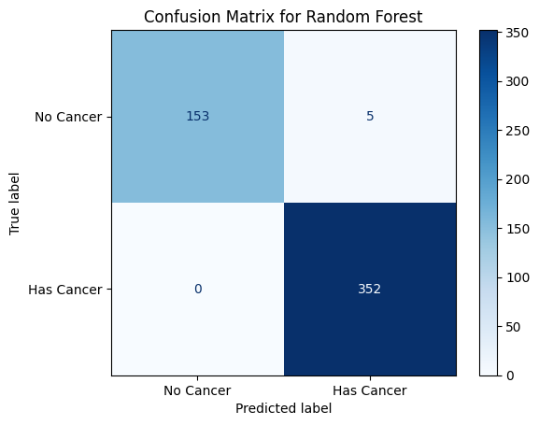
Cont’

Slide 13
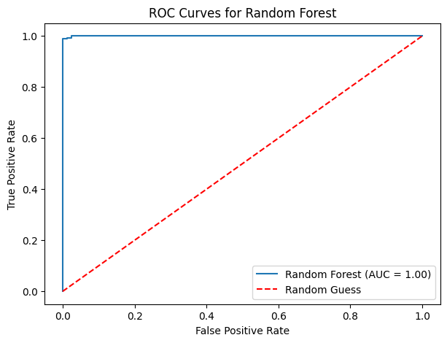
Cont’

Slide 14
Project Results
Best Algorithm: Random Forest (Accuracy: 0.99, AUC: 1).
Key Finding: Cuban dataset-based models outperformed models trained on US Hispanic data.
Notes:
Link: https://sorry.vse.cz/~berka/challenge/PAST/

Slide 15
Explainability
LIME
SHAP
SHAP was chosen
Notes:
Link: https://www.kaggle.com/datasets/santoshd3/bank-customers

Slide 16
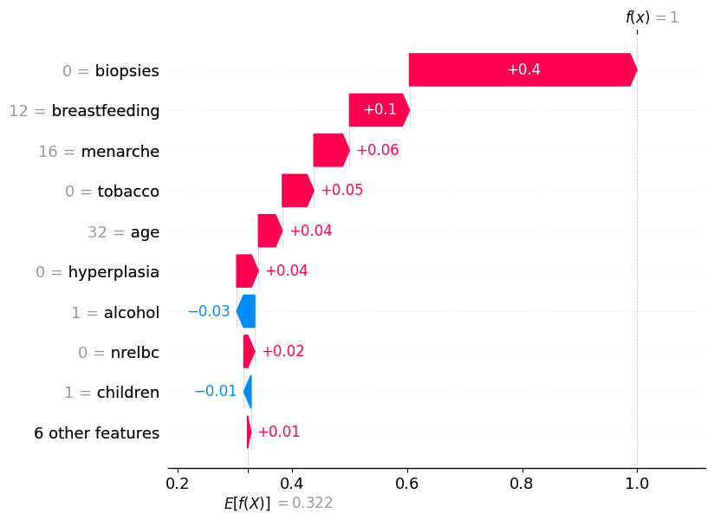
Cont’
Notes:
Link: https://www.kaggle.com/datasets/santoshd3/bank-customers

Slide 17
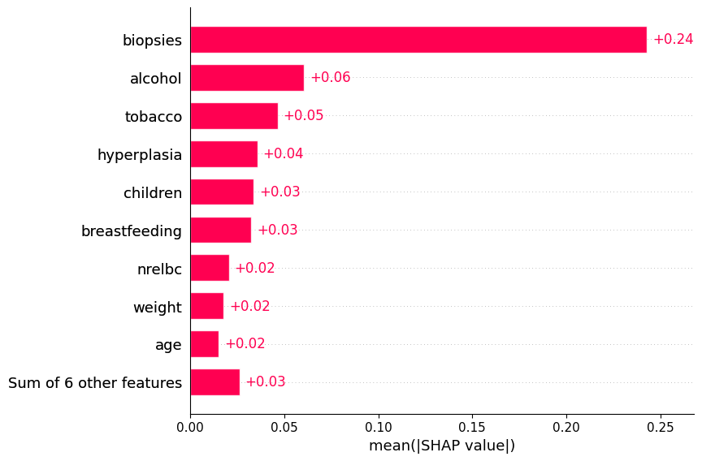
Cont’
Notes:
Link: https://www.kaggle.com/datasets/santoshd3/bank-customers

Slide 18
Conclusion and Future Work
Conclusion: The model provides better estimates of breast cancer risk for Cuban women, with the potential for use in other developing countries.
Future Work: Expanding the dataset, refining feature selection, and developing clinical tools for implementation.

Slide 19
References
[1] Richard Allman, Yi Mu, Gillian S Dite, Erika Spaeth, John L Hopper, and
Bernard A Rosner. Validation of a breast cancer risk prediction model based on the key risk factors: family history, mammographic density and polygenic risk. Breast Cancer Research and Treatment, 198(2):335–347, 2023.
[2] William E Barlow, Emily White, Rachel Ballard-Barbash, Pamela M
Vacek, Linda Titus-Ernstoff, Patricia A Carney, Jeffrey A Tice, Diana SM Buist, Berta M Geller, Robert Rosenberg, et al. Prospective breast cancer risk prediction model for women undergoing screening mammography. Journal of the National Cancer Institute, 98(17):1204–1214, 2006.
[3] Laura Fejerman, Amelie G Ramirez, Anna Mar´ıa Napoles, Scarlett Lin ´ Gomez, and Mariana C Stern. Cancer epidemiology in hispanic populations: what have we learned and where do we need to make progress? Cancer Epidemiology, Biomarkers & Prevention, 31(5):932–941, 2022.
[4] Pantelis Linardatos, Vasilis Papastefanopoulos, and Sotiris Kotsiantis.
Explainable ai: A review of machine learning interpretability methods. Entropy, 23(1):18, 2020.
[5] Edoardo Mosca, Ferenc Szigeti, Stella Tragianni, Daniel Gallagher,
and Georg Groh. Shap-based explanation methods: a review for nlp interpretability. In Proceedings of the 29th international conference on computational linguistics, pages 4593–4603, 2022.
[6] Donna Spiegelman, Graham A Colditz, David Hunter, and Ellen Hertzmark. Validation of the gail et al. model for predicting individual breast cancer risk. JNCI: Journal of the National Cancer Institute, 86(8):600– 607, 1994.
[7] Kathryn P Trayes and Sarah EH Cokenakes. Breast cancer treatment.
American family physician, 104(2):171–178, 2021.
[8] Giorgio Visani, Enrico Bagli, Federico Chesani, Alessandro Poluzzi, and
Davide Capuzzo. Statistical stability indices for lime: Obtaining reliable explanations for machine learning models. Journal of the Operational Research Society, 73(1):91–101, 2022.

