Slide 1
Title
Authors:
1. Eugene Munyaneza
2. Khadija Athman
Presented by – Eugene & Khadija
Affiliation: Makerere University
Uganda

Slide 2
Introduction
Topic: Using machine learning to improve breast cancer risk estimation for Cuban women.
Notes:
This report presents an analysis of breast cancer risk factors in Cuban women, employing machine learning algorithms to improve early detection and treatment planning.

Slide 3
Background
Breast cancer: leading cause of mortality among women globally.
In Cuba, high mortality is linked to late detection and limited access to quality treatment.

Slide 4
Literature Review
Traditional Models: Gail model, Barlow, Tyrer-Cuzick (IBIS).
Limitations: Ineffective in predicting risks for non-Western populations like Cuban women.
The need for population specific models:
Notes:
Tyrer-Cuzick Risk Assessment: This risk calculator asks questions about your personal and family history to determine your lifetime risk probability of developing breast cancer compared with the age adjusted U.S. population average probability of developing breast cancer.
The Gail Model
The Breast Cancer Risk Assessment Tool (BCRAT), also known as The Gail Model, allows health professionals to estimate a woman's risk of developing invasive breast cancer over the next five years and up to age 90 (lifetime risk).
The tool uses a woman's personal medical and reproductive history and the history of breast cancer among her first-degree relatives (mother, sisters, daughters) to estimate absolute breast cancer risk-her chance or probability of developing invasive breast cancer in a defined age interval.
Limitations are because we don’t take into considerations population specific characteristics like BMI, diet etc

Slide 5
Gaps in Related work
Existing models lack population-specific calibrations for Cuban women.
Most models do not account for risk factors unique to this demographic, such as diet and healthcare access.

Slide 6
Problem Statement
Current breast cancer risk models fail to accurately estimate risks for Cuban women, contributing to higher mortality rates.

Slide 7
Significance of the Project
Provides a tailored machine learning-based model that improves the prediction accuracy for breast cancer risk in Cuba.
Potential to be a cost-effective solution for other Latin American countries.

Slide 8
ML Research Objectives
Develop a model to estimate breast cancer risk based on Cuban women’s data.
Evaluate and compare machine learning algorithms to determine the best predictor.

Slide 9
Research Questions
Can machine learning algorithms improve breast cancer risk estimation for Cuban women?
Which algorithm provides the highest accuracy and interpretability for this demographic?
Can this model be generalized to other Latin populations?

Slide 10
Dataset Description
Cuban Dataset: 1,697 cases from Cuban hospitals.
US Hispanic Dataset: Breast Cancer Surveillance Consortium data for comparative validation.
Shape; 1697 records and 23 features.
Features were of many data types; strings, numeric etc.
Notes:
Risk factor: Description - Data type (Values)
age: Patient's age - Quantitative ( 20 - 90)
menarche: Age of menarche - Quantitative ( 8 - 17)
menopause: Age of menopause - Quantitative ( 0, 30 - 60)
agefirst: Age at first successful delivery - Quantitative ( 0, 9 - 46)
children: Number of children born alive - ( 0 - 6)
breastfeeding: Time breastfed in months - Quantitative ( 0 - 72(months))
nrelbc: Number of first-degree relatives with breast cancer - Quantitative ( 0 - 2)
biopsies: Number of breast biopsies - Quantitative ( 0 - 5)
hyperplasia: Atypical hyperplasia - Qualitative ( no, yes)
race: Race - Quantitative ( white, mixed, black)
year:
imc:
weight: Patients weight at screening - Quantitative - Kgs
exercise: Weekly physical activity - Quantitative ( 0 - 7)
alcohol: Alcohol consumption - Qualitative ( no, yes)
tobacco: Tobacco consumption - Qualitative ( no, yes)
allergies: Number of allergies suffered - Qualitative ( no, dermatitis, laryngitis, medications, other)
emotional:
depressive: Whether a patient is depressed or not - Qaulitative (yes, no)
histologicalclass:
birads: Breast Imaging-Reporting and Data System (BI-RADS) (0,1,2,3,4,5,6 broken into A,B and C)
cancer: Breast cancer diagnosis - Qualitative ( no, yes)

Slide 11
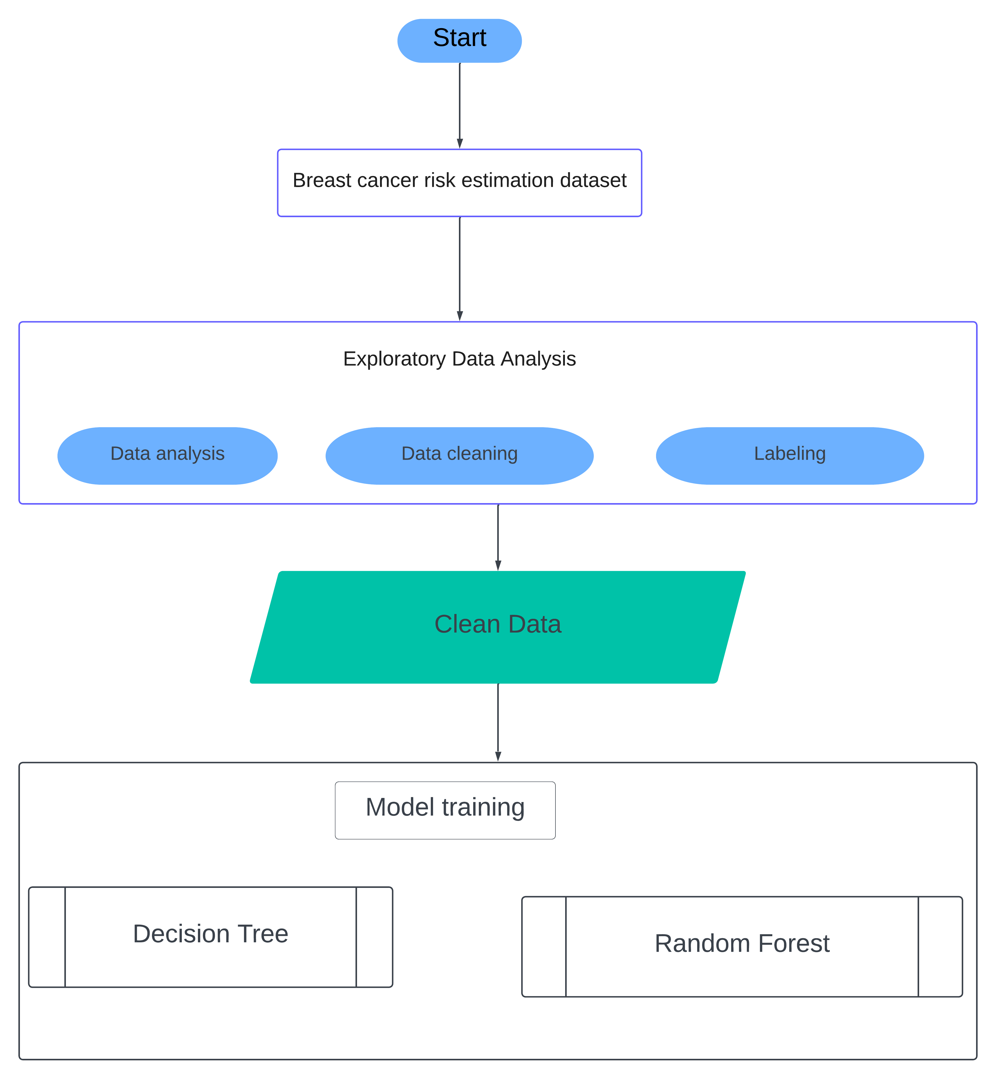
Methodology

Slide 12
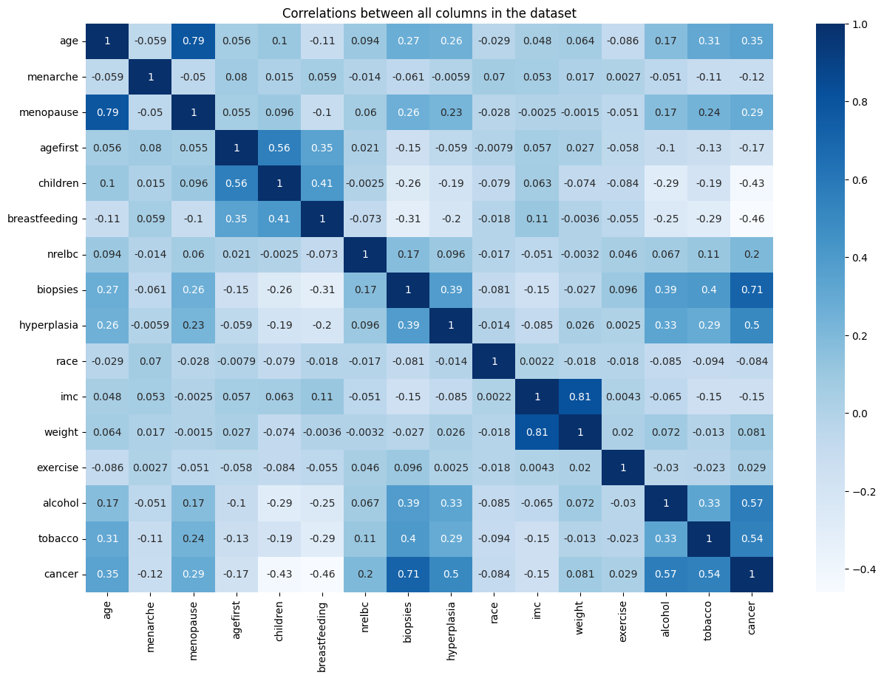
Cont’

Slide 13
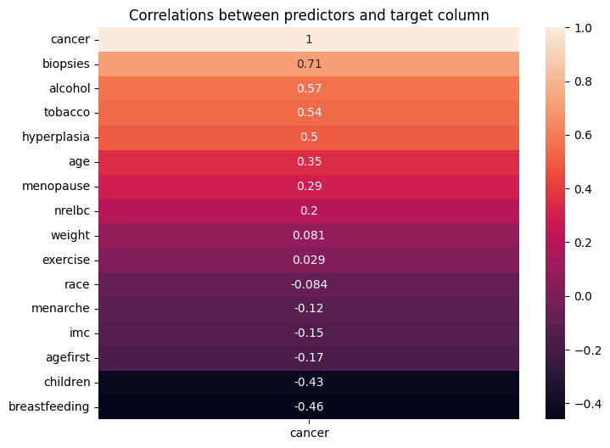
Cont’

Slide 14
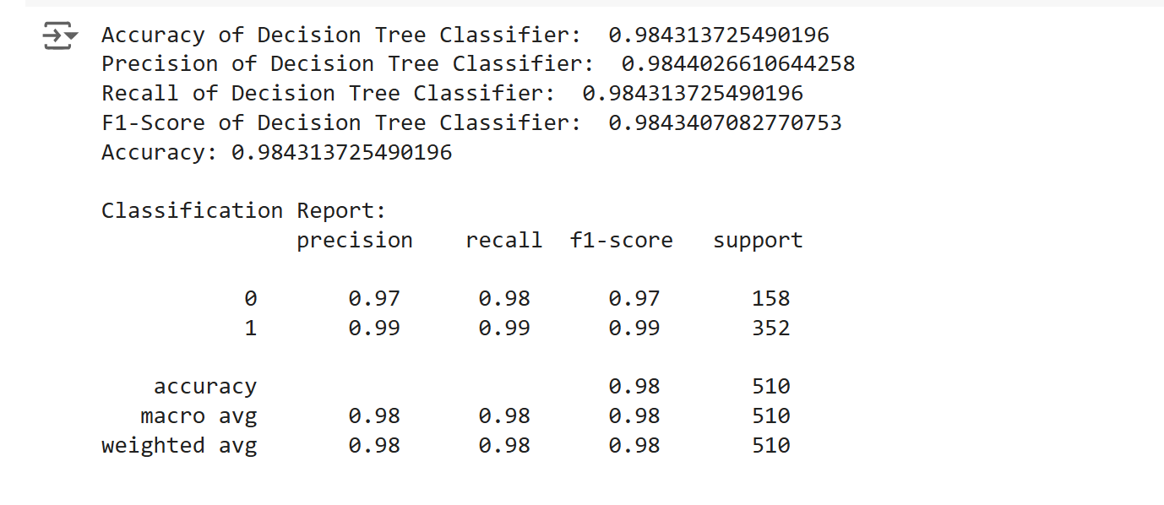
Decision Tree

Slide 15
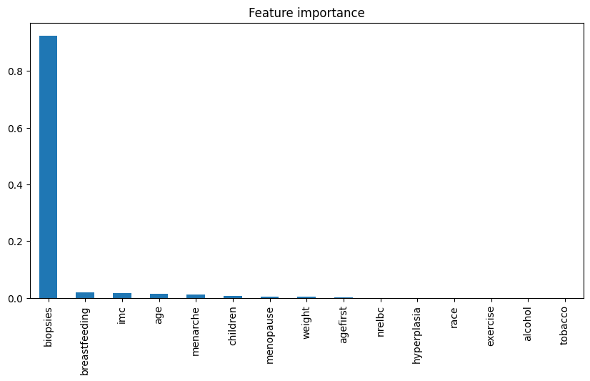
Decision Tree

Slide 16
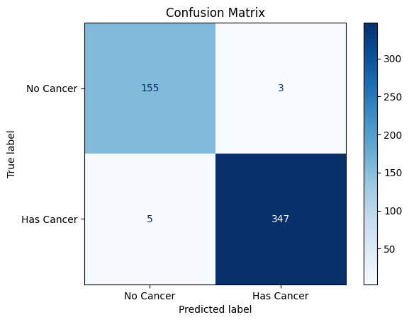
Decision Tree Confusion Matrix
Notes:
Link: https://www.kaggle.com/datasets/santoshd3/bank-customers

Slide 17
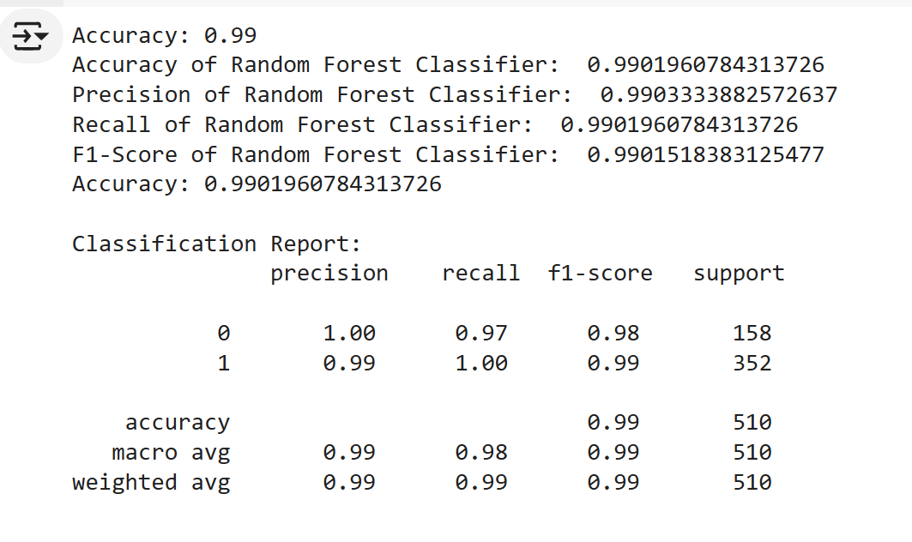
Random Forest

Slide 18
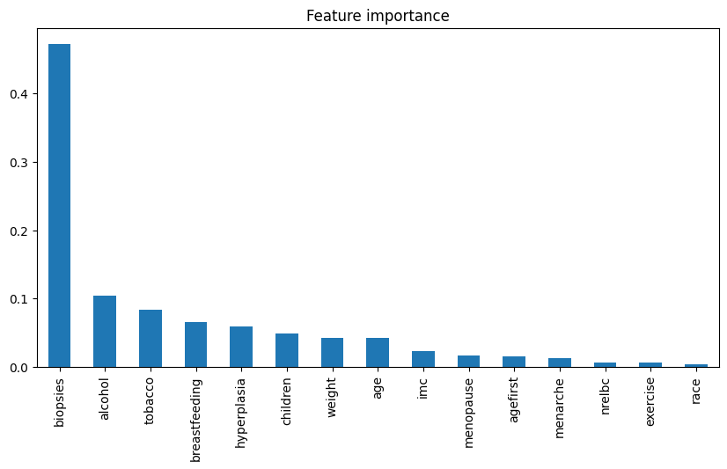
Random Forest

Slide 19

Random Forest Confusion Matrix

Slide 20
Random Forest LIME Analysis

Slide 21
Random Forest SHAP Analysis

Slide 22
Project Results
Best Algorithm: Random Forest (Accuracy: 0.996).
Key Finding: Cuban dataset-based models outperformed models trained on US Hispanic data.
Notes:
Link: https://sorry.vse.cz/~berka/challenge/PAST/

Slide 23
Conclusion and Future Work
Conclusion: The model provides better estimates of breast cancer risk for Cuban women, with the potential for use in other developing countries.
Future Work: Expanding the dataset, refining feature selection, and developing clinical tools for implementation.

Slide 24
References

