Slide 1

Case Study: Australia Post
Mobile Angular Website
Brett Uglow

Slide 2

“Chuck Norris doesn't program with a keyboard.
He stares the computer down until it does what he wants.”

Slide 3

Who am I
Front End Developer
Melbourne based
Currently working for Odecee
Worked mostly in large enterprises
Enjoy travelling, assembling IKEA furniture, hiking
Happily married

Slide 4
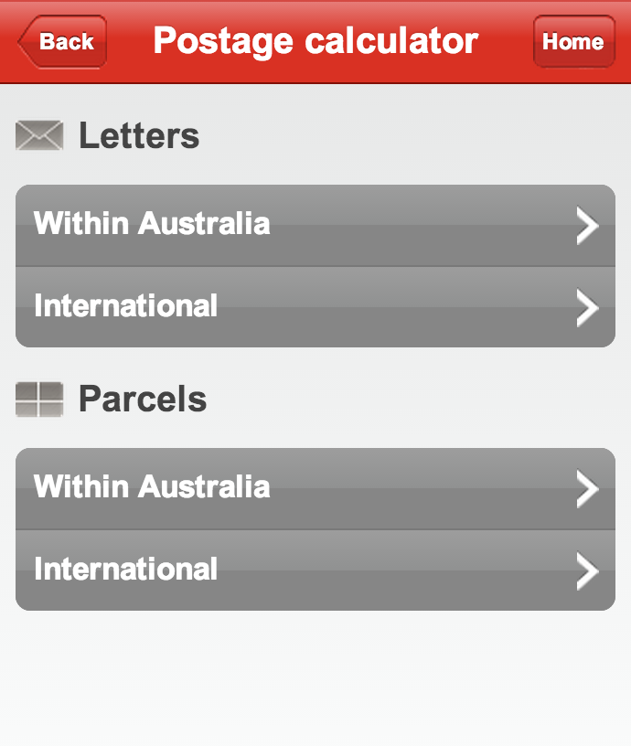
Old Mobile Website
THIS (when we started in March 2013) ->
Limited functionality
No CMS
Built in 2010

Slide 5
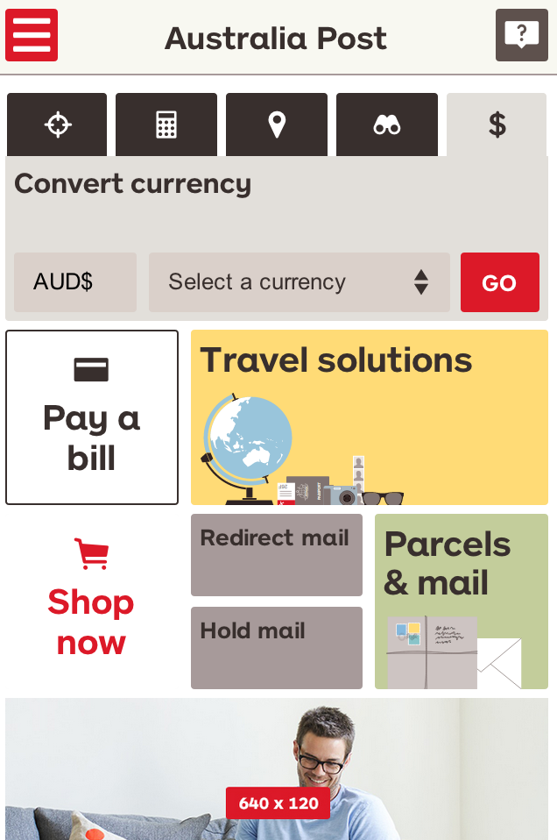
New Mobile Website
Designed by Australia Post
Built by Odecee (UI), Australia Post (APIs) and Deloitte (CMS)
Implemented in Angular 1.1.5, migrated to 1.2.x
Targets modern mobile devices (no IE8 ☺☺☺)

Slide 6

Why AngularJS?
Well, originally it was going to be jQuery Mobile
Changed to AngularJS because:
Easier to test than jQuery (dependency injection)
Previous experience
It was shiny and new
The architects liked it

Slide 7
Five AngularJS challenges
Integrating with a CMS
Organising code
Caching
End-to-end testing debug/production builds (stubbing)
Accessibility & form validation

Slide 8
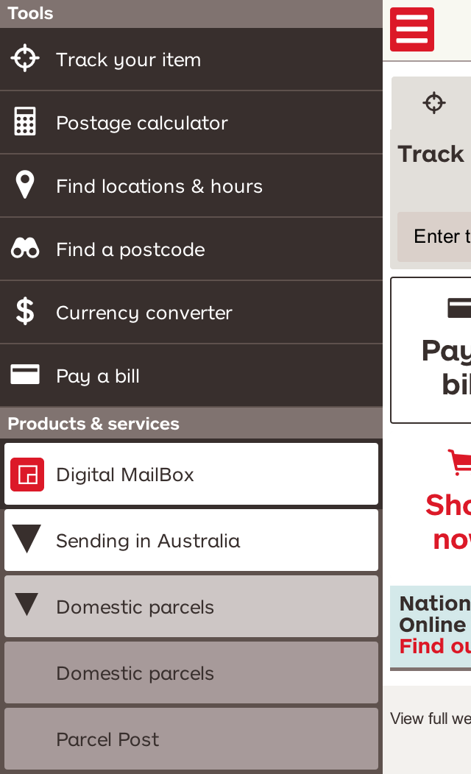
1. Integrating CMS into AngularJS
CMS builds a sitemap file and hosts it remotely
Sitemap contains both routing info + navigation hierarchy for a visual menu
Need to load the sitemap before AngularJS boots
DEMO 1A

Slide 9
1. Integrating CMS into AngularJS
Needed to massage the sitemap CMS data, and allow other modules to insert themselves into the visual menu
Solution: RouteService
Can be configured by other modules to inject their routes
Tracks both the hierarchy (for the menu) and the routes (for routing)
Each route may have a menuPriority or hidden property which allows menu items to be sorted and displayed correctly
Introduced after refactoring into modules (next section)
DEMO 1B

Slide 10
2. Organising code
Most generators and GruntJS tutorials in mid-2013 (and even now ☹) talk about this kind of project structure:
service
MyService.js
YourService.js
views
TeaService.js
controllers
app
test
…
…

Slide 11
2. Organising code
…but we found it didn’t scale well (debugging-by-feature was hard, code for new features is spread everywhere).
service
MyService.js
YourService.js
views
TeaService.js
controllers
app
test
…
…

Slide 12
2. Organising code
So we changed to feature based:
Like-code in one place
Easy to add & split-off modules
Tests are with the module
Debug build produces “module1.js”, “moduleN.js” for easier debugging
DEMO2
src
module1
<code> JS, HTML
sass
module2
<code> JS, HTML
test
templates
test
jslib
moduleN

Slide 13
3. Caching
For mobile websites, performance is crucial.
Needed to cache certain requests (like reference data) but not others (could use AngularJS $cacheFactory)
Needed to cache for different lengths of time (could not use $cacheFactory)
… so we rolled our own cache ☺

Slide 14
3. Caching
Local Storage
FooService
DataService
StubAdapter
CacheService
$http
get(…)
getFromCache(…)
doesExist(…)
isExpired(…)
object (data optional)
cached response
OR $http(…)
$http response

Slide 15
4. E2E testing
We want to reliably test the UI
Stub the $http calls
How to make the same code use $http for production, but use stubs when running tests?
This is where Protractor is invaluable – you can push JavaScript code from your test into your browser!

Slide 16
4. E2E testing
Protractor
Browser
DataService
StubAdapter
$http
executeScript( stubConfig)
var stubConfig = …; // set global variable
postcode.html
get(postcode:3000)
stubExists(postcode:3000)
checkStubConfig(…)
Stub found
postcodeStub.json
Missing stub – break the test!

Slide 17
5. Accessibility & Form Validation
Christmas 2013: “What do you mean by ‘AA’ compliant?”
Vision Australia assessment – some work to be done
Biggest (technical) issues:
Error messages not being read-out or associated with a field
We weren’t using custom directives for our form controls…if we wanted to change the behaviour everywhere, we had to change every control on every page. DOH!
Form validation was too aggressive (errors as soon as you type)

Slide 18
5. Accessibility & Form Validation
High Level Solution:
Decorate the <form|ngForm> directives’ controller to attach a configurable form-validation-and-error-display policy
Create directives that apply the form policy to show/hide errors at the appropriate times, and sync the ARIA attributes

Slide 19
5. Form policy
It would be nice if form validation behaviour was pluggable.
Default behaviour is “show errors immediately, even if the user hasn’t changed anything”
Rather than re-writing the AngularJS NgFormController and NgModelController, we decorated them
Form policies are split into 3 categories:
Check For Error: “Determine if an error has occurred”
Display Error: “Determine when to show an error”
Focus Behaviour: “What to do with the [focus, …?] when an error occurs”
Now we can easily define new policies, swap, combine, etc.

Slide 20
5. Form Policy
angular.module(‘app’, [‘formPolicy.checkForErrors.onChange’, …])
Form Policy Modules (use 0/1 of each kind)
form/ngForm directive
field directives
ngFormController
$error
$setValidity() …
ngController
$error …
Check for error Policy constants
CheckForError
extended properties
isErrorShowing
extended properties
_formPolicy
…
Display error Policy constants
CheckForError
FieldErrorController
uses _formPolicy
watches isErrorShowing
links error DOMElem to field: aria-describedby
Focus behaviour Policy constants
CheckForError
FieldErrorMsgContainer
watches isErrorShowing
displays error DOMElem
DEMO 5a

Slide 21
5. Form Policy
Benefits:
Errors are no-longer aggressive
Focus is set to the first field that has an error
Enforces the use of <form> elements as parents of field elements (semantic)
Easy to change policy
Can be changed on a per-form basis (default is site-wide)
Ties accessiblity features together
Australia Post is looking to open source the accessibility controls – what a great company!

Slide 22
5. Accessible controls
Problem: How do you make an accessible control?
Answer: There’s a lot to consider…
form label
required indicator
form control
aria-labelledby
isErrorShowing
ng-required
aria-describedby
aria-invalid
aria-required
field hints
error messages

Slide 23
5. Accessible controls
The Naïve solution:
Page: <form-input ng-model=“user.name” label=“…”> Compiled to: <input type=“text” ng-model=“…” aria-label=“…”
$addControl(name)
$addControl(no-name)
“Same” control added to Form Controller!
Zombie reference will hurt you later! (validation)
Form Controller
Compiler

Slide 24
5. Accessible controls
Better Solution: Create a directive which refers to other directives using an alias (so that the “child” directives are not compiled until after the parent directive has been compiled).
<form-input ff-ng-model=“…”
>>> Extensible!
DEMO 5b

Slide 25
5. Accessible Demo
http://m.auspost.com.au
Toggle VoiceOver (Mac): ⌘ + F5

Slide 26
Thanks for your time!

Slide 27
CHANGELOG.md
March 2013 – Started (1 Dev)
July 2013 – Finished (3 Devs)
Dec 2013 – Added Mail hold & redirection wizard (1.5 Devs)
… lots of small enhancements…
June 2014 – Accessibility enhancements (1 Dev)

Slide 28
Credits Roll
Brett Uglow (http://uglow.github.io)
Mario Skouros (mskouros@odecee.com.au)
Peter Mescalchin (http://magnetikonline.com/)
George Metaxas (designer) (george.metaxas@auspost.com.au)

