Slide 1
CiviCRM
Overview
Seminar
Welcome
Notes:
GOsC - SodalitaS Presentation
mtl Software Solutions Private & Confidential

Slide 2
Introductions
Richard Slade Sales Consultant
Nihas Rawther Account Manager
Notes:
GOsC - SodalitaS Presentation
mtl Software Solutions Private & Confidential

Slide 3

What we’ll be covering
• Introduction
• Overview of the solution
• Open forum
Notes:
GOsC - SodalitaS Presentation
mtl Software Solutions Private & Confidential

Slide 4
Our Company
PRIVATE - ready access to decision makers
LOYALTY of staff and clients
EXPERIENCE - 26 years in the NfP sector
DEDICATION – to the NfP sector
CONTINUITY of people & products (partnership)
COMPLETE PACKAGE of services
Notes:
GOsC - SodalitaS Presentation
mtl Software Solutions Private & Confidential

Slide 5
Why the appeal for us?
• Consistent with our product development strategy
• Ability to customise easily
• Low cost of ownership
• Web based
• More choice for our clients
• Collaborative/Community in line with our ethos
Notes:
GOsC - SodalitaS Presentation
mtl Software Solutions Private & Confidential

Slide 6
Which solution?
NfP focused
Internationalised and Localised
100+ NfP consultants involved
Feedback and very active forums/discussions
Seamless integration with open source CMS’s (drupal/joomla)
Commitment to open source for the future
Notes:
GOsC - SodalitaS Presentation
mtl Software Solutions Private & Confidential

Slide 7
What we are being asked for
• Development - recent examples include gift aid,
outlook integration, invoicing module, direct debits, mobile apps
Implementation Services – data migration, specification,
configuration, project management and training
Support Services – help desk/dial in support, standard enhancements
Involvement – training facilities, seminars/workshops, user/development days
Website – integration and design/build if needed
Notes:
GOsC - SodalitaS Presentation
mtl Software Solutions Private & Confidential

Slide 8
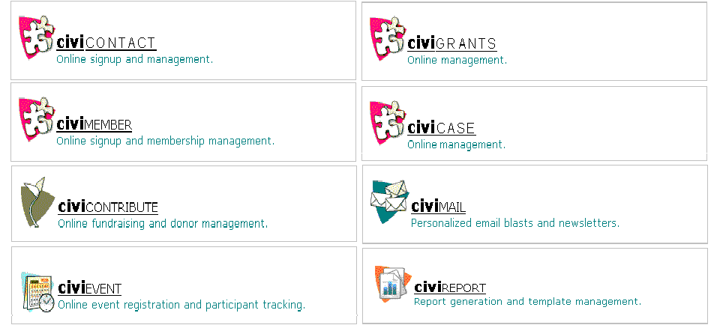
Product Components
Notes:
GOsC - SodalitaS Presentation
mtl Software Solutions Private & Confidential

Slide 9























Existing Clients using our solutions
Notes:
GOsC - SodalitaS Presentation
mtl Software Solutions Private & Confidential
A selection of MTL customers

Slide 10














Current Users – a few examples
Notes:
GOsC - SodalitaS Presentation
mtl Software Solutions Private & Confidential

Slide 11
Software Overview
Notes:
GOsC - SodalitaS Presentation
mtl Software Solutions Private & Confidential

Slide 12
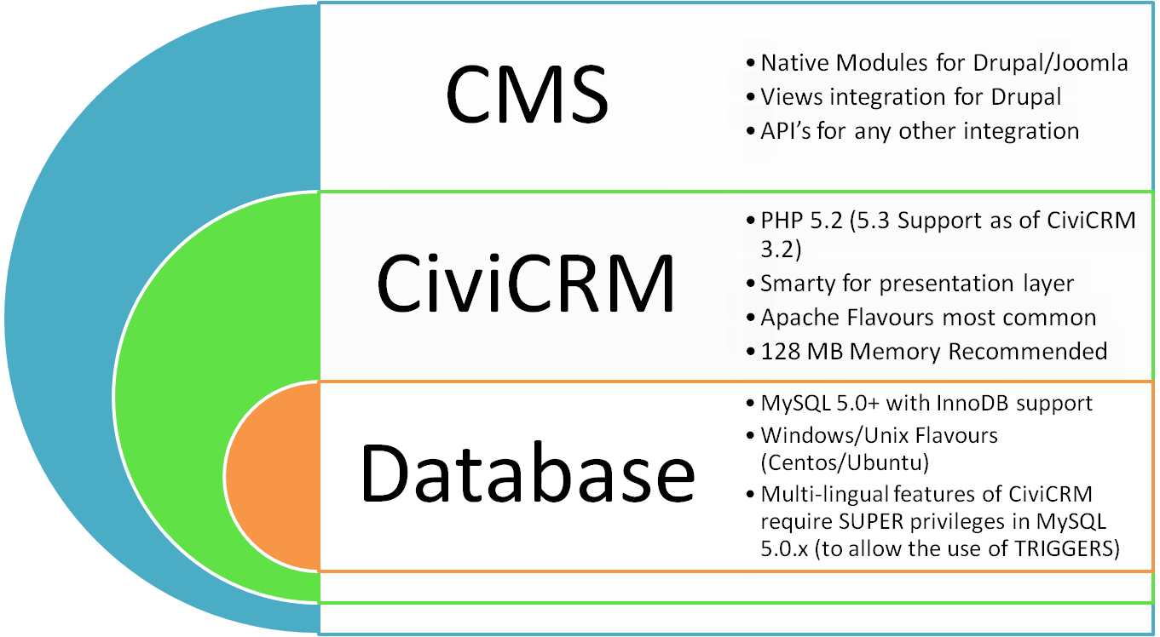
Technical Architecture
Notes:
GOsC - SodalitaS Presentation
mtl Software Solutions Private & Confidential

Slide 13
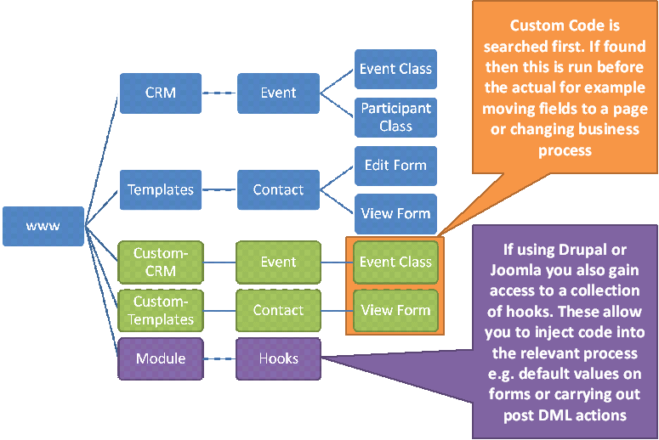
Code Customisation
Notes:
GOsC - SodalitaS Presentation
mtl Software Solutions Private & Confidential

Slide 14

OPEN FORUM
Notes:
GOsC - SodalitaS Presentation
mtl Software Solutions Private & Confidential

