Slide 1


Using Funny phrases and stories to remember
EXECUTIVE FUNCTION & MENTORING PROGRAM
Never Eat Soggy Waffles
Notes:
About this lesson:
Working Memory: Working memory is the ability to hold information in one’s mind and to mentally manipulate this information (e.g., mental math).
Short-Term Memory: Information received from the five senses is stored in short-term memory. This is retained for a short period of time before the information is either stored in long-term memory or forgotten.
Long-Term Memory: Long-term memory is the storage house for the brain; important information is stored for longer periods of time
How to Teach Working Memory Strategies
Mnemonics, devices that serve as memory aids, successfully improve students’ ability to remember information. Mnemonics can help students remember challenging or unfamiliar content, and they are also helpful for remembering the specific order of details as well as sequences of information. Many of these mnemonics depend on the student’s ability to use previous experiences or knowledge in order to make connections to new information. The two strategies introduced in this lesson—funny phrases and creative stories—require students to make these connections in order to help them to remember ordered information or sequential processes.
Crazy Phrases—These are silly, made-up phrases or sentences designed to help a student remember the specific order of information (e.g., Never Eat Soggy Waffles: North, East, South, West).
Creative Stories—Stories that make connections between ideas and concepts help students to paint a clear picture of the information they are trying to remember. For example, when learning about the events of the Civil War, a student can create a story that connects characters and events.
For more information, see the Lesson 6.3 Overview.

Slide 2

Objectives
Create funny phrases to help remember information in a specific order
Create stories to help remember processes
Notes:
Read objectives of the lesson.

Slide 3
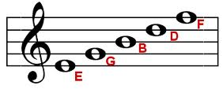
Crazy Phrases are silly, made-up phrases or sentences designed to help you remember the specific order of information.
“Every Good Boy Deserves Fudge”
Notes:
Ask students to generate examples of information they have had to learn where order matters. This example is often used to help piano players remember the order of the keys.

Slide 4
Order of Operations:
Parentheses
Exponents
Multiplication
Division
Addition
Subtraction
Crazy Phrase:
Please
Excuse
My
Dear
Aunt
Sally
List of Planets:
Mercury
Venus
Earth
Mars
Jupiter
Saturn
Uranus
Neptune
Crazy Phrase:
My
Very
Educated
Mother
Just
Served
Us
Noodles
Notes:
Here’s another example of a funny phrase that you may have heard before: “Please Excuse My Dear Aunt Sally” is a funny phrase we use in math to remember the order of operations (Parentheses, Exponents, Multiplication, Division, Addition, and Subtraction).
Click slide to show the list of planets (click only once!). Ask students to create their own funny phrase to help them remember the order of the planets.
Give the class time to create their own funny phrases. Once they have generated ideas, ask them to share with the class. Then, show the class the funny phrase provided here (click to reveal).

Slide 5
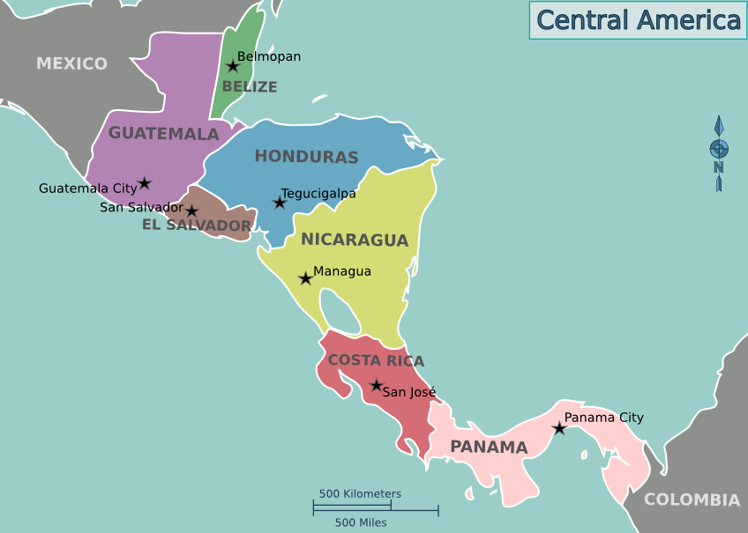
Try it out!
Notes:
Distribute the “Map of Central America” and “Crazy Phrases” handouts.
Now, we will practice using the funny phrase strategy. You will use the countries in Central America to make a funny phrase or two. Feel free to use the map displayed on the PowerPoint or the map from the worksheet to help you. Once you have created a funny phrase, write it down on the “Crazy Phrases” handout.
Allow students some time to come up with their funny phrases (about 5 minutes). Ask students to share their funny phrases. Encourage students to write down some of their classmates’ funny phrases if they think they are useful. After students have shared, collect their handouts.

Slide 6
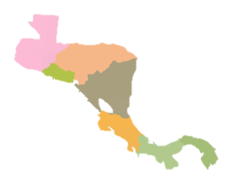
Try it out!
Notes:
Now distribute a blank map of Central America.
Fill in the map to the best of your ability using the funny phrases you created.
Challenge: To make this activity more difficult, wait until the end of the lesson to distribute the blank maps.

Slide 7
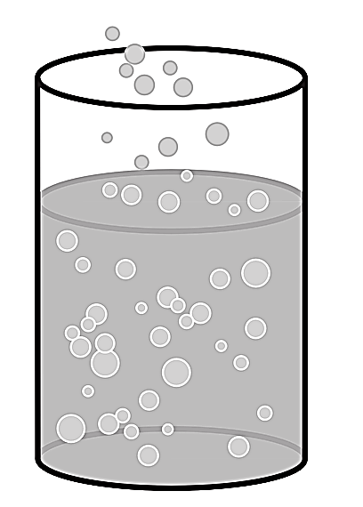





Stories can also be used to remember strings of information that are challenging to recall.
The Equation for Photosynthesis
Water+Carbon Dioxide+Sunlight→Oxygen+Sugar
“When he put carbonated water in the sun, the air smelled sweet.”
This Photo by Unknown Author is licensed under CC BY-NC
Notes:
Explain that in some cases there are processes or series of events that are difficult to remember (e.g., the order of U.S. presidents or the stages of photosynthesis). It is important to use strategies that help to make connections

Slide 8
Strategy Share
What strategy did you use?
How did you use it?
Was the strategy helpful?
If so, how do you know it was helpful?
Notes:
After students have had an opportunity to apply the strategy to their school work or activities outside of school, distribute a new strategy reflection sheet (typically 2-3 days following direct instruction of the strategy). Allow students 5-10 minutes to complete their strategy reflection sheets and to attach them to the piece of work that demonstrates the application of the strategy.
In some instances, students may not have the opportunity to apply the strategy they learned that week. Therefore, encourage them to reflect on a different strategy that they applied.
After all students have completed strategy reflection sheets, select 2-3 students to share their strategies. During the strategy share, students should answer the questions on the slide.

