Slide 1

HR Data Analytics : Job Change Prediction For Data Scientist
Group 4:
Maria Alvi
Ugochi Madumere
Aparna Rachoori
Sonakshi Sharma
Promodini Venkatakrishnan
BCIS 5110 Programming Languages for Business Analytics
Final Project Report

Slide 2
Agenda
Introduction & The business problem
Data Description
Data Exploration
Data Visualization
Data Preparation
Model and Analysis
Conclusion

Slide 3
Introduction
Hiring is time consuming process
Critical for Larger Firms
understand the workforce
Plan for the future
Example : University partnership
Retention Rate
Turnover Rate

Slide 4
The Business Problem
To classify the employees based on the job change identify the factors affecting the Employee’s turnover ratio!
Factors :Age , gender
Education level, University
Experience,
Training hours etc

Slide 5
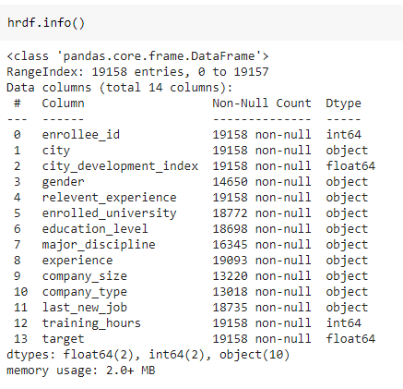
Data Description
Metadata

Slide 6
Data Description
No. of observations : 268212
Size of the dataset : 19158 X 14
Dependent Variable : Target
Independent Variable :Enrollee_id, education level, experience etc.

Slide 7
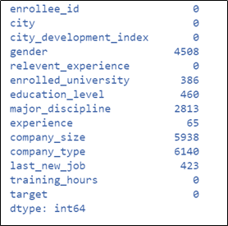
Data Exploration & Visualization
Checking Variables with Missing Values:

Slide 8
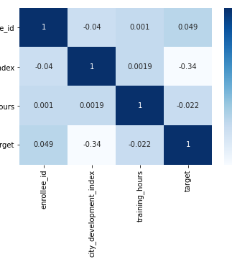
Data Exploration & Visualization
Correlation Matrix

Slide 9
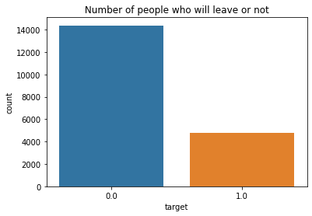
Data Exploration & Visualization
Analyzing Dependent Variable
0 = 14381
1 = 4777

Slide 10
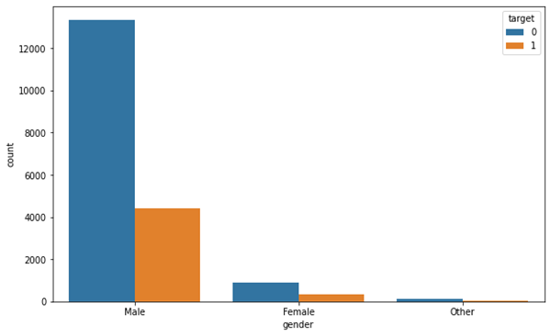
Data Exploration & Visualization
Analyzing Independent Variables
Gender

Slide 11
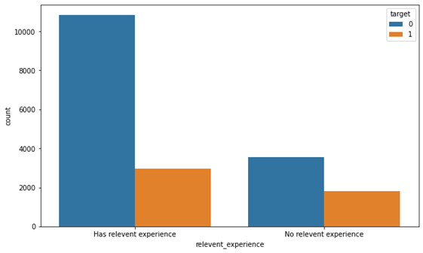
Data Exploration & Visualization
Analyzing Independent Variables
Relevant Experience

Slide 12
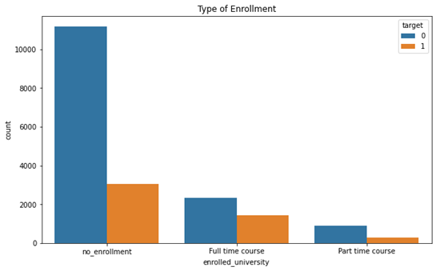
Data Exploration & Visualization
Analyzing Independent Variables
Enrolled in University

Slide 13
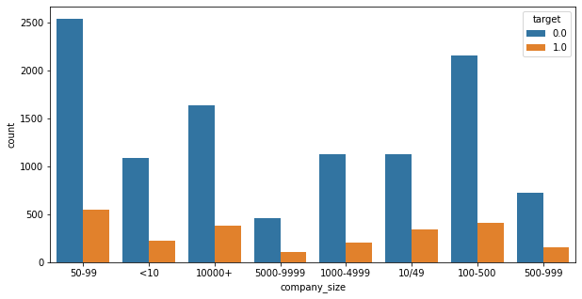
Data Exploration & Visualization
Analyzing Independent Variables
Company Size

Slide 14
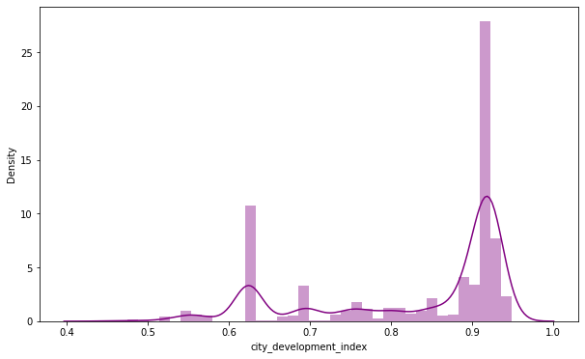
Data Exploration & Visualization
Analyzing Independent Variables
City Development Index.

Slide 15
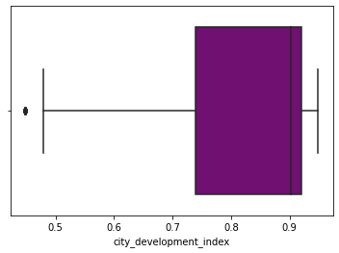
Data Exploration & Visualization
Analyzing Independent Variables
City Development Index.

Slide 16
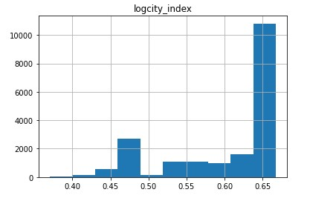
Data Exploration & Visualization
Analyzing Independent Variables
City Development Index (Log scale applied).

Slide 17
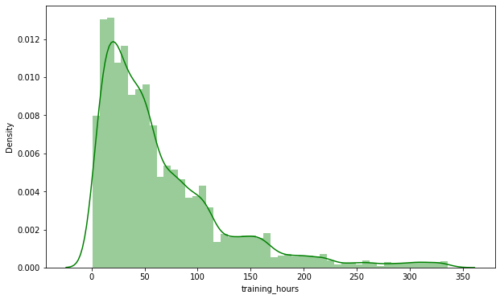
Data Exploration & Visualization
Analyzing Independent Variables
Training Hours.

Slide 18
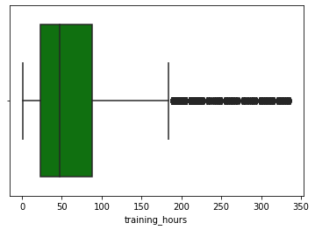
Data Exploration & Visualization
Analyzing Independent Variables
Training Hours.

Slide 19
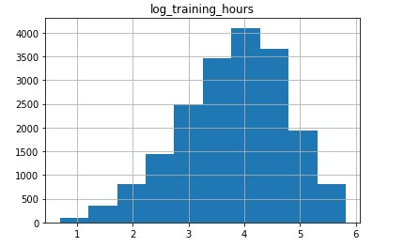
Data Exploration & Visualization
Analyzing Independent Variables
Training Hours. (log scale applied)

Slide 20
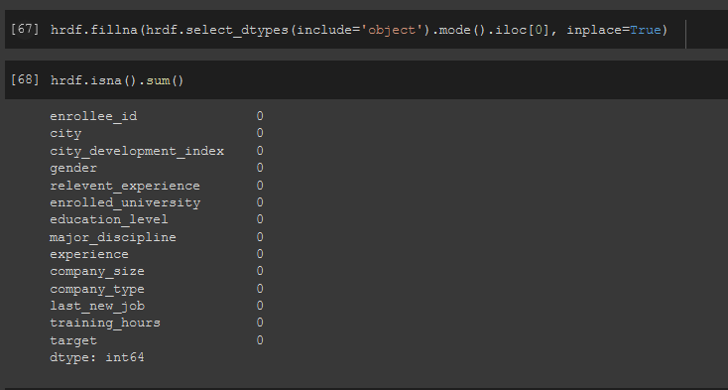
Data preparation - missing values
Imputation (mode)

Slide 21
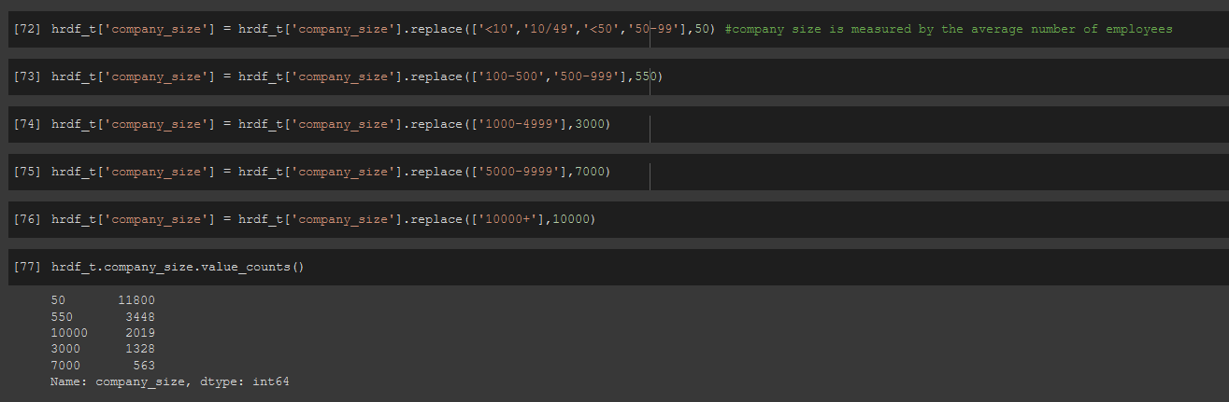
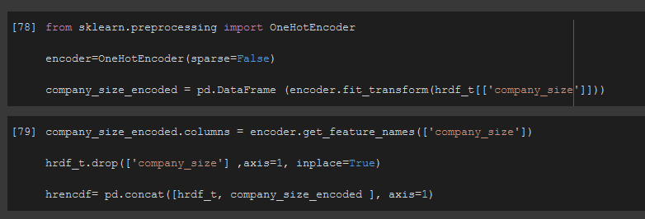
Data preparation – categorical encoding
replace()
Company Size
Education Level
Enrolled University
Last new Job
Experience
OneHotEncoder
Company Size
Company type
Major Discipline
Gender

Slide 22
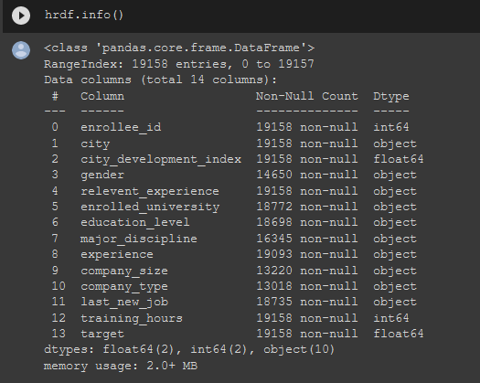
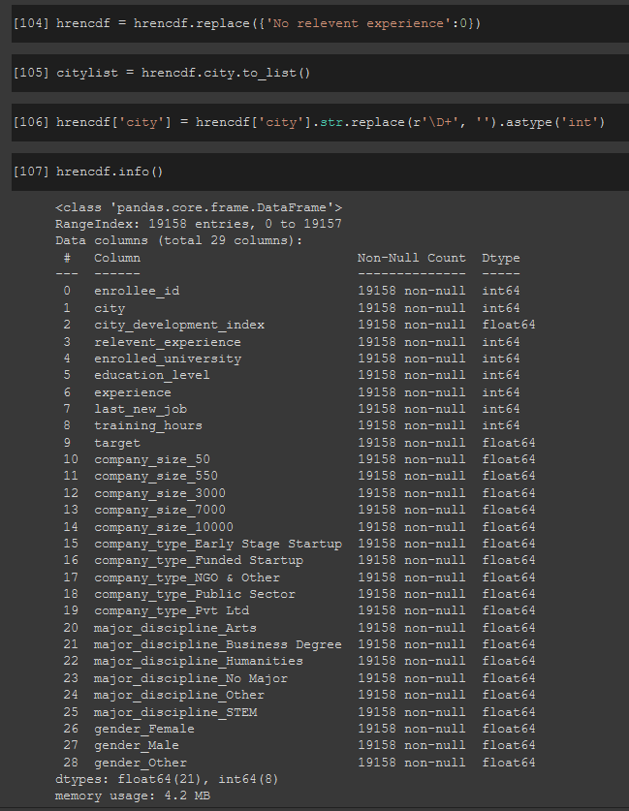
Data preparation – categorical encoding (contd)
Before After

Slide 23
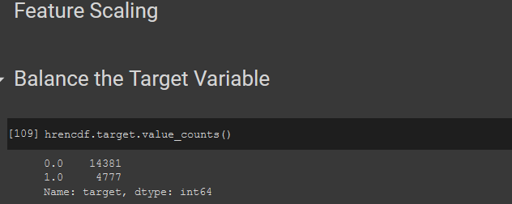

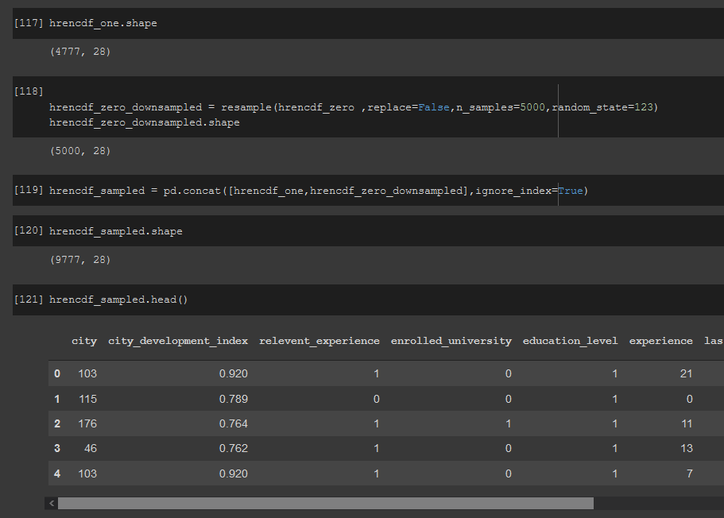
Data preparation – Feature Sampling
Imbalanced
Separated zeros and ones
Dropped “enrollee_id”
Downsampled (resample ())

Slide 24







Model and Analysis - Logistic Regression
IMPORT, FUNCTIONS, AND CLASSES
GET DATA
CREATE A MODEL AND TRAIN IT
EVALUATE THE MODEL
CLASSIFICATION REPORT AND CONFUSION MATRIX
SUMMARY
INTERPRETATION

Slide 25
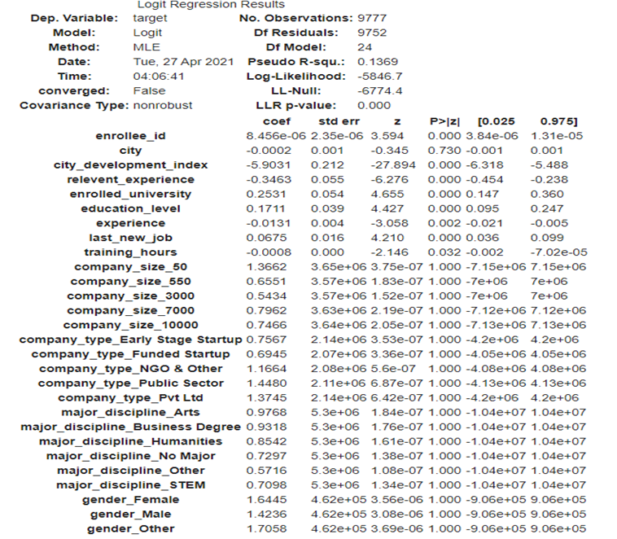
Model and Analysis - Logistic Regression
Summary of the Model

Slide 26
Model and Analysis - Logistic Regression
For every unit increase in the scale of the city development there is a decrease in the log odds of an employee changing the job of -5.9031.
Interpretation
For every unit increase in the relevant experience of an employee there is a decrease in the log odds of an employee changing the job of -0.3463.
For every unit increase in the type of university enrolled there is an increase in the log odds of an employee changing the job of 0.2531.
For every unit increase in the education level there is an increase in the log odds of an employee changing the job of 0.1711.
For every unit increase in experience there is a decrease in the log odds of an employee changing the job of -0.0131.
For every unit increase in the number of years between job change there is an increase in the log odds of an employee changing the job of 0.0675.
For every unit increase in the number of training hours there is a decrease in the log odds of an employee changing the job of -0.0008.

Slide 27



Model and analysis - Neural Networks
Import the Tensorflow and Keras packages
Neural networks mode definition:
Optimization is done using Adam Optimizer
Total no. of layers : 6
first five layers use the RELU activation function
Last layer uses the sigmoid function
batch size : 12
no. of epochs : 50

Slide 28
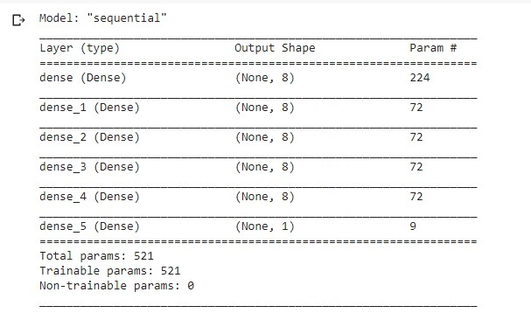
Model and analysis - Neural Networks contd.
Neural Network Dense Layers

Slide 29
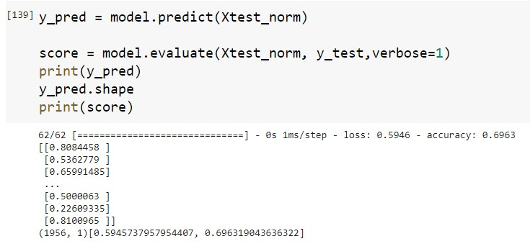
Model and analysis - Neural Networks contd.
Loss : 0.5946
Accuracy : 0.6963

Slide 30
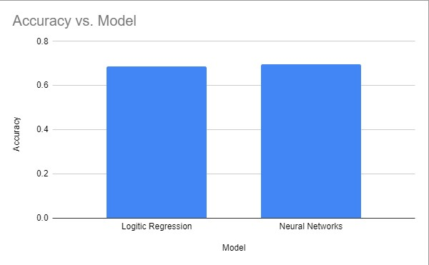
The comparison of the models
Model | Accuracy
Logistic Regression | 0.68
Neural Networks | 0.696

Slide 31
Business Recommendations
People who are working in the private, public sector are willing to change jobs. While people at startup are not willing to change the job.
All the major-discipline studied graduates are willing to change the job. Business degree, Arts, Stem discipline are more aggressive in job changing process.
Relevant experience has a negative effect on the dataset, which elucidates that relevant experience is not playing a vital role in employees switching their job.

Slide 32
Business Recommendations contd..
Both the gender are equally aggressive and will be looking to switch the jobs.
The positive effect on the company size variable elucidates that whatever the size of the company, candidates are willing to change the job.
Candidates are not tied to the city. Henceforth, Importance is not given to which city the job is posted.
The negative effect on the independent variable, experience proves that a candidate’s job change won’t be based on the number of years of experience they gained.

Slide 33
Conclusion
On Performing the analysis on the dataset, we could conclude that the independent variables say Education, Major discipline , Last new job plays a vital role in determining who is willing to join the organization when hired.

Slide 34
Thank You

