Slide 1
Elliptic Curve Cryptography
Shane Almeida
Saqib Awan
Dan Palacio

Slide 2
Outline
Background
Performance
Application

Slide 3
Elliptic Curve Cryptography
Relatively new approach to asymmetric cryptography
Independently proposed by Neal Koblitz and Victor Miller in 1985

Slide 4
Asymmetric Cryptosystems
Two mathematically related keys
  Public key for encryption
  Private key for decryption
Private key can not be easily deduced from the public key
  Security depends on a mathematical function whose inverse is difficult to calculate

Slide 5
Asymmetric Approaches
RSA
  Integer multiplication and factorization
Diffie-Hellamn
  Discrete exponentiation and logarithm
Elliptic Curve Cryptography
  Point multiplication and discrete logarithm

Slide 6
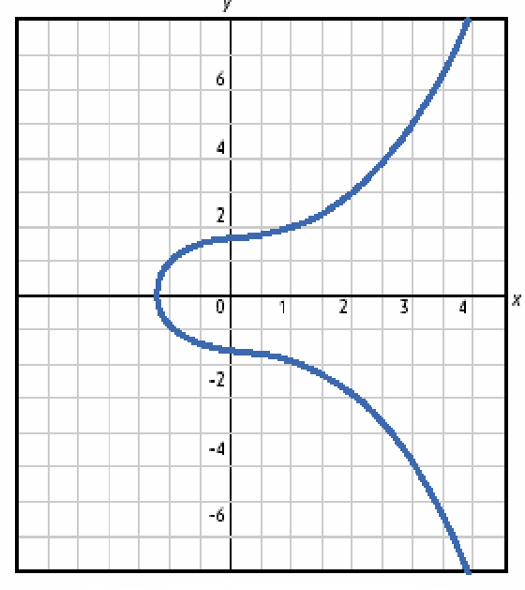
Elliptic Curves
Elliptic curves are not ellipses (the name comes from elliptic integrals)
Circle
  x² + y² = r²
Ellipsis
  a·x² + b·y² = c
Elliptic curve
  y² = x³ + a·x + b
Notes:
Graph from An intro to Elliptical Curve Cryptography at http://www.deviceforge.com/articles/AT4234154468.html, which is a reproduction of An Elliptic Curve Cryptography (ECC) Primer by Certicom.

Slide 7
Elliptic Curves Over Real Numbers
An elliptic curve over reals is the set of points (x,y) which satisfy the equation y² = x³ + a·x + b, where x, y, a, and b are real numbers
If 4·a³ + 27·b² is not 0 (i.e. x³ + a·x + b contains no repeated factors), then the elliptic curve can be used to form a group
An elliptic curve group consists of the points on the curve and a special point O
Elliptic curves are additive groups
  Addition can be defined geometrically or algebraically

Slide 8
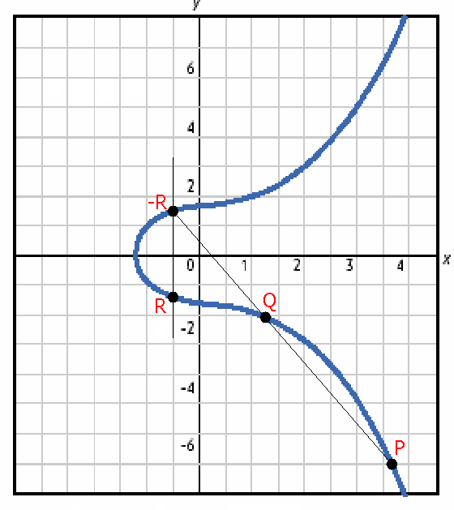
Adding Points P and Q
Draw a line that intersects distinct points P and Q
  The line will intersect a third point -R
Draw a vertical line through point -R
  The line will intersect a fourth point R
Point R is defined as the summation of points P and Q
  R = P + Q
Notes:
Shane added the points to this graph.

Slide 9
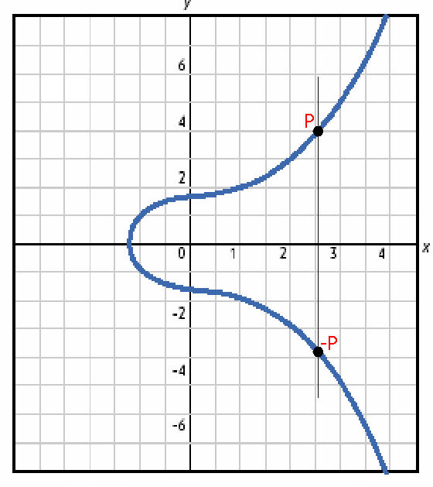
Adding Points P and -P
Draw a line that intersects points P and -P
  The line will not intersect a third point
For this reason, elliptic curves include O, a point at infinity
  P + (-P) = O
  O is the additive identity
Notes:
Shane added the points to this graph.

Slide 10
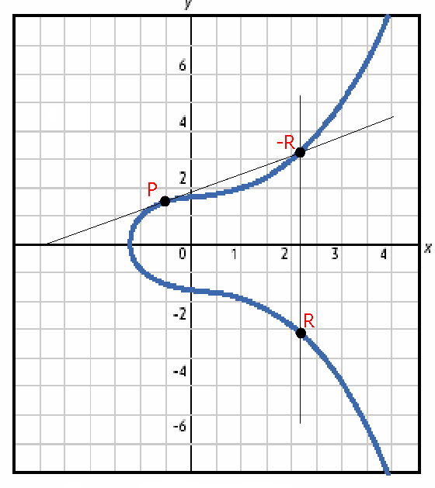
Doubling the Point P
Draw a line tangent to point P
  The line will intersect a second point -R
Draw a vertical line through point -R
  The line will intersect a third point R
Point R is defined as the summation of point P with itself
  R = 2·P
Notes:
Shane added the points to this graph.

Slide 11
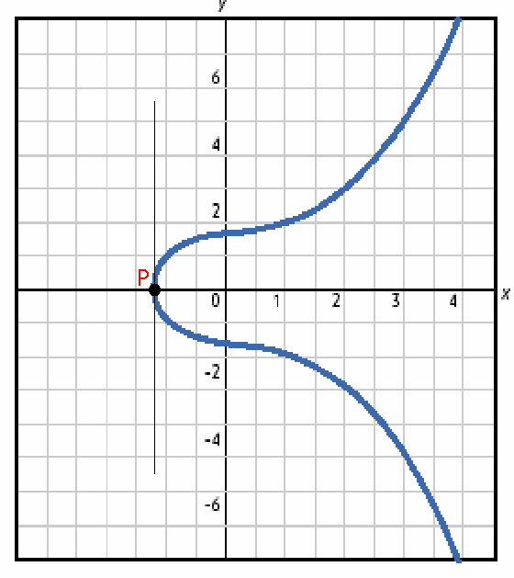
Doubling the Point P if yP = 0
Draw a line tangent to point P
  If yP = 0, the line will not intersect a second point
2·P = O when yP = 0
  3·P = P (2·P + P)
  4·P = O (2·P + 2·P)
  5·P = P (2·P + 2·P + P)
Notes:
Shane added the points to this graph.

Slide 12
Algebraic Approach
Point Addition
  R = P + Q
  s = (yP – yQ) / (xP – xQ)
  xR = s² – xP – xQ
  yR = -yP + s(xP – xR)
Point Doubling
  R = 2·P
  s = (3·xP² + a) / (2·yP)
  xR = s² – 2·xP
  yR = -yP + s(xP – xR)

Slide 13
Cryptography with Elliptic Curves
Calculations with real numbers are slow and rounding causes inaccuracy
Speed and accuracy are important for cryptography
Use elliptic curve groups over the finite field F_{p} *
Elliptic curves are formed by choosing a and b within the field F_{p}
  y² mod p = x³ + a·x + b mod p
* can also use F₂^{m}, but I’m skipping it

Slide 14
Cryptography with Elliptic Curves
Because it’s a finite field, a finite number of points make up the curve
  This means there is no true curve anymore
  But also no more rounding
Geometric definitions of addition and doubling don’t work on these curves
Algebraic definitions still hold

Slide 15
The Discrete Logarithm Problem
The discrete logarithm problem for ECC is the inverse of point multiplication
Point multiplication is simply calculating Q=kP, where k is an integer and P is a point on the curve

Slide 16
Elliptic Curve Discrete Logarithm
Given points P and Q, find a number k such that k·P = Q
  P is the base point on a specific, published curve
  Q is the public key
  k is the private key (very large prime number)
With doubling, we can go from P to 2·P
With addition, we can go from 2·P to 3·P

Slide 17
The Discrete Logarithm Problem
Determining the point k·P in this way is referred to as the scalar multiplication of a point
Scalar multiplication is intractable
  Elliptic Curve Discrete Logarithm Problem
  k is the discrete logarithm of Q to the base P
Brute force attacks range up to 3x10⁵⁷ operations by a stepping process
  Applies to NIST-defined P192 curve

Slide 18
Attacking ECC
ECC is not susceptible to index-calculus attacks
  Index-calculus relies on group properties that ECC groups do not have
Brute force does not fair well either as shown
Best possible way is a ‘collision attack’ known as Pollard’s rho attack
  As field size increases, the attack becomes harder at an exponential rate

Slide 19
Security Performance
Implementation allows for a significant reduction in key size
  ECC key of 163 bits is equivalent to RSA key of 1024 bits
  ECC key of 256 bits is equivalent to RSA key of 3072 bits
ECC’s main advantage: as key length increases, so does the difficulty of the inversion process

Slide 20
Performance Analysis - Speed
ECC performance is dependent on field operations
Arithmetic involved in ECC
  Algorithmic Level (addition and subtraction chains)
  Curve Arithmetic Level (selection of coordinate representation)
  Field Arithmetic Level (basis selection, multiplier and inverter structures)

Slide 21
Performance Analysis - Speed
How can ECC performance increase?
  Increase efficiency of finite field mathematics
    The performance of ECC relies heavily on the speed of the computations in the finite field
  Use particular finite fields and elliptic curves where applicable
  Implementing the right field representation

Slide 22
Representations
Types of representations for elements in a finite field
  Normal Basis
    Takes the form {1, α, α²,…, α^{n-1}}
    Type I and Type II representations optimized for N
  Polynomial Basis
    Takes the form {α, α², α^{2^2},…, α^{2^(n-1)}}
α is a root of an irreducible polynomial f(x) that has a degree N in a field

Slide 23
Which is better?
PB does inversion 10% faster
NB does scalar multiplication 12% faster
Both perform basic addition and subtraction efficiently
Performance depends on implementation
  Ex. ElGamel protocol - encryption using EC runs 22% faster when combined with NB rather than PB
  Using other protocols may show different results as well
Performance is also related to hardware design

Slide 24
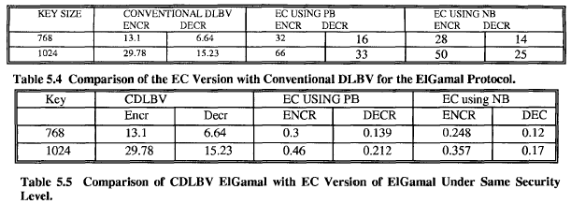
Performance Comparison
Key sizes for EC using PB are 155 and 183 respectively
Key sizes for EC using NB are 155 and 173 respectively

Slide 25

Implementing Efficient ECC For
Smart Cards
(ECDSA)
Presented By: Saqib Awan

Slide 26
Elliptic Curve Cryptosystems (ECC)
Merits:
  A 160 bit ECC has roughly the same security as 1024 bit RSA.
  Limited memory and computational power.
Purpose:
  Algorithms to achieve optimized implementation of the ECDSA over the field GF(p) on smart cards.
  Algorithms for modular reduction, modular inversion and scalar multiplication.

Slide 27
Discrete Logarithm Problem
Based on the difficulty of elliptic curve discrete logarithm problem (DLP).
DLP applies to mathematical structures called groups.
For higher security the rate of increase key size is much slower for RSA key sizes.
Faster implementation using less bandwidth and power- crucial for smart cards.
IEEE Std 1363-2000, WAP (Wireless Application Protocol), ANSI X9.62, ANSI X9.63 and ISO CD 14888-3) employs ECC.

Slide 28
Elliptic curve over a Galois field with p elements
E : y² = x³ + ax + b (mod p)
Addition and doubling of points are the group operations along with the identity element.
Definition ECDLP:
  Given the prime modulus p, the curve constants a and b and two points P and Q, find a scalar k such that Q = kP
Efficient Field Arithmetic in crypto coprocessor.
Effect of coordinate systems on speed of the scalar multiplication operations.

Slide 29
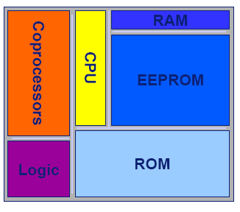
Smart Card Hardware
Motorola M-Smart JupiterTM smart card based on Java CardTM 2.1 technology and an ARM processor with a word size of 32 bits, 64KB of ROM,32KB of EEPROM, 3KB RAM and a modular arithmetic coprocessor (crypto coprocessor).

Slide 30
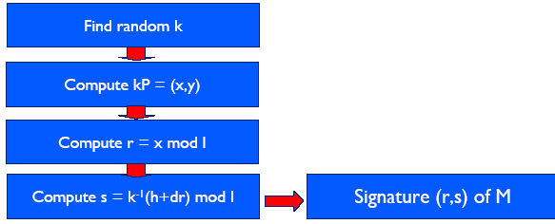
ECDSA Signature Generation
Signature generation for message M: private key d, hash value h=Hash(M), order l of base point P.

Slide 31
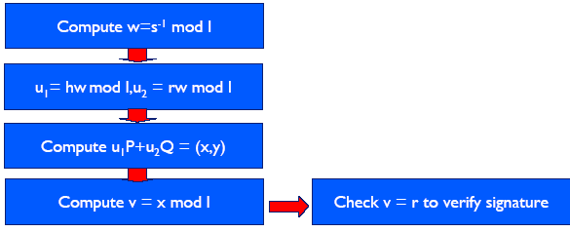
ECDSA Signature Verification
Signature verification for message M, signature (r,s), hash h: base point P, public key Q=dP, order l of base point P

Slide 32
Modular arithmetic of GF(p)
Modular Addition and Subtraction.
Modular Reduction (multiplication) algorithms:
  Barrett reduction.
  Montgomery reduction.
  NIST primes by Brown et al., very fast (6% and 33%) but specialized reduction algorithm.
  Pseudo-Mersenne prime.
Modular Inversion (Division)
  Binary extended GCD (BEGCD) algorithm
  Extended Euclidean algorithm (EEA)
  Exponentiation method (Fermat’s little theorem)

Slide 33
Scalar multiplication
Basic crypto operation of an ECC.
Series of point addition and doubling.
Binary method due to no pre-computation phase .
Faster processing when using signed representation of the scalar value.

Slide 34
Point coordinates and Scalar Multiplication
Addition and Doubling
  Affine - a point is represented as (x_{A}, y_{A}).
  Projective - (X, Y,Z) where x_{A} = XZ⁻¹ and y_{A} = Y Z⁻¹.
  Jacobian, Modified Jacobian and Chudnovsky Jacobian.
  Issue of Temporary variables required by each algorithm.
  Mixed coordinate multiplication.

Slide 35
Background References
Elliptic Curve Cryptography at the Wikipedia
  http://en.wikipedia.org/wiki/Elliptic_curve_cryptography
  http://en.wikipedia.org/wiki/Elliptic_curves
Elliptic curve cryptography FAQ by George Barwood
  http://www.cryptoman.com/elliptic.htm
Elliptic Curve Cryptography according to Steven Galbraith
  http://www.isg.rhul.ac.uk/~sdg/ecc.html
An Elliptic Curve Cryptography (ECC) Primer by certicom
  http://www.deviceforge.com/articles/AT4234154468.html
Online Elliptic Curve Cryptography Tutorial by certicom
  http://www.certicom.com/index.php?action=ecc_tutorial,home

Slide 36
Performance References
Bednara, M. et. al. “Tradeoff Analysis of FPGA Based Elliptic Curve Cryptography.” Circuits and Systems, 29 May 2002.
Qizhi, Qui “Research on Elliptic Curve Cryptography.” Computer Supported Cooperative Work in Design. 26 May 2004

Slide 37
Application References
Implementing an efficient elliptic curve cryptosystem over GF(p) on a smart card, Yvonne Hitchcock, Edward Dawson, Andrew Clark, Paul Montague, October 2002.
THE ELLIPTIC CURVE CRYPTOSYSTEM FOR SMART CARDS, A Certicom White Paper, Published: May 1998

