Slide 1
PRIMETRUST BANK • SOLUTION PRESENTATION
LanceBox — simple mobile invoicing
From customer onboarding
to an invoice ready to share.
CASE STUDY BRIEF
Onboarding + invoicing
Flutter implementation
Code + solution walkthrough
60-minute task constraint
A Flutter mobile application built from the supplied LanceBox designs, with Riverpod managing shared app data.
Scope: a local mobile demo with PDF export and device sharing.
LANCEBOX / Senior Analyst, Mobile Development case study
1 / 6
Notes:
Introduce the assignment: PrimeTrust Bank asks for a simple app with onboarding and invoicing, using Flutter or React and the supplied Figma. The brief specifies a maximum of 60 minutes; this slide does not claim measured implementation time. Source: Case study - Senior Analyst, Mobile Development - Individual 3.docx. Implementation: lib/main.dart, lib/app/app.dart, pubspec.yaml.

Slide 2
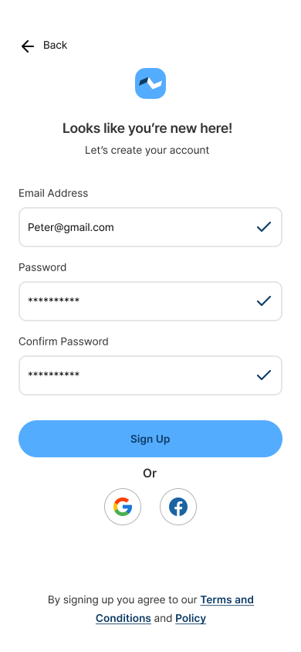
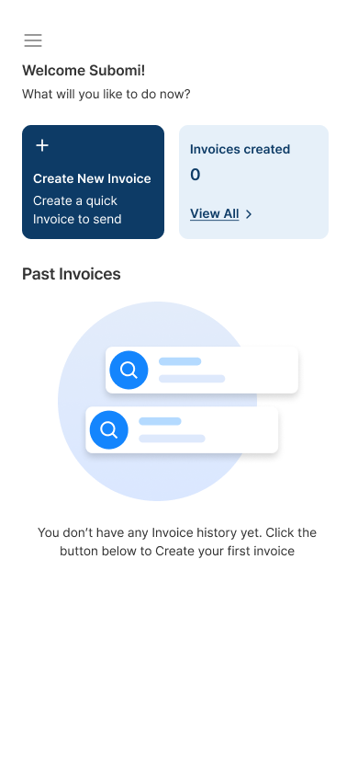
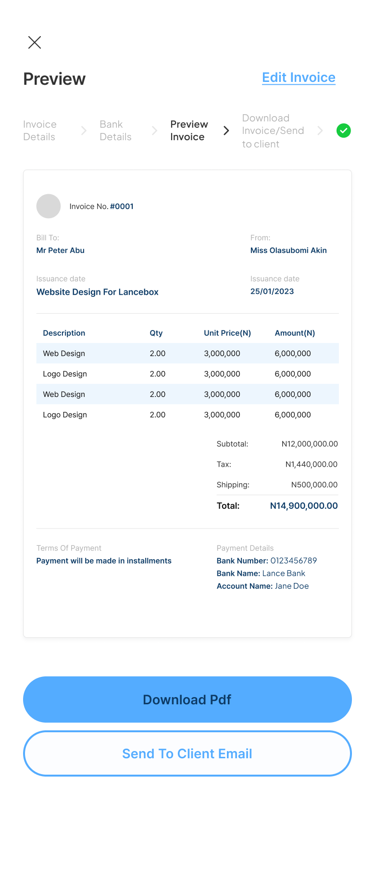
SCREENS & DESIGN FIDELITY
One connected customer journey
Sign up → profile → dashboard
Invoice details → bank → preview
SUPPLIED DESIGN REFERENCES — not runtime screenshots
• Validated inputs and completion ticks
• Logo upload and account-type choice
• Editable items, VAT and shipping
• PDF download and email-app handoff
Pretendard typography, blue accents and reusable controls.
Sign up
Dashboard
Preview
LANCEBOX / Senior Analyst, Mobile Development case study
2 / 6
Notes:
Walk through the user journey. These images are supplied design references, not screenshots of the current build. The app calculates actual invoice totals; the sample design totals are inconsistent. The current preview exposes Download PDF and Send to Client Email. Social sign-in is an explanatory demo, not connected OAuth. Sources: lib/features/onboarding/, editor.dart, preview.dart, invoice_document.dart, app/theme.dart and the supplied PNGs.

Slide 3
CODE QUALITY • STATE MANAGEMENT • GROWTH
Clear code with one shared state owner
Screens
Riverpod store
Local storage
→
→
Show the design and handle user actions.
Owns profile and saved-invoice snapshots.
Keeps small app data on this device.
Shared data: appStoreProvider
Local form data: InvoiceFormData
Calculations: Invoice model
Small files separate layout, validation and actions.
Storage succeeds before Riverpod publishes a new snapshot.
LANCEBOX / Senior Analyst, Mobile Development case study
3 / 6
Notes:
Code walkthrough: main.dart initializes preferences and provides them to ProviderScope. app/store.dart defines NotifierProvider<AppStore, AppState>. ref.watch rebuilds the UI when relevant state changes; ref.read(...notifier) invokes actions. Form controllers, focus and transient loading remain local. InvoiceFormData converts a draft to an Invoice. Theme and shared widgets are separate files. No extra repository/use-case layers were added. Open docs/CODE_GUIDE.md for the file map.

Slide 4
ERROR HANDLING • RESPONSIVENESS • RESOURCES
Guardrails for a reliable mobile flow
Validate before continuing
Recover from failures
Required fields, matching passwords, bank-number length and valid numeric inputs.
Storage retry, export errors, save cancellation and loading-state cleanup.
Fit smaller phones
Keep resource use controlled
Scrollable forms and preview layout checks at 320 and 390 pixels, including enlarged text.
Dispose controllers; resize uploaded logos; select relevant Riverpod state to limit rebuilds.
LANCEBOX / Senior Analyst, Mobile Development case study
4 / 6
Notes:
Validation: bank numbers accept 1–10 digits and preserve leading zeros; bank names reject digits. VAT is 0–100%, optional shipping defaults to zero, quantity must be positive. Money uses integer minor units; invoice.dart calculates totals. Reliability: errors are translated into user messages, export flags reset in finally, corrupt stored invoices are protected from overwrite. Resource practices are implemented, but performance has not been benchmarked. Onboarding intentionally includes a 3-second button spinner and a 2-second branded loader; these are demo delays, not measured network latency. Sources: shared/validation.dart, invoice.dart, main.dart, preview.dart, logo_picker.dart, app/app.dart and test/invoice_document_test.dart.

Slide 5
TESTING & DOCUMENTATION
Evidence behind the implementation
21
4
0
automated tests passed
visual baselines matched
static-analysis issues
Checks cover
Calculations, validation, persistence, PDF output, onboarding and preview/edit flow.
Handover includes
README setup instructions and a plain-language code guide for new contributors.
Latest refactor verification • native file picking/sharing still requires device testing
LANCEBOX / Senior Analyst, Mobile Development case study
5 / 6
Notes:
These are results from the completed refactor verification in this workspace: flutter test passed 21 tests; flutter analyze reported no issues. Four golden comparisons cover signup, dashboard, editor and preview, proving no pixel changes against the captured pre-refactor baselines, not exact equivalence to Figma. Tests include 320-pixel creation/preview/edit flow and enlarged-text document layouts. Documentation: README.md and docs/CODE_GUIDE.md. Do not claim native sharing, file pickers or iOS have been fully device-validated.

Slide 6
PANEL WALKTHROUGH & NEXT STEPS
Demonstrate the flow, then close the gaps
LIVE WALKTHROUGH
CURRENT BOUNDARIES
1. Show validation and complete onboarding.
2. Add invoice items; change VAT/shipping.
3. Preview, edit and confirm retained values.
4. Download a PDF or open device sharing.
5. Show Riverpod, calculations and tests.
Local demo; no backend authentication.
Email uses the device share menu.
Save logic exists; no visible Save button.
NEXT PRIORITIES
Connect the save flow and authentication; verify on devices; profile performance.
LANCEBOX / Senior Analyst, Mobile Development case study
6 / 6
Notes:
Use this sequence to present both code and final solution as requested by the brief. Important existing limitation: preview.dart has a save method and the Riverpod store supports persistence, but the current screen has no visible Save control. Do not demonstrate end-to-end saving as available. Authentication/OAuth and real delivery services are not connected. Next steps require product agreement and device testing; they are not claims of completed features. The deck reflects the existing codebase without changing app behavior.

