Slide 1
Revision AD conversion
Exercise 1:
Start building the board
Wood board
Arduino mega
Breadboard for electrical circuits
Joystick (if available, if not tell Esa & Vihtori)

Slide 2


Revision – Binary IO
Exercise 2:
Create traffic lights
Use red/yellow/green leds
User register control for leds (optional)

Slide 3
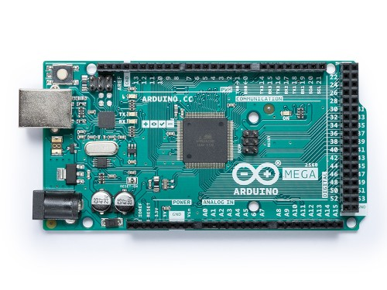
Revision - AD conversion
Recall spring lesson: AD conversion
In mega Analog input pins are: A0 – A15

Slide 4
Revision AD conversion
Exercise 3:
Create program that prints to LCD-display
the voltage of potentiometer and
The voltage of 3.3V pin of Mega

Slide 5
Revision – AD conversion
Example of LCD
Pot.meter = 2.45 V
3.3 level =3.2 V

