Slide 1
Chapter 11
Recursion

Slide 2
Recursion
Recursion is a fundamental programming technique that can provide an elegant solution certain kinds of problems
Chapter 11 focuses on:
  thinking in a recursive manner
  programming in a recursive manner
  the correct use of recursion
  recursion examples
© 2004 Pearson Addison-Wesley. All rights reserved
11-<number>

Slide 3
Outline
Recursive Thinking
Recursive Programming
Using Recursion
© 2004 Pearson Addison-Wesley. All rights reserved
11-<number>

Slide 4
Recursive Thinking
A recursive definition is one which uses the word or concept being defined in the definition itself
When defining an English word, a recursive definition is often not helpful
But in other situations, a recursive definition can be an appropriate way to express a concept
Before applying recursion to programming, it is best to practice thinking recursively
© 2004 Pearson Addison-Wesley. All rights reserved
11-<number>

Slide 5
Recursive Definitions
Consider the following list of numbers:
24, 88, 40, 37
Such a list can be defined as follows:
A LIST is a: number
or a: number comma LIST
That is, a LIST is defined to be a single number, or a number followed by a comma followed by a LIST
The concept of a LIST is used to define itself
© 2004 Pearson Addison-Wesley. All rights reserved
11-<number>

Slide 6
Recursive Definitions
The recursive part of the LIST definition is used several times, terminating with the non-recursive part:
number comma LIST
24 , 88, 40, 37
number comma LIST
88 , 40, 37
number comma LIST
40 , 37
number
37
© 2004 Pearson Addison-Wesley. All rights reserved
11-<number>

Slide 7
Infinite Recursion
All recursive definitions have to have a non-recursive part
If they didn't, there would be no way to terminate the recursive path
Such a definition would cause infinite recursion
This problem is similar to an infinite loop, but the non-terminating "loop" is part of the definition itself
The non-recursive part is often called the base case
© 2004 Pearson Addison-Wesley. All rights reserved
11-<number>

Slide 8
Recursive Definitions
N!, for any positive integer N, is defined to be the product of all integers between 1 and N inclusive
This definition can be expressed recursively as:
1! = 1
N! = N * (N-1)!
A factorial is defined in terms of another factorial
Eventually, the base case of 1! is reached
© 2004 Pearson Addison-Wesley. All rights reserved
11-<number>

Slide 9
Recursive Definitions
5!
5 * 4!
4 * 3!
3 * 2!
2 * 1!
1
120
24
6
2
© 2004 Pearson Addison-Wesley. All rights reserved
11-<number>

Slide 10
Outline
Recursive Thinking
Recursive Programming
Using Recursion
© 2004 Pearson Addison-Wesley. All rights reserved
11-<number>

Slide 11
Recursive Programming
A method in Java can invoke itself; if set up that way, it is called a recursive method
The code of a recursive method must be structured to handle both the base case and the recursive case
Each call to the method sets up a new execution environment, with new parameters and local variables
As with any method call, when the method completes, control returns to the method that invoked it (which may be an earlier invocation of itself)
© 2004 Pearson Addison-Wesley. All rights reserved
11-<number>

Slide 12
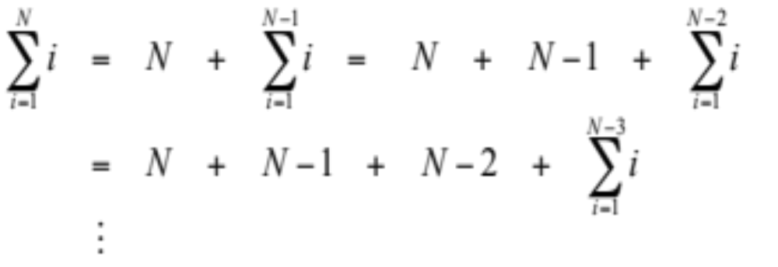
Recursive Programming
Consider the problem of computing the sum of all the numbers between 1 and any positive integer N
This problem can be recursively defined as:
© 2004 Pearson Addison-Wesley. All rights reserved
11-<number>

Slide 13
Recursive Programming
// This method returns the sum of 1 to num
public int sum (int num)
{
int result;
if (num == 1)
result = 1;
else
result = num + sum (n-1);
return result;
}
© 2004 Pearson Addison-Wesley. All rights reserved
11-<number>

Slide 14
Recursive Programming
result = 6
main
sum(3)
sum
result = 3
sum(2)
sum
result = 1
sum(1)
sum
© 2004 Pearson Addison-Wesley. All rights reserved
11-<number>

Slide 15
Recursive Programming
Note that just because we can use recursion to solve a problem, doesn't mean we should
For instance, we usually would not use recursion to solve the sum of 1 to N problem, because the iterative version is easier to understand
However, for some problems, recursion provides an elegant solution, often cleaner than an iterative version
You must carefully decide whether recursion is the correct technique for any problem
© 2004 Pearson Addison-Wesley. All rights reserved
11-<number>

Slide 16
Indirect Recursion
A method invoking itself is considered to be direct recursion
A method could invoke another method, which invokes another, etc., until eventually the original method is invoked again
For example, method m1 could invoke m2, which invokes m3, which in turn invokes m1 again
This is called indirect recursion, and requires all the same care as direct recursion
It is often more difficult to trace and debug
© 2004 Pearson Addison-Wesley. All rights reserved
11-<number>

Slide 17
Indirect Recursion
m1
m2
m3
m1
m2
m3
m1
m2
m3
© 2004 Pearson Addison-Wesley. All rights reserved
11-<number>

Slide 18
Outline
Recursive Thinking
Recursive Programming
Using Recursion
Recursion in Graphics
© 2004 Pearson Addison-Wesley. All rights reserved
11-<number>

Slide 19
Maze Traversal
We can use recursion to find a path through a maze
From each location, we can search in each direction
Recursion keeps track of the path through the maze
The base case is an invalid move or reaching the final destination
See MazeSearch.java (page 583)
See Maze.java (page 584)
© 2004 Pearson Addison-Wesley. All rights reserved
11-<number>

Slide 20
Towers of Hanoi
The Towers of Hanoi is a puzzle made up of three vertical pegs and several disks that slide on the pegs
The disks are of varying size, initially placed on one peg with the largest disk on the bottom with increasingly smaller ones on top
The goal is to move all of the disks from one peg to another under the following rules:
  We can move only one disk at a time
  We cannot move a larger disk on top of a smaller one
© 2004 Pearson Addison-Wesley. All rights reserved
11-<number>

Slide 21
Towers of Hanoi
Original Configuration
Move 1
Move 2
Move 3
© 2004 Pearson Addison-Wesley. All rights reserved
11-<number>

Slide 22
Towers of Hanoi
Move 4
Move 5
Move 6
Move 7 (done)
http://vornlocher.de/tower.html
© 2004 Pearson Addison-Wesley. All rights reserved
11-<number>

Slide 23
Towers of Hanoi
An iterative solution to the Towers of Hanoi is quite complex
A recursive solution is much shorter and more elegant
See SolveTowers.java (page 590)
See TowersOfHanoi.java (page 591)
© 2004 Pearson Addison-Wesley. All rights reserved
11-<number>

Slide 24
Summary
Chapter 11 has focused on:
  thinking in a recursive manner
  programming in a recursive manner
  the correct use of recursion
  recursion examples
© 2004 Pearson Addison-Wesley. All rights reserved
11-<number>

