Slide 1

Solving Sudoku Puzzles in Parallel
Ugur Koc & Mahmoud Sayed
CMSC 714 Term Project
Prof. Alan Sussman

Slide 2
Introduction
What is Sudoku?
  A puzzle game with 9x9 board
What are the rules?
  No duplicate numbers in
    any row
    any column
    any sub-board
Properties
    Only one valid solution
    Can be of bigger sizes
CMSC 714 – HPC

Slide 3
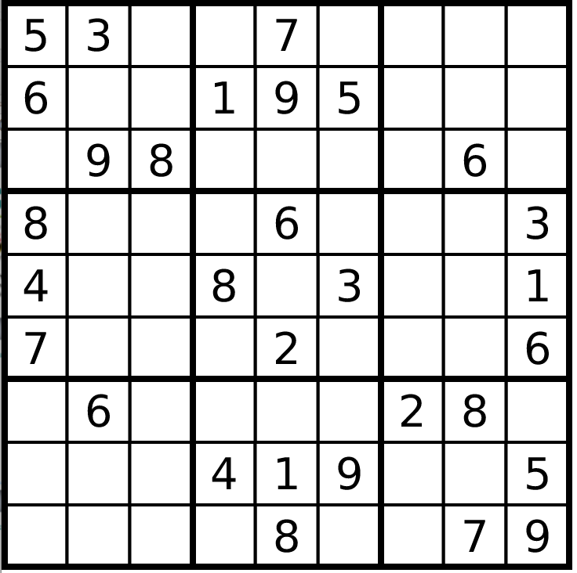
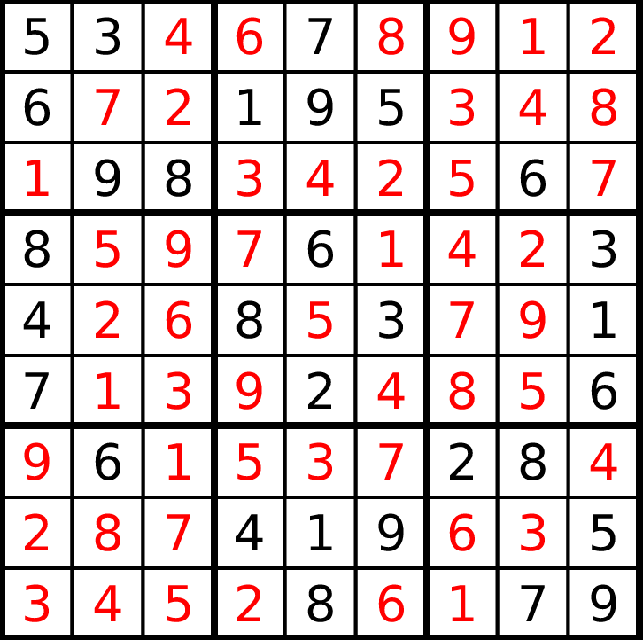
Introduction - Example
CMSC 714 – HPC

Slide 4
Outline
Objective
Humanoid Strategies
Techniques
  Tree Search
    Brute Force
    A*
  Simulated Annealing
Related Work
Results
Conclusion
CMSC 714 – HPC

Slide 5
Objective
Can be modeled as a constraint satisfaction problem
  We can apply search algorithms
  A lot of loops and recursion subject to parallelization
The goal of our work is to do a practical study of different types of algorithms
  Brute force, greedy, and local search algorithms
A framework for similar problems like
  Many puzzles have similar settings and rules
    NxN board to place N queens
CMSC 714 – HPC

Slide 6


Humanoid Strategies
Rule of single possibility
  When an empty cell with only one possible value
  Value should be assigned
Rule of k-positions
  When k values appear only in k cells (row/column/sub-board)
  No other values can appear in those cells
  We apply only when k = 1
CMSC 714 – HPC

Slide 7
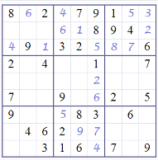
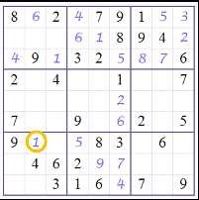
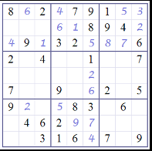
Techniques
Tree search algorithms can be applied
  Expanding the initial puzzle by trying different values for the first empty cell
  Backtracking if we reach invalid board
  Cell ordering ?
  Value ordering ?
CMSC 714 – HPC

Slide 8
Techniques (cont.)
A* star algorithm
  Benefit function f(n) is developed for each empty cell
  f(n) = g(n) + h(n)
  g(n) how many cells are filled so far
  h(n) how many canceled possibilities for that cell
  Select the cell with the highest benefit to expand first
CMSC 714 – HPC

Slide 9
Techniques (cont.)
Two approaches to parallelize A*
Shared priority queue
  Each thread picks the first element,
  expands to some depth and insert in the priority queue
  Pros: even work
  Cons: synchronization, hard to implement
Independent threads
  Expand the initial tree to an adequate number equal to the number of threads
  Each thread works on independent branch
  Pros: No synchronization, easy to implement
  Cons: different amount of work
CMSC 714 – HPC

Slide 10
Techniques (cont.)
Simulated Annealing
  A stochastic optimization approach
    or a local search from AI point of view
  Emulated from physical annealing process
  Computational complexity does not depend on size of input
Adaptation
  First time used for this problem
  Hard to parallelize
CMSC 714 – HPC

Slide 11
Techniques (cont.)
Problem Modeling for SA
  State: A board fulfilled with numbers from 1 - N
  Cost: Count the number of the violations
  Transition function: Swap the numbers of two random cells of a random row
    At least one of the cells must have a violation
  Goal: Have a board with no violation - 0 cost
Initialization for SA
  When we fulfill the board, we
    apply elimination and lone ranger
    make sure that no violation occurs in rows
      Violations in columns and sub squares are to be solved
CMSC 714 – HPC

Slide 12
Techniques (cont.)
Parallelizing SA
  Used pthread library
  Task specific threads
    one thread for copy task
    one thread for accept task
CMSC 714 – HPC

Slide 13
Related Work
Parallelization of Sudoku
  Constraint Propagation and back tracking
  Pthreads with locking and message passing
  Toronto University, 2012
Parallel sudoku solver.
  OpenMP
  Humanoid techniques
    Elimination, lone ranger etc.
  Technical report, Carnegie Mellon University, 2013
Parallel Sudoku Solver using MPI and C
  Constraint Propagation and Search
  Technical report, State University of New York at Buffalo, 2014
CMSC 714 – HPC

Slide 14
Results
Threads | BF | A* | SA | Toronto
1 / Seq | >3d** | 0.077s* | 6.48/4.82s | 12.77/7.4s
2 | - | 0.119s* | 24/11.13s* | 12.5/12.4s
3 | - | 0.023s* | - | 12.65/12.59s
4 | - | 0.021s* | - | 12.45/12.41s
5 | - | 0.022s* | - | 6.09/6.08s
6 | - | 0.032s* | - | 6.08/6.07s
7 | - | 0.044s* | - | 6.03/6.02s
8 | - | 0.047s* | - | 5.88/5.88s
16 | - | 0.065s* | - | -
  * results obtained in a different environment
  ** no solution found
CMSC 714 – HPC

Slide 15
Observations
Brute Force is infeasible
  Could not solve 16x16 evil puzzle in 3 days
  Can only be applicable for 9x9 puzzle
A*
  Fastest so far
  We need to apply on different puzzles
Simulated Annealing
  Can be effective in sequential but hard to parallelize
    each iteration depends on the previous one
  Had a high variation in execution time for same puzzle
Solving 25x25 puzzles is really hard
  We will work on this until final report due date
CMSC 714 – HPC

Slide 16
Thanks
CMSC 714 – HPC

Slide 17
References
  Alton Chiu, Ehsan Nasiri, and Rafat Rashid. Parallelization of sudoku. Technical report, University of Toronto, 2012.
  William Dudziak. Arbitrary size parallel sudoku creation. Technical report, 2006.
  Hilda Huang and Lindsay Zhong. Parallel sudoku solver. Technical report, Carnegie Mellon University, 2013.
  Rohit H. Shreekant. Parallel sudoku solver using mpi and c. Technical report, State University of New York at Buffalo, 2014.
CMSC 714 – HPC

