Slide 1

Jim Beam Brands: Performance Analysis
A data-driven SWOT analysis based on Iowa liquor transactional sales data from market position to strategic recommendations.
IOWA LIQUOR DATASET
VENDOR PERFORMANCE REVIEW

Slide 2
Analytical Framework: Key Questions
We are analyzing Jim Beam Brands using Iowa state liquor transactional data to test a hypothesis-driven scenario. The goal is to determine whether performance changes are driven by market conditions, competitive position, or customer behavior.
- What is driving the changes in Jim Beam’s sales performance over time?
- Is the decline in sales caused by overall market trends or internal performance issues?
- How does Jim Beam perform relative to its competitors in top stores?
- Is performance driven more by transaction volume or customer spending behavior?
- Where are the key strengths, weaknesses, and growth opportunities for Jim Beam in this market?

Slide 3
Summary Statistics: Where Jim Beam Stands
4th
$5.1M
Vendor Rank
Total Revenue
Out of major Iowa liquor vendors — behind Diageo, Sazerac, and Pernod Ricard
Significant gap to leader Diageo Americas at $14.4M
~8%
~50%
Avg. Market Share
Summer Drop
Typical range of 7–9%, with peaks near 12% and lows near 6%
Transaction volume decline during June–July seasonal trough

Slide 4
SWOT — STRENGTHS
Strength 1: Strong Market Position
Jim Beam ranks 4th among major Iowa liquor vendors
$5.1M in total revenue demonstrates established market presence
Top-4 position indicates strong brand recognition and shelf presence
Competitive positioning provides foundation for growth

Slide 5
SWOT — STRENGTHS
Strength 2: Market Correlation
Jim Beam's revenue closely tracks overall market demand
When the category grows, Jim Beam benefits proportionally
Strong correlation indicates brand is a go-to choice during peak demand periods
Market alignment provides predictable revenue during favorable conditions

Slide 6
SWOT — WEAKNESSES
Weakness 1: Revenue Gap to Leaders
Jim Beam generates $5.1M vs. Diageo's $14.4M — only 35% of market leader revenue
Significant gap to Sazerac ($7.1M) and Pernod Ricard ($6M) limits competitive leverage
Revenue gap reflects structural disadvantage in market influence and negotiating power
Missed opportunity to capture greater share of growing category

Slide 7
SWOT — WEAKNESSES
Weakness 2: Unstable Market Share
Jim Beam's market share fluctuates between 6% and 12% — a 100% swing
Peak share of ~12% occurs March–May; lows near 6% in other periods
Inconsistent performance indicates reactive positioning, not stable brand loyalty
Volatility suggests vulnerability to competitive pressure and market shifts

Slide 8
SWOT — OPPORTUNITIES
Opportunity 1: Peak Season Expansion
March–May represents Jim Beam's strongest period, reaching ~12% market share
Peak season demonstrates proven consumer demand and brand pull
Targeted promotions and inventory optimization can extend peak window
Strategic marketing during high-demand periods can deepen market penetration
The column chart illustrates Jim Beam's revenue index across months, clearly showing a strong performance during the March-May peak season. This period demonstrates elevated consumer demand, providing a strategic opportunity for enhanced marketing efforts and extended promotional activities.

Slide 9
SWOT — OPPORTUNITIES
Opportunity 2: Increase Average Transaction Value
Average transaction value = spending per transaction, NOT product shelf price
This metric fluctuates independently from transaction volume — a key insight
Independent movement indicates room to increase customer spend per order
Strategies: premium bundles, curated gift sets, multi-bottle promotions
Lifting transaction value provides revenue growth without requiring more transactions
This dual-axis chart visually demonstrates the independent fluctuation of transaction volume and average transaction value across months. The distinct movement of each line highlights that increasing customer spend per order (Average Transaction Value) is an opportunity that can be pursued without solely relying on an increase in the number of transactions.

Slide 10
SWOT — THREATS
Threat 1: Seasonal Volume Collapse
Transaction volume drops ~50% during June–July — a recurring seasonal trough
December shows severe anomaly requiring investigation (operational or data issue)
Seasonal collapse directly erodes annual revenue and profitability
Structural vulnerability suggests need for counter-seasonal strategies

Slide 11
SWOT — THREATS
Threat 2: Volume-Driven Decline
Revenue decline is driven primarily by transaction volume drops, not pricing pressure
When fewer customers transact, revenue falls — indicating demand weakness
Volume-driven model creates vulnerability to market downturns with limited margin protection
Lack of pricing power or premium positioning leaves Jim Beam exposed to competitive shifts
This dual-axis chart clearly demonstrates the strong correlation between transaction count and revenue. The parallel movement of both lines indicates that the primary driver of revenue decline is a drop in transaction volume, highlighting Jim Beam's vulnerability to market downturns driven by fewer customer transactions.

Slide 12
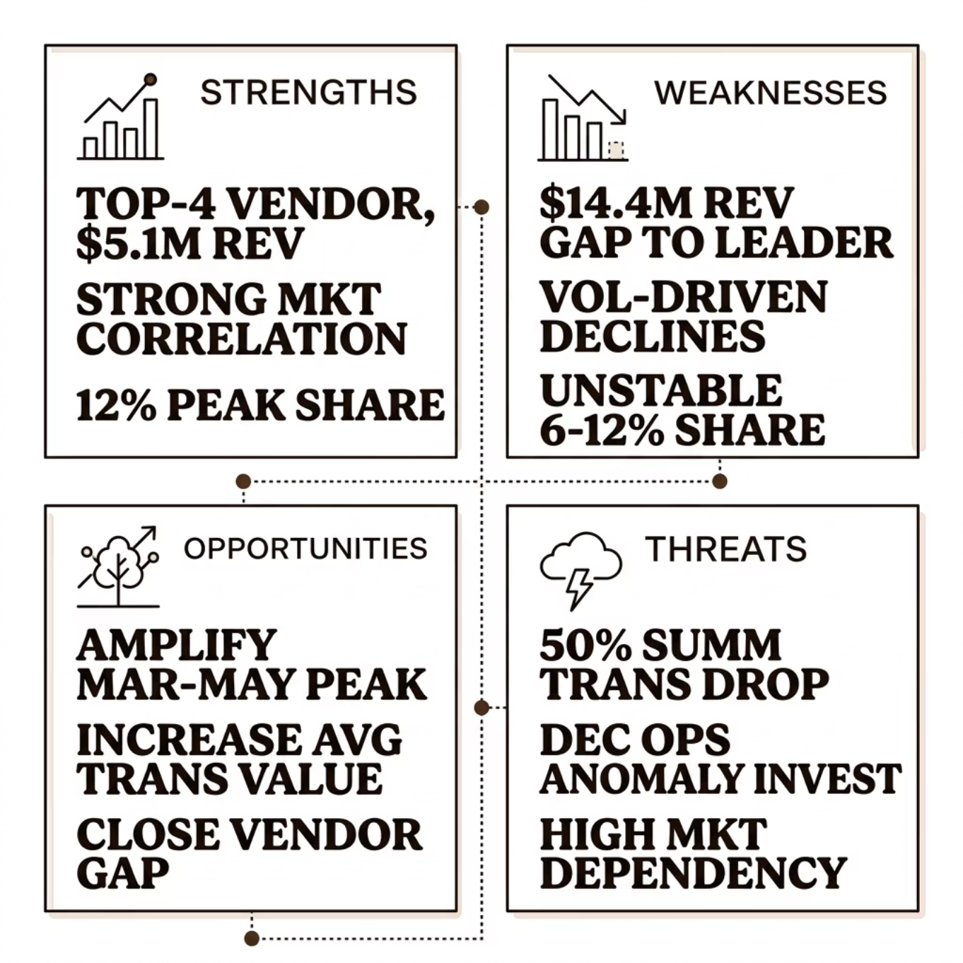

SWOT Summary
From Data to Strategy
Jim Beam is a solid but vulnerable player — strong brand recognition offset by volume instability and market dependency.
Leverage peak season strength to build momentum
Stabilize transaction volume year-round
Reduce reliance on overall market demand
Investigate December anomaly and summer drop causes

Slide 13



Recommendations: Three Priority Actions
Stabilize Volume Year-Round
Lift Transaction Value
Build Brand Differentiation
Launch summer promotions and investigate the December drop. Diversify channels to reduce seasonal dependency.
Introduce premium bundles and curated gift sets to increase average spend per order, independent of volume.
Reduce market correlation through loyalty programs, exclusive SKUs, and targeted retail partnerships.

