Slide 1
Modeling Pedal Electric Bike’s Electric Motor Support with Simulink
Ugur Bolat
Embedded Systems Master Program

Slide 2

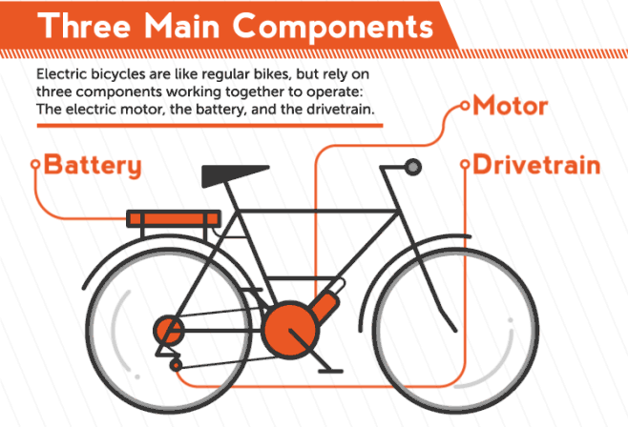
Notes:
What is an electric bike?
It is a like regular bike that you pedal but with the extra electric components. These electric components are meant to augment human power. It makes obstacles like hills and winds more manageable and allows you to travel without getting tired.
How does it work?
In our project, the electric motor is activated when the pedals are in motion. Then, the motor will provide the certain power drivetrain based on your motor support model. I chose the motor support, the one with the percentage distribution which is based on velocity. And, I gonna talk about the design and test results in the following slides

Slide 3
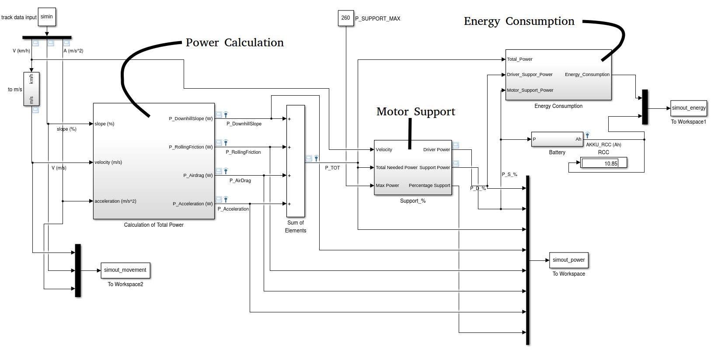
Simulink Model of Pedelec
Notes:
So, this is my complete simulink design, which consists of 3 main subsystems.
On the left side, we have power calculation subsystem, where I calculated the required power to reach or keep desired speed of the bike at certain point and time on the track.
In the center, I have motor support subsystem, where I make decision about how to distribute the power between driver and motor.
On the right side, I calculate the energy consumption by both driver and motor and I also have battery connected to this subsystem so that we can make observation about remaining battery.

Slide 4
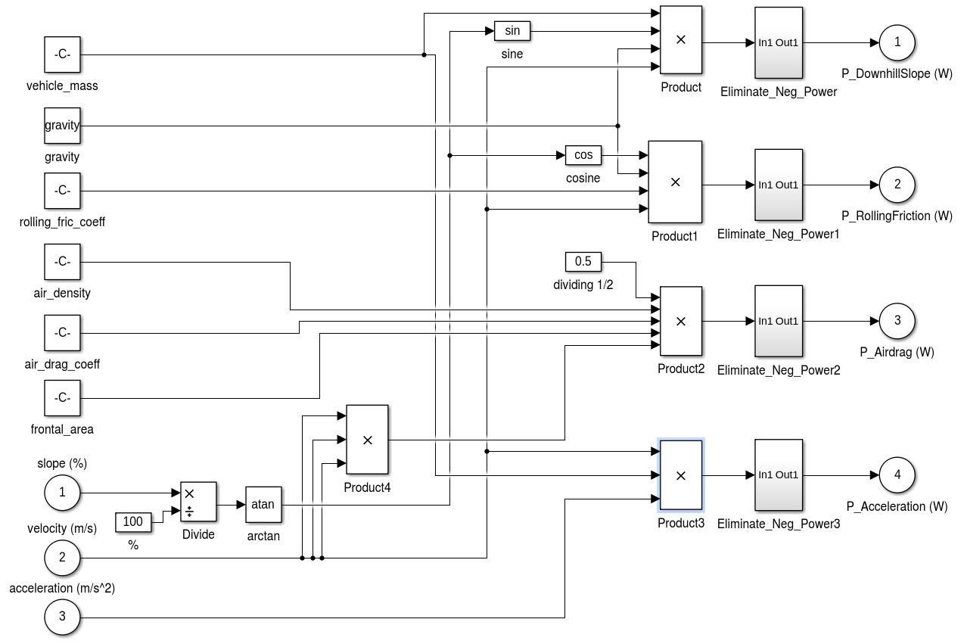
Power Calculation Subsystem
Notes:
Okay, here we see inside the power calculation subsystem. Based on the given equation, we calculate 4 different parameters here.
Power needed for the acceleration of the bike
Power needed for the rolling friction of the tires
Power needed for air drag of the bike and driver
And lastly, power needed for the downhill slope of the track
So I took this formula from the report; however, I believe downhill slope term is wrong. I think it should be uphill slope because driver or motor needs to provide power when riding on the uphill not downhill.

Slide 5
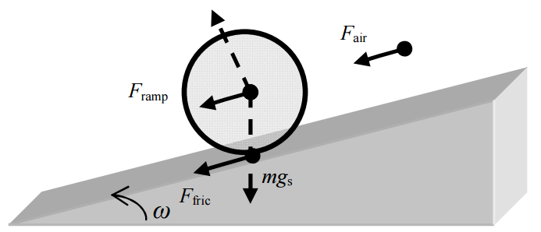
Uphill Motion
Notes:
So I put this figure to show better.
This is the friction between tires and ground which result in resistance during the ride
This is an airdrag force→ EXPLAIN IT AFTER YOU SEARCH FOR IT WHAT IT IS REALLY AIR DRAG
And finally, if I assume that the bike is moving upward direction so the gravity force is much more active than riding biking on the flat field. So that’s why driver needs to generate extra power

Slide 6
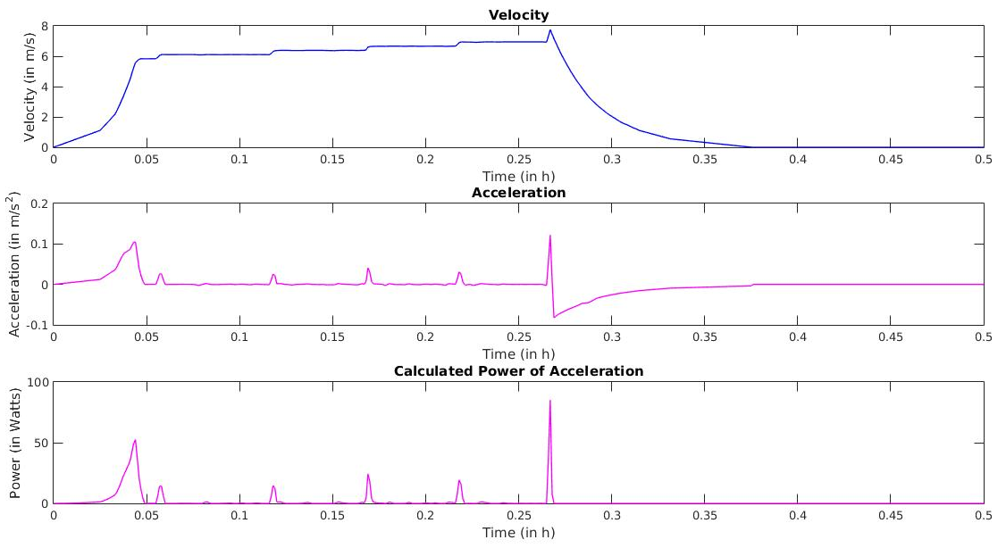
Power for Acceleration
Notes:
So, I assigned sort of realistic speed to the bike.
At the beginning of the track, the bike stand still and have zero speed. Then, it’s starting to accelerate and after this point of time, it’s speed almost constant except at these moments.
Power needed for the acceleration of the bike is given in the below graph!
And it actually makes sense when we look at those power values

Slide 7
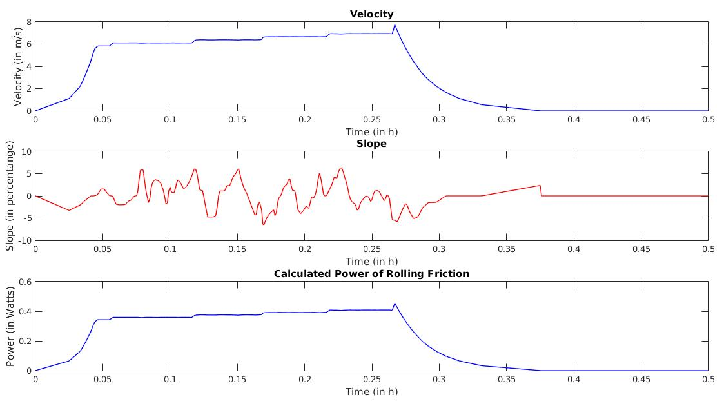
Power for Rolling Friction
Notes:
Here we see the required power to fight against the friction.
Except velocity and slope, all the other parameters are constant so power is directly proportional to velocity and slope.
As we can see, the below graph’s behavior is quite similar to the velocity but the effect of slope is not as big as the velocity.
If we zoomed into this graph we would also see the effect of slope

Slide 8
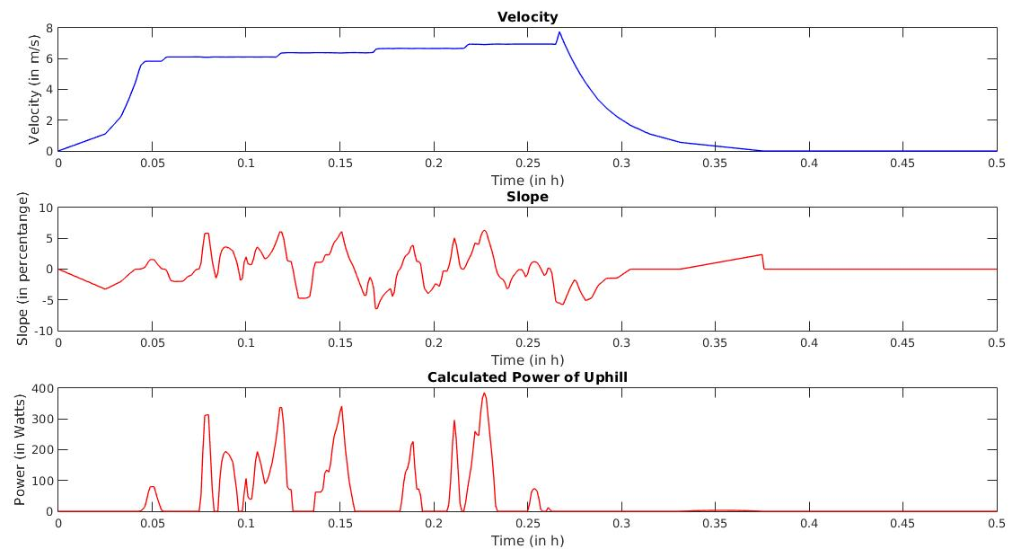
Power for Uphill !
Notes:
Since we assume that our bike’s motor does not store energy in the battery from the bike’s movement, we only need to consider positive sign power calculation.
So, when we ride the bike upward, we have to provide power.
The below graph shows how much power is need to based on the velocity and slope. Again other parameters are constant.

Slide 9

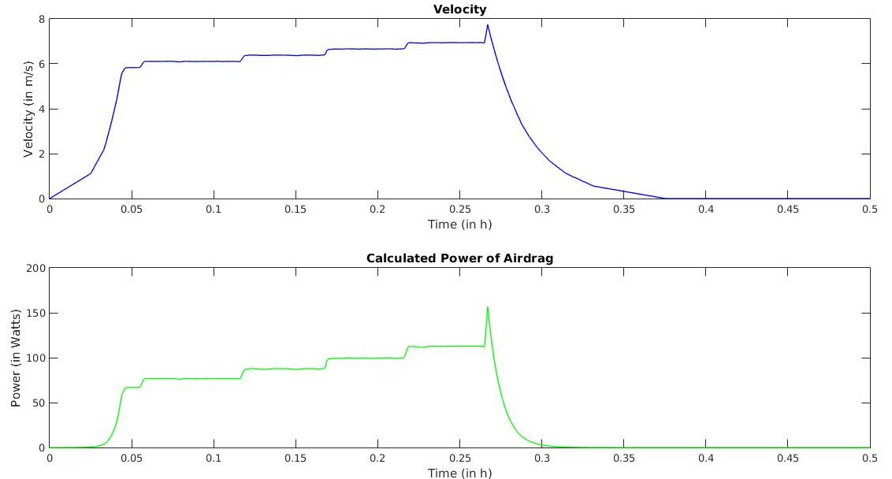
Power for Air Drag
Notes:
Here is the required power for the air drag, which is directly proportional to velocity.

Slide 10
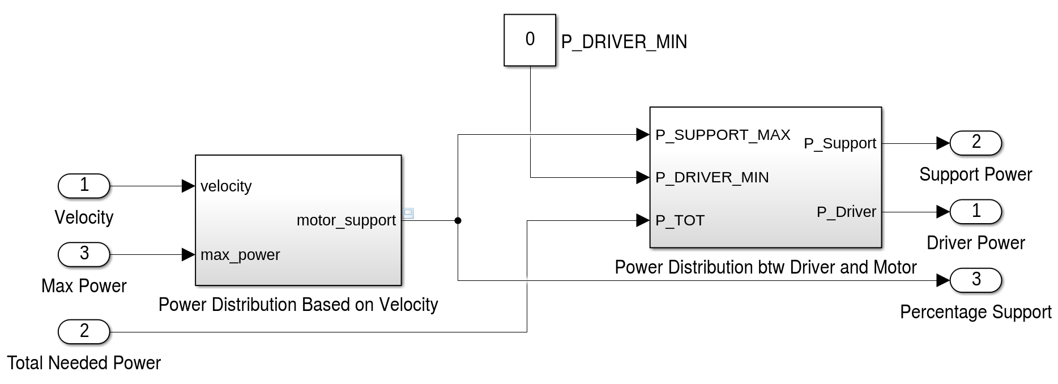
Power Support Subsystem
Notes:
So we calculate the total required power and we are going to distribute it between the motor and the driver.
There are two stages:
At the first stage, I will make a decision what is the maximum power I can provide through the motor based on the current speed of the bike.
At the second stage, I will distribute the power between the driver and the motor

Slide 11
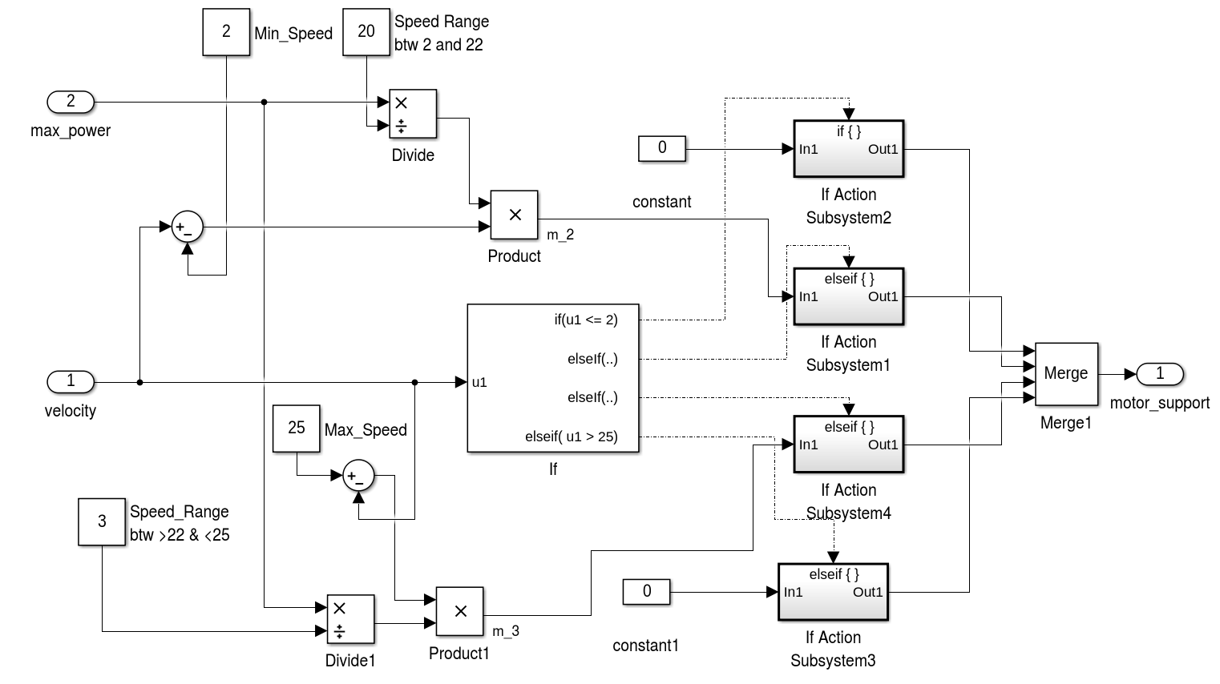
Power Support Based On Speed
Notes:
This is inside the Power Support Algorithm based on current speed.
Here I decide the maximum power that I can support. There are 4 simple cases it can happen:
First case, when the speed is less than or equal to 2 km/hour. And supporting power is 0.
Second case, when the speed between 2 km/h and 22 km/h. Here I multiplied the current speed with this coefficient to get percentage distribution effect. The more you are speedy the more power supporting power you get.
Third case, where I decrease the supporting power if the speed between 22 km/h and 25 km/h. So here it is reverse logic. The more you are speedy the less power you get.
Last case, when the speed is above 25 km/h, which I have no support.

Slide 12
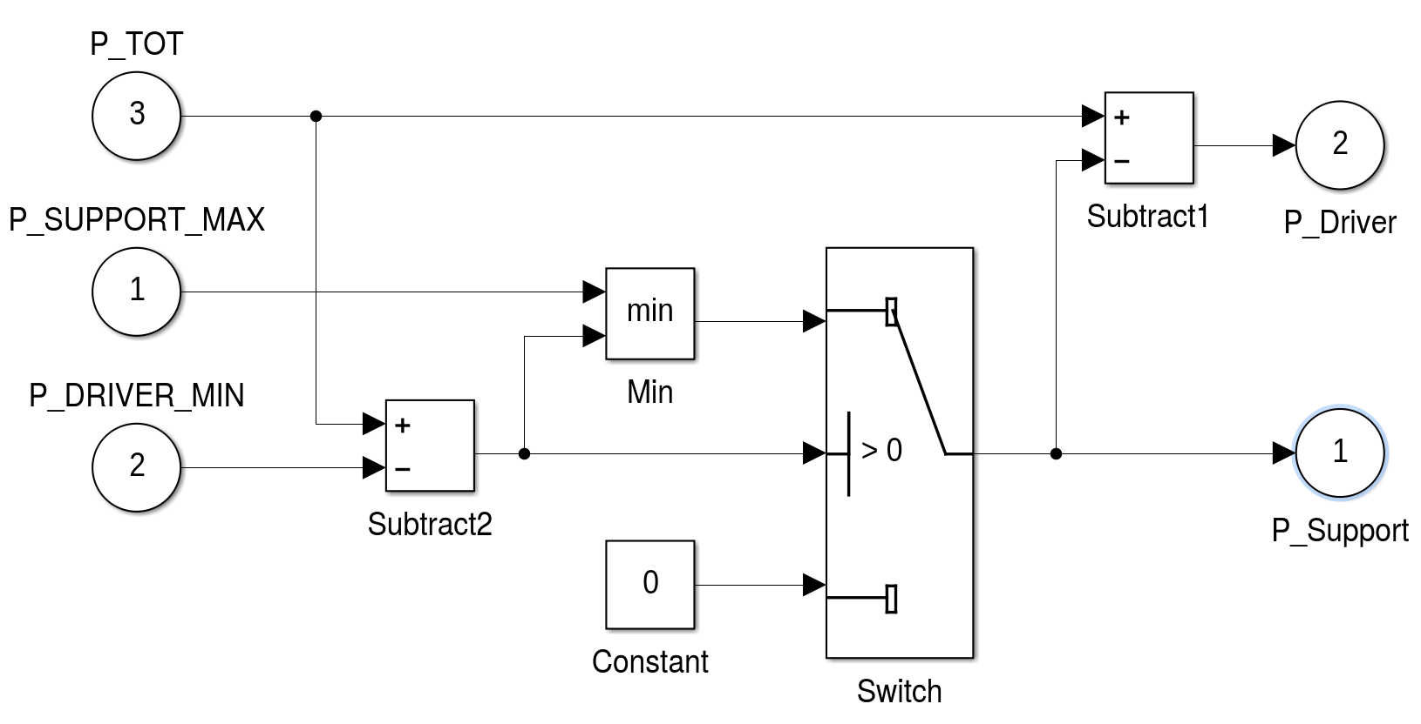
Power Distribution Between Driver and Motor
Notes:
This is original the subsystem from lab task. I only modified P_SUPPORT_MAX input. Instead of providing the constant power, I provide the result of a subsystem where I decide maximum power support based on the current speed.

Slide 13
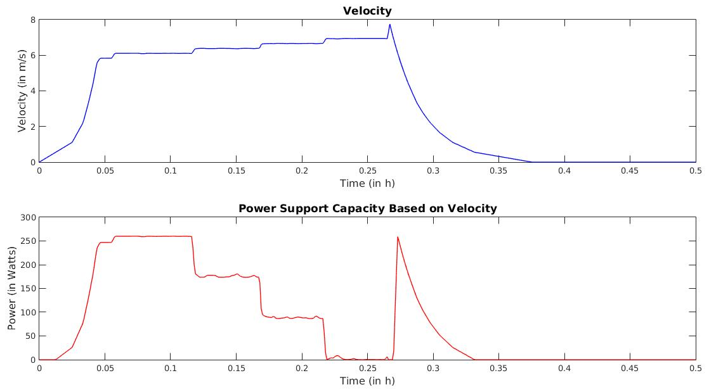
Maximum Power Support Capacity Based on Velocity
Notes:
Here is the resulting graph. As you can see, I have different potential supporting power based on the speed.

Slide 14
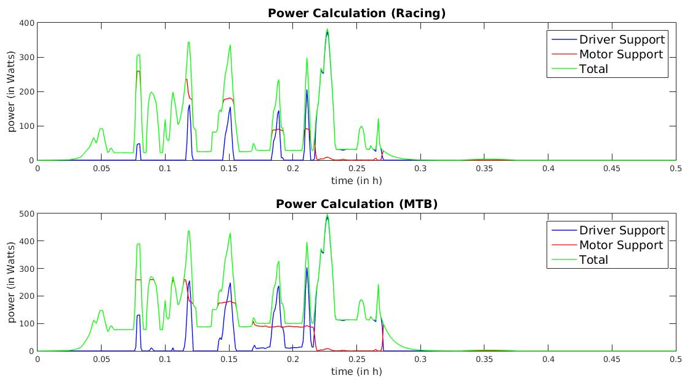
Power – MTB vs Racing Bike
Notes:
Finally, I set two different parameters for the MTB and Racing Bike cases in the matlab to see differences on required power and energy consumption.
Above graph shows required power of the racing bike and below graph shows the MTB.
The difference is that with the racing biking you need to provide less power like we would expected due to slim tiers and light-weight bike body.

Slide 15
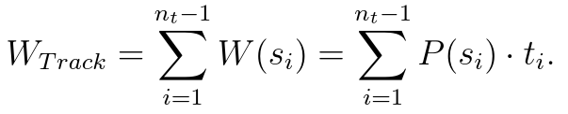
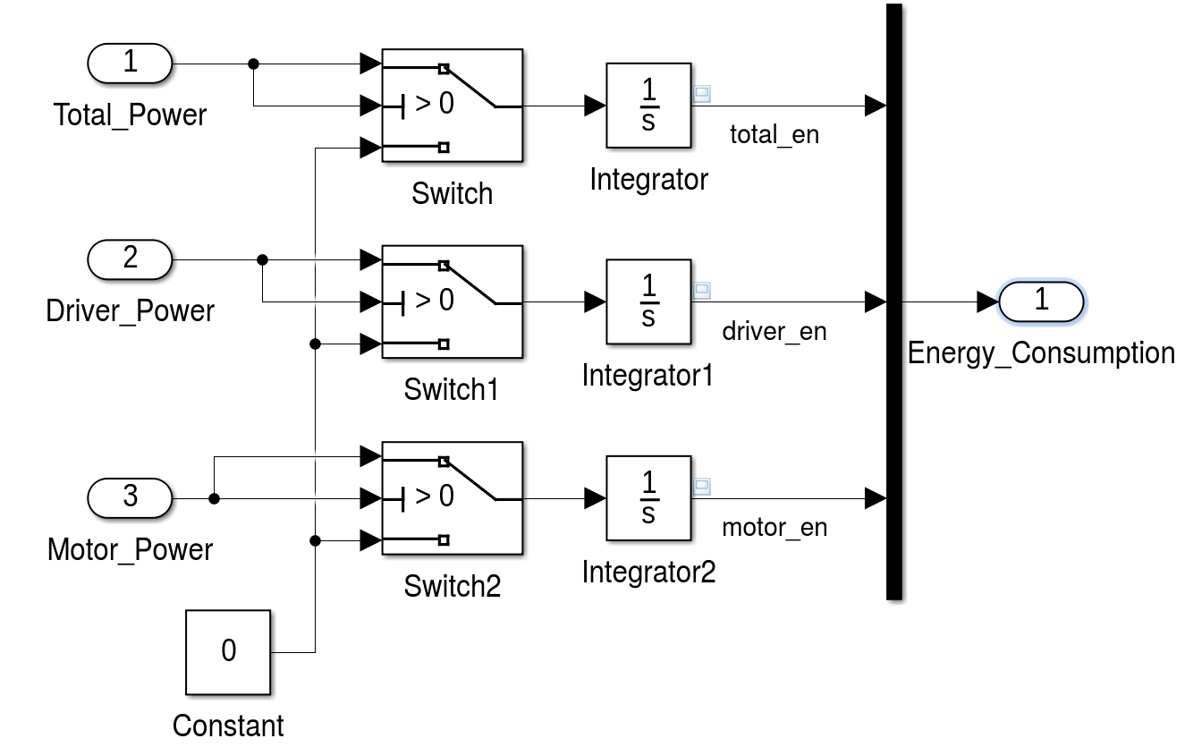
Energy Consumption Subsystem
Notes:
This is how I calculate the energy consumption simply by integrating the power. Nothing fancy.

Slide 16
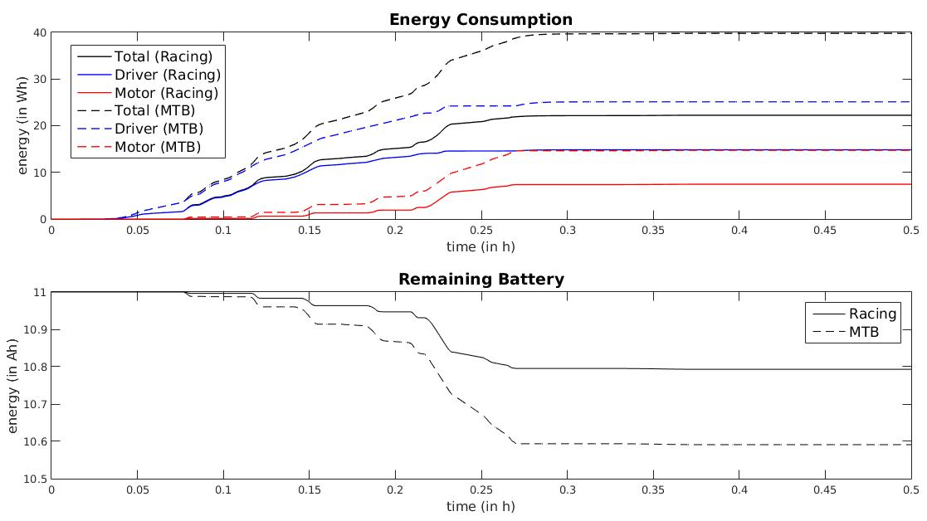
Energy – MTB vs Racing Bike
Notes:
So these are the total energy consumption for two different bike. Again for the racing bike, we consumed less energy. As a consequence, we have more energy left in the battery.
THE END

