Slide 1

A Graph-SLAM based Approach for
RSSI Fingerprinting
Uğur Bolat
Research Project Final Presentation
Date: 26. April 2018
Supervisors:
Daniel Froß
Steffen Weichold
Notes:
Hi, my name is Ugur Bolat and I am a student of Embedded Systems. Today, I will be talking about the final finding of my research project. By picking this topic, I (kind of) pushed myself out of my comfort zone because the problem I am trying to tackle here requires good knowledge of mobile robotics. So, I will try my best to use correct terminology in this talk and I hope I can manage this in a clear way.

Slide 2
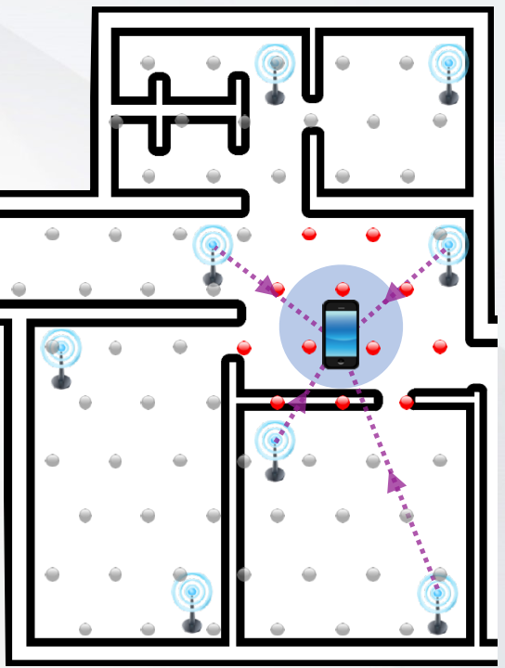
1. Problem Statement
Indoor Positioning
with Smartphone
Fingerprinting
Wi-Fi
Bluetooth
Magnetic Field
How about the map?
And, how to maintain this map?
Notes:
That being said, let’s dive into the problem right away. I believe some people here in this room have already substantial experience in variety of indoor positioning technologies. However, I would like to describe my indoor positioning application scenario briefly.
Suppose, I am standing with my smartphone and I would like to know where is the current my location of the phone in this indoor environment. However, the indoor map information is not available to me. Therefore, I need to build the map to localize myself.
To solve this problem, one could exploit the existing wireless communication network infrastructure inside the building. So what people do nowadays is to use the fingerprinting method, where you save radio signal measurements from the surrounding access points at the specified reference locations into your database. BTW, as an abbreviation, we call this received radio signal measurement as RSSI . For example, I marked the reference point as grey dots in this figure. The next time when you want to localize yourself in this environment, you try to match your RSSI measurements with one of your reference points in your database.
Well, it is a simple solution and it provides good results when you have a static environment and have reliable map information. However, these assumptions are not gonna get you anywhere since the digital indoor map is not available most of the time. Even if you build this indoor map, you have to maintain your fingerprint database since the environment is dynamic and changing over time. Therefore, you need an efficient way to build or update your map.

Slide 3
2. Research Question
How can I build an indoor map along with the fingerprint information by using a commercial smartphone?
Notes:
Now is the perfect time to ask the research question under these circumstances.
How can I build an indoor map along with the fingerprint information by using a commercial smartphone?
This is the problem I am trying to solve in this research project.

Slide 4
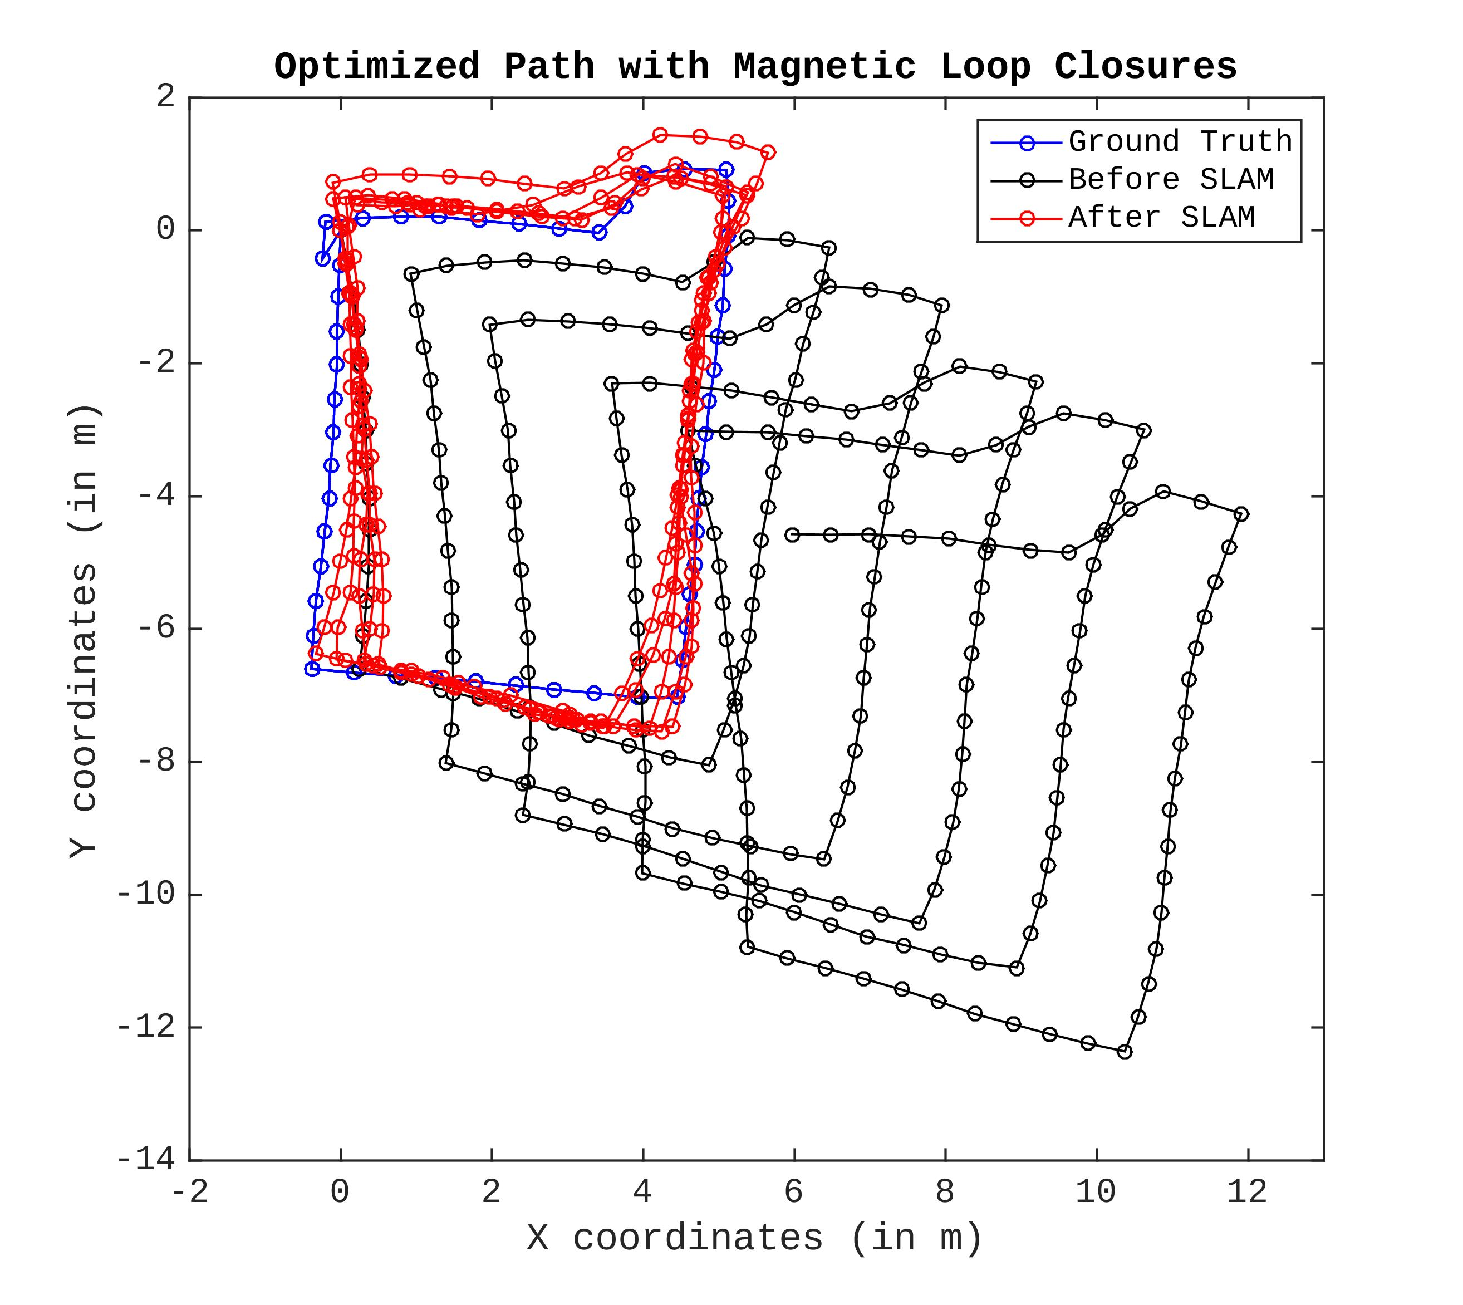
3. Research Methods
Pedestrian Dead Reckoning (PDR)
Graph-based Simultaneous Localization and Mapping (SLAM)
  Loop closure detection
    Wi-Fi
    BLE
    Magnetic Field
Notes:
Roughly, I will go over the methods that I’ve used to solve this problem. So, I need two information to build an 2D indoor map, X and Y coordinates. And, I could take advantage of the motion sensors that is already available in smartphones and I am using PDR algorithm, which is the abbreviation for Pedestrian Dead Reckoning. Unfortunately, PDR is not enough alone since you get so-called drift effects. For example, I draw these drift effects in this figure by using the real-world measurements. So, the blue lines represent the ground truth of the walking path and black lines represent the measured walking path. As you can see, the measured walking path starts to drift away from the ground truth after a while.
Therefore, we need some kind of a calibration technique to recover from these drift effects. And, this brings us to the main and challenging part of the project, which is the Graph SLAM algorithm, which stands for Graph-based Simultaneous Localization and Mapping. Remember that we have unique fingerprints for each step position if we keep collecting the Wi-Fi, Bluetooth and Magnetic Field measurements during the walk. Then, what we can do is to compare current measurements with the previous one to see if there are any correlation. If you can catch this high correlation behavior, then you can say that I re-enter into the same place. Then, you get a chance to recover your path with SLAM.
The whole idea is to recognize the place that you’ve previously visited along this walking path. BTW, Robotics people call this revisiting events as loop closures.

Slide 5
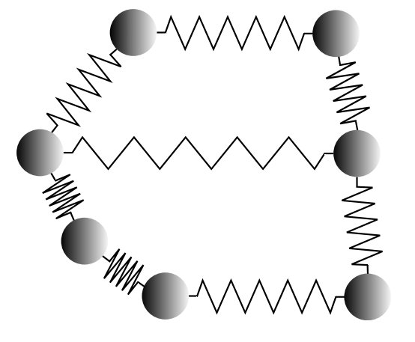
4.1. Intuitive Analogy of SLAM
Each mass is pose (unknown variable).
Each spring is constraint.
How do we get the minimum energy configuration?
Ref. Figure-1: [Sün12]
Notes:
Before I start explaining the SLAM algorithm, I would like to give you a more intuitive analogy to improve our understanding because I found it a little intimidating when I studied the SLAM at first.
So, here we have a spring-mass system and these masses apply a certain amount of forces each other via springs. My ultimate goal is to find the minimal energy configuration in this system and let’s assume that this is the minimum configuration energy I am looking for.
As we can see, some springs are shorter than other ones because their stiffness constants are bigger than these one. That’s why these masses are positioned theirselves closer comparing the other ones.
That’s the analogy I would like you to keep in mind during the talk.

Slide 6
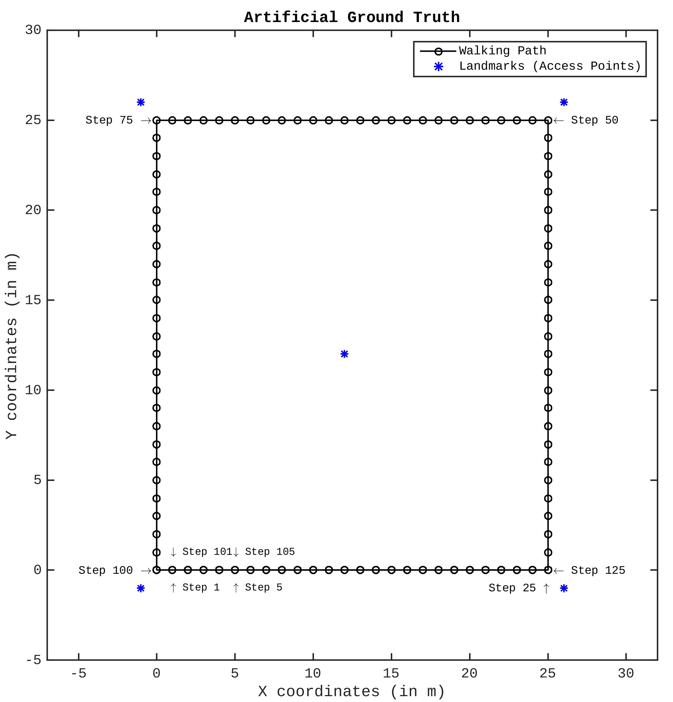
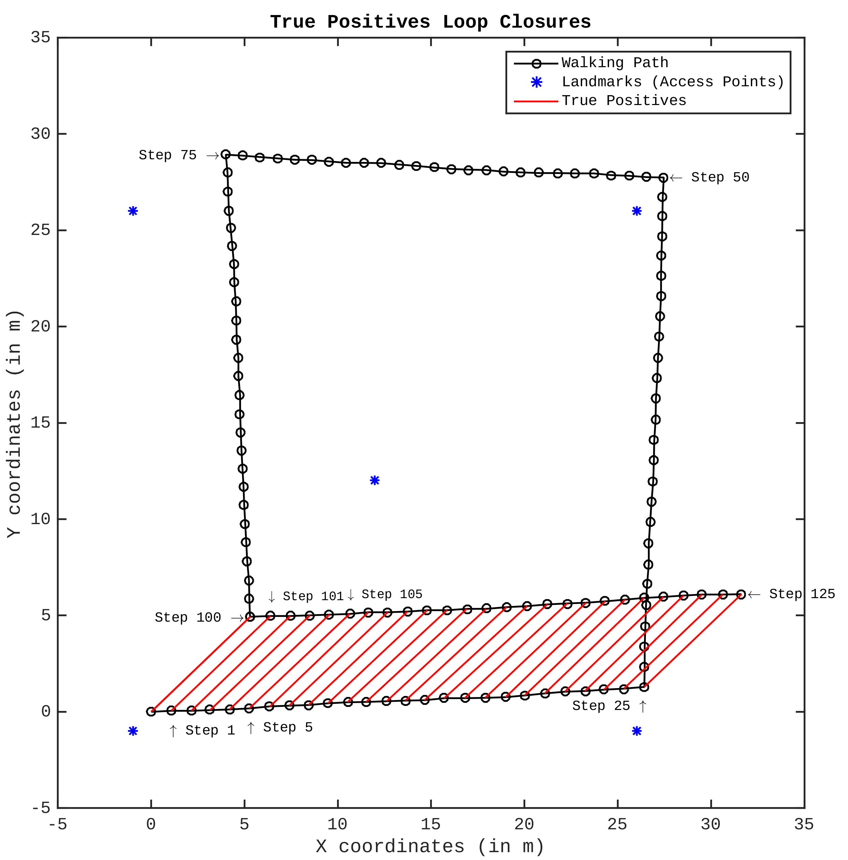
4.2. Graph SLAM
Notes:
Now, I want to introduce you to the SLAM problem. Let’s say I’ve walked this squared shape path. However, what I would measure something like this, which we can see clear drift errors.
What I also know that I revisited some places by coming at the place where I began walking. For example the 1st step position and 101st step positions are the same in real-world and the same relationship these steps as well.
Now, I would like you to remember this spring-mass analogy. In this system, I have masses, which represent the step position. Plus, two kind of springs. One is black and the other is red. I can create black springs by using consecutive steps because I know they come subsequently. And I can create red springs because I know that they are loop closures due to RSSI comparison.
Now, if I assigned these red spring’s stiffness coefficient similar to the black springs and if I apply the same force over the system, I would end up dragging these masses towards each other but I will still keep the topology of the walking path mostly intact since I have these black springs.
That’s the real idea behind the SLAM.

Slide 7
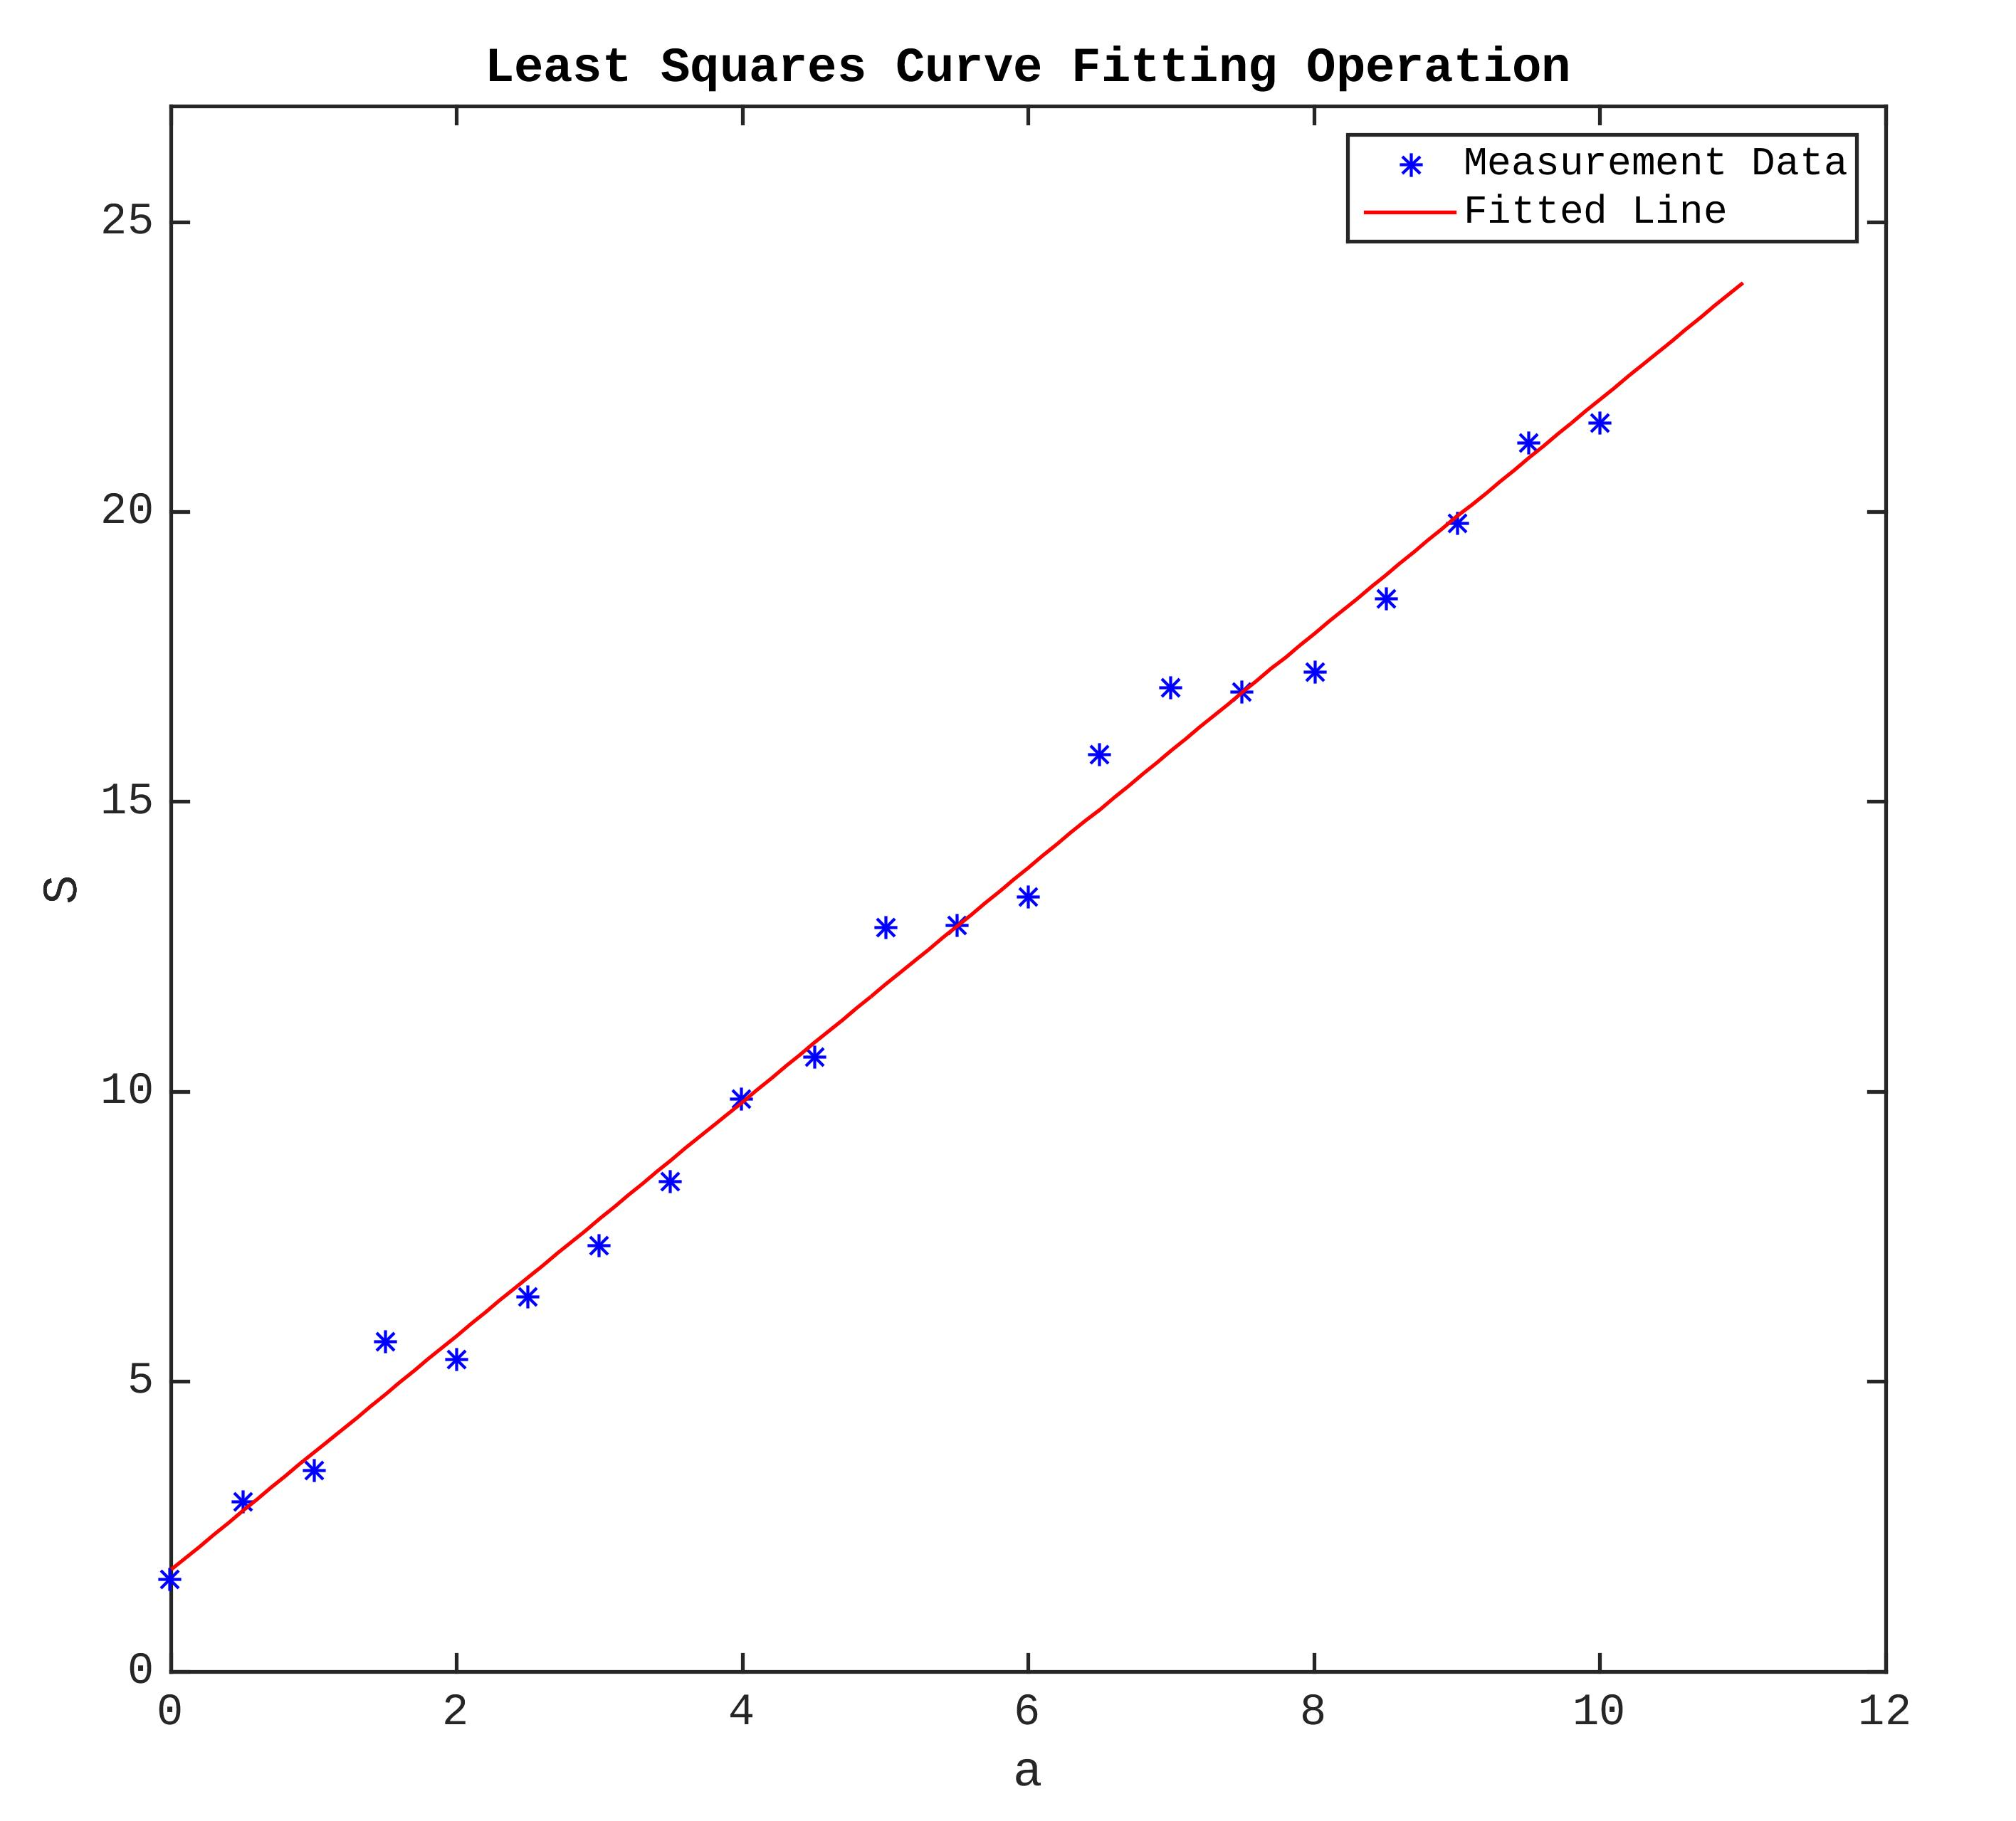
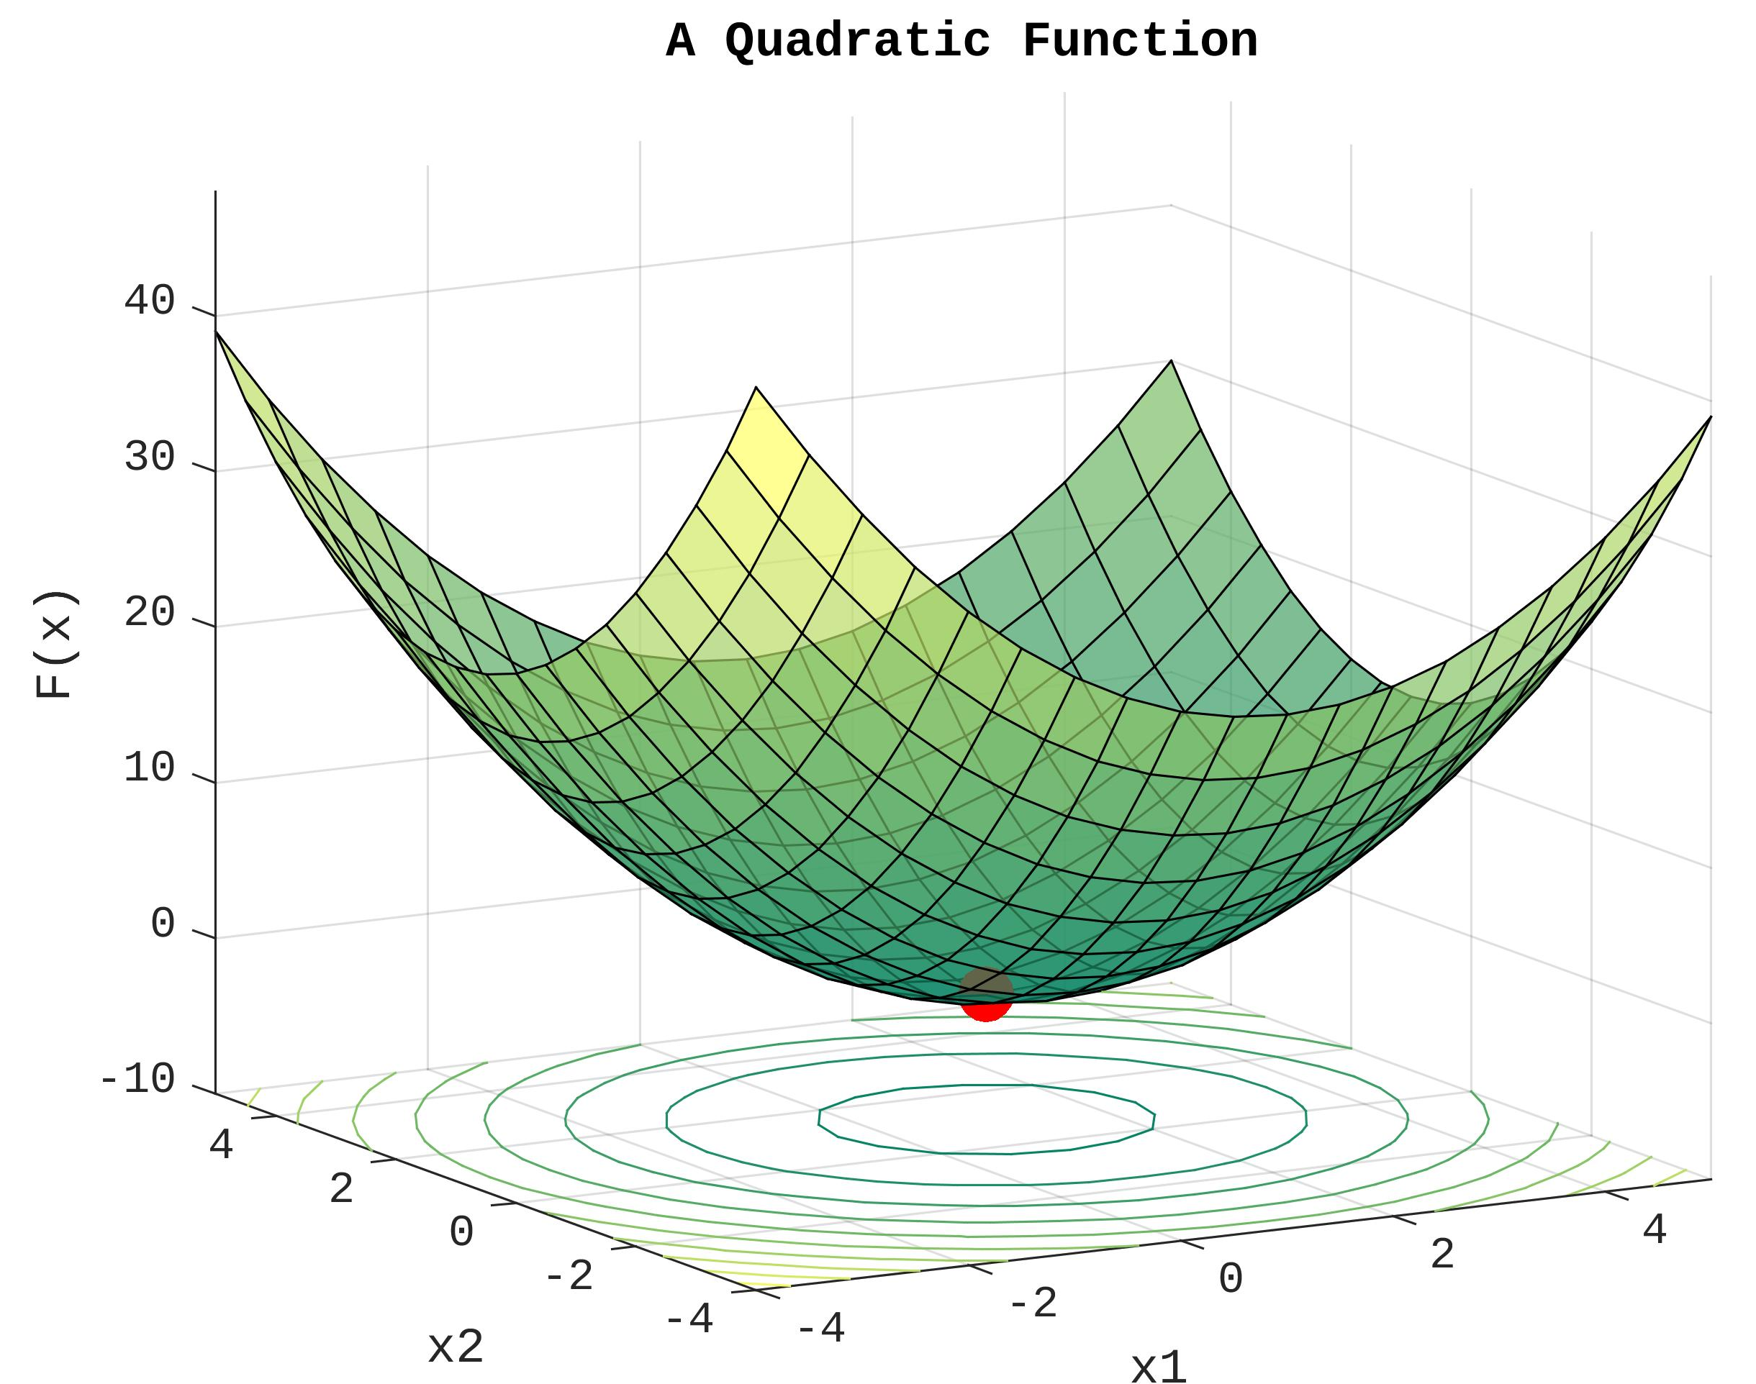
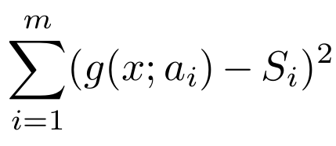
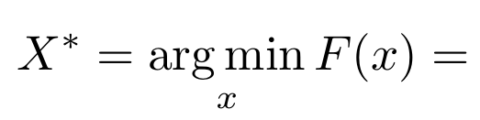
4.3. Least Squares Optimization
Notes:
So, how do we perform this dragging operation mathematically?
I’ve used the Least Squares Optimization method for this purpose.
Again remember that, I wanted to find the minimal energy configuration in the spring-mass system. But, if we think it in another way, I can also say that those springs might represent the error functions, which I can try to minimize using the least squares.
BTW, the least squares method is a widely-known approach for finding local or global minimum on a non-linear function. To give you an example, I draw this simple least square curve fitting problem with two unknown parameters. And my goal is to find the line which could with the minimum error. To do so, I need a model function and real-world measurements and then I can use this two information to calculate the error function.
We also should keep in mind that this is just a simplification, though. In our case, number of unknowns depends on the number steps in the walking path.

Slide 8
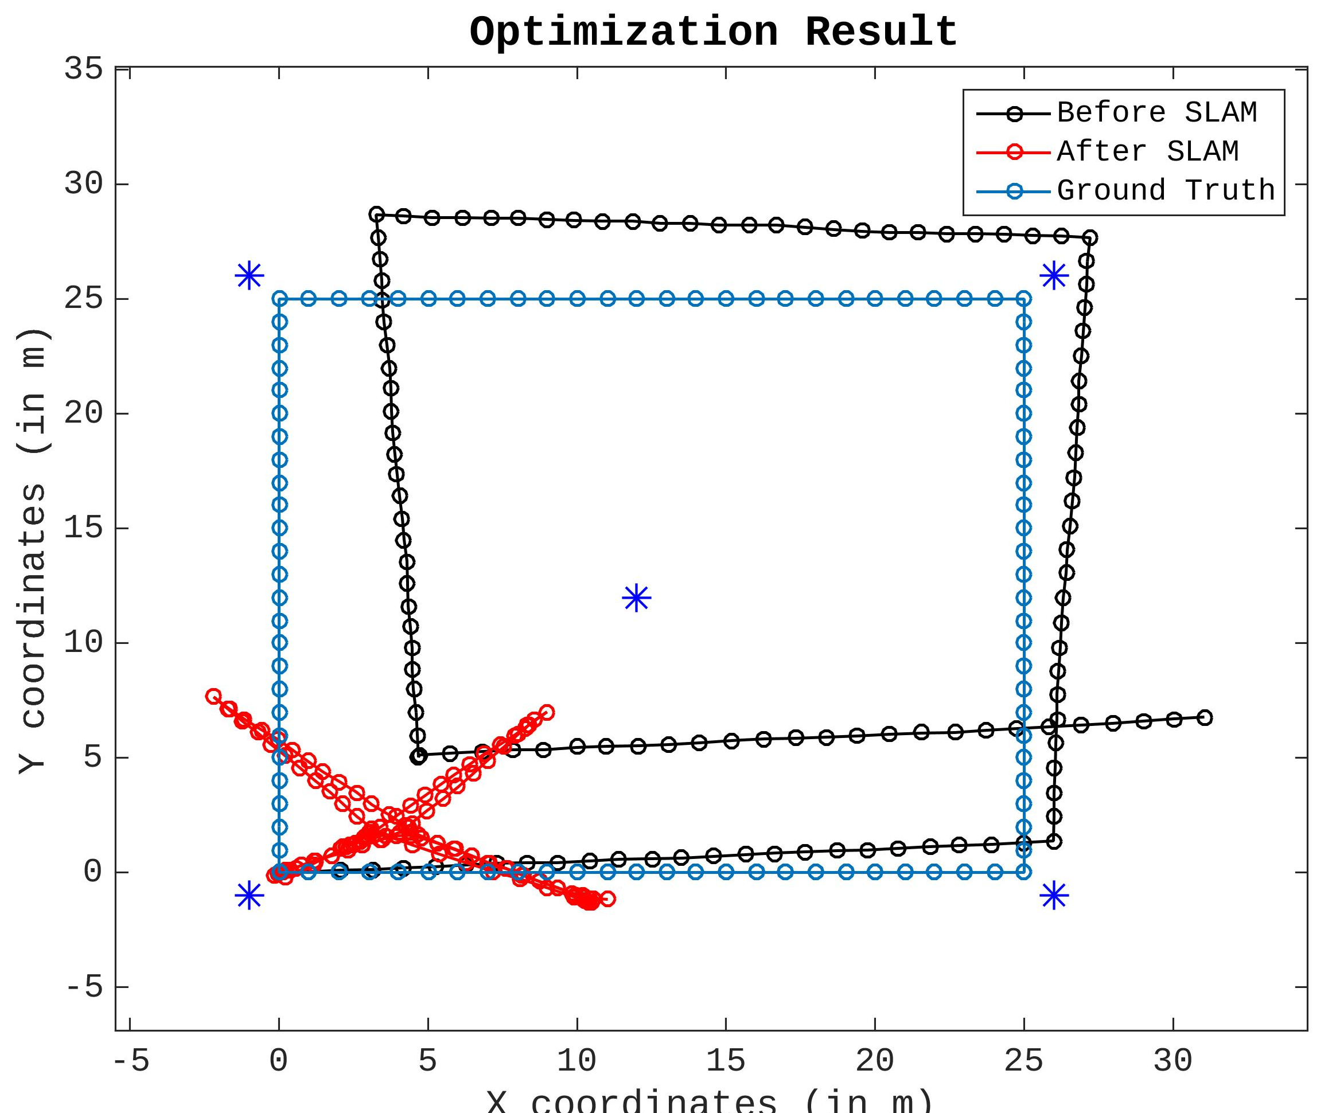
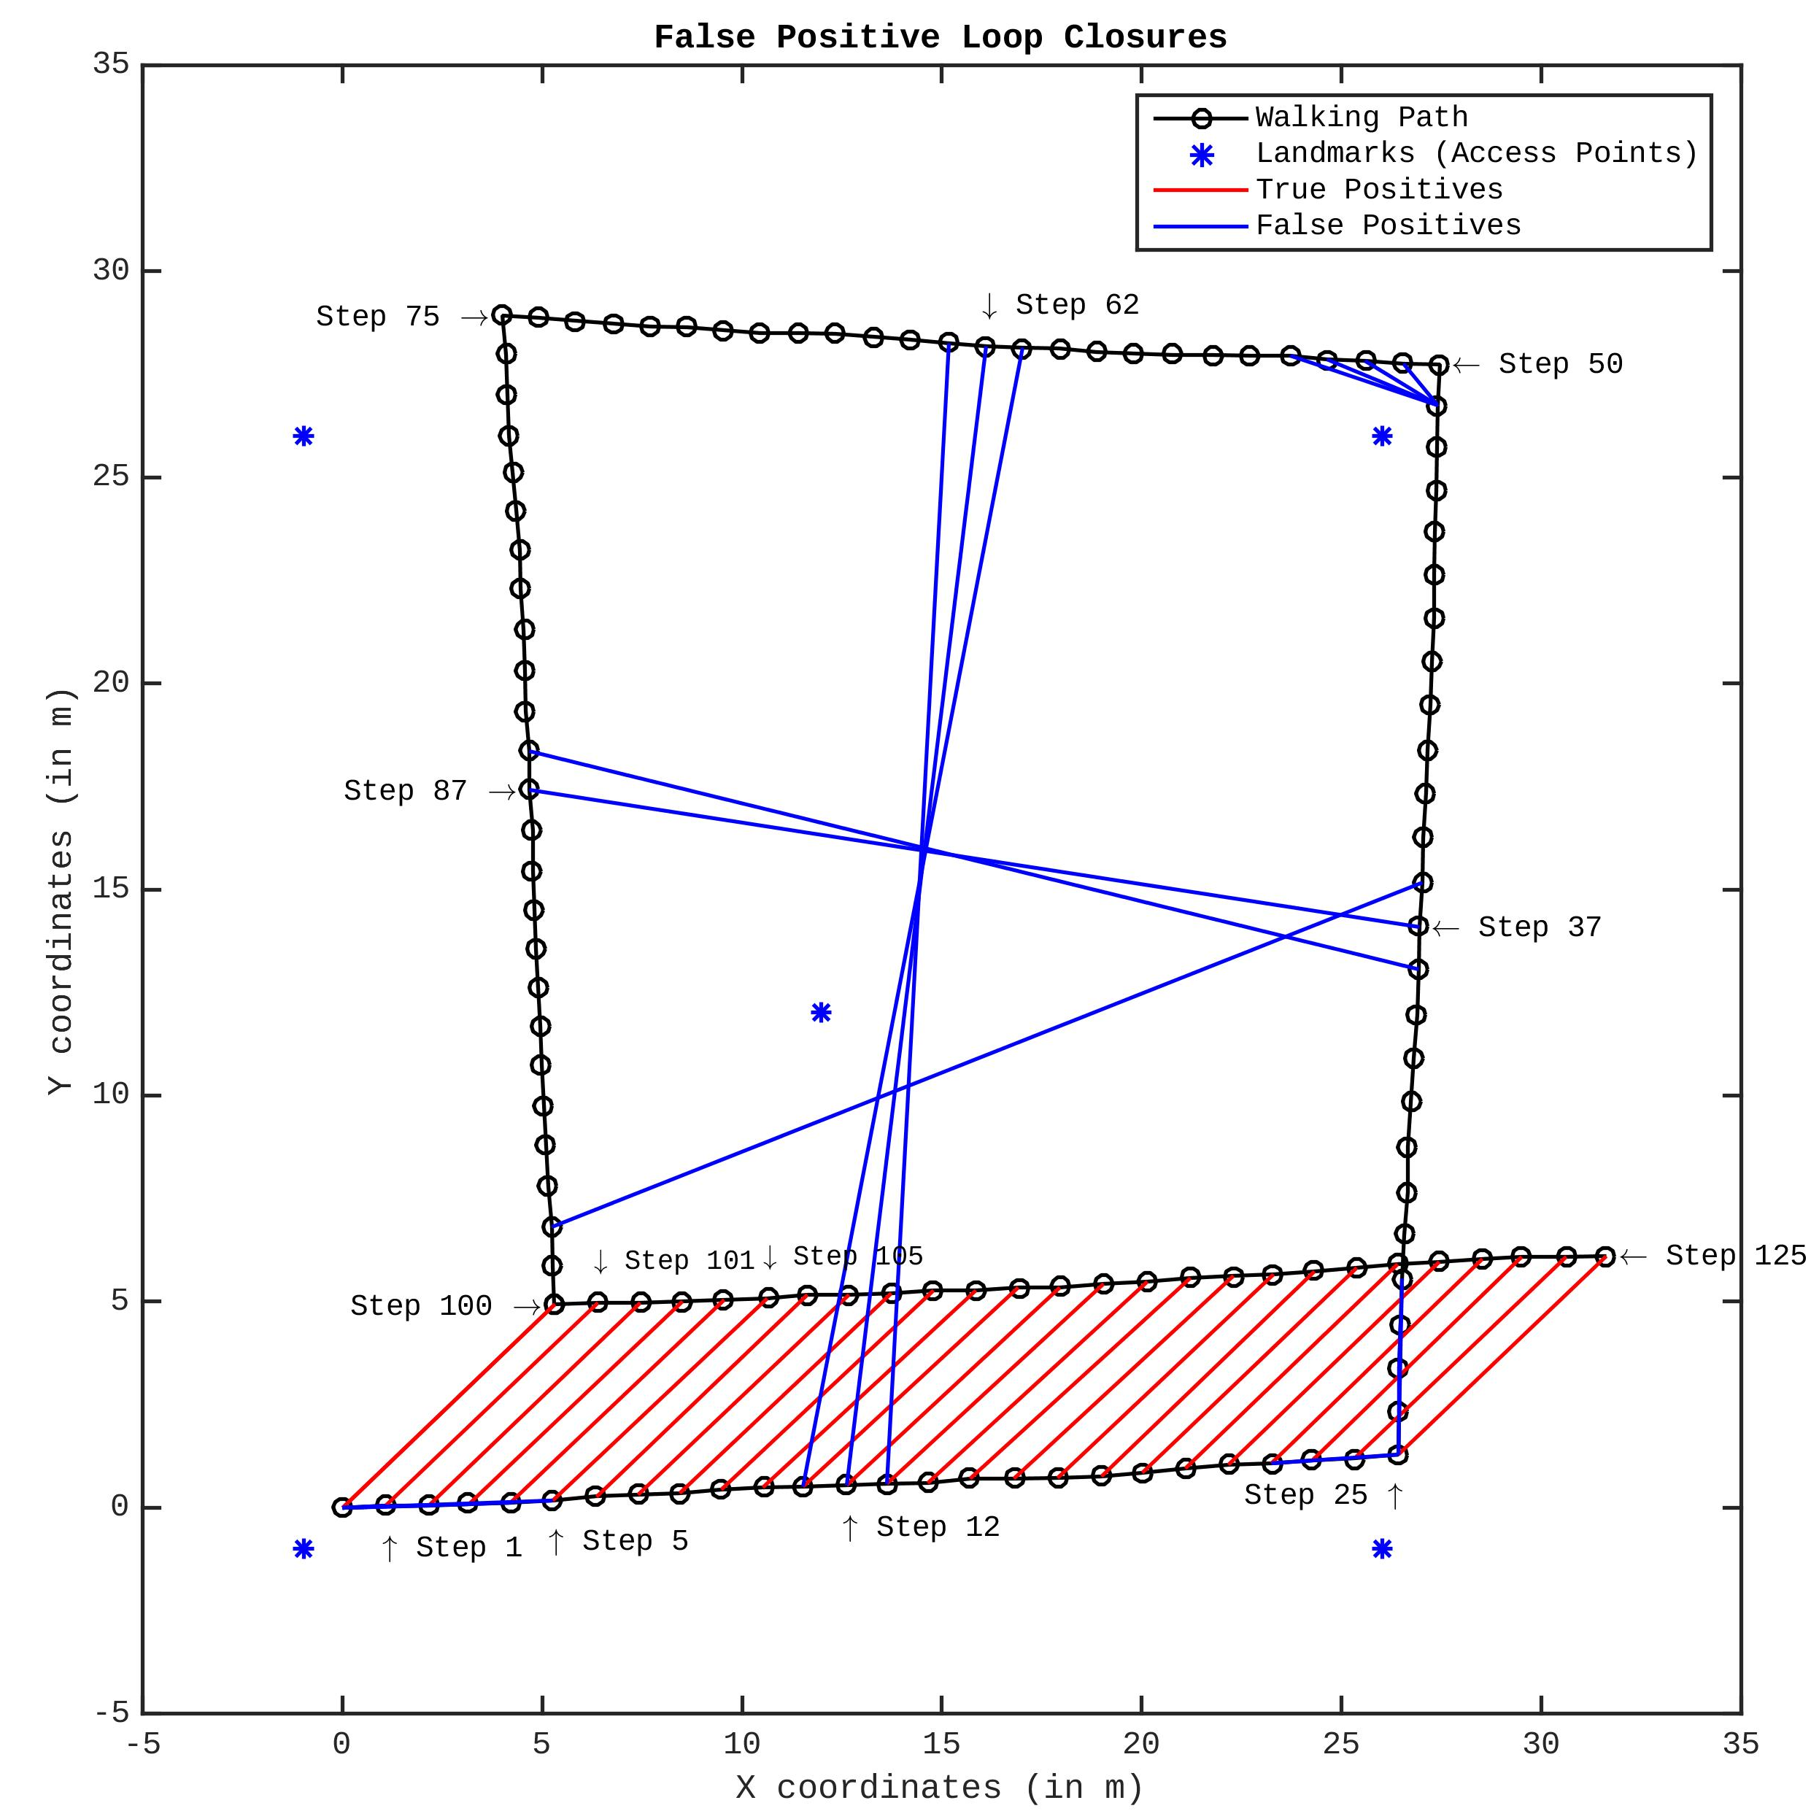
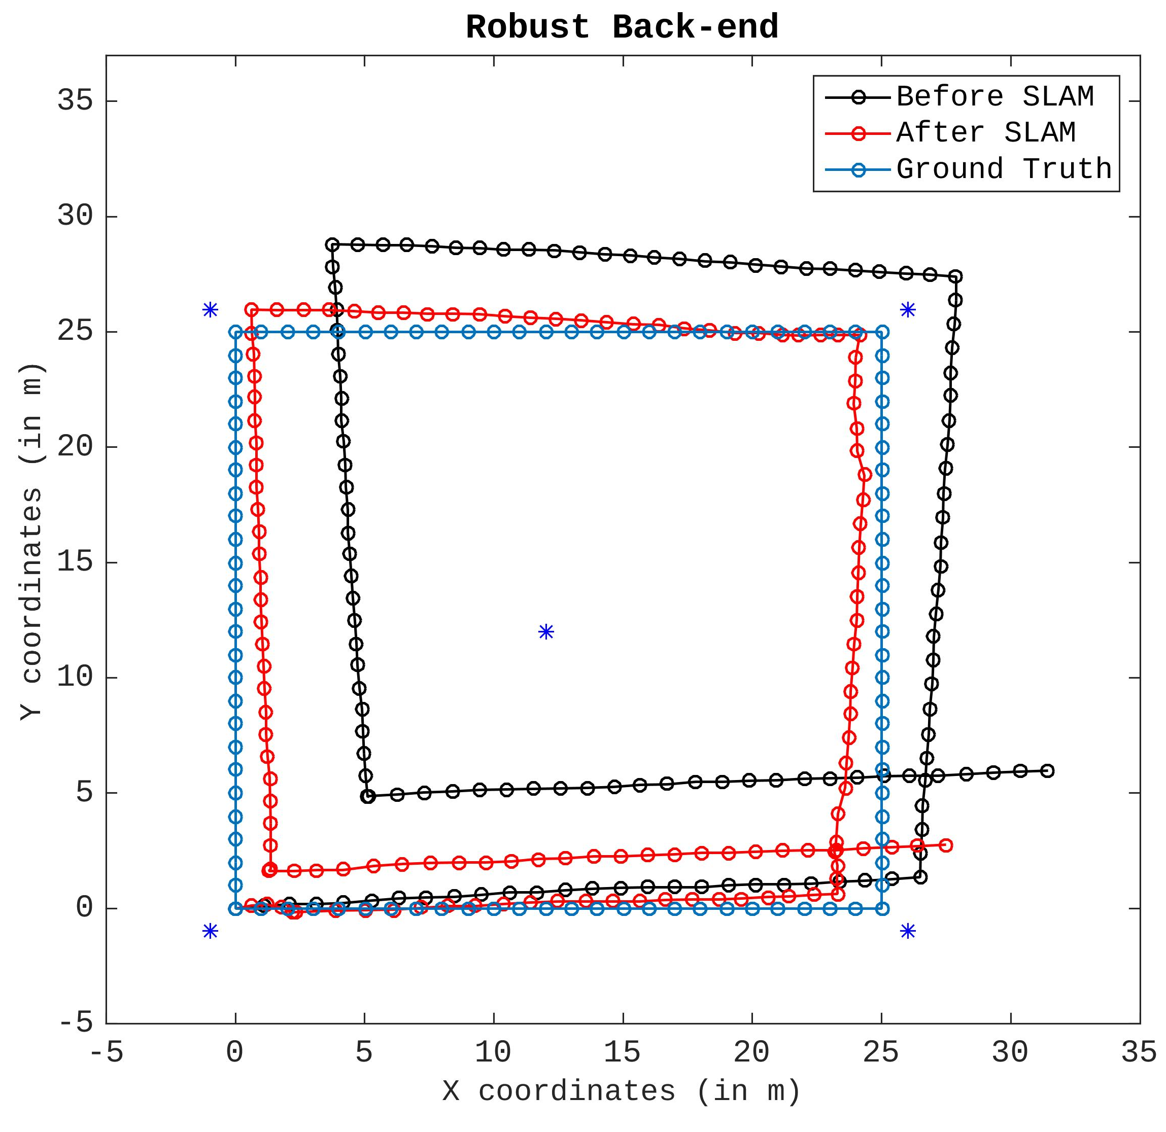
4.4. False Positive
Loop Closures
Notes:
Now, I want to talk about very important issue for the SLAM. In reality, we have two types of loop closures. One is true positive and the other is false positives. True positive loop closure are the one says I am at the same position and they are correct. However, false positive loop closures are the one say I am at the same position but they are in fact wrong statements.
The true positive loop closures are represented with the red line and false positive one are represented with the blue lines. From now, I will call false positive loop closure as outliers for simplicity.
So the figure, which is on top right, represents the path optimization results done by SLAM. The blue lines are the ground truth path, black lines are the measured path with the drift effects as we can see, and red lines are the optimized path result. So, you can again relate to the spring-mass analogy here since the shape was shrunk exactly from these points. This is due to the outliers in our system.
In literature, there are several robust SLAM algorithms to deal with such outliers and I picked the one that tries to deactivate these outliers during the optimization. I’ve used a method called switchable constraints. The idea is to find a way to switch off these outliers based on the error value they produce. For example, these blue line will produce an large error comparing to red one. Therefore, it is more likely that I switch off the blue ones during the optimization.
That’s the idea of rejecting false positive loop closures.

Slide 9
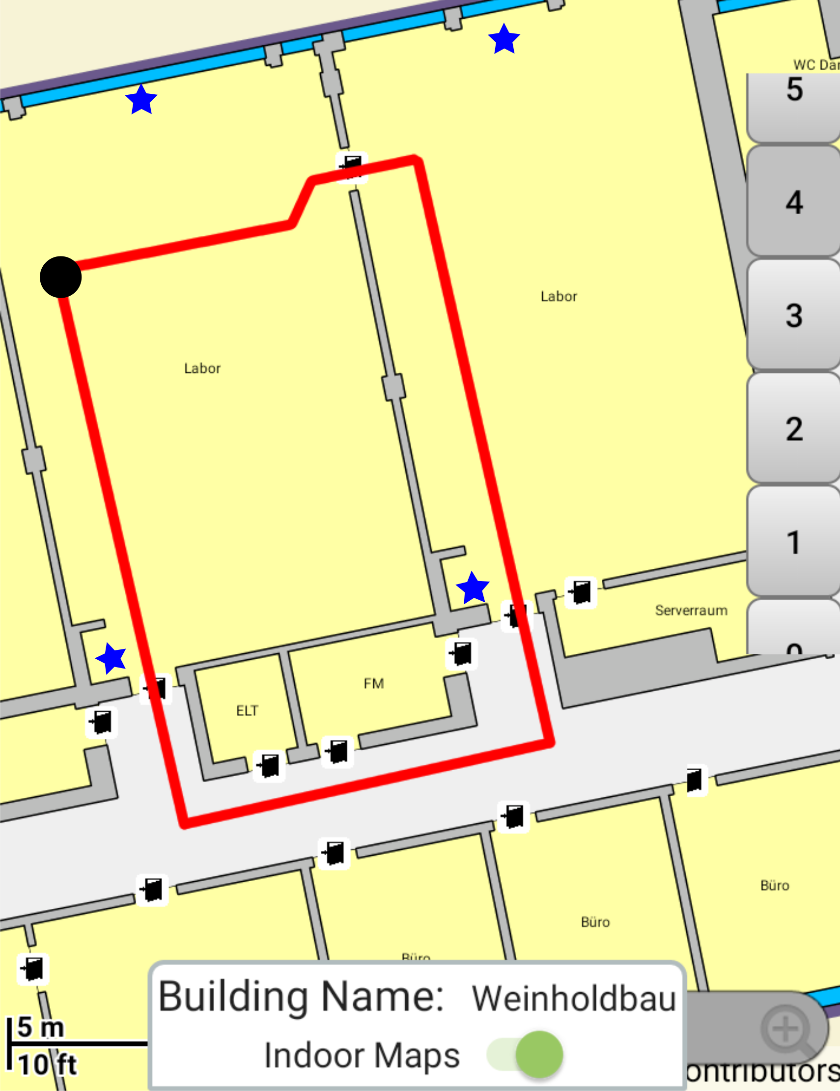
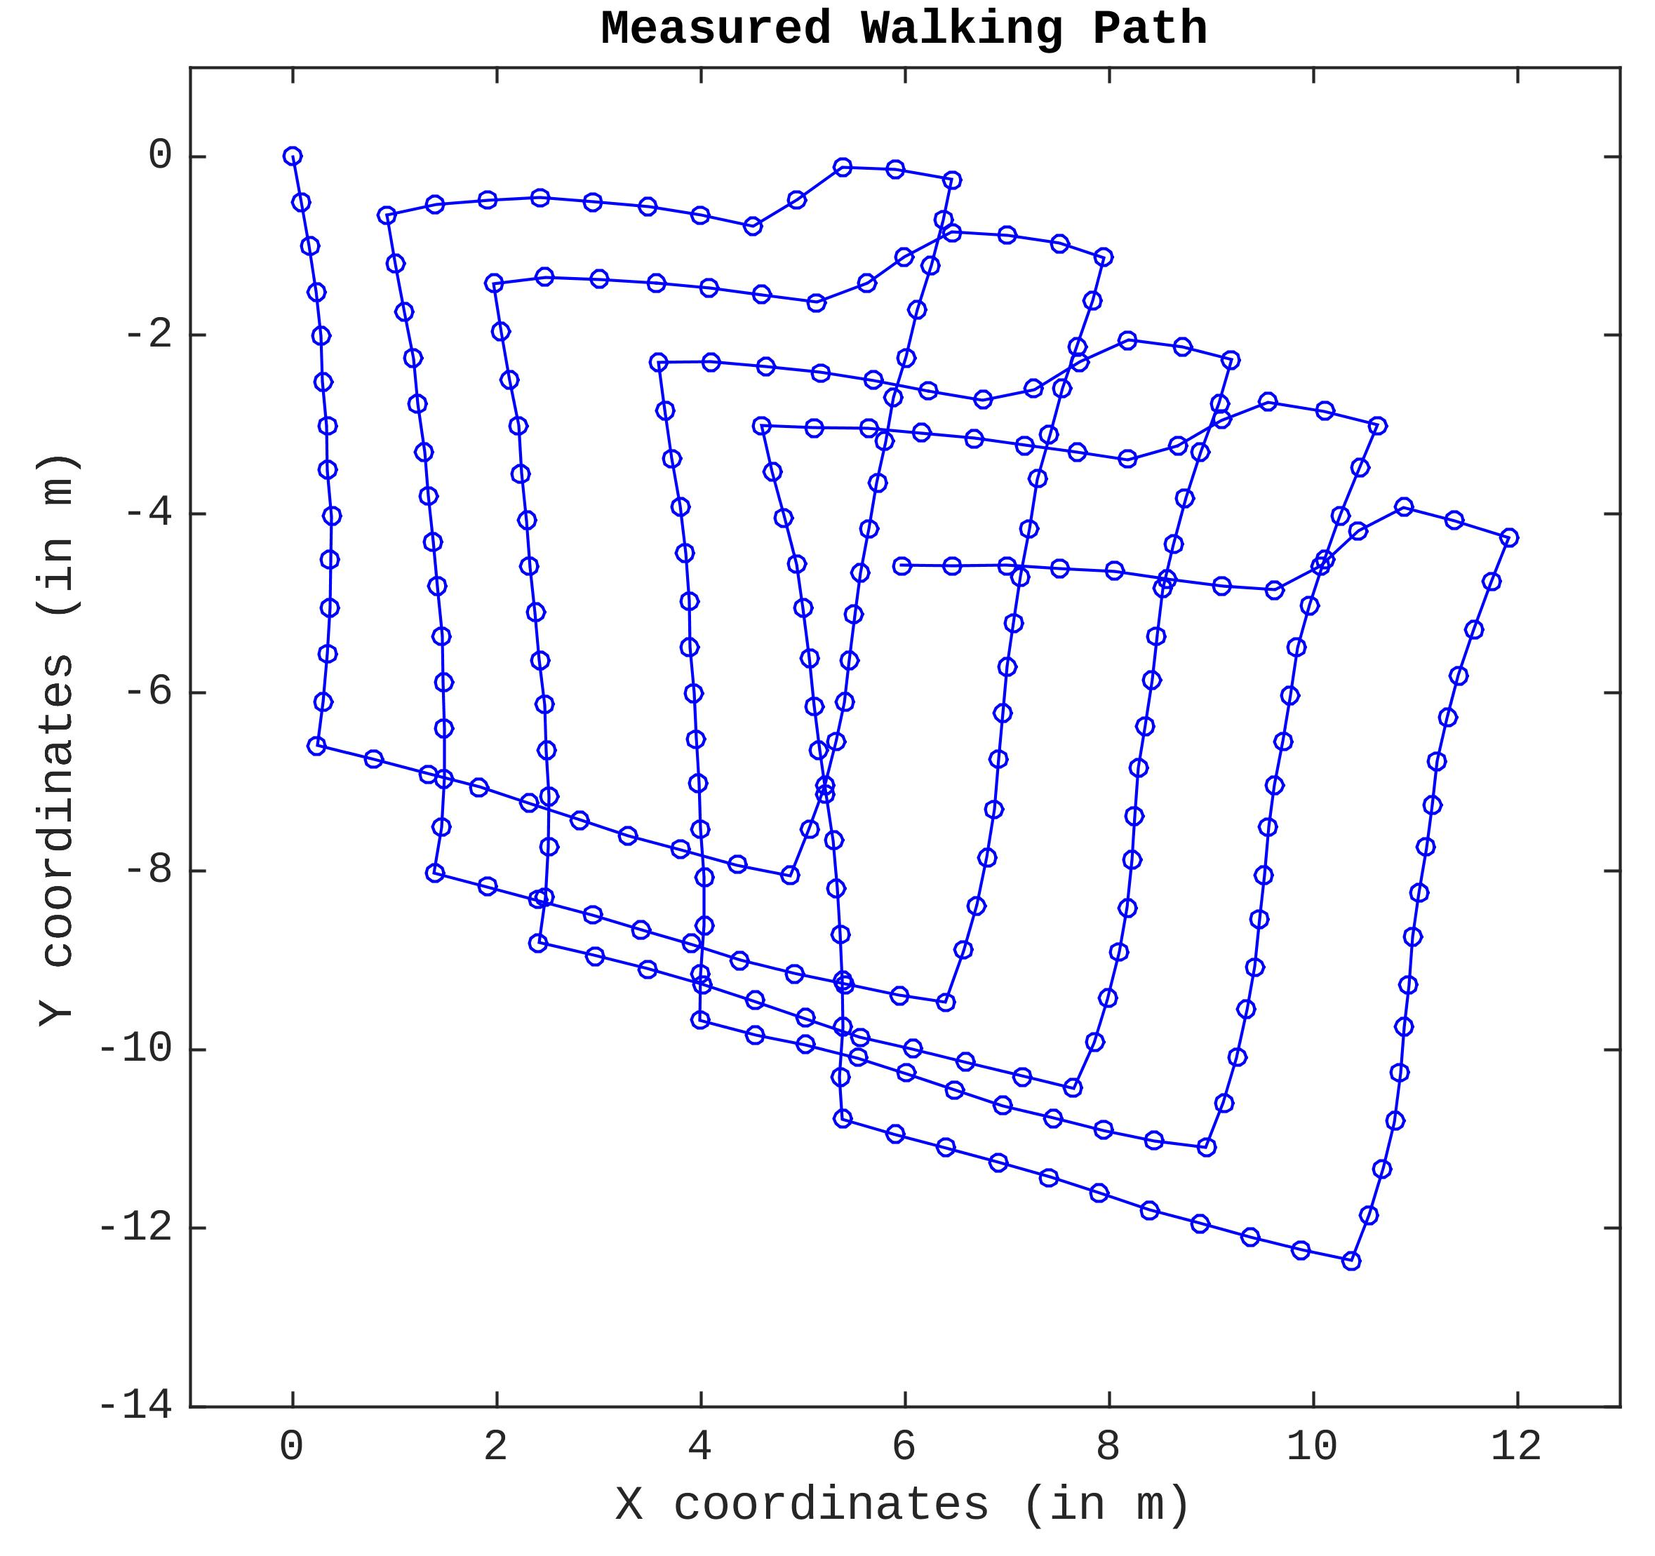
5. Evaluation
Notes:
After implementing the SLAM algorithm in the simulation environment, I wanted to test the algorithm by using real-world data.
I developed an Android data acquisition app for collecting all sensor data that I need it.
Then, I took out this device and start walking around this reference path while I collect all the sensor measurements.
On the right side, we see a walking path that is drawn by PDR algorithm, which includes the drift errors.
So, my goal is to find the loop closures and fix the drift errors with the least square optimization method.

Slide 10
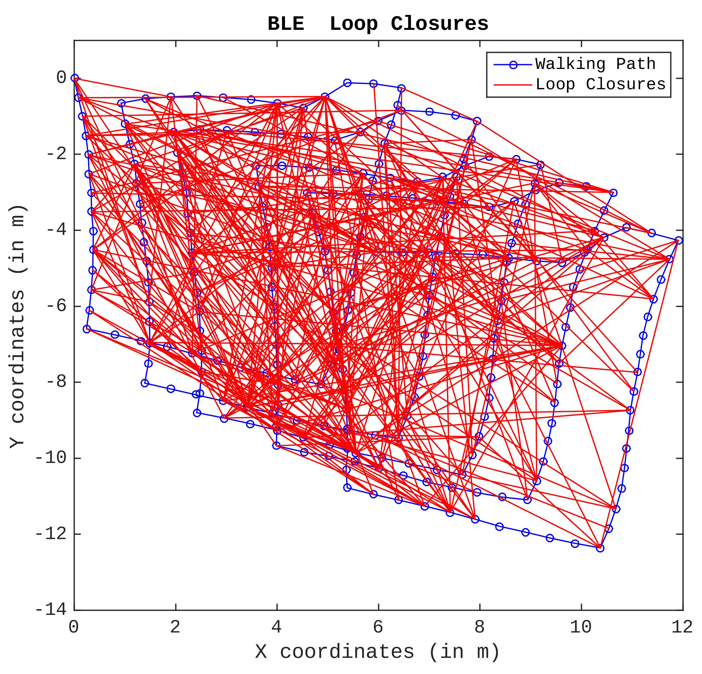
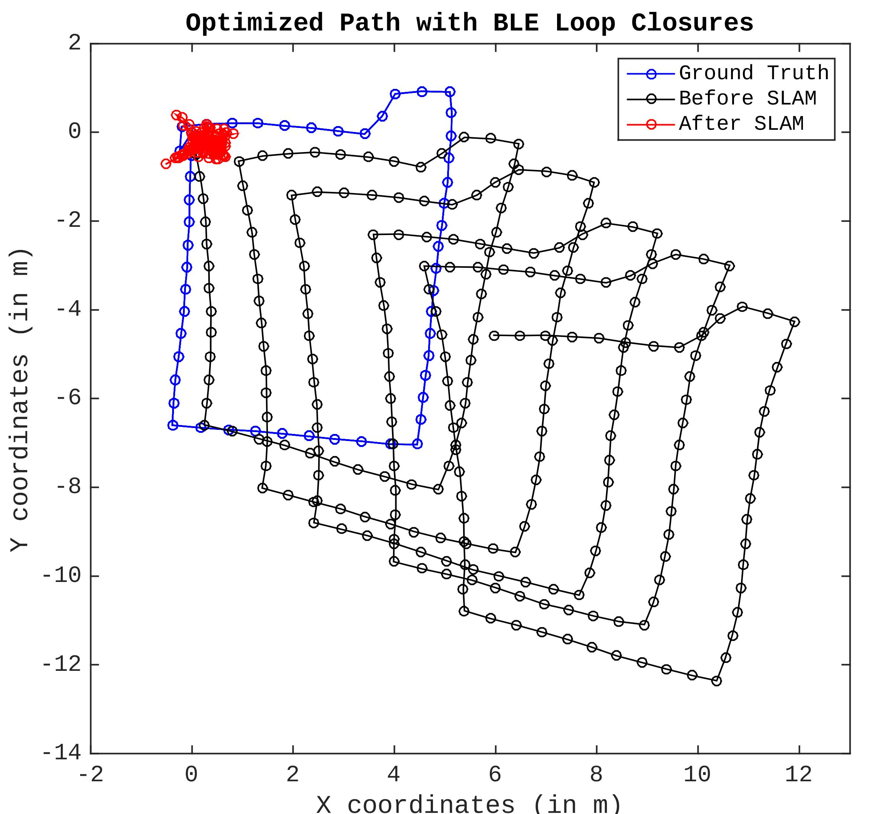
5.1. BLE Loop Closures
Notes:
So here are the SLAM results for BLE. To find loop closures with BLE, I come up with this simple dissimilarity function.
However, the left and ugly figure shows how badly we find loop closures using BLE. Each red line represents a loop closure, but majority of them are outliers. Therefore, outlier rejection and optimization process fails.
In the end, here is the SLAM result we get.

Slide 11
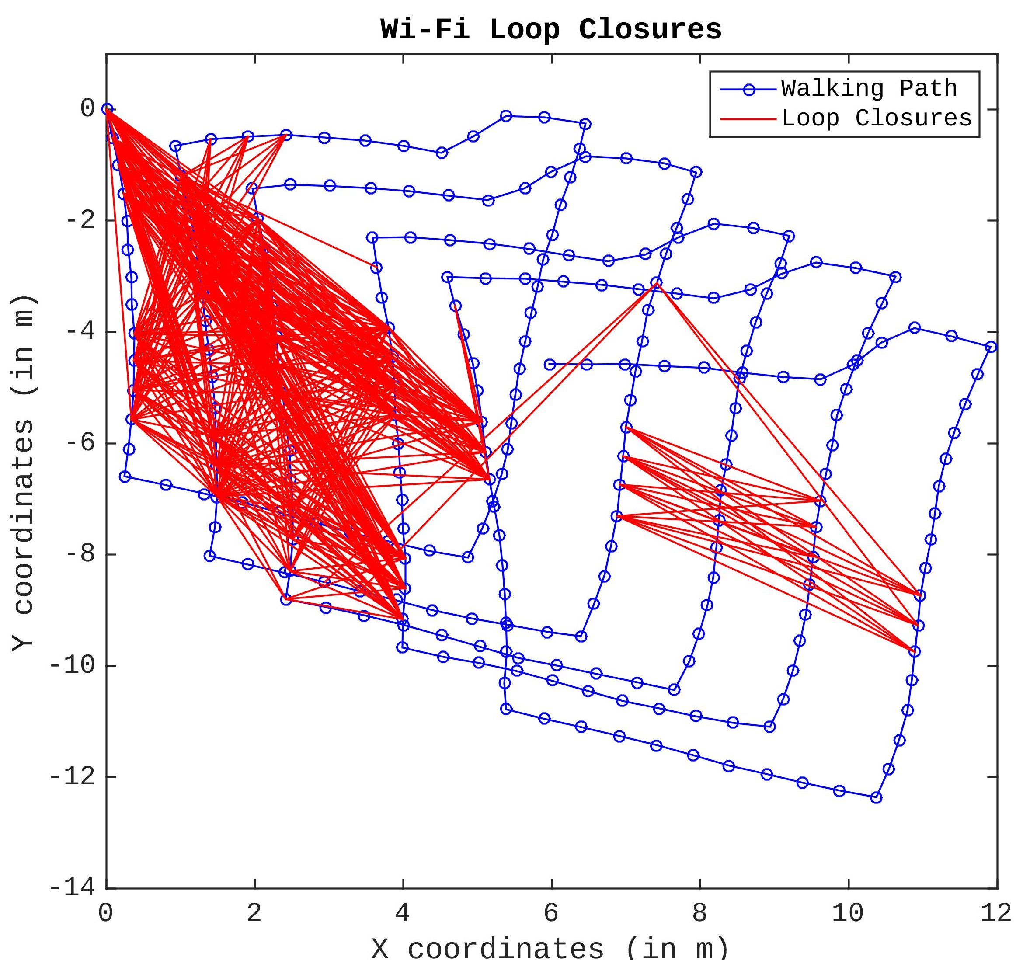
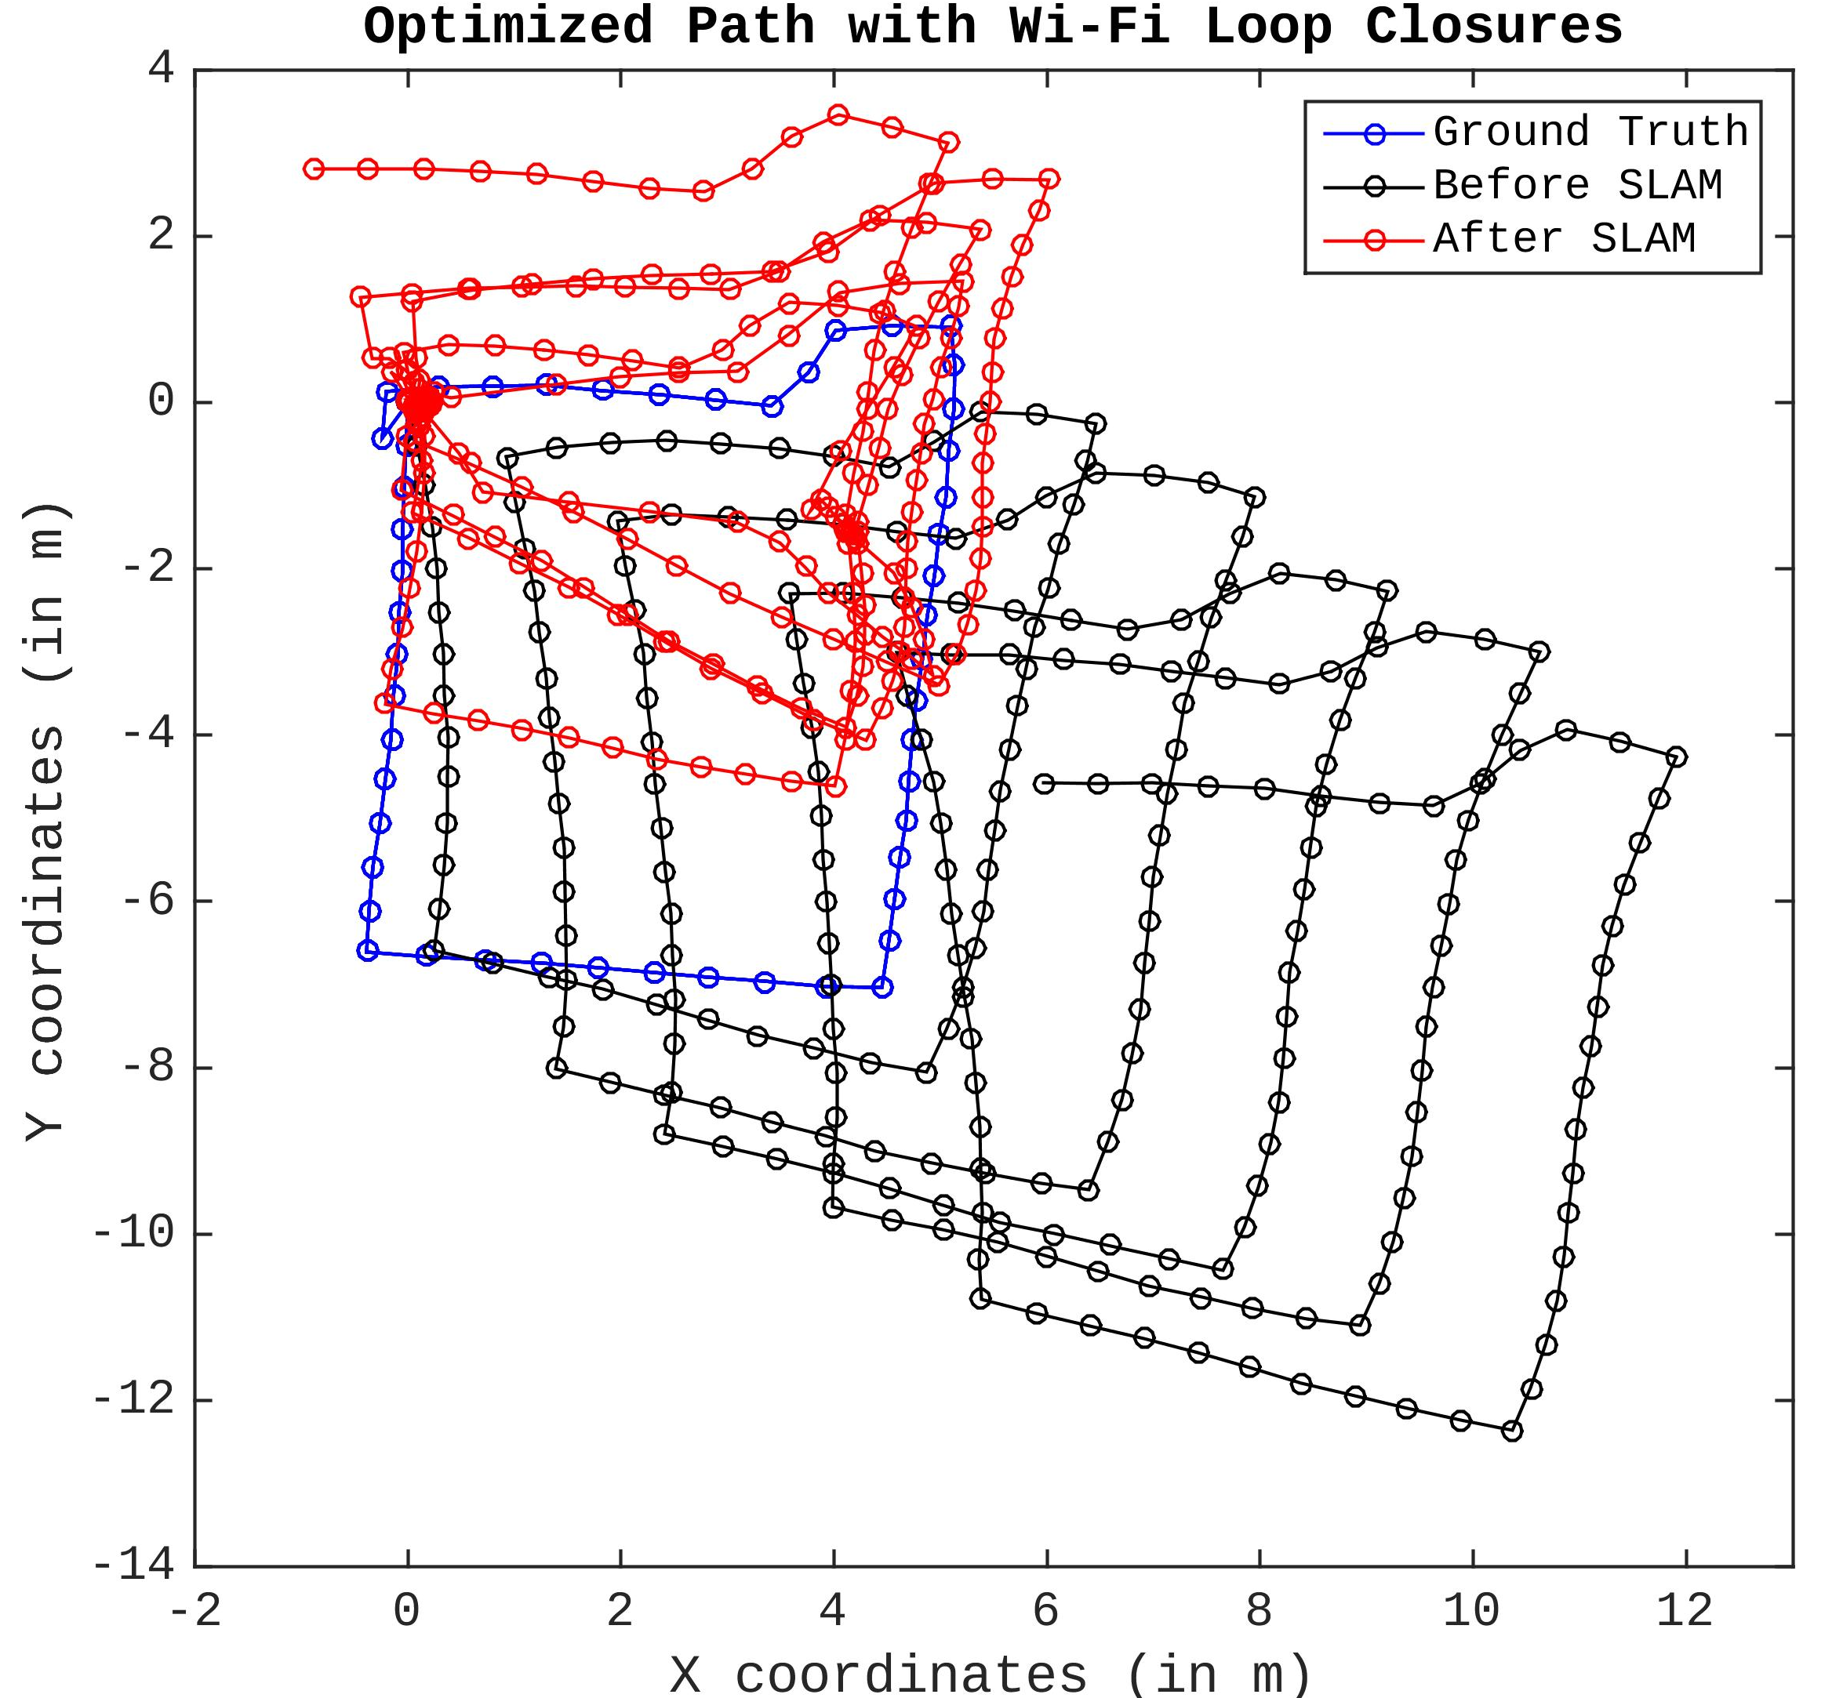
5.2. Wi-Fi Loop Closures
Notes:
I performed the same operation by using Wi-Fi and I get somewhat better results comparing to BLEs but still there are many outliers.
And, the resulting optimized path is shown in this figure.

Slide 12
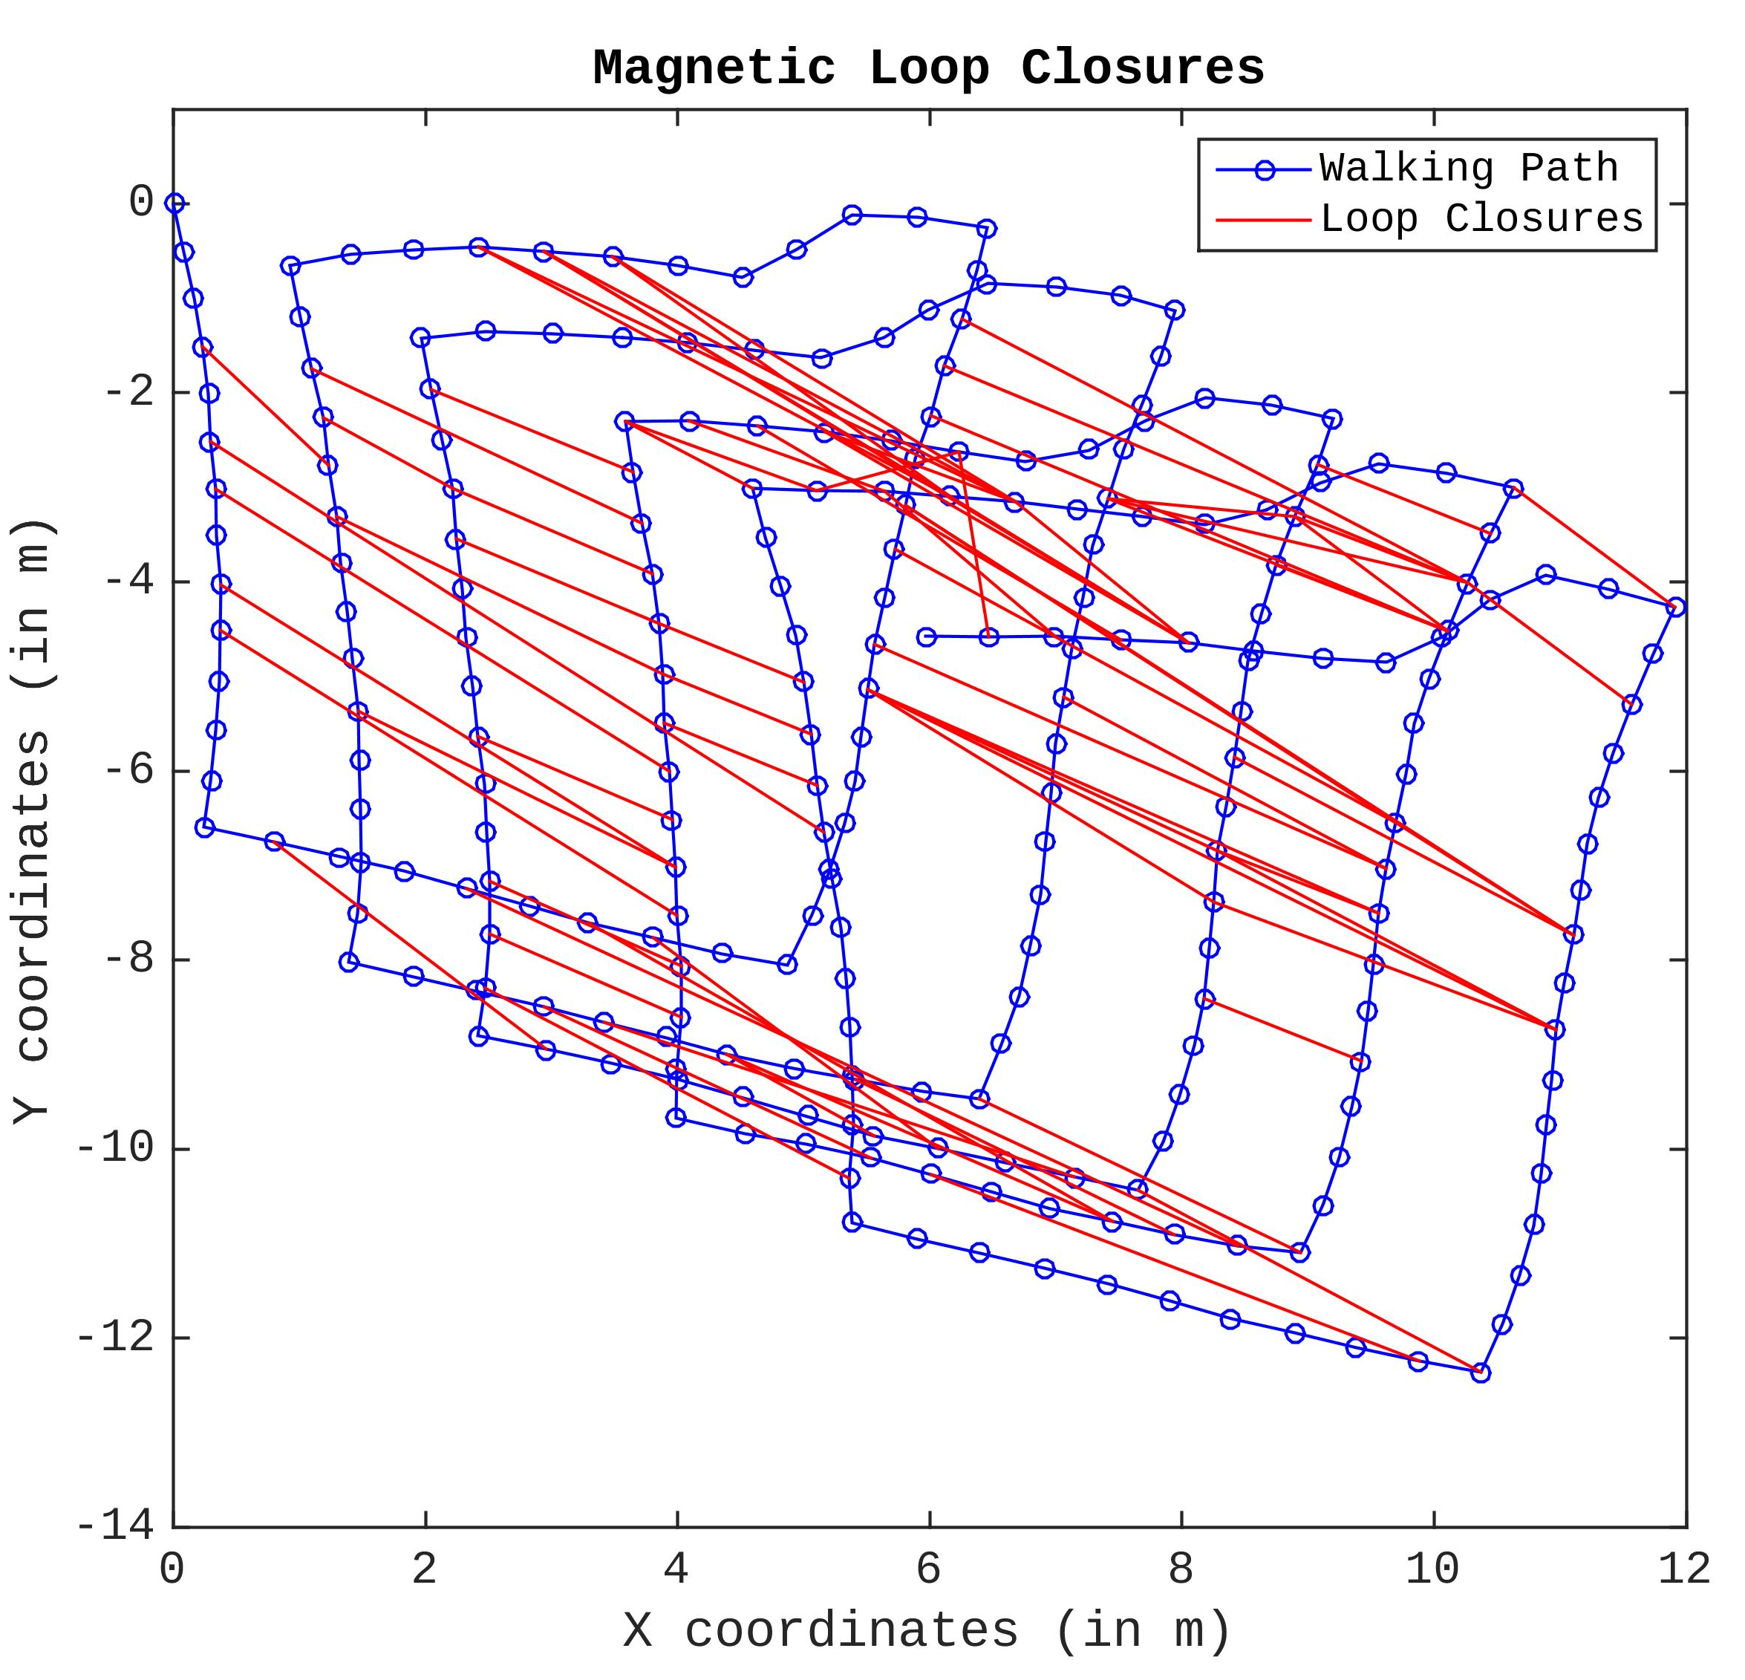
5.3. Magnetic Loop Closures
Notes:
Up until now, I showed you the RSSI based loop closures, which I calculated by using Wi-Fi and BLE. Now, let’s see the SLAM result if we use magnetic field loop closures.
Same logic applies for the magnetic field as well. Each step has a unique magnetic field fingerprint and I’m comparing the steps with each other to find the loop closures.
As we can, only minority of the loop closure are outliers, which means I am able to recognize the revisited places very precisely. Then, if I provide these loop closures information to the optimizer, I get this nice converged path result, which is pretty close to the ground truth.

Slide 13
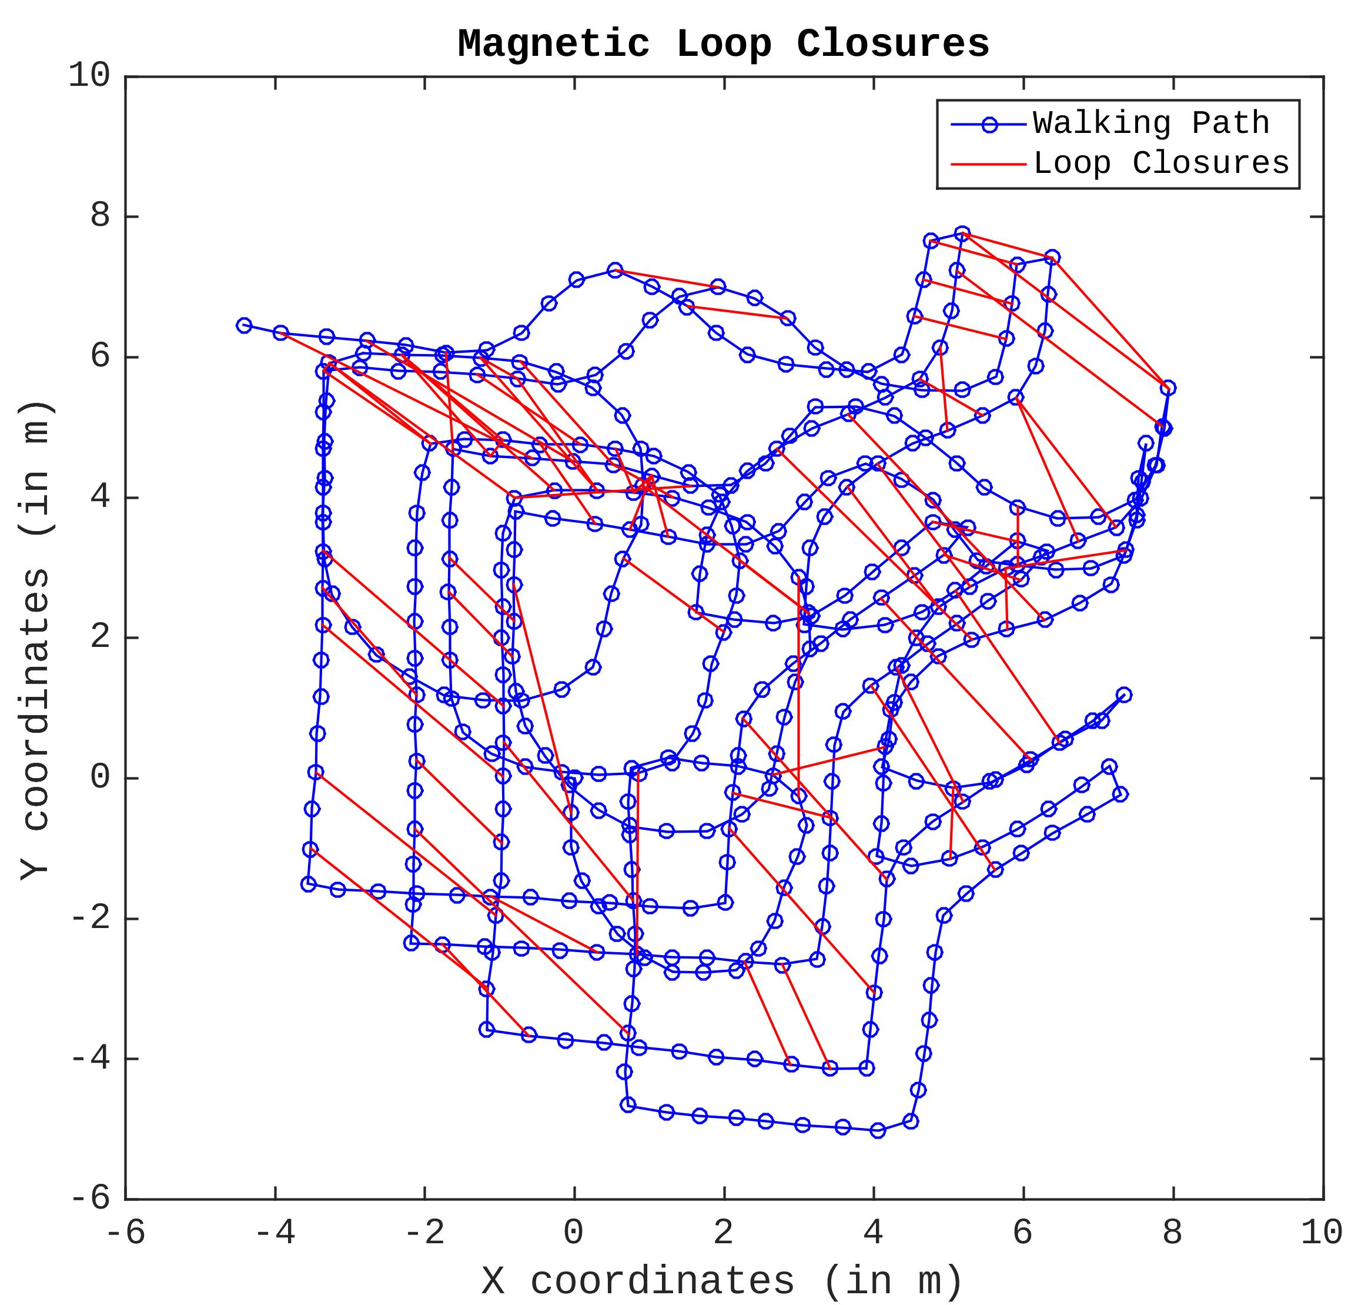
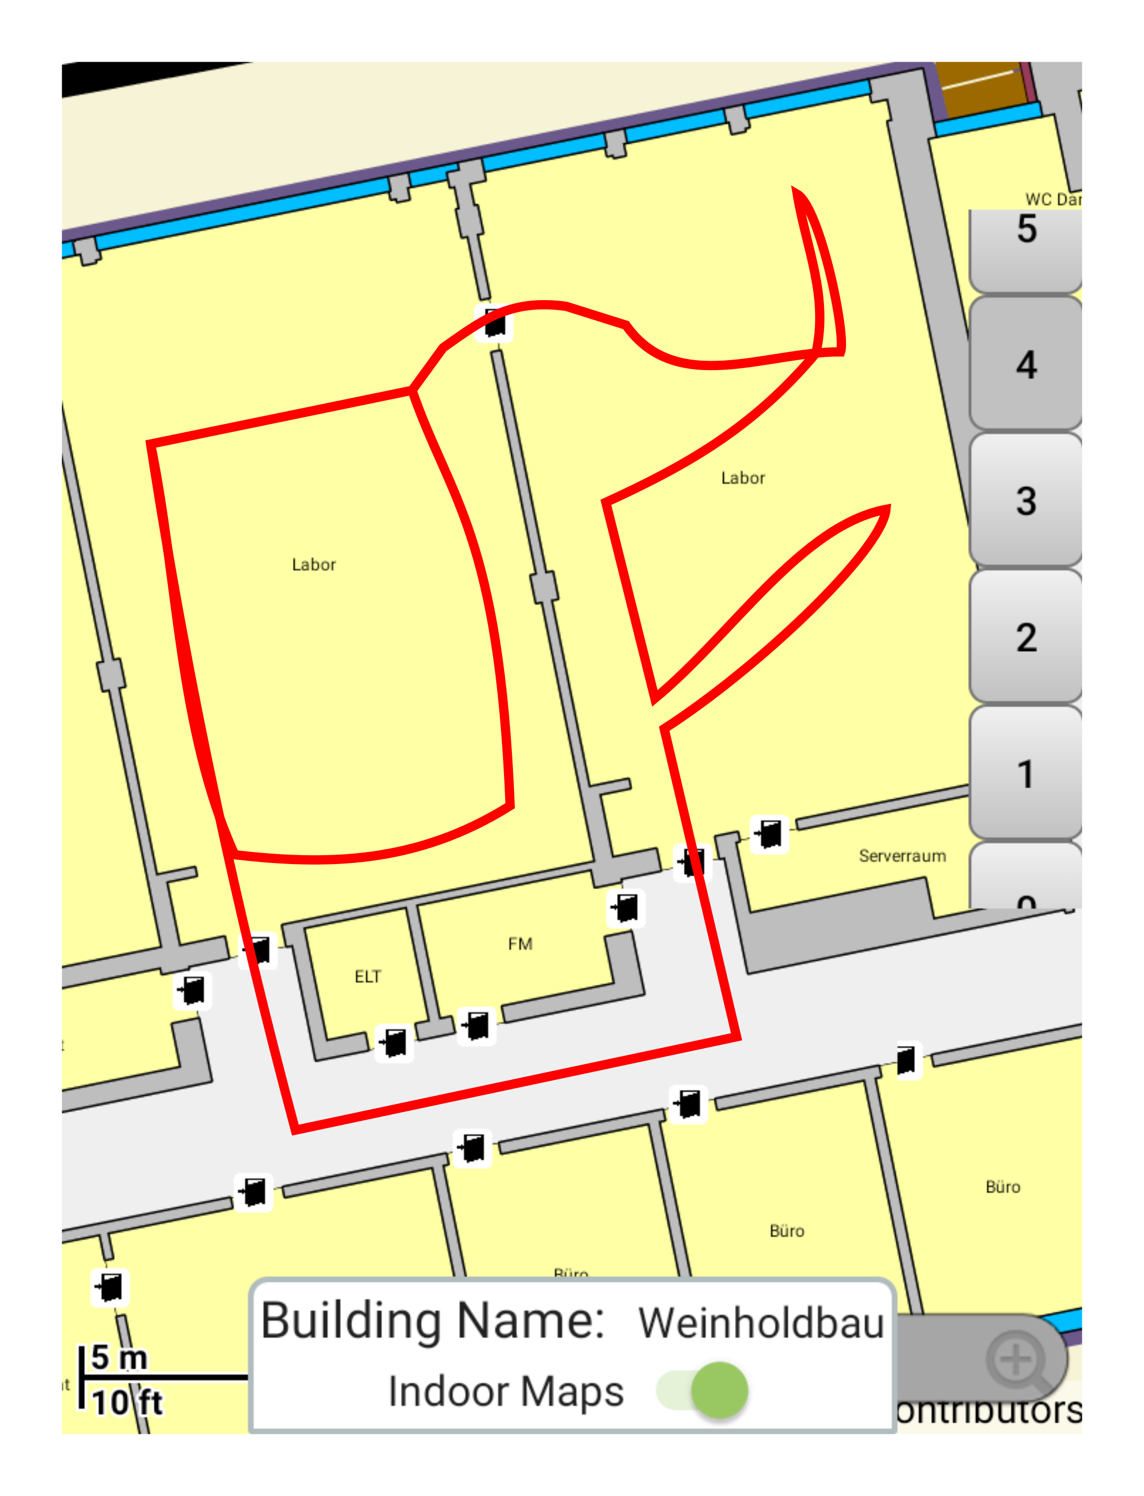
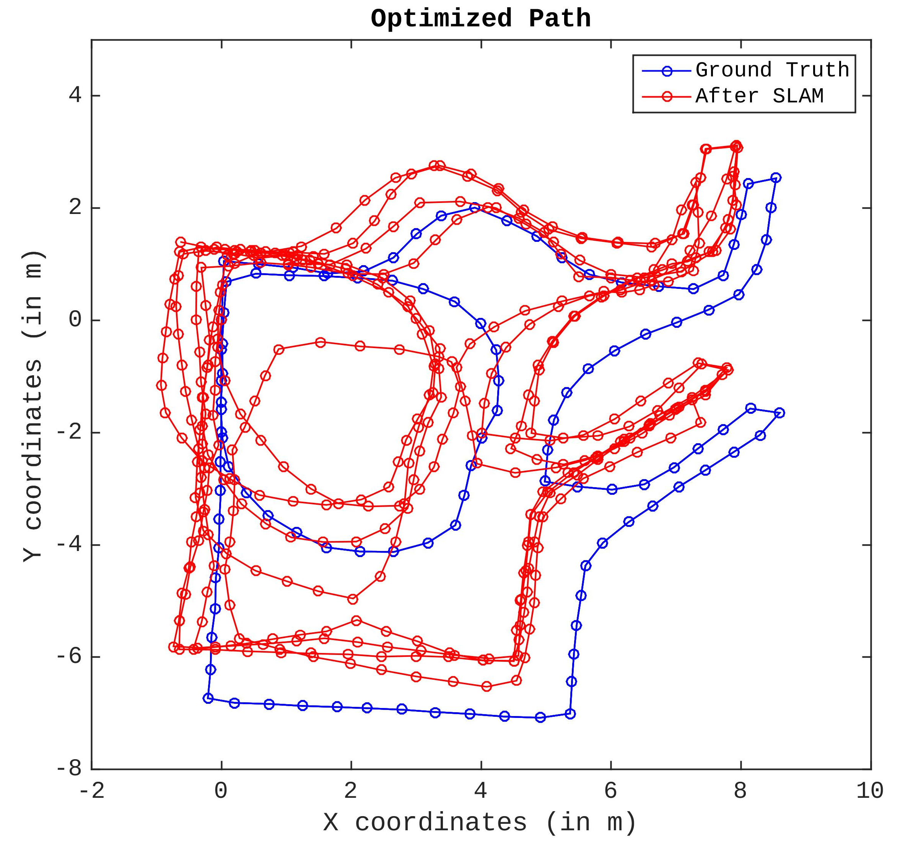
5.4. A More Challenging Route
Notes:
If you noticed, first dataset that I’ve collected by walking square shape route involves mostly straight lines.
Now, I collected 2. dataset, which is more challenging since it is a more natural walking style.
Then, I run my magnetic field loop closure recognition algorithm and then I get this result. Again, only minority of the loop closures are outliers. Even tough there are places drifted from ground truth, we can see that overall the walking path topology kept intact.

Slide 14
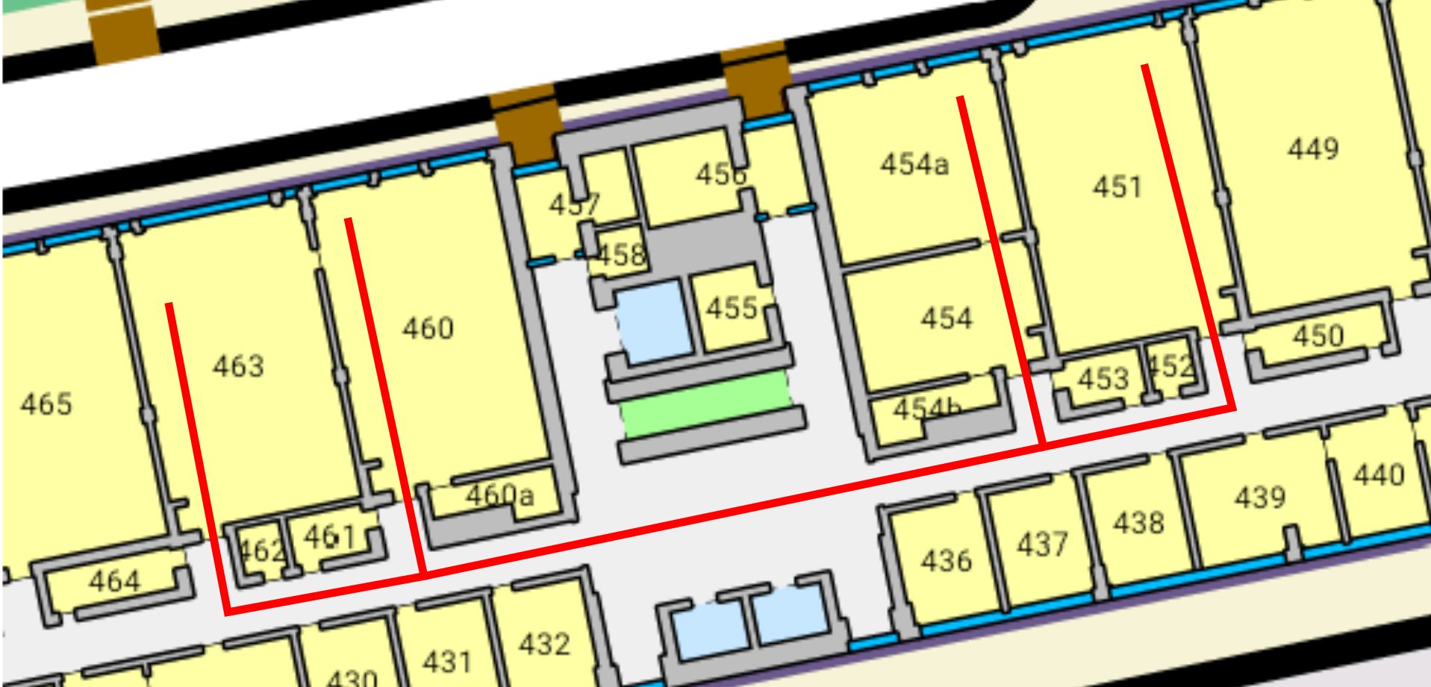
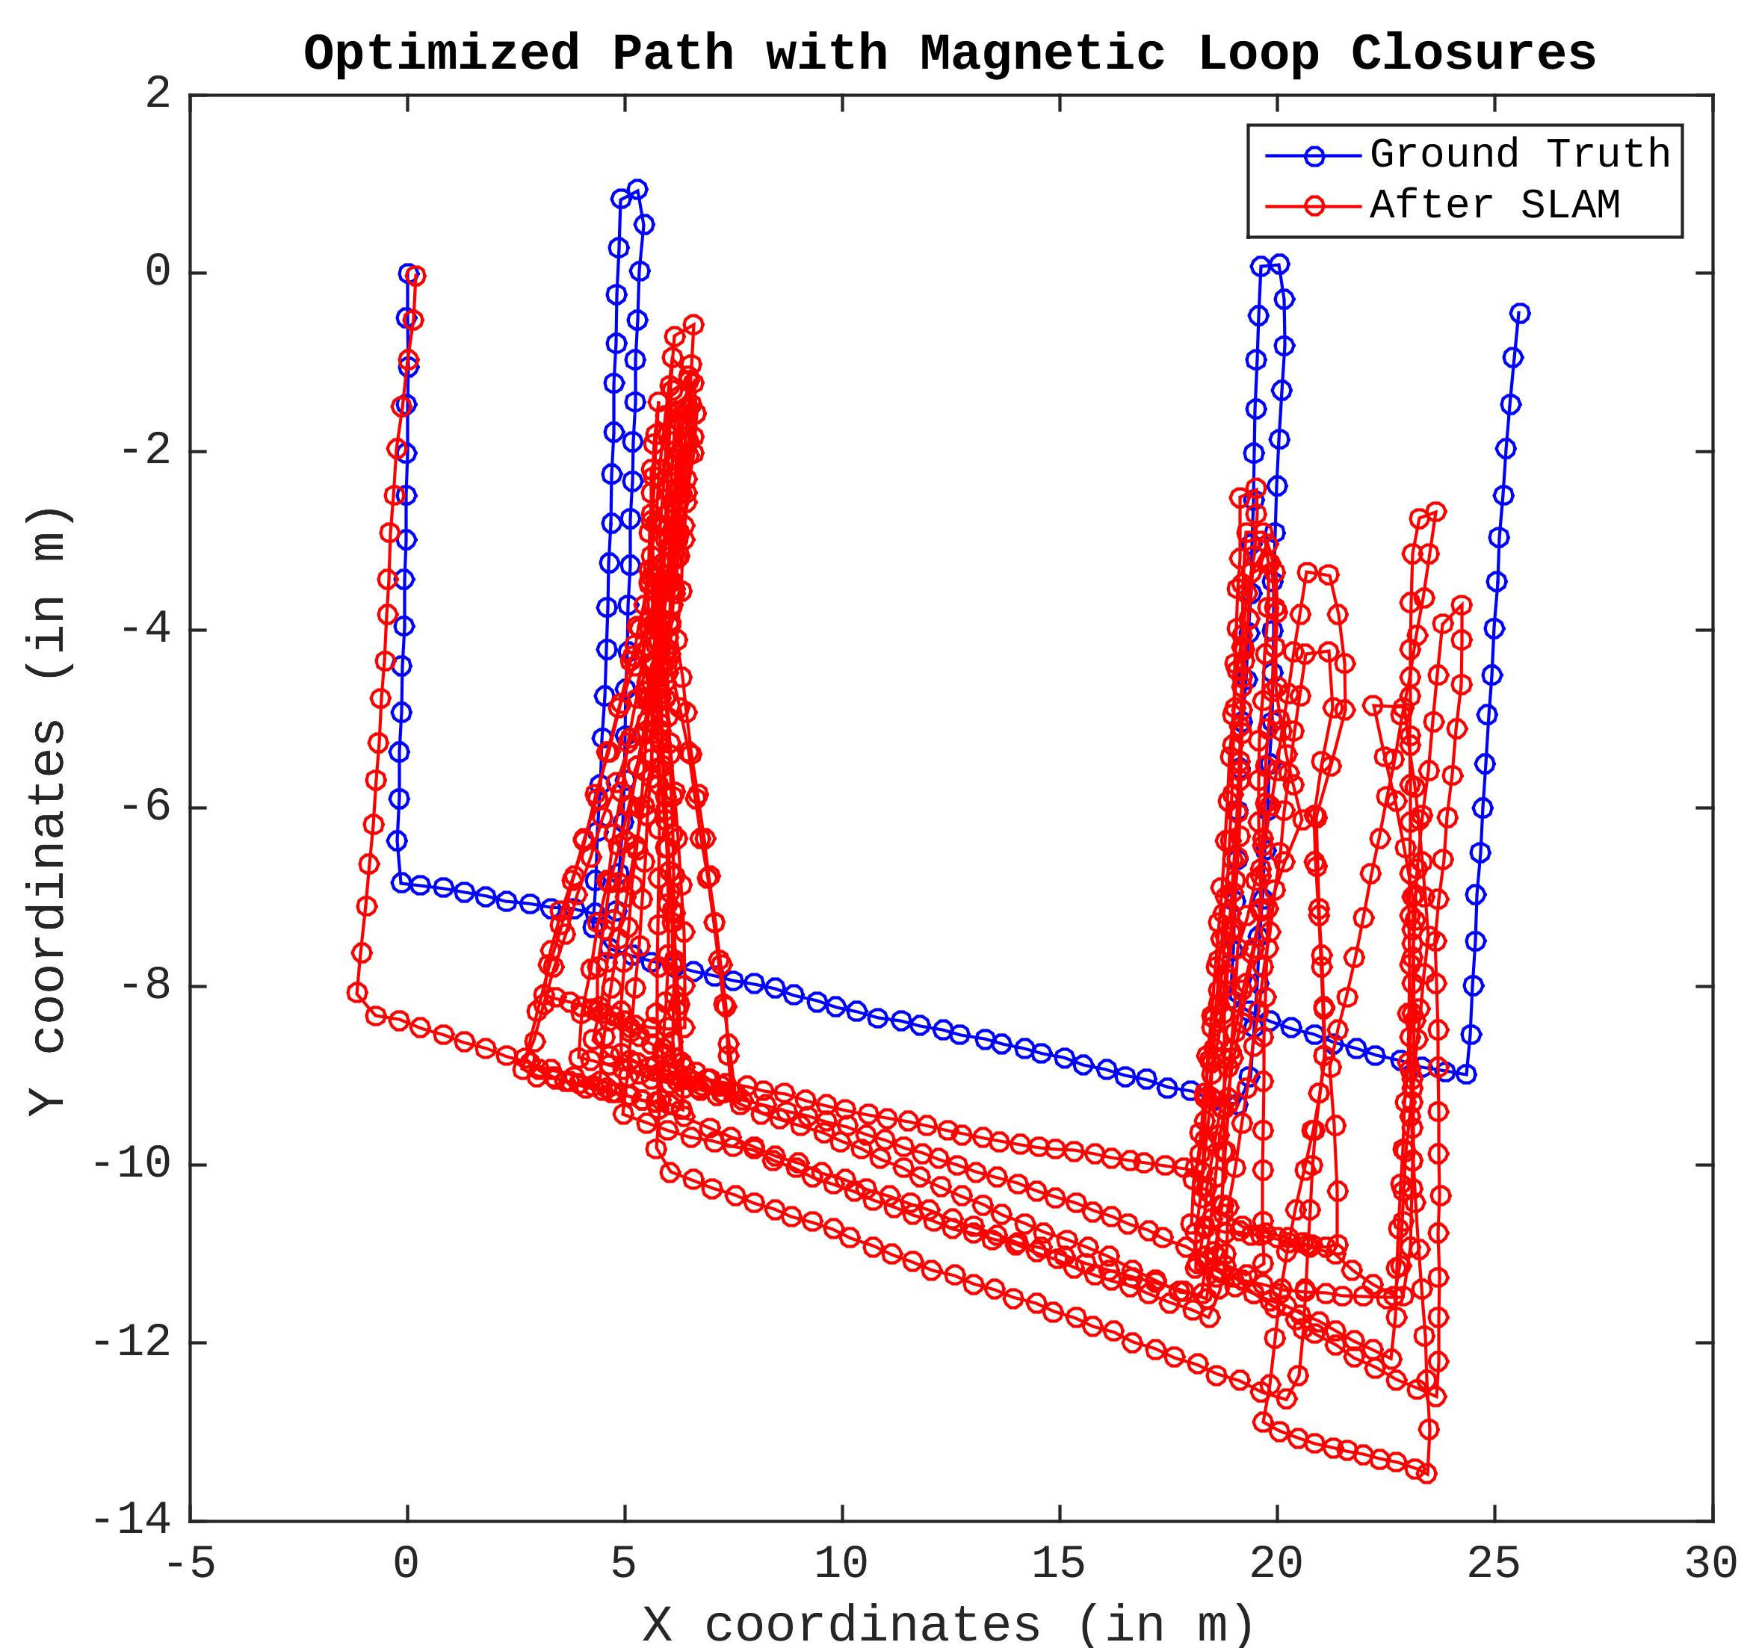
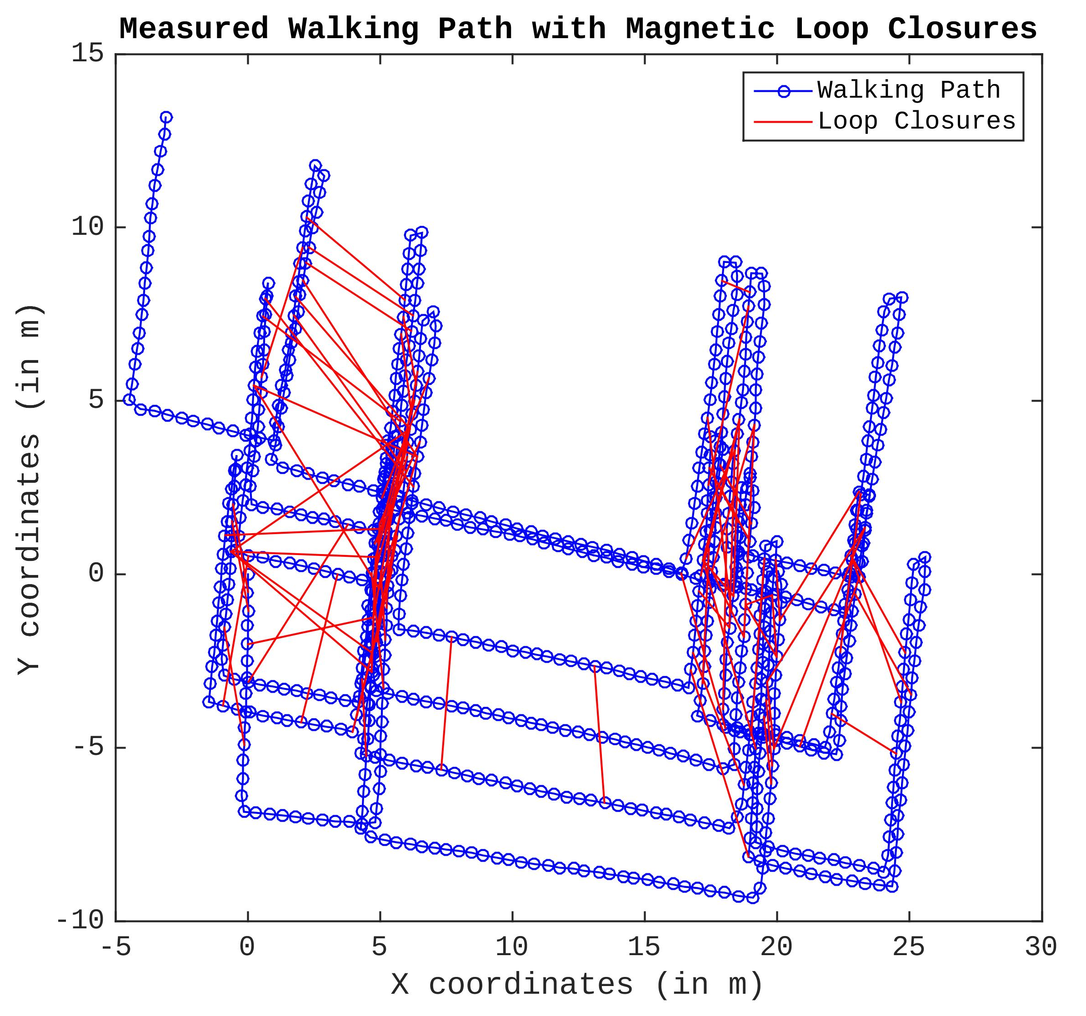
5.5. Even More Challenging Route
Notes:
Now, we have the 3. dataset, which is even more challenging, where I walked at the bigger region.
As we again see that the path is hugely drifted from its starting point.
For the first time our SLAM algorithm faces with the real challenge. The outliers that are happening at this region largely affects our mapping results.
The main reason is that these two rooms happened to have very similar magnetic field distortion. Therefore, our loop closure algorithm tells us that they are the same room but it is clearly not the case!

Slide 15
6. Conclusion
Discoveries
  Graph SLAM is a powerful recovery mechanism against drift problem.
  Magnetic field outperforms Wi-Fi and BLE at loop closures.
Limitations
  Long corridors and halls can be problematic.
  More sophisticated fingerprint matching algorithm is required for better accuracy.
Notes:
As a result, I would like to make a couple points before I finish this talk.
I wanted to mention what I’ve learned about SLAM in the context of smartphone indoor mapping.
As I’ve shown you today, SLAM algorithm can provide us sufficient results for indoor mapping.
I believe last and most important discovery of this research project is that magnetic field outperforms Wi-Fi and BLE in terms of simple loop closure detection algorithm.
OFC, there are certain limitations to SLAM algorithm. SLAM algorithm expects from users to perform many loop closing movements.
And, for the mapping large and complicated building, I still need to work on more sophisticated loop closure algorithm rather than simple dissimilarity comparison that I have it right now.

Slide 16
7. Reference
[Sün12] Niko Sünderhauf. Robust Optimization for Simultaneous Localization and Mapping - PhD Thesis. pages 1–231, 2012.

