Slide 1

INTRODUCTION to COMPUTATION & PROGRAMMING FOR IE
Assoc. Prof. Dr. Gürkan ÖZTÜRK & Assist. Prof. Dr. Emre ÇİMEN
Week 10

Slide 2
Modules
﻿A module is a .py file containing Python definitions and statements. We could create, for example, a file circle.py such as
Circle.py
import circle
print(circle.pi)
print(circle.area(3))
print(circle.circumference(3))
print(circle.sphereSurface(3))
pi = 3.14159
def area(radius):
return pi*(radius**2)
def circumference(radius):
return 2*pi*radius
def sphereSurface(radius):
return 4.0*area(radius)
def sphereVolume(radius):
return (4.0/3.0)*pi*(radius**3)
3.14159
28.27431
18.849539999999998
113.09724
28/04/2020

Slide 3
Modules
geometri.py
def kare(x,char):
        for i in range(x):
        for j in range(x):
        print(char,end=’’)
        print()
def dikdortgen(x,y,char):
for i in range(x):
for j in range(y):
print(char,end=’’)
print()
def histogram(a, b, c, d):
kalinlik = 2
  s= '-'*5+'Bu bir histogramdir '+'-’*5
  print(s)
  dikdortgen(kalinlik,a,'a ‘)
  dikdortgen(kalinlik,b,'b ‘)
  dikdortgen(kalinlik,c,'c ‘)
  dikdortgen(kalinlik,d,'d ‘)
  print('-'*len(s))
import geometri as g
g.kare(10,'% ')
@ @ @ @ @
@ @ @ @ @
@ @ @ @ @
@ @ @ @ @
@ @ @ @ @
import geometri as g
g.histogram(5, 10, 2, 7)
-----Bu bir histogramdir -----
a a a a a
b b b b b b b b b b
c c
d d d d d d d
------------------------------
-----Bu bir histogramdir -----
a a a a a
a a a a a
b b b b b b b b b b
b b b b b b b b b b
c c
c c
d d d d d d d
d d d d d d d
------------------------------
kalinlik = 2
kalinlik = 1
29/04/2020

Slide 4
Files
﻿Every computer system uses files to save things from one computation to the next. Python provides many facilities for creating and accessing files. Here we illustrate some of the basic ones.
nameHandle = open('kids','w')
nameHandle = open('kids2.txt','w')
for i in range(2):
name=input('Enter name:’)
nameHandle.write(name +'\n')
nameHandle.close
nameHandle = open('kids2.txt','a')
nameHandle.write('Ozlem\n')
nameHandle.close()
nameHandle=open('kids2.txt','r')
for line in nameHandle:
print(line[:-1])
nameHandle.close()

Slide 5
Files
fn is a string representing a file name.
fh is a file handle which returns as a result of open command
fh = open(fn, ‘w')
Creates a file for writing and returns a file handle.
fh = open(fn, ‘r')
Open an existing file for reading and returns a file handle.
fh = open(fn, ‘a')
Open an existing file for appending and returns a file handle.
fh.read()
returns a string containing the contents of the file associated with the file handle fh.
fh.readlines()
returns a list each element of which is one line of the file associated with the file handle fh.
fh.write(s)
writes the string s to the end of the file associated with the file handle fh.
fh.writeLines(S)
writes each element of S ( a sequence of string) to the file associated with the file handle fh.
fh.close()
Closes the file associated with the file handle fh.

Slide 6
File Examples
﻿TSP problem and solution reading from text file
def readProblem(dosyaAdi):
    dosyaProblem = open(dosyaAdi,'r’)
    print('TSP Problem att48’)
    for s in dosyaProblem.readlines():
    print(s[:-1])
    dosyaProblem.close
dosya1 = './w10b- 1,2 Apr/att48-2.tsp'
readProblem1(dosya1)
./w10b- 1,2 Apr/att48-2.tsp
NAME : att48\n
COMMENT : 48 capitals of the US (Padberg/Rinaldi)\n
TYPE : TSP\n
DIMENSION : 48\n
EDGE_WEIGHT_TYPE : ATT\n
NODE_COORD_SECTION\n
1 6734 1453\n
2 2233 10\n
3 5530 1424\n
…
47 5185 3258\n
48 3023 1942\n
EOF\n
TSP Problem att48
NAME : att48
COMMENT : 48 capitals of the US (Padberg/Rinaldi)
TYPE : TSP
DIMENSION : 48
EDGE_WEIGHT_TYPE : ATT
NODE_COORD_SECTION
1 6734 1453
2 2233 10
3 5530 1424
4 401 841
5 3082 1644
6 7608 4458
…
42 1916 1569
43 7280 4899
44 7509 3239
45 10 2676
46 6807 2993
47 5185 3258
48 3023 1942
EOF

Slide 7
File Examples
﻿TSP problem and solution reading from text file
…
def readProblem2(dosyaAdi):
dosyaProblem = open(dosyaAdi,'r’)
icerik = dosyaProblem.read()
a = icerik.split("\n")
for aa in a:
print(aa)
dosyaProblem.close
dosya1 = './w10b- 1,2 Apr/att48-2.tsp'
readProblem2(dosya1)
./w10b- 1,2 Apr/att48-2.tsp
NAME : att48\n
COMMENT : 48 capitals of the US (Padberg/Rinaldi)\n
TYPE : TSP\n
DIMENSION : 48\n
EDGE_WEIGHT_TYPE : ATT\n
NODE_COORD_SECTION\n
1 6734 1453\n
2 2233 10\n
3 5530 1424\n
…
47 5185 3258\n
48 3023 1942\n
EOF\n
0 | NAME : att48
1 | COMMENT : 48 capitals of the US (Padberg/Rinaldi)
2 | TYPE : TSP
3 | DIMENSION : 48
4 | EDGE_WEIGHT_TYPE : ATT
5 | NODE_COORD_SECTION
6 | 1 6734 1453
7 | 2 2233 10
8 | 3 5530 1424
… | …
52 | 47 5185 3258
53 | 48 3023 1942
54 | EOF
TSP Problem att48
NAME : att48
COMMENT : 48 capitals of the US (Padberg/Rinaldi)
TYPE : TSP
DIMENSION : 48
EDGE_WEIGHT_TYPE : ATT
NODE_COORD_SECTION
1 6734 1453
2 2233 10
3 5530 1424
4 401 841
5 3082 1644
6 7608 4458
…
42 1916 1569
43 7280 4899
44 7509 3239
45 10 2676
46 6807 2993
47 5185 3258
48 3023 1942
EOF

Slide 8
File Examples
﻿TSP problem and solution reading from text file
…
def readProblem3(dosyaAdi):
dosyaProblem = open(dosyaAdi,'r’)
icerik = dosyaProblem.read()
aa = icerik.split("\n")
for a in aa[6:-2]:
bb=a.split(' ‘)
for b in bb:
print(b, end="\t")
print()
dosyaProblem.close
dosya1 = './w10b- 1,2 Apr/att48-2.tsp'
readProblem2(dosya1)
./w10b- 1,2 Apr/att48-2.tsp
NAME : att48\n
COMMENT : 48 capitals of the US (Padberg/Rinaldi)\n
TYPE : TSP\n
DIMENSION : 48\n
EDGE_WEIGHT_TYPE : ATT\n
NODE_COORD_SECTION\n
1 6734 1453\n
2 2233 10\n
3 5530 1424\n
…
47 5185 3258\n
48 3023 1942\n
EOF\n
0 | NAME : att48
1 | COMMENT : 48 capitals of the US (Padberg/Rinaldi)
2 | TYPE : TSP
3 | DIMENSION : 48
4 | EDGE_WEIGHT_TYPE : ATT
5 | NODE_COORD_SECTION
6 | 1 6734 1453
7 | 2 2233 10
8 | 3 5530 1424
… | …
52 | 47 5185 3258
53 | 48 3023 1942
54 | EOF
1 6734 1453
2 2233 10
3 5530 1424
4 401 841
5 3082 1644
6 7608 4458
7 7573 3716
…
39 3484 2829
40 6271 2135
41 4985 140
42 1916 1569
43 7280 4899
44 7509 3239
45 10 2676
46 6807 2993
47 5185 3258
48 3023 1942

Slide 9
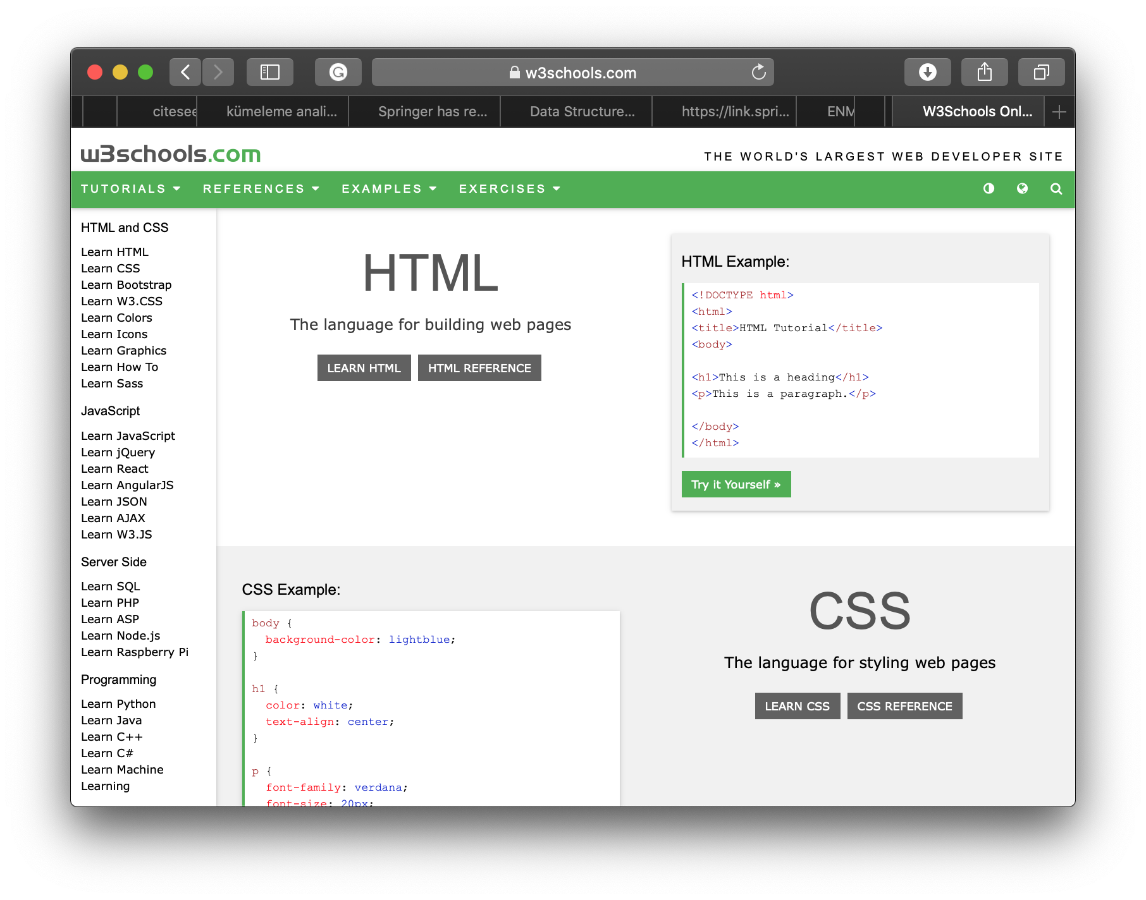
Well known text files : HTML

Slide 10
Create a HTML file with python
Can we create such a text file with a “.html” file extension?
<!DOCTYPE html>
<html>
<head>
<title>Page Title</title>
</head>
<body>
<h1>This is a Heading</h1>
<p>This is a paragraph.</p>
</body>
</html>

Slide 11
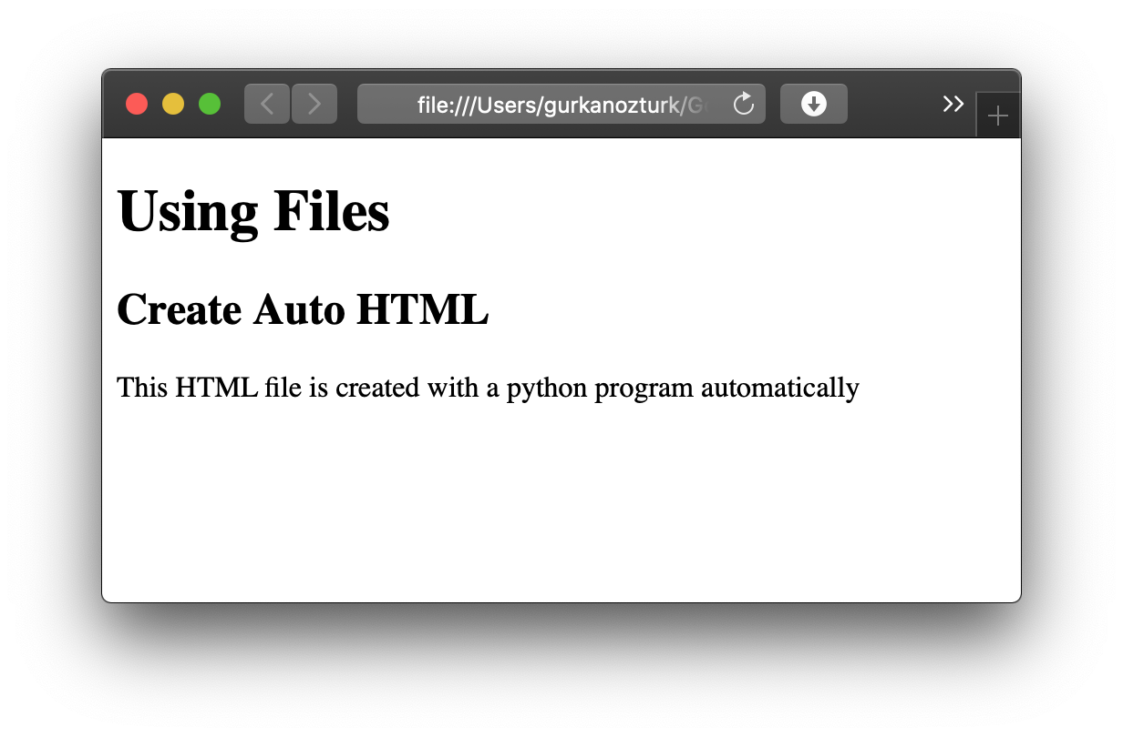
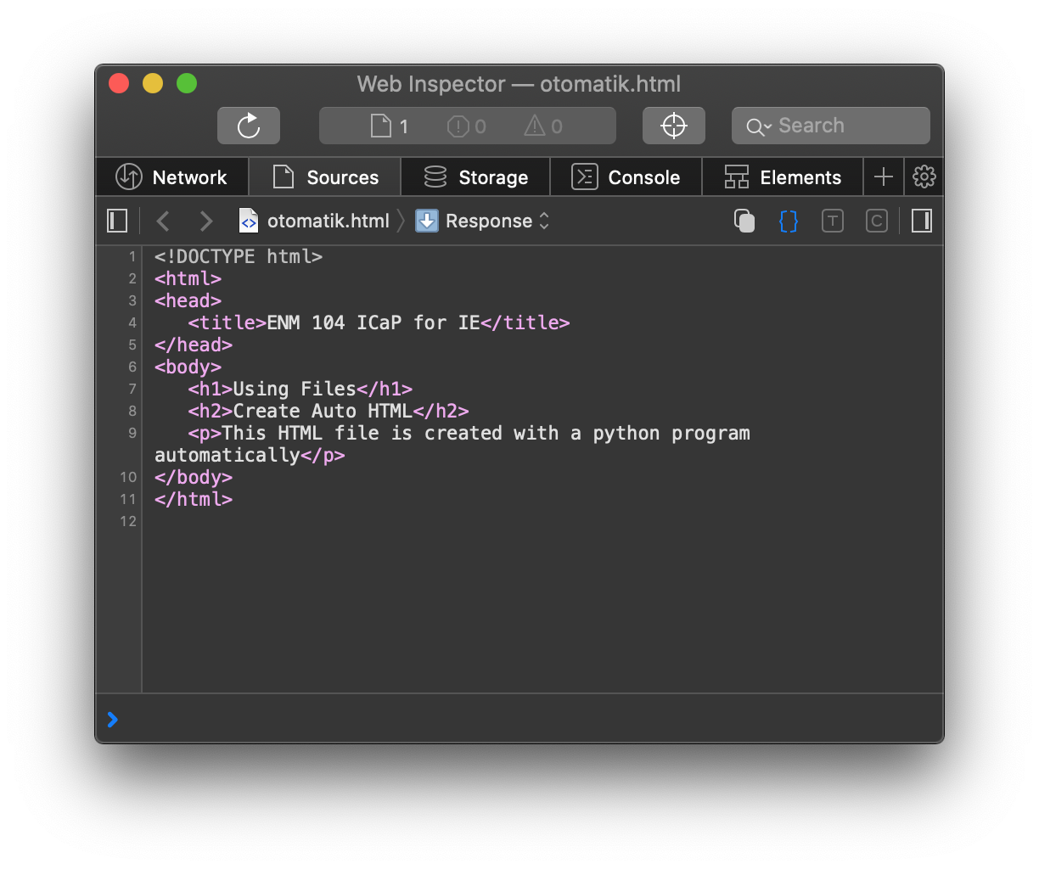
Create a HTML file with python
def htmlDosyaOlustur(dosyaAdi, baslik, altBaslik1, altBaslik2, paragraf):
htmlDosya = open(dosyaAdi, 'w’)
HTMLicerik = ""
HTMLicerik += " <!DOCTYPE html> <html> <head> "
HTMLicerik += "<title>" + baslik + "</title> </head> <body>"
#baslik 1 ekle
HTMLicerik +="<h1>" + altBaslik1 +"</h1>"
#baslik 2 ekle
HTMLicerik +="<h2>" + altBaslik2 +"</h2>"
HTMLicerik += "<p>" + paragraf + "</p>"
HTMLicerik += "</body></html>"
htmlDosya.write(HTMLicerik)
print('html file created...’)
htmlDosya.close()
dosya1 = './w10b- 1,2 Apr/otomatik.html'
htmlDosyaOlustur(dosya1, 'ENM 104 ICaP for IE',
'Using Files',
'Create Auto HTML',
'This HTML file is created with a python program automatically')
html file created...

Slide 12
Well known text files : SVG
SVG Rectangle - <rect>
<svg width="400" height="110">
<rect width="300" height="100" style="fill:rgb(0,0,255);stroke-width:3;stroke:rgb(0,0,0)" />
</svg>
SVG Circle - <circle>
<svg height="100" width="100">
<circle cx="50" cy="50" r="40" stroke="black" stroke-width="3" fill="red" />
</svg>
SVG Ellipse - <ellipse>
<svg height="140" width="500">
<ellipse cx="200" cy="80" rx="100" ry="50"
style="fill:yellow;stroke:purple;stroke-width:2" />
</svg>

Slide 13
Well known text files : SVG
SVG line - <line>
<svg height="210" width="500">
<line x1="0" y1="0" x2="200" y2="200" style="stroke:rgb(255,0,0);stroke-width:2" />
</svg>
SVG Polygon - <polygon>
<svg height="210" width="500">
<polygon points="200,10 250,190 160,210" style="fill:lime;stroke:purple;stroke-width:1" />
</svg>
SVG Polyline - <polyline>
<svg height="200" width="500">
<polyline points="20,20 40,25 60,40 80,120 120,140 200,180"
style="fill:none;stroke:black;stroke-width:3" />
</svg>

Slide 14

Create a HTML file with python
def addCircle(cx, cy, r, stroke, st_w, fill ):
svgCode=' <circle cx="'+ str(cx) +' " cy="' + str(cy) +' " r="'+ str(r) +'" ‘
svgCode+='stroke= "'+ stroke +'" stroke-width="' + str(st_w) +'" fill="'+ fill +'" /> ‘
return svgCode
import svgBase
def makeSVG(height, width, fileName):
svgFile=open(fileName, 'w’)
svgContent = '<svg height="' + str(height) + '" width="' + str(width)+ '">’
svgContent += svgBase.addCircle(50,50,30,"black",2,"blue")
svgContent += "</svg>"
svgFile.write(svgContent)
svgFile.close()
dosya1 = './w10b- 1,2 Apr/ornekSVG.svg'
makeSVG(100,100,dosya1)

Slide 15

Create a SVG file with python
import svgBase
import random as r
def makeSVG(height, width, fileName):
svgFile=open(fileName, 'w’)
svgContent = '<svg height="' + str(height) + '" width="' + str(width)+ '”’
svgContent += ' viewBox="0 0 ' +str(height) + ' '+str(width) +'" xmlns="http://www.w3.org/2000/svg">’
for i in range(100):
cx = r.random()*height
cy = r.random()*height
cr = r.random()*height/4
r1,r2,r3=str(r.randint(0,255)), str(r.randint(0,255)),str(r.randint(0,255))
strokeColor = 'RGBA('+r1+','+ r2 +','+ r3 +',0.2)’
r1,r2,r3=str(r.randint(0,255)), str(r.randint(0,255)),str(r.randint(0,255))
fillColor = 'RGBA('+r1+','+ r2 +','+ r3 +',0.2)’
svgContent += svgBase.addCircle(cx,cy,cr,strokeColor,2,fillColor)
svgContent += "</svg>"
svgFile.write(svgContent)
svgFile.close()
dosya1 = './w10b- 1,2 Apr/ornekSVG.svg'
makeSVG(500,500,dosya1)

Slide 16
Refenrences
John V. Guttag, Introduction to Computation and Programming Using Python, The MIT Press Cambridge, Massachusetts London, England, 2013

Slide 17
INTRODUCTION to COMPUTATION & PROGRAMMING FOR IE
Assoc. Prof. Dr. Gürkan ÖZTÜRK & Assist. Prof. Dr. Emre ÇİMEN
Week 10

