Slide 1

INTRODUCTION to COMPUTATION & PROGRAMMING FOR IE
Assoc. Prof. Dr. Gürkan ÖZTÜRK & Assist. Prof. Dr. Emre ÇİMEN
Week 8

Slide 2
Exhaustive Enumeration
The algorithmic technique used in this program is a variant of guess and check called exhaustive enumeration.
We enumerate all possibilities until we get to the right answer or exhaust the space of possibilities.
The code prints the integer cube root, if it exists, of an integer. If the input is not a perfect cube, it prints a message to that effect.
15/04/2020

Slide 3
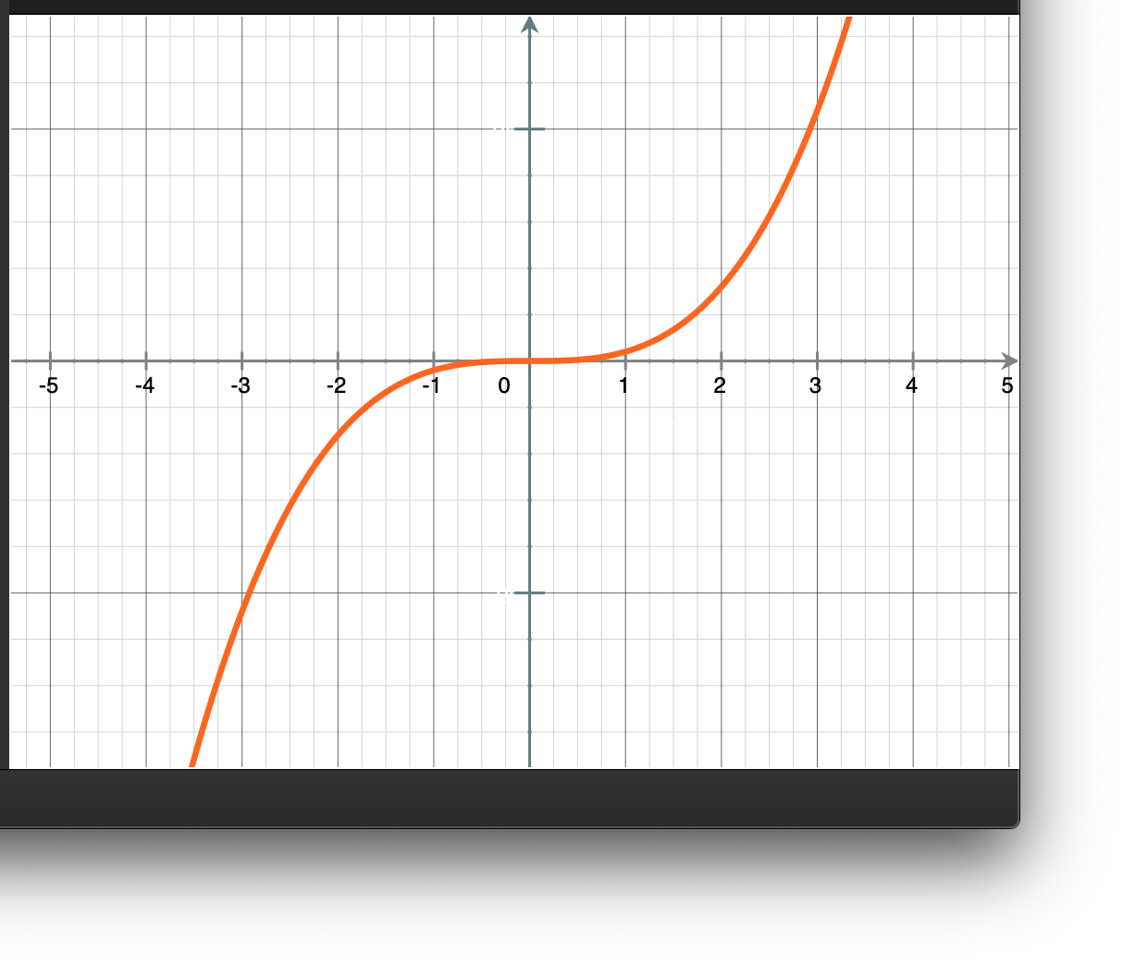




Exhaustive Enumaration
How to find a perfect cube root a given number?
$$y$$
$$f\left(x\right)=x^{3}, −∞<x<∞, x integer$$
$$y=x^{3}$$
start
Read y
$$x$$
$$Search space : ans$$
x = 0
x = x + 1
T
x ³ < |y|
F
T
T
x ³ ==|y|
y < 0
F
F
x = - x
print(y, 'is not a perfect cube’)
print('Cube root of’, y, 'is', x)
end

Slide 4

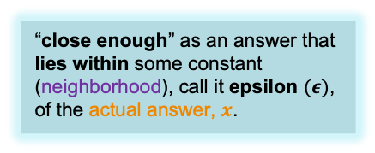




Approximate Solutions and Bisection Search
How to find a square root of any nonnegative number?
  For example, what should the program do if asked to find the square root of 2?
  The right thing to have asked for is a program that finds an approximation to the square root
    an answer that is close enough to the actual square root to be useful.
Some new operators;
  “ += , ans += step → ans = ans + step
  “ -= and “ *=“ work similarly.
“close enough” as an answer that lies within some constant (neighborhood), call it epsilon $(ε)$, of the actual answer, $x$.
$$x−ε$$
$$x$$
$$x+ε$$
$$N_{ε}\left(x\right)=\left\{t∈R\right| x−ε<t<x+ε\}$$
$ε$neighborhood of $x$

Slide 5




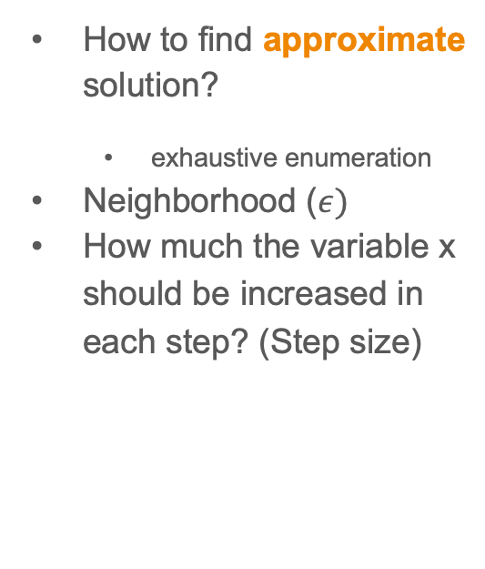


﻿Approximating the square root using exhaustive enumeration
How to find approximate solution?
  exhaustive enumeration
Neighborhood ($ε)$
How much the variable x should be increased in each step? (Step size)
$$y−ε$$
$$y$$
$$y+ε$$
$$x−ε$$
$$x$$
$$x+ε$$

Slide 6
﻿Approximating the square root using exhaustive enumeration
y = 25
epsilon = 0.01
step = epsilon ** 2
numGuesses = 0
x = 0.0
while abs(x**2-y) >= epsilon and x <= y:
x += step
numGuesses +=1
print('numGuesses :', numGuesses)
if abs(x**2-y) >= epsilon:
print('Failed on square root of ', y)
else:
print(x, ' is close to square root of ', y)
numGuesses : 49990
4.999000000001688 is close to square root of 25

Slide 7
﻿Approximating the square root using exhaustive enumeration
y = 123456
epsilon = 0.01
step = epsilon ** 2
numGuesses = 0
x = 0.0
while abs(x**2-y) >= epsilon and x <= y:
x += step
numGuesses +=1
print('numGuesses :', numGuesses)
if abs(x**2-y) >= epsilon:
print('Failed on square root of ', y)
else:
print(x, ' is close to square root of ', y)
$$y−ε$$
$$y$$
$$y+ε$$
step = epsilon ** 3
﻿numGuesses = 3513631
Failed on square root of 123456
Step size will be 0.000001
Square root is around 351.36
351,000,000 guesses to find satisfactory answer
$$x−ε$$
$$x$$
$$x+ε$$

Slide 8

















﻿Approximating the square root using bisection search
y = 25
epsilon = 0.01
numGuesses = 0
low = 0.0
high = max(1.0, y)
x = (high + low)/2.0
while abs(x**2-y) >= epsilon:
print('low', low, 'high=', high, 'x=',x)
numGuesses +=1
if x**2 <y:
low = x
else :
high = x
x = (high + low)/2.0
print('numGuesses :', numGuesses)
print(x, ' is close to square root of ', y)
$$0$$
$$max$$
$$0$$
$$guess$$
$$max$$
$$low=0$$
$$12.5$$
$$high=25$$
﻿low 0.0 high= 25 x= 12.5
low 0.0 high= 12.5 x= 6.25
low 0.0 high= 6.25 x= 3.125
low 3.125 high= 6.25 x= 4.6875
low 4.6875 high= 6.25 x= 5.46875
low 4.6875 high= 5.46875 x= 5.078125
low 4.6875 high= 5.078125 x= 4.8828125
low 4.8828125 high= 5.078125 x= 4.98046875
low 4.98046875 high= 5.078125 x= 5.029296875
low 4.98046875 high= 5.029296875 x= 5.0048828125
low 4.98046875 high= 5.0048828125 x= 4.99267578125
low 4.99267578125 high= 5.0048828125 x= 4.998779296875
low 4.998779296875 high= 5.0048828125 x= 5.0018310546875
numGuesses : 13
5.00030517578125 is close to square root of 25
$$low=0$$
$$6.25$$
$$high$$
$$low=0$$
$$3.125$$
$$high$$
$$low$$
$$high$$
$$4.68755$$

Slide 9
﻿Approximating the square root using bisection search
y = 123456
epsilon = 0.01
numGuesses = 0
low = 0.0
high = max(1.0, y)
x = (high + low)/2.0
while abs(x**2-y) >= epsilon:
print('low', low, 'high=', high, 'x=',x)
numGuesses +=1
if x**2 <y:
low = x
else :
high = x
x = (high + low)/2.0
print('numGuesses :', numGuesses)
print(x, ' is close to square root of ', y)
﻿low 0.0 high= 123456 x= 61728.0
low 0.0 high= 61728.0 x= 30864.0
low 0.0 high= 30864.0 x= 15432.0
low 0.0 high= 15432.0 x= 7716.0
low 0.0 high= 7716.0 x= 3858.0
low 0.0 high= 3858.0 x= 1929.0
low 0.0 high= 1929.0 x= 964.5
low 0.0 high= 964.5 x= 482.25
low 0.0 high= 482.25 x= 241.125
low 241.125 high= 482.25 x= 361.6875
low 241.125 high= 361.6875 x= 301.40625
low 301.40625 high= 361.6875 x= 331.546875
low 331.546875 high= 361.6875 x= 346.6171875
low 346.6171875 high= 361.6875 x= 354.15234375
low 346.6171875 high= 354.15234375 x= 350.384765625
low 350.384765625 high= 354.15234375 x= 352.2685546875
low 350.384765625 high= 352.2685546875 x= 351.32666015625
low 351.32666015625 high= 352.2685546875 x= 351.797607421875
low 351.32666015625 high= 351.797607421875 x= 351.5621337890625
low 351.32666015625 high= 351.5621337890625 x= 351.44439697265625
low 351.32666015625 high= 351.44439697265625 x= 351.3855285644531
low 351.32666015625 high= 351.3855285644531 x= 351.35609436035156
low 351.35609436035156 high= 351.3855285644531 x= 351.37081146240234
low 351.35609436035156 high= 351.37081146240234 x= 351.36345291137695
low 351.35609436035156 high= 351.36345291137695 x= 351.35977363586426
low 351.35977363586426 high= 351.36345291137695 x= 351.3616132736206
low 351.3616132736206 high= 351.36345291137695 x= 351.3625330924988
low 351.3625330924988 high= 351.36345291137695 x= 351.36299300193787
low 351.36299300193787 high= 351.36345291137695 x= 351.3632229566574
low 351.36299300193787 high= 351.3632229566574 x= 351.36310797929764
numGuesses : 30
351.36305049061775 is close to square root of 123456

Slide 10
A few words about using floats
﻿Most of the time, numbers of type float provide a reasonably good approximation to real numbers.
But “most of the time” is not all of the time, and when they don’t it can lead to surprising consequences.
For example, try running the code:
x=0.0
for i in range(10):
x=x+0.1
if x == 1.0:
print (x, '=1.0')
else:
print(x, 'is not 1.0')
1.0 is not 1.0
0.9999999999999999 is not 1.0
﻿Finger exercise: What is the decimal equivalent of the binary number 10011?

Slide 11
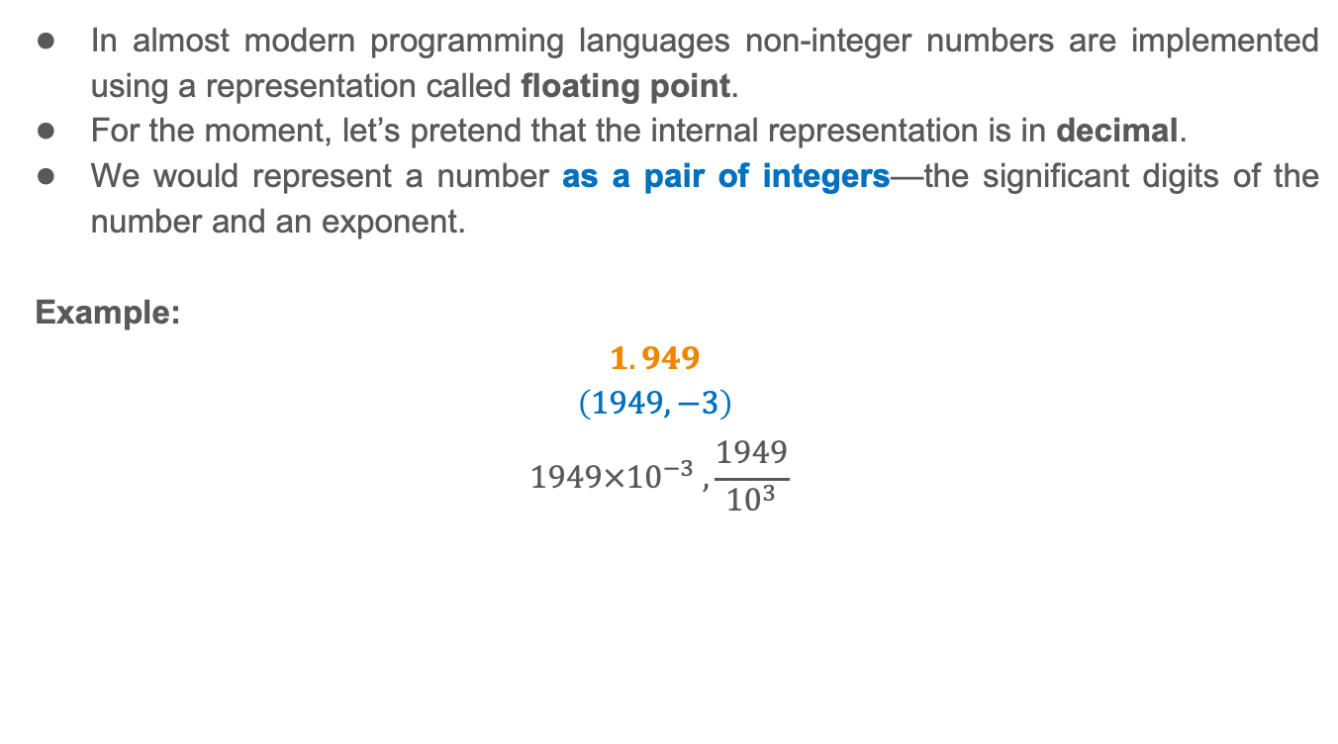
A few words about using floats
﻿In almost modern programming languages non-integer numbers are implemented using a representation called floating point.
For the moment, let’s pretend that the internal representation is in decimal.
We would represent a number as a pair of integers—the significant digits of the number and an exponent.
Example:
$$1.949$$
$$\left(1949, −3\right)$$
$$1949×{10}^{−3} ,\frac{1949}{{10}^{3}}$$
Presicion: Number of digits
Rounded value: 1.9

Slide 12
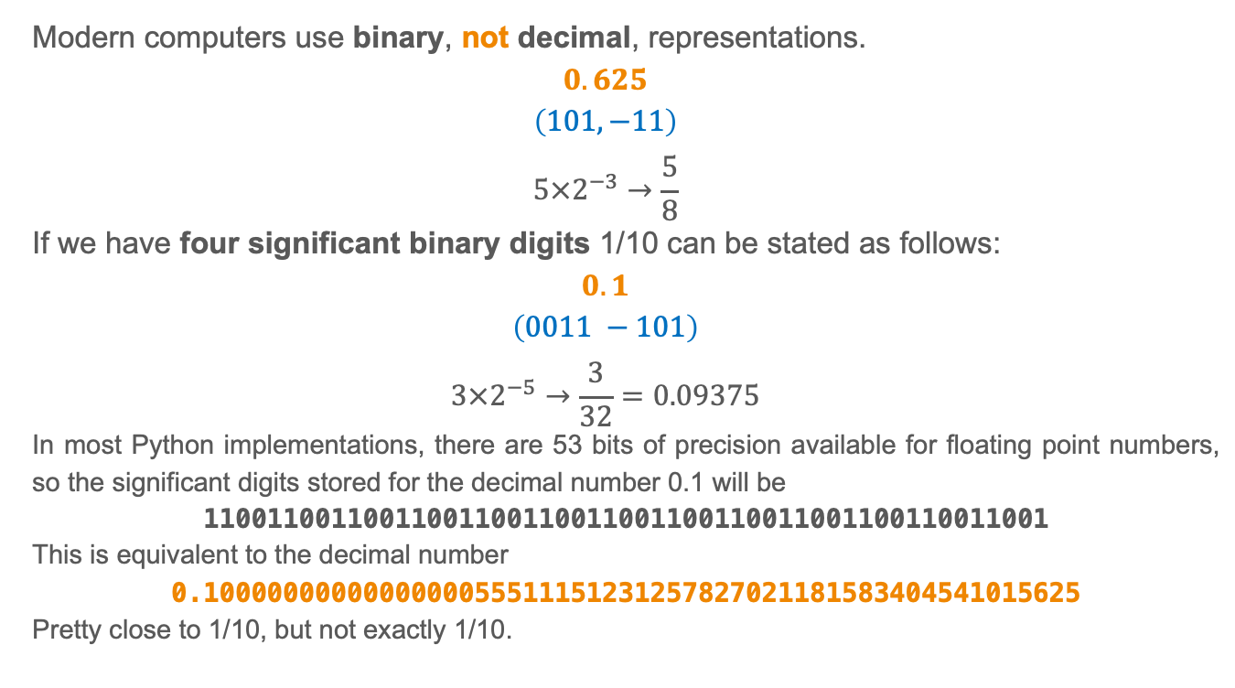
A few words about using floats
﻿Modern computers use binary, not decimal, representations.
$$0.625$$
$$\left(101, −11\right)$$
$$5×2^{−3}→\frac{5}{8}$$
If we have four significant binary digits 1/10 can be stated as follows:
$$0.1$$
$$\left(0011 −101\right)$$
$$3×2^{−5}→\frac{3}{32}=0.09375$$
﻿In most Python implementations, there are 53 bits of precision available for floating point numbers, so the significant digits stored for the decimal number 0.1 will be
11001100110011001100110011001100110011001100110011001
This is equivalent to the decimal number
0.1000000000000000055511151231257827021181583404541015625
Pretty close to 1/10, but not exactly 1/10.

Slide 13

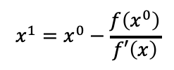









Newton-Raphson
$$f\left(x\right)=x^{2}−24$$
$$f′\left(x\right)=2x$$
$$f′\left(x\right)=\tan{α=\frac{f\left(x^{0}\right)}{x^{0}−x^{1}}}$$
$$x^{0}−x^{1}{=\frac{f\left(x^{0}\right)}{f′\left(x\right)}}$$
$$x^{1}{=x^{0}−\frac{f\left(x^{0}\right)}{f′\left(x\right)}}$$
$$f\left(x^{0}\right)$$
$$x^{1}{=x^{0}−\frac{x^{2}−24}{2x}}$$
$$α$$
$$x^{0}−x^{1}$$
$$x^{1}$$
$$x^{0}$$

Slide 14
Newton-Raphson
# Newton - Raphson for square root
# Find x such that x**2 – 25 is within epsilon 0
epsilon = 0.01
k=25
x = k / 2.0
n=0
while abs(x**2-k)>=epsilon:
x = x - (x**2-k)/(2*x)
n+=1
print('square root of ',k, ' is about ', x)
print('numGuesses :', n)
# Newton - Raphson for square root
# Find x such that x**2 – 25 is within epsilon 0
epsilon = 0.01
k=123456
x = k / 2.0
n=0
while abs(x**2-k)>=epsilon:
x = x - (x**2-k)/(2*x)
n+=1
print('square root of ',k, ' is about ', x)
print('numGuesses :', n)
square root of 25 is about 5.000012953048684
numGuesses : 4
square root of 123456 is about 351.3630601485824
numGuesses : 11

Slide 15
Refenrences
John V. Guttag, Introduction to Computation and Programming Using Python, The MIT Press Cambridge, Massachusetts London, England, 2013

Slide 16
INTRODUCTION to COMPUTATION & PROGRAMMING FOR IE
Assoc. Prof. Dr. Gürkan ÖZTÜRK & Assist. Prof. Dr. Emre ÇİMEN
Week 8

