Slide 1
Baseball Pitch Result Prediction
Ugur Oguz
Griffith Collage, MSCBD,
Under the supervision of Osama Abushama

Slide 2
Introduction
About Project
Baseball Rules
Data & Feature Selection
Model
Conclussion

Slide 3
About Project
Why sports
Why baseball
What is diffrent
What it offers

Slide 4
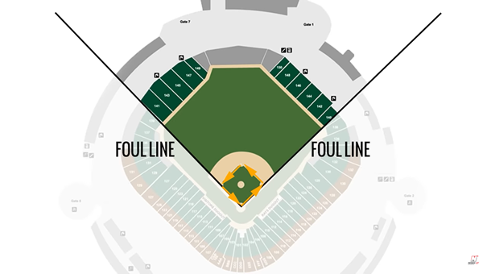
Baseball Rules
Inning:Baseball game scheduled for nine inning. Innings are splitted to two half. In each half, one team bats until three outs are made, with other team playing defence.

Slide 5
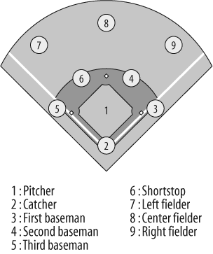
Positioning & How to score
Batter runing through all bases back to home plate

Slide 6
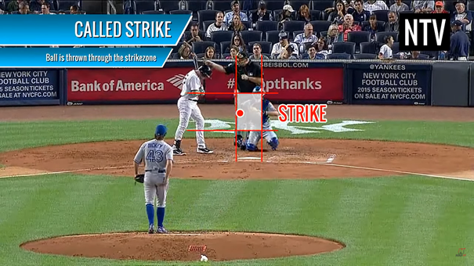
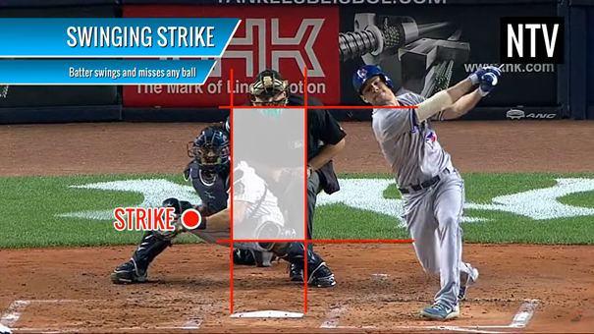
Pitch Results
Strike | Pitcher Throws the ball into strike zone Batter swings to ball
Ball | Pitches thrown out side of the strike zone
Play | Batter hits the pitch

Slide 7
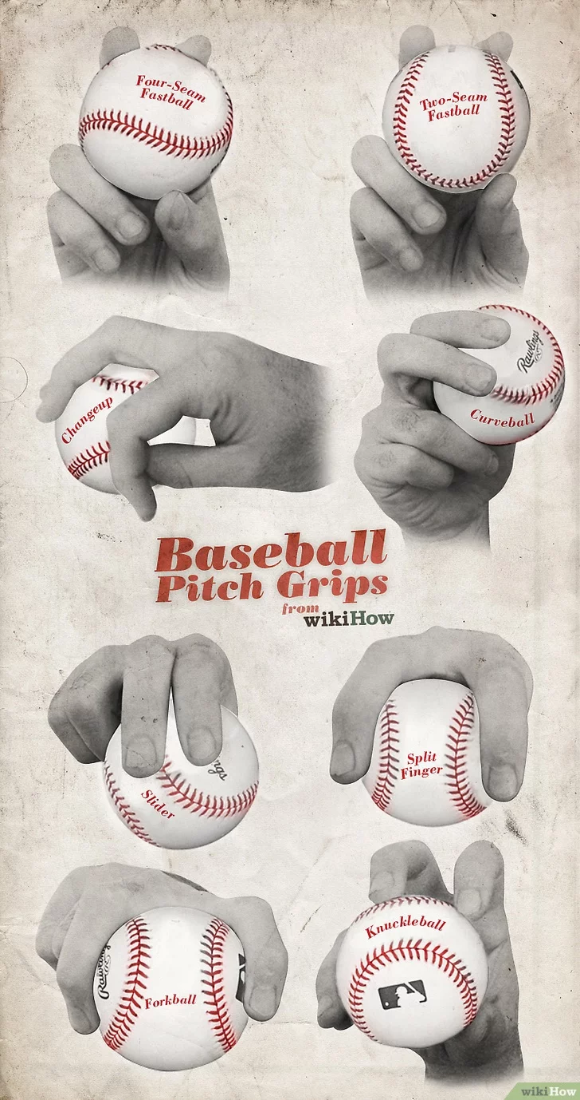
Pitch Types & Grips
CH - Changeup | KC - Knuckle curve
CU - Curveball | KN - Knuckeball
EP - Eephus | PO - Pitchout
FC - Cutter | SC - Screwball
FF - Fastball | SI - Sinker
FS - Splitter | SL - Slider

Slide 8
Data & Feature Selection
Table of selected features and their meanings
Game Situation | Inning | P_score | B_Score | Outs | P_num | On_1b | On_2b | On_3b
Ball Information | Spin_rate | Spin_dir | Start_speed | End_speed | Pitch types binary (twelve feature)
Pitcher Limit | Amount of each pitch type pitcher can throw
Pitcher Potential | Game_pt_p_Count (pitcher pitch count) |  |  |  | Game_pt_t_s (pitcher strike count)
In the model, we are using total 41 features. Three of them are the classes that we want to predict (strike, ball, play). Eight of them are current game situation (Inning, pitcher team score, batter team score, outs, current pitch number against batter, on_1b , on_2b , on_3b). As ball information four features (spin_rate, spin_dir, start_speed, end_speed), plus twelve features that shows which pitch type thrown in other words, we have used onehotencode method to binaries the pitch type. Also twelve features that interpreted as total types of pitches that pitcher can throw. Finally, two features that we created shows potential pitch amount that pitcher can
throw and how many of them will result with a strike.

Slide 9
Noises & Anomalies
Untangable effects Pressure, mood, form, momentum, etc.
Measurement effects breaking angle, hight of pitcher, etc.

Slide 10
Model
Tested Models
Various models were tested with diffrent combinations of features
Models accuracies based on finalized dataset.
Model | Accuracy Rate %
Random Forest | 0.23
Decision Tree | 38
kNN | 33
OneVsRest (linear-SVC) | 44
OneVsRest (SVC) | 3
MLP (adadelta) | 45
MLP (rmspromp) | 45
MLP (adam) | 46

Slide 11
Final Model
MLP model
optimizer adam
loss categorical_crossentropy
activation relu & softmax

Slide 12
Conclussion
Accomplishments
Using anomalies to get more realistic results.
Data is not limited.
Giving more options to player & betting companies.

Slide 13

Thank You

