Slide 1
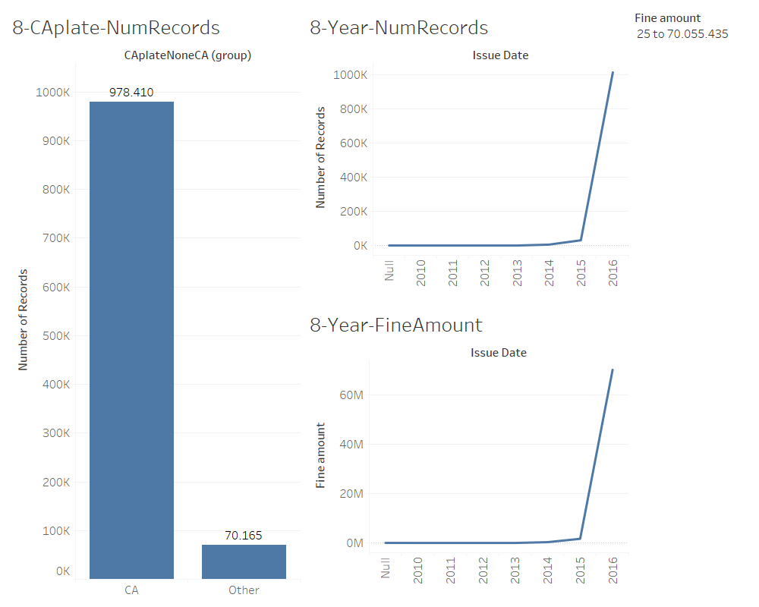
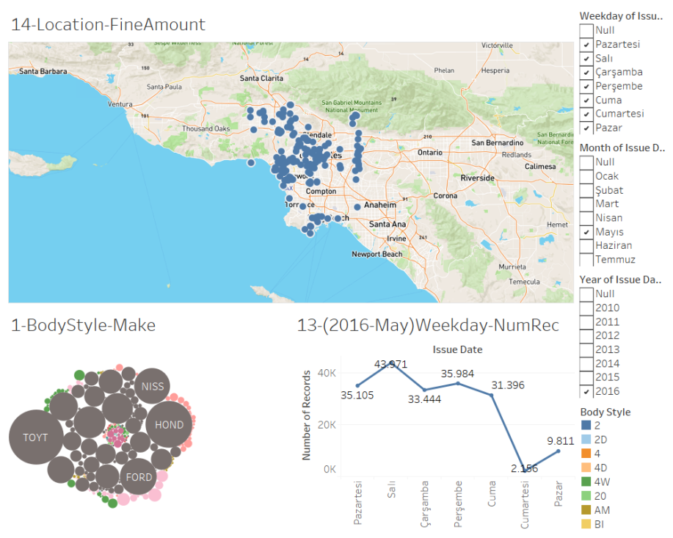
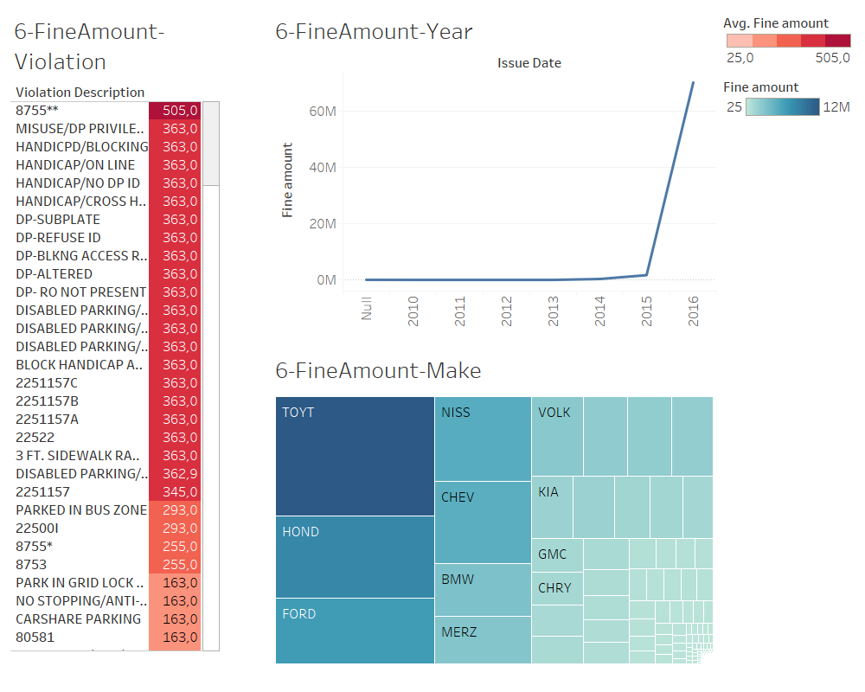
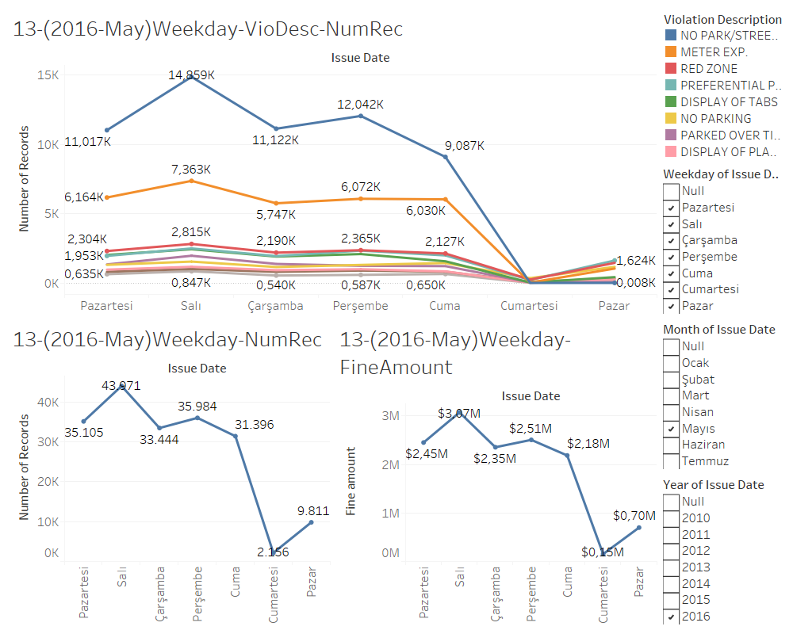
LA - Parking Citation
At right dashboard we can observe the locations of violations that fine are not defined,
Right dashboard gives us the locations and days, we can observe that most of the record mistakes maken in Tuesday. We can see what type of vehicles fine amount is not defined.
Introduction
The dataset is provided by City of Lost Angeles. It contains information about parking citations with days and geographical coordinates.
Questions
Is there specific area that fine amounts are not paid?
Which days most of the violations happening?
Is there any breaking point that increased the violations?
Does the violations have any relations with vehicle make?
Dashboard gives us a general idea about LA violation increase, we can see drasticle increase starting at 2015. Over all number of violation occurence by locals and people come from diffrent state.
Right Dashboard Shows us Most 10 violation in LA and we are observing the number of violations occurence in weekdays, while we expected to have most violations on weekends we can see it is actually on Tuesday.
Right Dashboard shows us the price of the violations and make type of the vehicles that paid higher fine amount. We can filter these violations and see the relation between vehicle make.

Slide 2
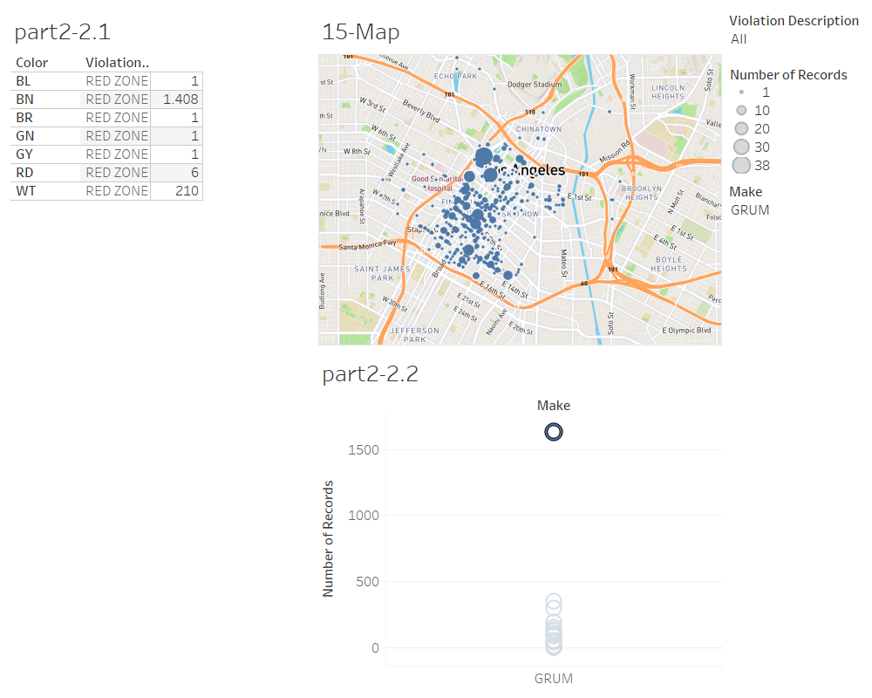
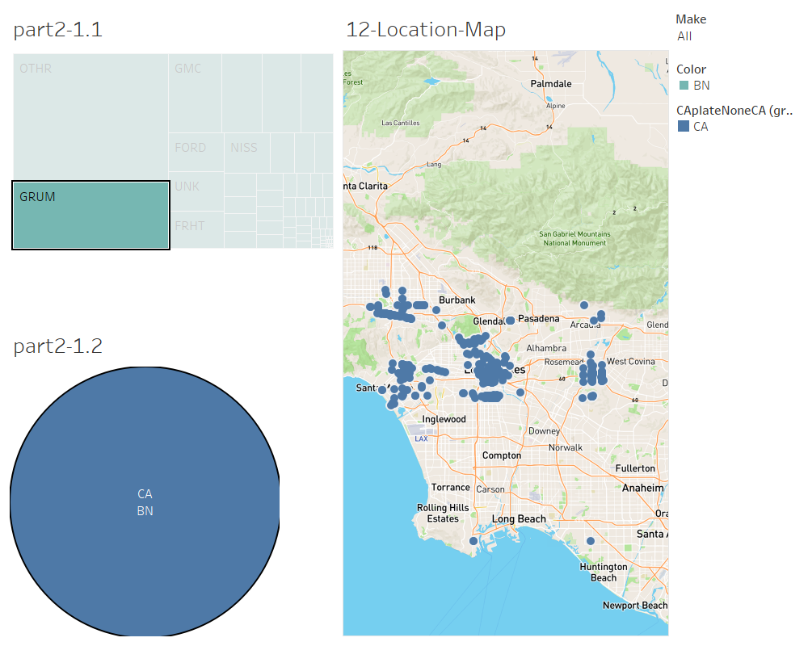
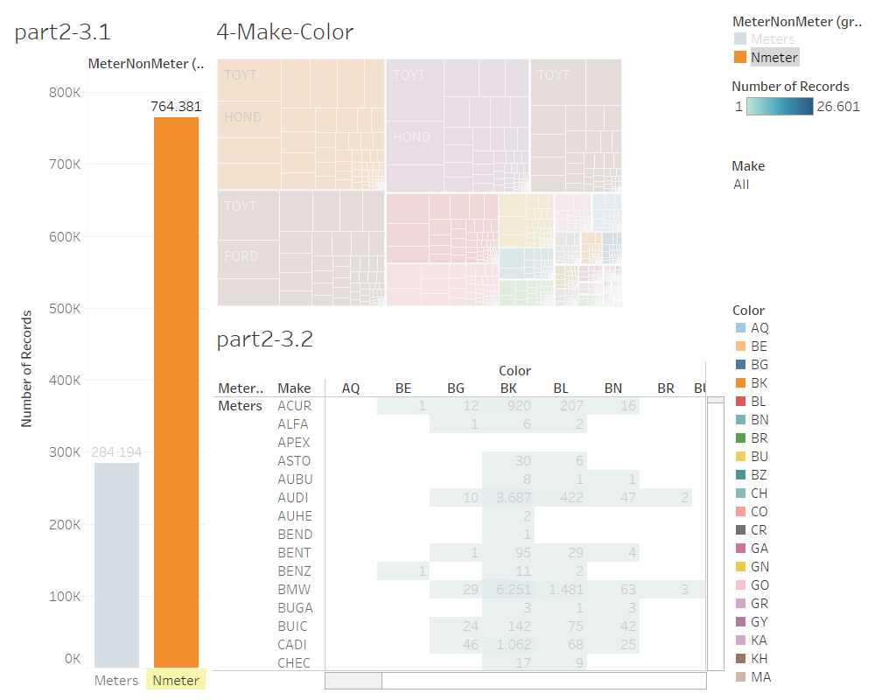
LA - Parking Citation Applied Data Analytics ugur oguz - 2982620
Introduction
To confirm the relation between attributes, we have used apriori algorithm in our dataset and we have found some rules. The rules confidence are between 85% -87% Based on these rules we have created new dashboards and verified the relations.
Upper dashboard shows the location of records which satisfied the rules.
we used make and violation rule to see if we will achieve the same result in our algorithm, we can see the number of records that satisfy our condition is 1628,and number of records that vehicle color is BN. 1408/1628 = 0,86 shows us that the rule we found is correct.
10 Rules
1-Make= GRUM, Violation Description = Red Zone
2-Make= GRUM, MeterNonMeter = Nmeter, Violation Description = Red Zone
3-CAplateNoneCA = CA, Make= GRUM, Violation Description = Red Zone
4-Make= GRUM, State Plate = CA, Violation Description = Red Zone
5-CAplateNoneCA = CA, Make= GRUM, MeterNonMeter = Nmeter, Violation Description = Red Zone
6-Make= GRUM, MeterNonMeter = Nmeter, RpStatePlate = CA, Violation Description = Red Zone
7-CAplateNoneCA = CA, Make= GRUM, RpStatePlate = CA, Violation Description = Red Zone
8-CAplateNoneCA = CA, Make= GRUM, MeterNonMeter = Nmeter, RpStatePlate = CA, Violation Description = Red Zone
9-CAplateNoneCA = CA, Make= GRUM
10-Make= GRUM, RpStatePlate = CA
Dashboard shows connection between meter,make and color

