Slide 1
LA Parking Citations
Ugur Oguz

Slide 2
Content
Dataset
Dashboards
Insights
Apriori Algorithm

Slide 3
Dataset
The dataset belongs to City of Los Angeles goverment
Dataset have 19 Attribute with 9.37m instances

Slide 4
Dataset Attributes
Ticket number: Unique number of the citation that has been stored.
Issue Date: The format of the attribute is yyyy-MM-dd. Gives information about the citation Date.
Issue time: on a 24 hour clock time format Meter Id: Id of the park meter
Marked Time: time of the issued ticket
RP State Plate: 2 digit code of the states.

Slide 5
Dataset Attributes
Plate Expiry Date: expiry date of the plate that has been cited
VIN: due to data anonymity this field is kept empty.
Make: the maker of the car.
Body Style: standard abbreviations of the vehicle body-style.
Color: 2 digit code of the colors.
Location: Los Angeles Street names.
Route: Route Number of record location.

Slide 6
Dataset Attributes
Agency: Number that attended to Agency. Information about which agency has citied the ticket.
Violation code: Code of violation description.
Violation Description: Short description what kind of violation made.
Fine amount: penalty price for violation.
Latitude & Longitude: Parking citations with latitude / longitude (XY) in US Feet coordinates according to the NAD_1983_StatePlane_California_V_FIPS_0405_Feet projection.

Slide 7
Dataset Attributes
I have created custom attributes for better understanding the dataset.
MeterNonMeter: Attribute defines that is the citation written by park-meter or not.
CaPlateNoneCa: Attribute shows us if the vehicle is from California or from other state.

Slide 8
Insights we can gain
In this dataset we can answer several questions
Is there any releation between vehicles and violation description?
Does agencies trying to contribute comminity or just filling their record limit?
In which area parking-citation are not defined?
Is there Enough warnings about parking?

Slide 9
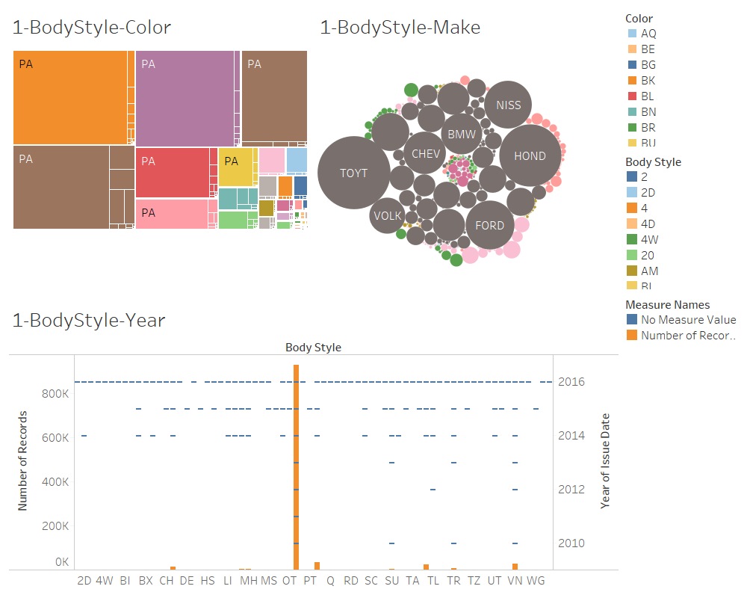
Dashboards

Slide 10
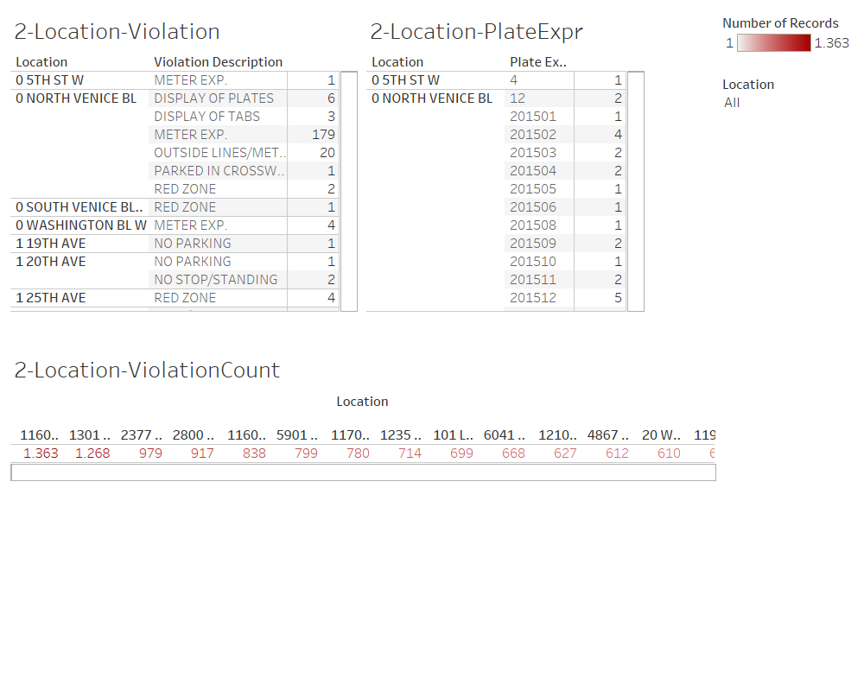

Slide 11
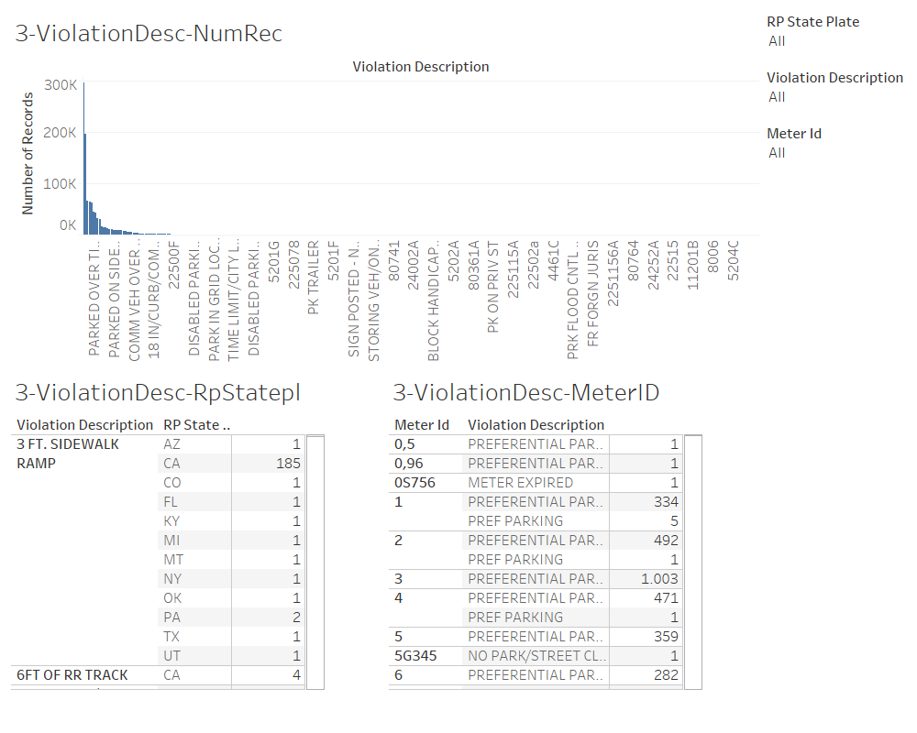

Slide 12
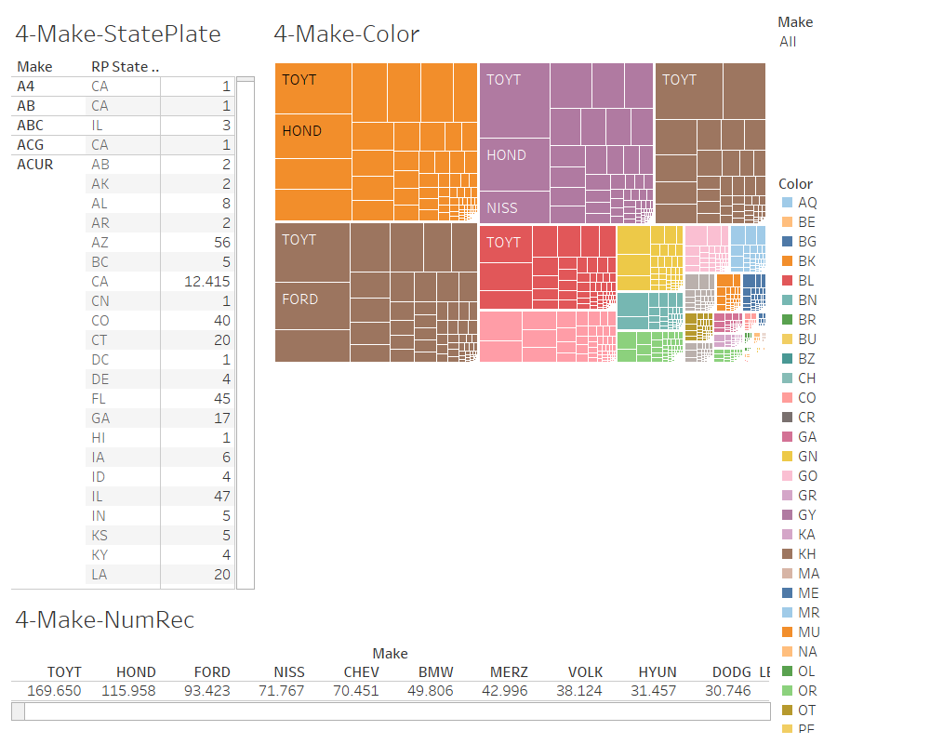

Slide 13
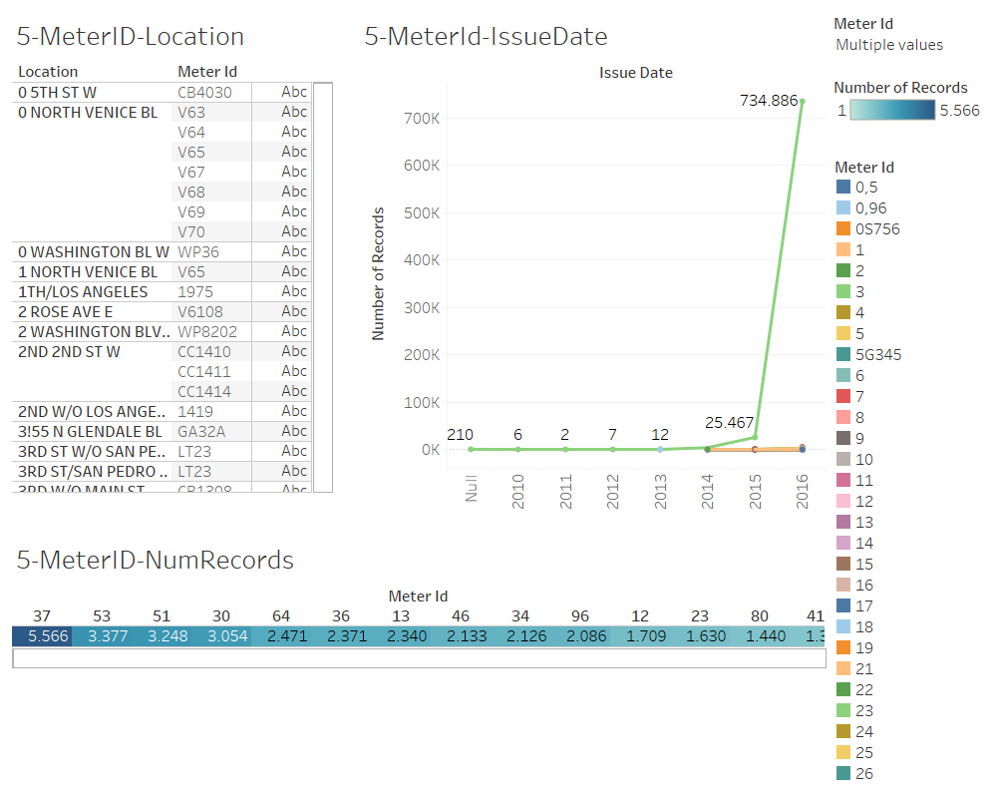

Slide 14
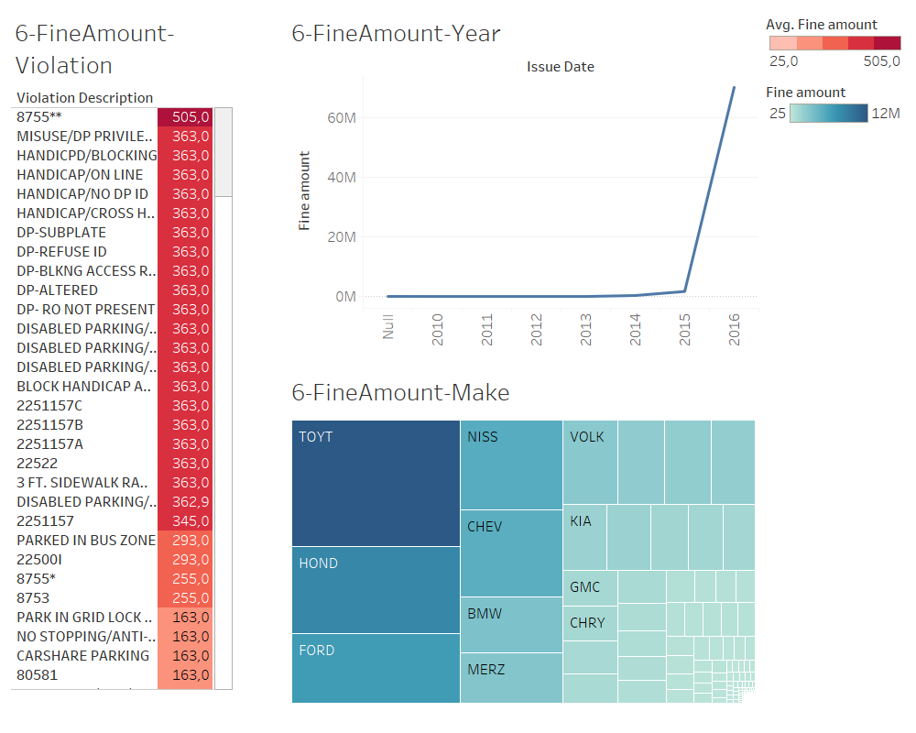

Slide 15
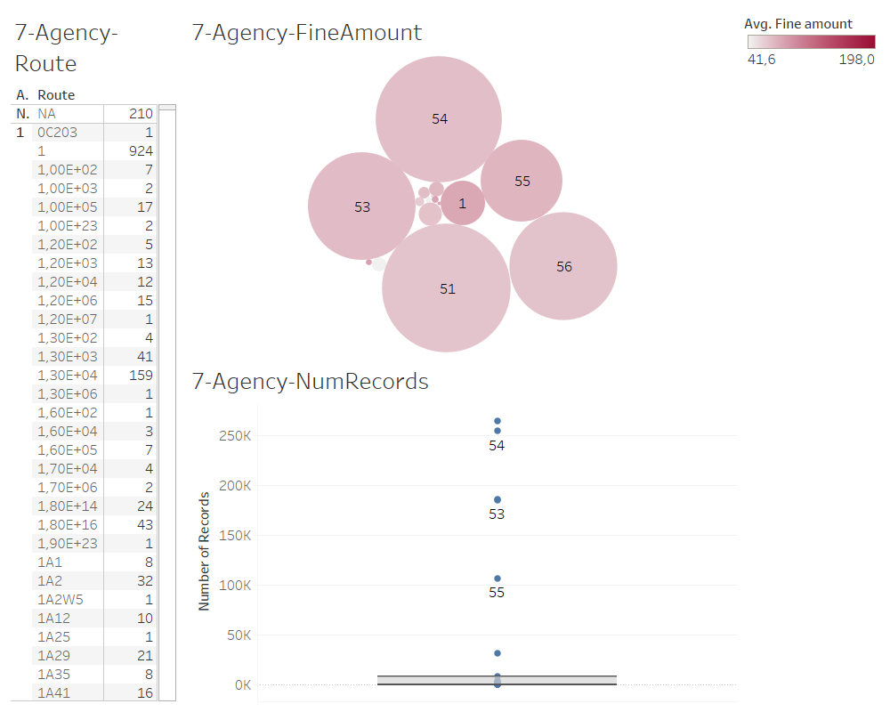

Slide 16
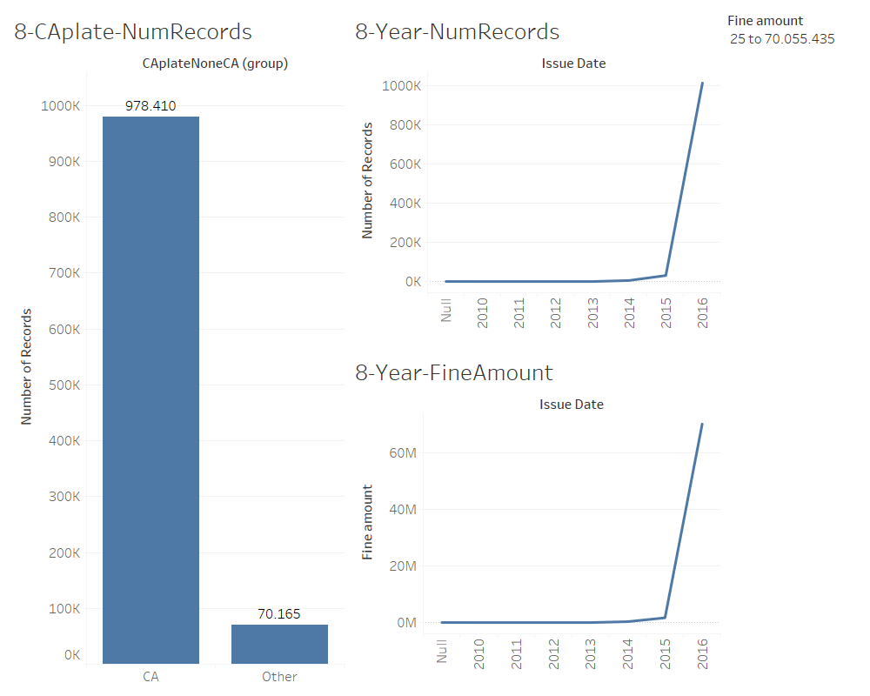

Slide 17
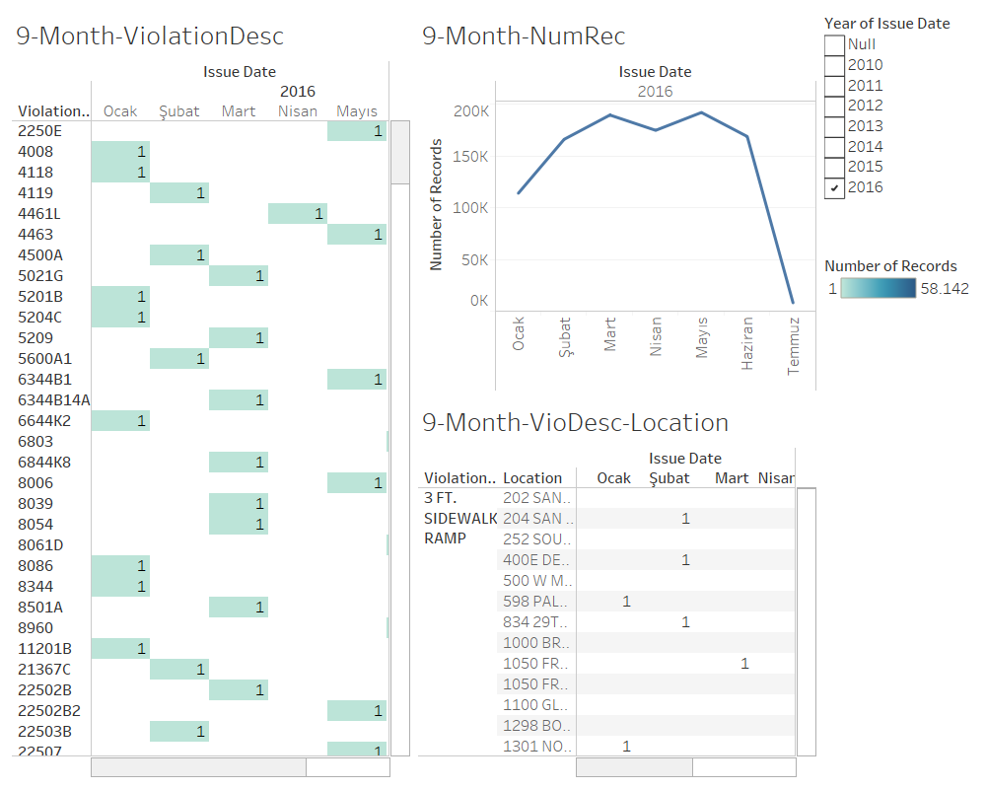

Slide 18
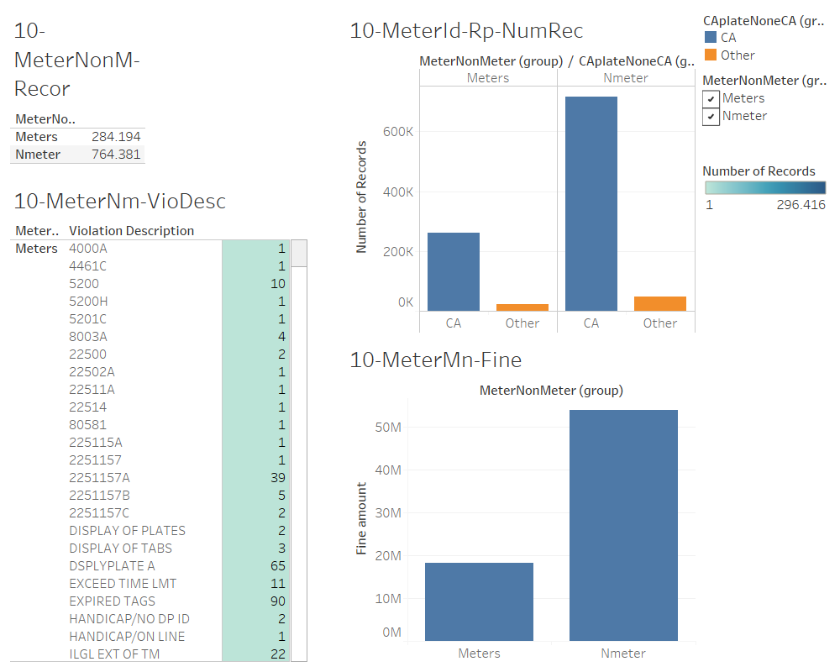

Slide 19
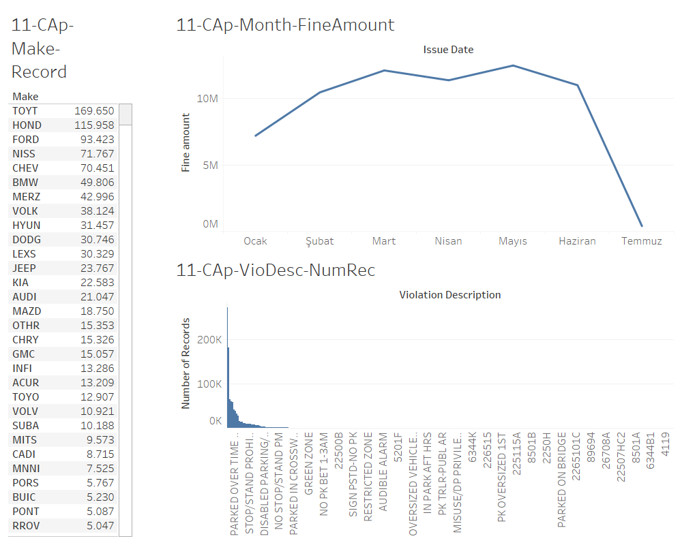

Slide 20
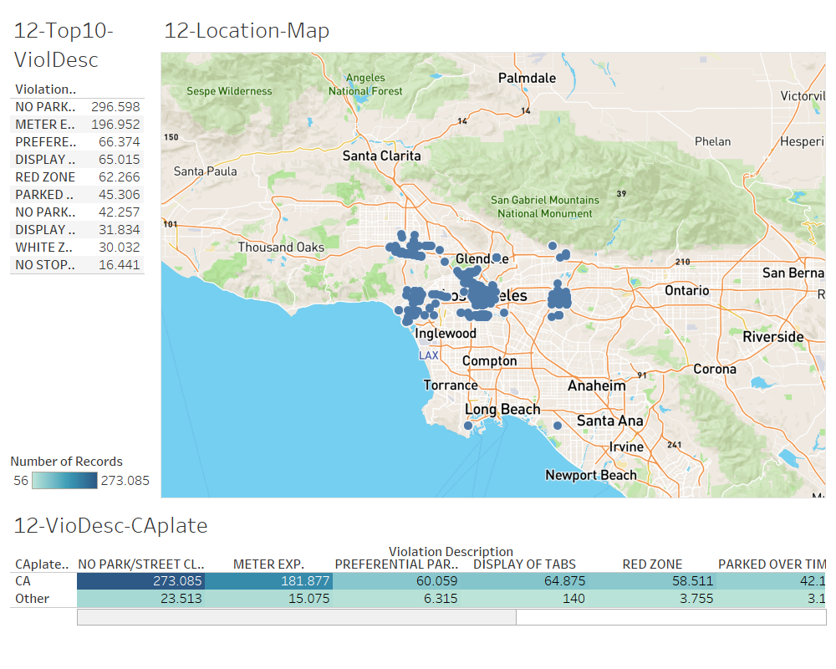

Slide 21
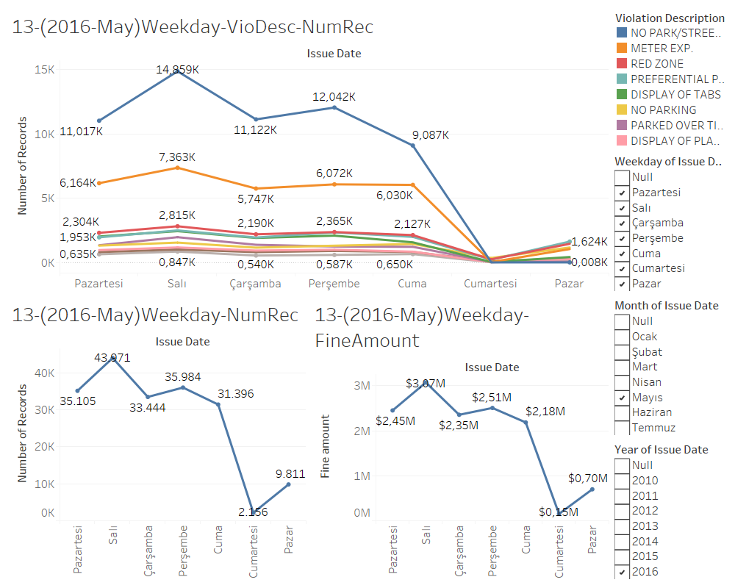

Slide 22
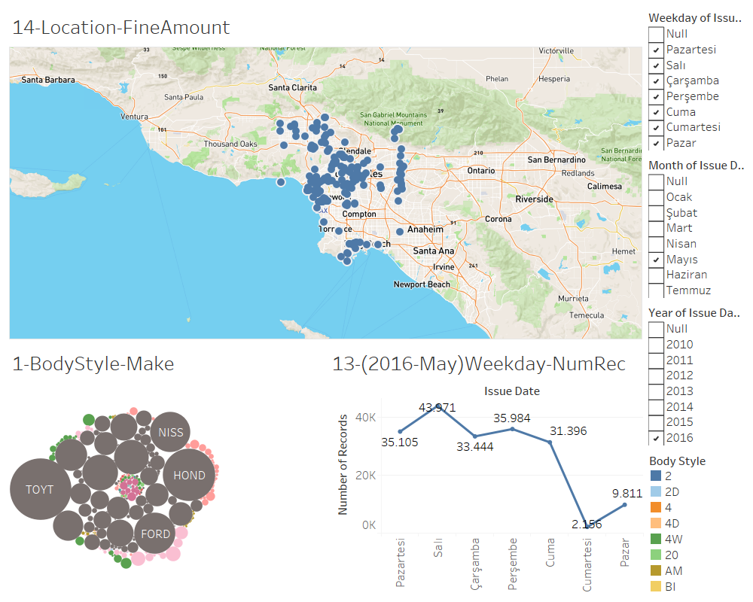

Slide 23
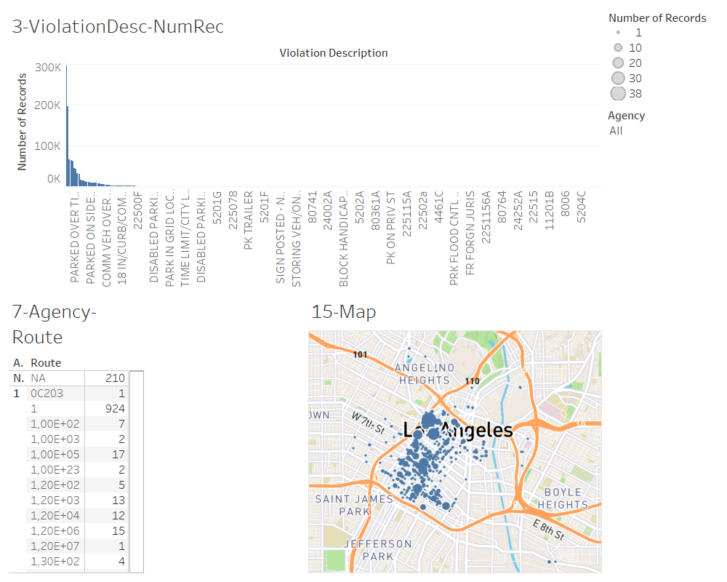

Slide 24
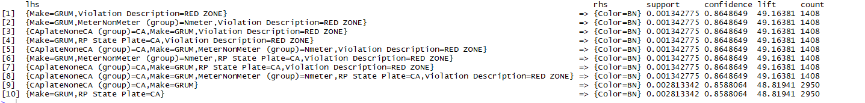
Apriori Algorithm
To see the relations between attributes more clearly we have used apriori algorithm
The attributes that have releation
Make, violation description,CA plate,Color

Slide 25
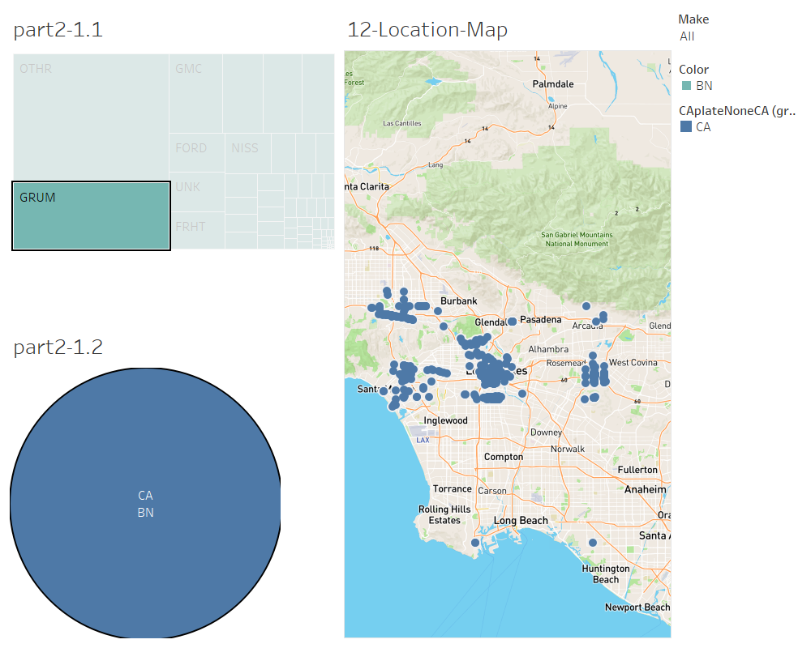

Slide 26
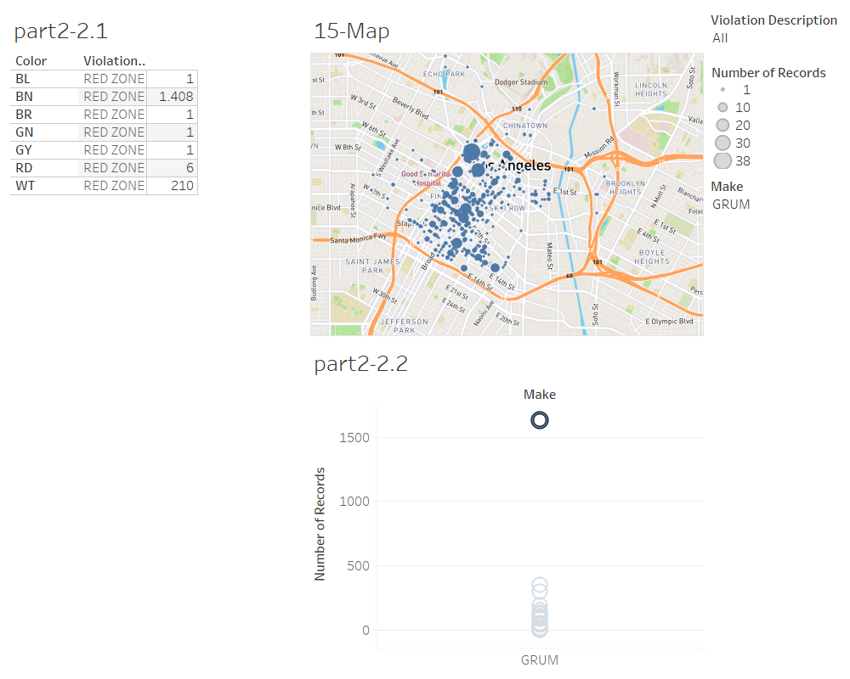

Slide 27
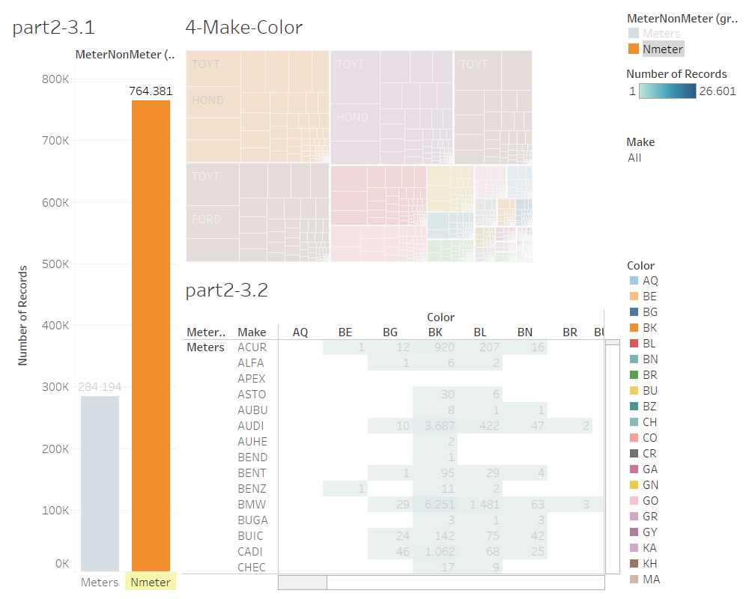

Slide 28
Thank You

