Slide 1
SOFTWARE ENGINEERING
Week 4
Software Project Management

Slide 2
Agenda
Project Management Concepts
Project Planning
Estimation
Process Metrics
Quality Management

Slide 3

Project Management Concepts
Project Management Concepts
Estimation
Planning
Management

Slide 4
Software Project Management
Concerned with activities involved in ensuring that software is delivered on time and on schedule and in accordance with the requirements of the organisations developing and procuring the software.
Project management is needed because software development is always subject to budget and schedule constraints that are set by the organisation developing the software.
Success Criteria
Deliver the software to the customer at the agreed time.
Keep overall costs within budget.
Deliver software that meets the customer’s expectations.
Maintain a happy and well-functioning development team.

Slide 5
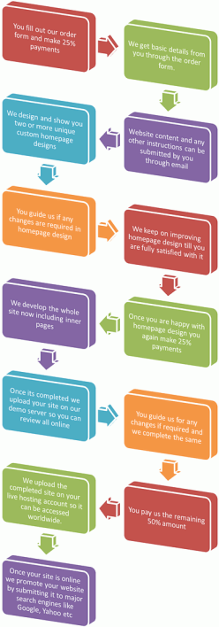


4P’s
People the most important element of a successful project
2. Product the software to be built
3. Process the set of framework activities and software engineering tasks to get the job done
4. Project all work required to make the product a reality

Slide 6
Software Project Management
What to Estimate?
Effort
Time
What to Plan?
People
Tasks
Time
How to manage?
Risk
Quality - What to Measure?
Process Metrics
OO Metrics
Deliveries

Slide 7

Estimation
Project Management Concepts
Estimation
Planning
Management

Slide 8
Estimation
Organizations need to make software effort and cost estimates.
Estimation of resources, cost, and schedule for a software engineering effort requires
experience
access to good historical information (metrics
the courage to commit to quantitative predictions when qualitative information is all that exists
Estimation carries inherent risk and this risk leads to uncertainty.
There is no simple way to make an accurate estimate of the effort required to develop a software system.
Initial estimates are usually based on inadequate information about user requirements.

Slide 9
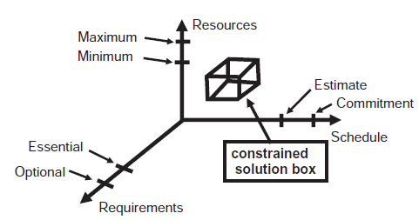
Estimation
In theory anything is negotiable, in practice
Time: Usually customer has a strict deadline
Cost: The budget of the project is almost fixed due to competition
Quality: There is a certain amount of quality induced according to the type of the project.
Man-month= Man-month is a hypothetical unit of work representing the work done by one person in one month
Brooks's law: Adding manpower to a late software project makes it later.

Slide 10
Estimation
Coding
40-50%
Testing
30-40%
Analysis and Design
15-20%
WRONG!!

Slide 11
Estimation
Analysis and Design
40-50%
Testing
Coding
30-40%
15-20%

Slide 12
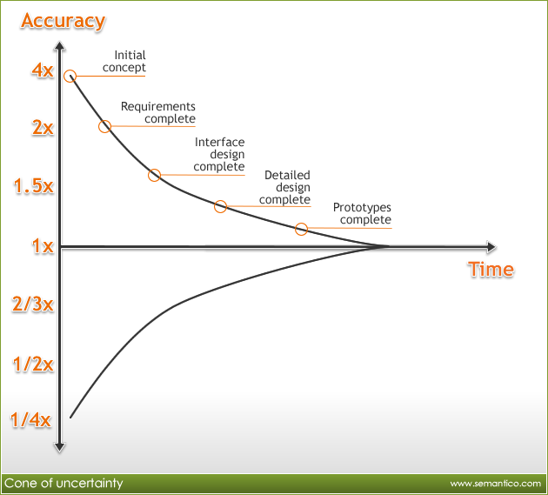
Estimation

Slide 13
Estimation Techniques
Estimation by analogy The cost of a new project is estimated by analogy with similar completed projects.
Expert judgement Several experts on the proposed software application domain are consulted. They each estimate the project cost. The estimation process iterates until an agreed estimate is reached.
Algorithmic cost modelling A model based on historical cost information that relates some software metric (usually its size) to the project cost is used. COCOMO is an example of algorithmic cost modelling.
Parkinson's Law Parkinson’s Law states that work expands to fill the time available. The cost is determined by available resources rather than by objective assessment.
Pricing to win The estimated effort depends on the customer’s budget and not on the software functionality.

Slide 14
Algorithmic Cost Modelling
Cost (i.e. Effort) is estimated as a mathematical function of product, project and process attributes whose values are estimated by project managers:
Effort = A * (Size)^{E} * EAF
where
A is an organisation-dependent constant,
E reflects the disproportionate effort for large projects,
EAF (Effort Adjustment Factor) is a multiplier reflecting product, process and people attributes.
The most commonly used product attribute for cost estimation is code size.
Most models are similar but they use different values for A, E and EAF.

Slide 15
Function Points
Function Point is a measurement estimation method for a software from the functionality perspective.
Functionality as viewed from the user’s perspective.
This estimation method is based on a empirical model which is mainly independent of programming language.
Function Points can be used for several purposes:
Estimating the FP of a new planned software.
Assessing the retail value of an existing software.
Developed by Allan J. Albrecht, and standardized by the “International Function Point User Group”. (www.ifpug.org)

Slide 16
FP – Project Types
Project Type | FP Purpose
Development Project | Measures the functions that will be provided to the users in a new application.
Enhancement Project | Measures the modifications to an existing application.
Application Assesment | Measures the functionality provided to users in an existing application.

Slide 17
FP – Counting Steps
Count Data Functions and Transactional Functions
Calculate Unadjusted Function Point
Calculate Value Adjustment Factor (VAF)
Calculate Adjusted Function Point

Slide 18
FP - Equations
Adjusted FP = (Unadjusted FP) * VAF
VAF: Value Adjustment Factor
GSC: General System Characteristic factors

Slide 19
FP - Value Adjustment Factor (VAF)
VAF consists of 14 General System Characteristics (GSC) such as data communications, response times, end user efficiency, multiple sites, flexibility,etc.
Each GSC can be an integer value between 0 and 5.
Min VAF = (14*0)*0.01 + 0.65 = 0.65
Max VAF = (14*5)*0.01 + 0.65 = 1.35
The overall effect of VAF can vary in range from 0.65 (when all GSCs are low) to 1.35 (when all GSCs are high), so its overall adjustment effect could be ± 35 %.
We will study the GSCs and VAF later.

Slide 20
FP – Calculating Unadjusted Function Points
Type of Component | Complexity of Components
 | Low | Average | High | Total
EI | x 3 | x 4 | x 6 | =
EO | x 4 | x 5 | x 7 | =
EQ | x 3 | x 4 | x 6 | =
ILF | x 7 | x10 | x15 | =
EIF | x 5 | x 7 | x10 | =
Unadjusted Function Points |  |  |  | =

Slide 21
FP – Standard Functions
In counting FPs there are five standard “functions'' that you count.
Data Functions:
Internal Logical Files (ILF)
External Interface Files (EIF)
Transactional Functions:
External Inputs (EI)
External Outputs (EO)
External Inquiries (EQ)

Slide 22
FP – Data Functions
ILF:
Files controlled by the program.
Each data file (or database table) is counted.
Examples
ILF refers to logical group of data files maintained by the application such as Employee file.
Note the inside application data is updated and not any external data.
EIF:
Files controlled by other programs.
All machine readable interfaces (import/export data file) that are used to transmit information to another system are counted.
Examples
EIF refers to logical group of data referenced but not maintained internally such as an Currency file.

Slide 23
FP - Transactional Functions
EI:
Each user input (screens, forms, dialog boxes, controls etc.) that provides distinct data to the software is counted.
Individual data items within a data-entry screen are not counted separately.
Inputs should be distinguished from inquiries, which are counted separately.
EO:
Each user output that provides information to the user is counted.
In this context, output refers to reports, screens, graphs, error messages, etc.
Individual data items within a report are not counted separately.
EQ:
An inquiry is defined as an on-line input that results in the generation of some immediate software response in the form of an on-line output.
Each distinct inquiry is counted.

Slide 24
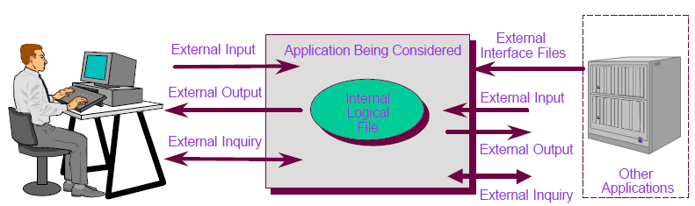
FP – System Example 1

Slide 25
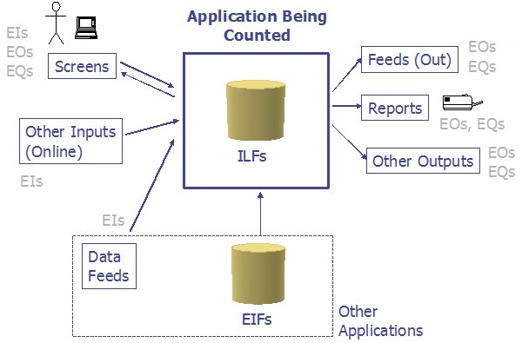
FP – System Example 2

Slide 26
FP – Logical File (ILF) example
ILF refers to logical group of data files maintained by the application such as Employee file.
Note the inside application data is updated and not any external data.

Slide 27
FP – External Interface File (EIF) example
EIF refers to logical group of data referenced but not maintained internally such as an Currency file.

Slide 28
FP – External Input (EI) examples
The basic EI is from user screens (for data entry / editing ).
Users should have interface through which they can maintain the data files in ILF through Add, Delete, Update menu selections (transactional functions).
Passing control data such as menu selections into the application is considered as EI.

Slide 29
FP – External Output (EO) examples
EO usually refers to reports which contain derived data from the internal files (ILF) such as calculated totals.
Formatted data sent out of application with added value.
For example, list of students and the calculated grade average in a class.
EO can also refer to screens which contain the followings:
Displaying derived data from the internal files (ILF).
Prefilling a listbox with hardcoded data in the program.
Outputs sent to external systems are EO.
For example, your application generates CSV (comma separated values) files.
These files are then used by some external application to update the external application tables (EIF).

Slide 30
FP – External Query (EQ) examples
EQ functions will be mainly reports which do not contain derived data.
Formatted data sent out of application without added value. (For example, only the list of students in a class)
Reports may have input criteria, so that can be another EQ.
Also search screens are EQ.
Prefilling a listbox from ILF is considered as EQ, because this is an implied inquiry.
Note EQ functions don’t update any ILF or EIF. They only fetch data for display.

Slide 31
FP Example : “Customer” Application
In this simple example, we will evaluate a Customer GUI (Graphical User Interface) application.
The database has only one table, which contains customer information.
The GUI program will allow the user add, delete, and update the records.

Slide 32
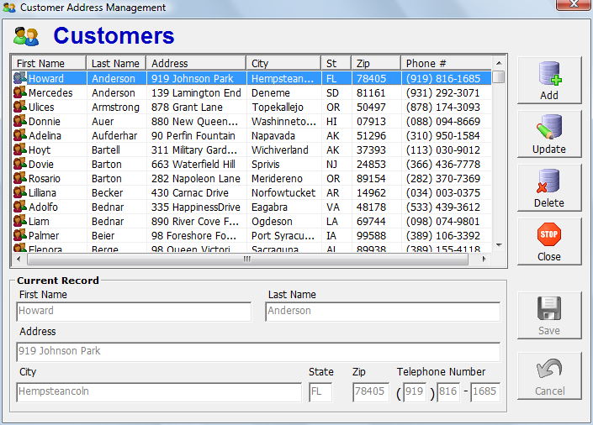
FP Example :“Customer” Screen

Slide 33
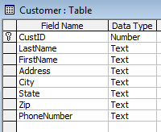
FP Example : Counting the Functions (1)
There is 1 Internal Logical File
Customer table

Slide 34
FP Example : Counting the Functions (2)
There are 3 External Inputs
“Customer selection” area in the screen for selecting a customer
“Current record” area in the screen for entering / editing customer data
All transaction buttons (ADD, UPDATE, DELETE, etc.)

Slide 35
FP Example : Counting the Functions (3)
There are 2 External Outputs
The output listbox of all customer names and addresses (always read only)
“Current record” area in the screen for displaying currently selected customer data (read only in display mode)
There is 1 External Query
The confirmation dialog boxes for “Delete” and “Save” buttons

Slide 36
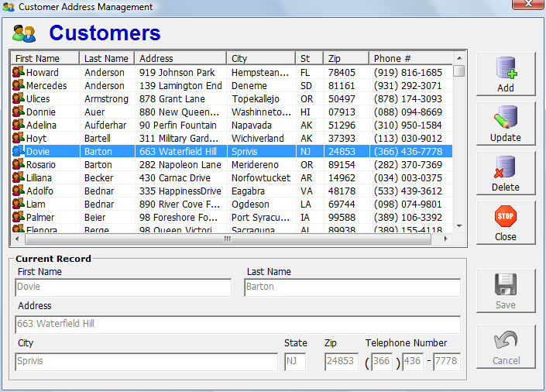
FP Example : EI
1.External Input

Slide 37
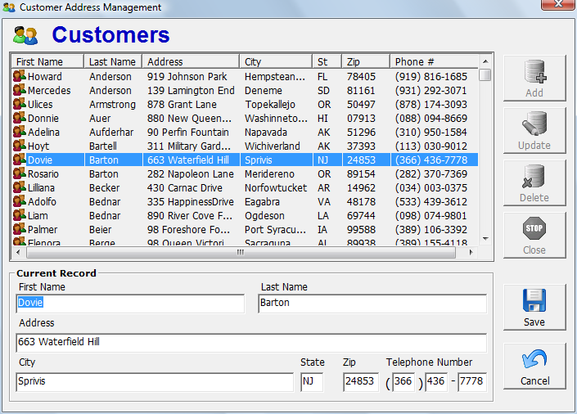
FP Example : EI
2.External Input

Slide 38
FP Example : EI
3.External Input

Slide 39
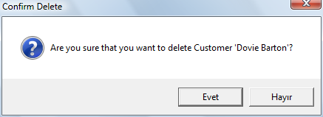
FP Example : EQ
External Query

Slide 40
FP Example : EO
1.External Output

Slide 41
FP Example : EO
2.External Output

Slide 42
Unadjusted Function Points
Type of Component | Complexity of Components
 | Low | Average | High | Total
EI |  | x4 |  | =
EO | x4 |  |  | =
EQ | x3 |  |  | =
ILF | x7 |  |  | =
Unadjusted Function Points |  |  |  | =
3
12
2
8
1
3
1
7
30

Slide 43
FP - General System Characteristics (GSC)
This is a very important part in Function Points.
GSC factors can affect the software a lot and also the cost of it.
GSC gives us something called as VAF (Value Added Factor).
There are 14 GSC points considered to come out with VAF.
Each GSC can have a rating between 0 and 5.

Slide 44
FP - General System Characteristics
Data Communication
Distributed data processing
Performance
Heavily used configuration
Transaction rate
Online data entry
End user efficiency
Online update
Complex processing
Reusability
Installation ease
Operational ease
Multiple sites
Facilitate change
Description | Rating
No influence | 0
Incidental | 1
Moderate | 2
Average | 3
Significant | 4
Essential | 5

Slide 45
FP - GSC Definitions (1)
Data communications: How many communication facilities are there to aid in the transfer or exchange of information with the application or system?
Distributed data processing: How are distributed data and processing functions handled?
Performance: Did the user require response time or throughput?
Heavily used configuration: How heavily used is the current hardware platform where the application will be executed?
Transaction rate: How frequently are transactions executed; daily, weekly, monthly, etc.?
On-Line data entry: What percentage of the information is entered On-Line?
End-user efficiency: Was the application designed for end-user efficiency?

Slide 46
FP - GSC Definitions (2)
On-Line update: How many ILFs are updated by On-Line transaction?
Complex processing: Does the application have extensive logical or mathematical processing?
Reusability: Was the application developed to meet one or many user’s needs?
Installation ease: How difficult is conversion and installation?
Operational ease: How effective and/or automated are start-up, back up, and recovery procedures?
Multiple sites: Was the application specifically designed, developed, and supported to be installed at multiple sites for multiple organizations?
Facilitate change: Was the application specifically designed, developed, and supported to facilitate change?

Slide 47
FP - GSCs for “Customer” Example
GSC | Value (0-5)
1. Data communications | 0
2. Distributed data processing | 0
3. Performance | 3
4. Heavily used configuration | 3
5. Transaction rate | 4
6. On-Line data entry | 5
7. End-user efficiency | 4
8. On-Line update | 1
9. Complex processing | 0
10. Reusability | 0
11. Installation ease | 0
12. Operational ease | 2
13. Multiple sites | 0
14. Facilitate change | 0
Total = | 22

Slide 48
FP - Adjusted FP for “Customer” Example
VAF = 0.65 + (Sum of all GSC factors) * 0.01) = 0.65 + (22 * 0.01) = 0.87
Adjusted FP = VAF * (Total Unadjusted FP) = 0.87 * 30 ≈ 26

Slide 49
FP - Approximate Estimation of Size and Effort
Assume the program will be implemented in Visual Basic, which has a standard rate of 50 LOC/FP.
The project will be approximately 50 * 26 ≈ 1300 lines of code.
Assume a programmer works for 5 FP per day.
The project will take approximately 26 / 5 ≈ 5 days.

Slide 50
FP - Actual Lines of Code in Visual Basic
Module Name | Total Lines | Effective Coded Lines
frmCustMaint.frm | 989 | 400
modGeneral.bas | 65 | 60
modValidate.bas | 246 | 240
TOTALS = | 1300 | 700

Slide 51
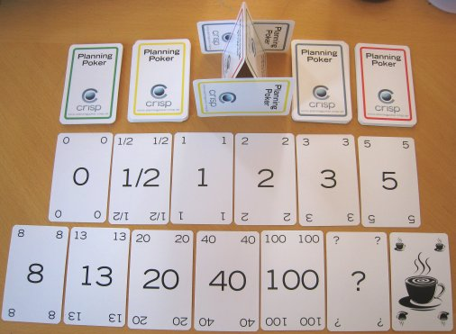
Estimation for Agile Projects
Each user scenario (a mini-use-case) is considered separately for estimation purposes.
The scenario is decomposed into the set of software engineering tasks that will be required to develop it.
Each task is estimated separately. Note: estimation can be based on historical data, an empirical model, or “experience.”
Alternatively, the ‘volume’ of the scenario can be estimated in LOC, FP or some other volume-oriented measure (e.g., use-case count).
Estimates for each task are summed to create an estimate for the scenario.
Alternatively, the volume estimate for the scenario is translated into effort using historical data.
The effort estimates for all scenarios that are to be implemented for a given software increment are summed to develop the effort estimate for the increment.

