Slide 1

SOFTWARE ENGINEERING
Week 4
Software Project Management

Slide 2
Agenda
Project Management Concepts
Project Planning
Estimation
Process Metrics
Quality Management

Slide 3

Planning
Project Management Concepts
Estimation
Planning
Management

Slide 4
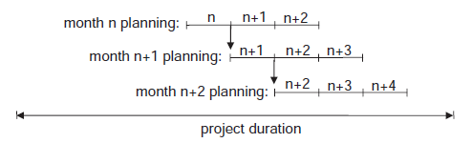
Project Planning
Planning techniques, includes the following activities
Identify and organize resources (e.g. team, hardware) required for the project
Develop a work breakdown structure (WBS) and identify packages for the tasks in the work breakdown structure(WBS)
Define a schedule of objectively measurable milestones organized as a GANTT chart
Prepare a schedule network and identify the critical path(s)
Planning activities should be continuously held during the project as a rolling wave

Slide 5
Team Planning
3. Planning
3.1. Team Planning
3.2. Task Planning
3.3. Time Planning

Slide 6
Software Teams
The following factors must be considered when selecting a software project team structure
the difficulty of the problem to be solved
the size of the resultant program(s) in lines of code or function points
the time that the team will stay together (team lifetime)
the degree to which the problem can be modularized
the required quality and reliability of the system to be built
the rigidity of the delivery date
the degree of sociability (communication) required for the project

Slide 7
Team Organizations
There exist two main types of organizational structures:
Hierarchical organization: All the people associated with a project are grouped into functional departments that report directly within the vertical line of command.
Matrix organization: People are grouped based on the functions they perform.
Also based on the location of the project personnel, teams may be:
Centralized
Distributed
Globally distributed
Mixed
Small software engineering groups are usually organised informally without a rigid structure.
For large projects, there may be a hierarchical structure where different groups are responsible for different sub-projects.

Slide 8
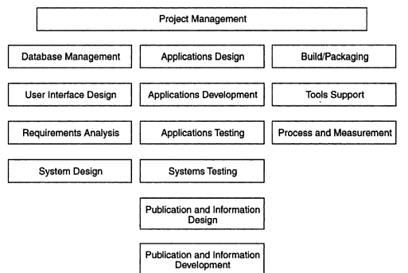
Team Organizations

Slide 9
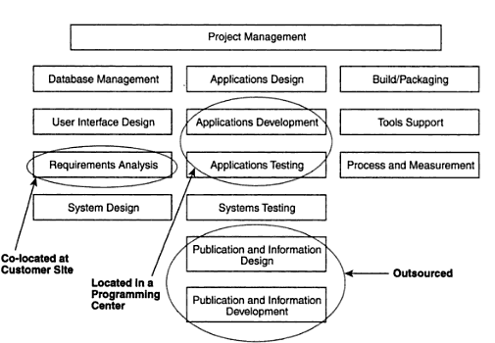
An Example Team Organization

Slide 10
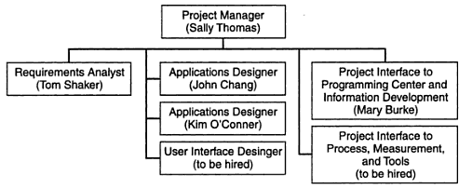
An Example Team Organization

Slide 11
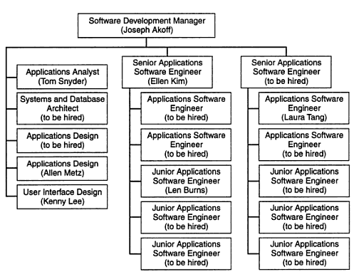
Team Organizations

Slide 12
Agile Teams
Agile teams have the following characteristics
Co-location
Engaged Customers
Self-Organizing
Accountable and Empowered
Cross-Functional
Tips for Forming Your Agile Team
Look for Generalists
People Who Are Comfortable with Ambiguity
Team Players Who Can Check Their Egos at the Door

Slide 13
Task Planning
3. Planning
3.1. Team Planning
3.2. Task Planning
3.3. Time Planning

Slide 14
Task Planning
In order to work your way down in decomposition towards atomic tasks, you need to come up with an architectural decomposition.
Architectural design of software is concerned with specifying the software modules, their interrelationships, and their connections to the environment of the software.
We will examine Software Architectures in detail later. But let’s work on a trivial ATM software example to illustrate how we obtain WBS.

Slide 15
Task Planning
Some prioritized requirements for ATM software
Essential requirements
E1 Financial transactions shall be authorized by an ATM card and a password
E2 Financial transactions shall be terminated if a customer fails to enter the correct password « settable » times
E3 Financial transaction shall allow quick cash withdrawals
E4 Financial transaction shall provide a printed receipt for each transaction
E5 The ATM shall retain the information listed in the requirements specification, for each customer transaction
E6 Financial transaction shall process Terminate requests from customers

Slide 16
Task Planning
Some prioritized requirements for ATM software
Desirable requirements
D1 Financial transaction should accommodate balance inquiry transactions
D2 Financial transaction should accommodate standard withdrawal transactions
D3 Financial transaction should accommodate deposit transactions
D4 Customers should be allowed to conduct multiple transactions per session
Optional requirements
O1 Financial transaction could support debit card transactions
O2 Financial transaction could support payment of utility bills
O3 Financial transaction could allow customers to purchase postage stamps which will be disbursed by the ATM hardware

Slide 17
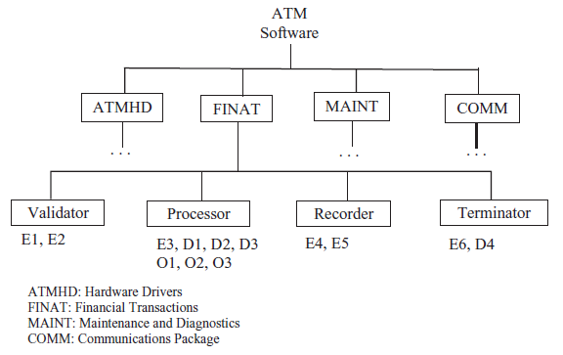
Task Planning

Slide 18
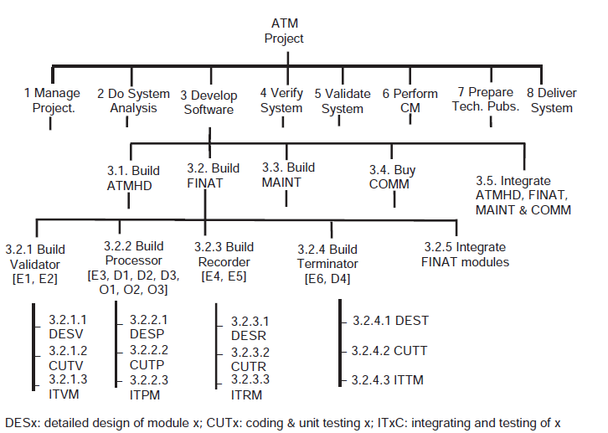
Task Planning - WBS

Slide 19
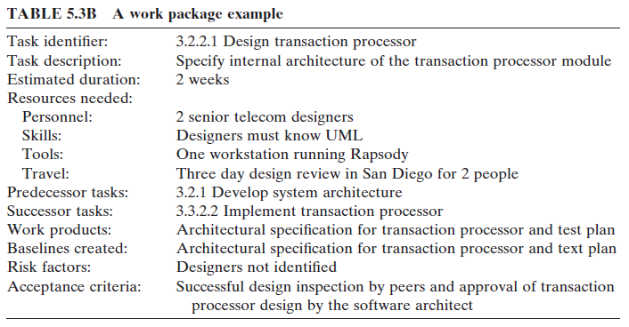
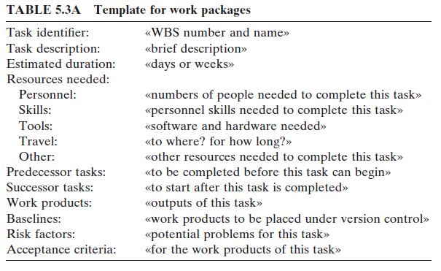
Task Planning – Task Extraction
Following WBS construction, tasks should be extracted to build a time plan and assign to resources(team). Tasks can also be assigned story points and can be used in estimation and tracking for agility.

Slide 20
Time Planning
3. Planning
3.1. Team Planning
3.2. Task Planning
3.3. Time Planning

Slide 21
Effort and Delivery Time
Putnam–Norden–Rayleigh (PNR) Curve

Slide 22
For Scheduling
PERT Chart:
Shows the relationships based on tasks or activities
Defines tasks that can be done concurrently or not and critical path
Gantt Chart:
Shows schedule (timeline) information for each task as a bar chart

Slide 23
PERT Chart
Project Evaluation and Review Technique
Also known as Task Network Diagram
Nodes: activities / tasks and estimated duration
Edges: dependencies
Critical path: Longest path from start to finish. Any slippage on the critical path will cause project delay.

Slide 24
PERT Example : Tasks and Durations
TASKS | WEEKS
1.2 Software Development | 11
1.2.1 Requirements Analysis | 3
1.2.2 Architectural Design | 2
1.2.3 Procedural Design | 2.5
1.2.4 Code | 3.5
1.3 Testing | 7
1.3.1 Unit Test | 3
1.3.2 Integration Test | 4
1.3.3 Acceptance Test | 1
1.4 Operations | 5
1.4.1 Packaging | 1
1.4.2 Customer Training | 5

Slide 25
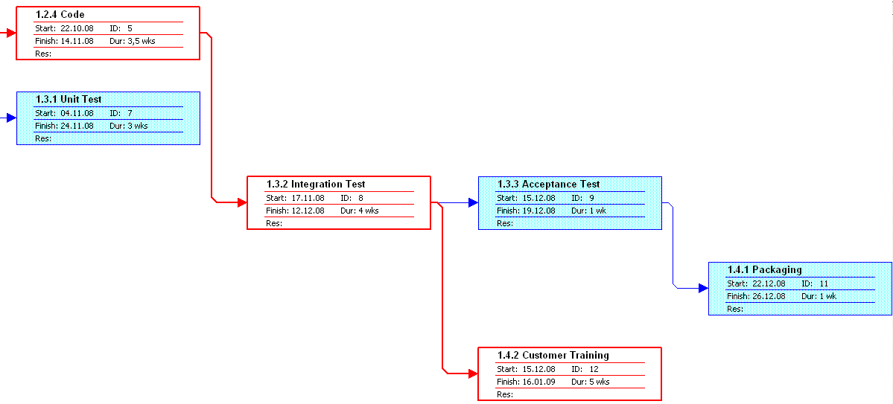
PERT Chart

Slide 26
GANTT Chart
Also known as timeline chart
Shows high level view of whole project
Horizontal bars show duration of tasks
Triangles show milestones
Vertical lines show dependencies

Slide 27
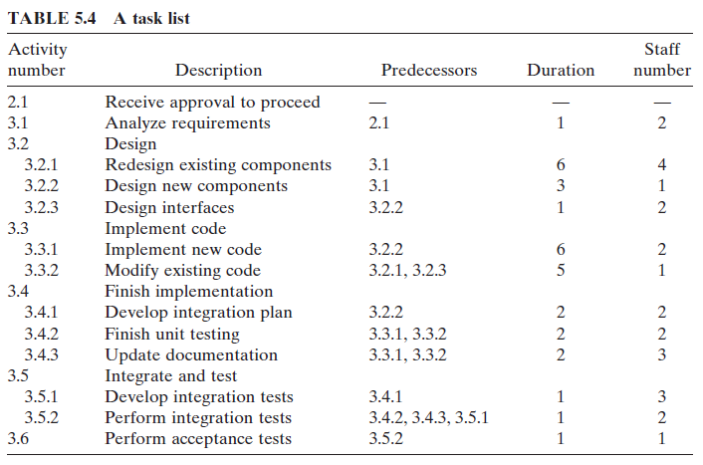
An example
Let’s assume we identify the following tasks

Slide 28
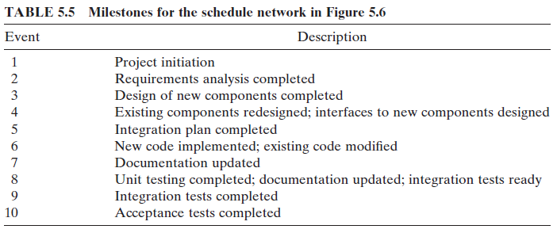
An example
Following milestones can be extracted

Slide 29
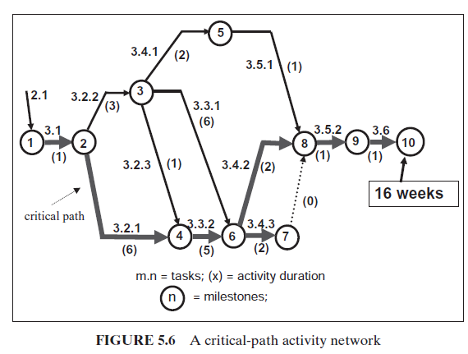
An example
Sometimes a task network is constructed to identify critical paths.

Slide 30
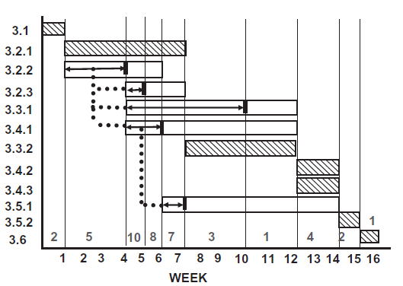
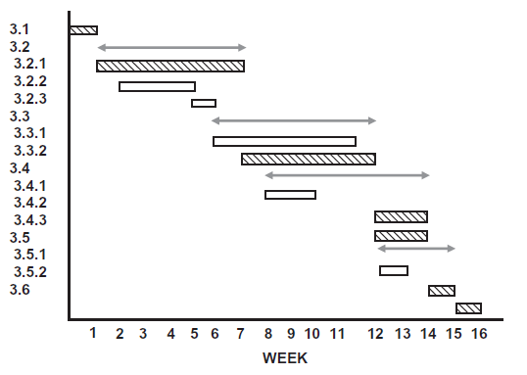
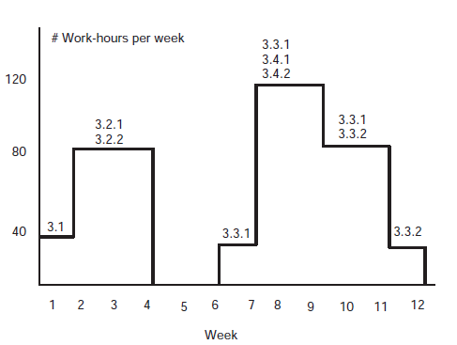
An example
A final remark is to identify dependencies and pay attention to workloads

Slide 31
Project Plans
In a plan-driven development project, a project plan sets out the resources available to the project, the work breakdown and a schedule for carrying out the work.
Plan sections
Introduction
Project organization
Risk analysis
Hardware and software resource requirements
Work breakdown
Project schedule
Monitoring and reporting mechanisms

Slide 32
A Typical Software Project Plan Document
1. Introduction
A. Purpose of Plan
B. Project Scope and Objectives
2. Project Estimates
A. Historical Data Used for Estimates
B. Estimation Techniques
C. Estimates of Effort, Cost, Duration
3. Risks Management Strategy
A. Risk Table
B. Discussion of Risks to be Managed
C. RMMM Plan
4. Schedule
A. Project Work Breakdown Structure
B. Task Network
C. Timeline Chart
D. Resource Table
5. Project Resources
A. People
B. Hardware and Software
C. Special Resources
6. Staff Organization
A. Team Structure
B. Management Reporting
7. Tracking and Control Mechanisms
A. Quality Assurance and Control
B. Change Management and Control
8. Appendices

Slide 33

Risk Management
4. Management
4.1. Risk Management
4.2. Quality Management
4.3. Change Management

Slide 34
Risk Estimation
Risk projection, also called risk estimation, attempts to rate each risk in two ways
the likelihood or probability that the risk is real
the consequences of the problems associated with the risk, should it occur.
The are four risk projection steps:
establish a scale that reflects the perceived likelihood of a risk
delineate the consequences of the risk
estimate the impact of the risk on the project and the product,
note the overall accuracy of the risk projection so that there will be no misunderstandings.

Slide 35
Risk Table
Risks | Category | Probability % | Impact | Remedy Plan
Size estimate may be significantly low | PS | 60 | 2
Larger number of users than planned | PS | 30 | 3
Less reuse than planned | PS | 70 | 2
End users resist system | BU | 40 | 3
Delivery deadline will be tightened | BU | 50 | 2
Funding will be lost | CU | 40 | 1
Customer will change requirements | PS | 80 | 2
Technology will not meet expectations | TE | 30 | 1
Lack of training on tools | TE | 60 | 3
Staff inexperienced | ST | 30 | 2
Staff turnover will be high | ST | 60 | 2
. . . . . . .
Sort the table by probability and impact
Cut-off low probability risks

Slide 36
Examples of Different Risk Types
Risk type | Possible risks
Technology | The database used in the system cannot process as many transactions per second as expected. (1) Reusable software components contain defects that mean they cannot be reused as planned. (2)
People | It is impossible to recruit staff with the skills required. (3) Key staff are ill and unavailable at critical times. (4) Required training for staff is not available. (5)
Organizational | The organization is restructured so that different management are responsible for the project. (6) Organizational financial problems force reductions in the project budget. (7)
Tools | The code generated by software code generation tools is inefficient. (8) Software tools cannot work together in an integrated way. (9)
Requirements | Changes to requirements that require major design rework are proposed. (10) Customers fail to understand the impact of requirements changes. (11)
Estimation | The time required to develop the software is underestimated. (12) The rate of defect repair is underestimated. (13) The size of the software is underestimated. (14)

Slide 37
Risk Impact
The overall risk exposure, RE, is determined using the following relationship
RE = P x C
where
P is the probability of occurrence for a risk
C is the cost to the project should the risk occur

Slide 38
Risk Impact Example
Risk identification. Only 70 percent of the software components scheduled for reuse will, in fact, be integrated into the application. The remaining functionality will have to be custom developed.
Risk probability. 80% (likely).
Risk impact. 60 reusable software components were planned. If only 70 percent can be used, 18 components would have to be developed from scratch (in addition to other custom software that has been scheduled for development). Since the average component is 100 LOC and local data indicate that the software engineering cost for each LOC is $14.00, the overall cost (impact) to develop the components would be 18 x 100 x 14 = $25,200.
Risk exposure. RE = 0.80 x 25,200 ~ $20,200.

Slide 39
Risk Mitigation, Monitoring, Management
Risk Mitigation,Monitoring,Management (RMMM)
Mitigation : how can we avoid the risk?
Monitoring : what factors can we track that will enable us to determine if the risk is becoming more or less likely?
Management :what contingency plans do we have if the risk becomes a reality?

Slide 40
Examples of common risks
Risk | Affects | Description
Staff turnover | Project | Experienced staff will leave the project before it is finished.
Management change | Project | There will be a change of organizational management with different priorities.
Hardware unavailability | Project | Hardware that is essential for the project will not be delivered on schedule.
Requirements change | Project and product | There will be a larger number of changes to the requirements than anticipated.
Specification delays | Project and product | Specifications of essential interfaces are not available on schedule.
Size underestimate | Project and product | The size of the system has been underestimated.
CASE tool underperformance | Product | CASE tools, which support the project, do not perform as anticipated.
Technology change | Business | The underlying technology on which the system is built is superseded by new technology.
Product competition | Business | A competitive product is marketed before the system is completed.

Slide 41
Quality Management and Metrics
4. Management
4.1. Risk Management
4.2. Quality Management
4.3. Change Management

Slide 42
Why Do We Measure?
process
process metrics
project metrics
measurement
product metrics
product
What do we
use as a
basis?
• size?
• function?

Slide 43
Why Do We Measure?
assess the status of an ongoing project
track potential risks
uncover problem areas before they go “critical,”
adjust work flow or tasks,
evaluate the project team’s ability to control quality of software work products.

Slide 44
Software Process Improvement
Process model
SPI
Process improvement
recommendations
Improvement goals
Process metrics

Slide 45
Typical Project Metrics
Effort/time per software engineering task
Errors uncovered per review hour
Scheduled vs. actual milestone dates
Changes (number) and their characteristics
Distribution of effort on software engineering tasks
Examples:
total FP estimation (Function Points)
total LOC estimation (Lines of Code)
FP per person-month
LOC per person-month
errors or defects per KLOC (thousand LOC)
pages of documentation per KLOC

Slide 46
Object-Oriented Metrics
Number of scenario scripts (use-cases)
Number of support classes (required to implement the system but are not immediately related to the problem domain)
Average number of support classes per key class (analysis class)
Number of subsystems (an aggregation of classes that support a function that is visible to the end-user of a system)

Slide 47
Web Project Metrics
Number of static Web pages (the end-user has no control over the content displayed on the page)
Number of dynamic Web pages (end-user actions result in customized content displayed on the page)
Number of internal page links (internal page links are pointers that provide a hyperlink to some other Web page within the WebApp)
Number of persistent data objects
Number of external systems interfaced
Number of static content objects
Number of dynamic content objects
Number of executable functions

Slide 48
Change Management
4. Management
4.1. Risk Management
4.2. Quality Management
4.3. Change Management

Slide 49
What are changes?
Changes in
business requirements
Changes in
technical requirements
Other
documents
Changes in
user requirements
software models
Project
Plan
Data
Test
Code

Slide 50
Terminology
Term | Explanation
Configuration item or software configuration item (SCI) | Anything associated with a software project (design, code, test data, document, etc.) that has been placed under configuration control. There are often different versions of a configuration item. Configuration items have a unique name.
Configuration control | The process of ensuring that versions of systems and components are recorded and maintained so that changes are managed and all versions of components are identified and stored for the lifetime of the system.
Version | An instance of a configuration item that differs, in some way, from other instances of that item. Versions always have a unique identifier, which is often composed of the configuration item name plus a version number.
Baseline | A baseline is a collection of component versions that make up a system. Baselines are controlled, which means that the versions of the components making up the system cannot be changed. This means that it should always be possible to recreate a baseline from its constituent components.
Codeline | A codeline is a set of versions of a software component and other configuration items on which that component depends.

Slide 51
Terminology - II
Term | Explanation
Mainline | A sequence of baselines representing different versions of a system.
Release | A version of a system that has been released to customers (or other users in an organization) for use.
Workspace | A private work area where software can be modified without affecting other developers who may be using or modifying that software.
Branching | The creation of a new codeline from a version in an existing codeline. The new codeline and the existing codeline may then develop independently.
Merging | The creation of a new version of a software component by merging separate versions in different codelines. These codelines may have been created by a previous branch of one of the codelines involved.
System building | The creation of an executable system version by compiling and linking the appropriate versions of the components and libraries making up the system.

Slide 52
Versioning
During maintenance, at all times there are at least two versions of the product:the old version, and the new version
There are two types of versions: revisions and variations
Revisions:
A version to fix a fault in the artifact
We cannot throw away an incorrect version
The new version may be no better
Some sites may not install the new version
Perfective and adaptive maintenance also result in revisions

Slide 53
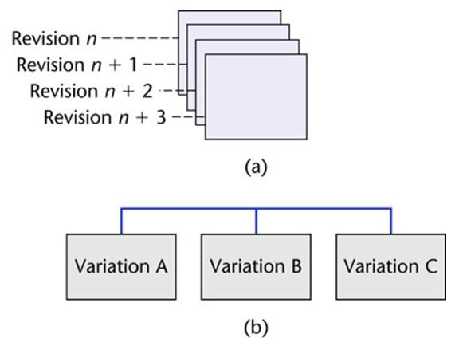
Variations
Variations:
A variation is a version for a different operating system
Variations are designed to coexist in parallel

Slide 54
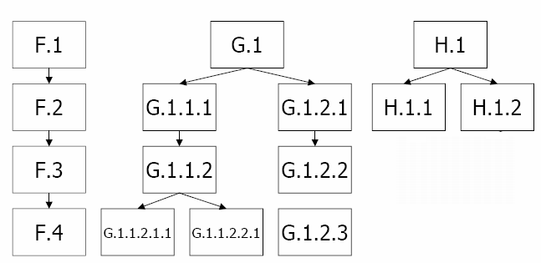
Baseline Versioning

Slide 55
Configuration-Control Tools
Configuration-Control Tools
Gradle
Maven
Build.NET
Versioning Tools
CVS
SVN
GIT
Other commercial tools
TFS (Microsoft)
ClearCase (IBM Rational Software)

Slide 56
Wrap-up
This week we present
Project Estimation: How to forecast about the project before the project goes underway
Project Planning: What kind of activities should be perform to organize the project resources-activities in a plan-driven way
Project Management: How can we measure-monitor-assess various indicators of project progress

Slide 57
Next Week
We will introduce various techniques and contemporary issues in Requirements Engineering!!!

