Slide 1
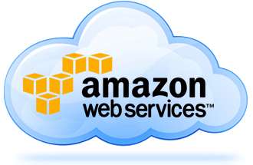
RDBMS – SQL Server
Venkat Gandhi
Requirements:
There are 2 developers have their csv files with different data in their on-premises network. They wanted them to setup the data in MySQL on Linux.
Each of them they need to have the copy of the AMIs to cross share. It means each of them will access to other developers AMIs.
Each developer need to have the VMs of Linux.
Each need to setup an EC2 with MySQL and Import the csv files to MySQL on their Linux EC2.
Each developer will create AMI of their Linux EC2 and should be able to cross share their AMIs to their individual AWS account.
Prerequisite:
Make sure you have in 2 excel files with different data of 2k rows.
Make sure to follow the security policies of your company.
Venkat Gandhi
www.linkedin.com/in/ugvenkat

