Slide 1
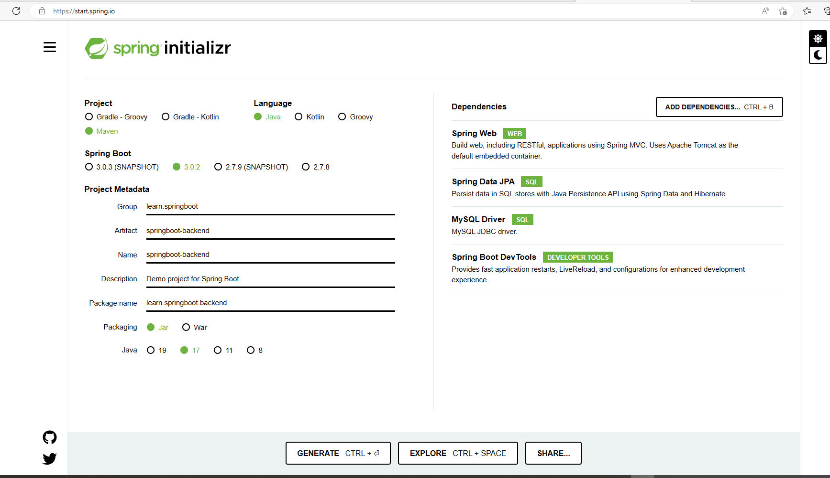

Slide 2
docker run --detach --env MYSQL_ROOT_PASSWORD=rootpassword --env MYSQL_USER=empuser --env MYSQL_PASSWORD=password --env MYSQL_DATABASE=employee_management_system --name mysql --publish 3306:3306 mysql:8-oracle
* To connect to Mysql
docker exec -it mysql mysql -uroot -p

Slide 3
org.hibernate.dialect.MySQLDialect
application.properties
spring.datasource.url=jdbc:mysql://localhost:3306/employee_management_system?allowPublicKeyRetrieval=true&useSSL=false
spring.datasource.username=empuser
spring.datasource.password=password
spring.jpa.properties.hibernate.dialect = org.hibernate.dialect.MySQLDialect
spring.jpa.hibernate.ddl-auto = update

Slide 4
How to Push an Existing Project to GitHub

