Slide 2
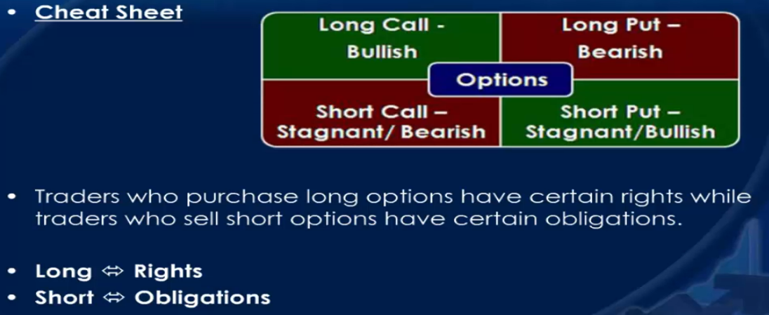
Buying a call: I have the right to buy a security at a predetermined price.
Selling a call: I must deliver the security at a predetermined price to the option buyer if they exercise the option.
Buying a put: I have the right to sell a security at a predetermined price.
Selling a put: I must buy the security at a predetermined price from the option buyer if they exercise the option.
A call options is the right to buy.
A put option is right to sell
Long Initiate a trade with a purchase (Buy to Open).
Short Initiate a trade with a sale (Sell to Open).
You will hear, Investment managers saying Long the market.
Meaning going to go up.
Long Option Purchasers will always have certain rights
Right to sell option | Right to exercise option | Right to let option expire
Short Option sellers will have certain Obligations:
A short call seller may be assigned an obligation to sell stock at a fixed price with in a limited time period
A short put seller may be assigned an obligation to buy stock at a fixed price with in a limited time period
Buy to Open ⬄ Sell to Close
Sell to Open ⬄ Buy to Close

Slide 3
Select stocks with higher volume and higher volatility stocks
Select stocks only from S&P 500 and Nasdaq
Use RSI effectively Buy when RSI < 30 and price at support | Sell when RSI > 70 and price is at Resistance. (Buy low sell high)
Use Bollinger Band / SMA / EMA / MACD / RSI / Keltner Channel / Support / Resistance / Trend Lines.
User Stop Loss or Hedge your stocks for downside. Learn to protect profit by using trailing stop loss.
Patience is the key in buying and selling. (If you are in doubt on trade, then don’t trade, your first thought is 90 percent correct)
Use Covered Call / Covered Put to generate income.
You need to know of important dates -> https://tradingeconomics.com/calendar and their impact on stock market.
Note down the each of your stocks earnings dates | Buy Stocks 3 weeks before the Earnings date and sell the same 2 or 3 days before the Earnings date.
Don’t run through the earning.
Set Alerts on stocks | Keep daily track of stocks. | Work the night before and do analysis and be ready for the next day.
Read Books on Stocks / Options
Treat every $ as your Parents/Wife/Kids money. You will automatically become very responsible.
Watch news like CNBC etc to keep up to date in the market.
Set 1% or 2% daily profit goal.
Don’t average on losing stock.
Developers: Learn to Trade Stocks/ Master the trade. Don’t spend time in automating unless you are planning to make and sell a full fledged product.
Financial Analysis/Ideas/Trend Analysis data etc available in the market at 20$ a month.
On buy call give at least 60 days. Anywhere between 60 to 90 days is good time frame for long option. Going longer time frame increases the cost
Some say let me max days be 120 and you close it at the 90th day and open a new one
TEAM : Together Each Achieves More ( Validate and do you own analysis after getting tips from TEAM).
If you have 100$, Buy stock for first 50$, Keep the other 50$ to buy on Red Day.
Try to stay very little time in the market little as possible.
Keep Max Margin as 10% of your portfolio / Keep Max Option as 20% of your portfolio.
Don’t switch strategies, Review what you could have done better.
Have multiple monitors.
Follow great investors like Nancy Peloski, Warren.

Slide 4
Call Buyer/ Buy Call have –
The right to buy a stock
At a certain price, (Strike Price)
By a certain time, (Expiration Date)
For this right, they Pay a premium
Call option is a Bullish position (meaning stock going up)
Breakeven = Strike Price + Premium
Max Profit = Unlimited
Max Loss = Premium amount.
Call Sellers / Sell Call have –
The Obligation to Sell a stock
At a certain price, (Strike Price)
By a certain time, (Expiration Date)
For this right, they Receive a premium
Put Option is a Bearish Position
Breakeven = Strike Price – Premium
Max Profit
Max Loss = Total - Premium
Long Put Means Buyer, Short Put means Seller
When price goes down put options are going to increase in value, when the price goes up Call Options is going to increase in value

Slide 5
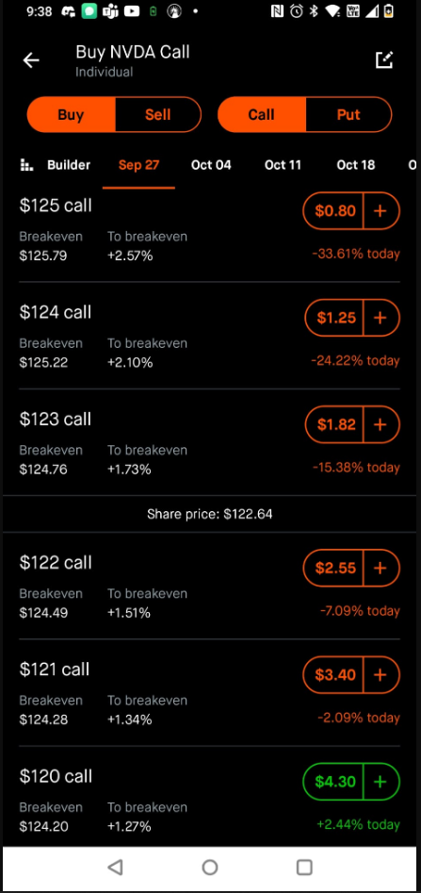
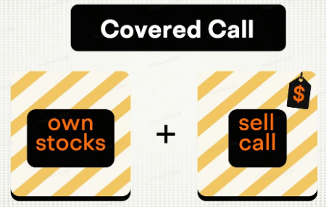
… at strike price (predetermined price)
+++ if they exercise the option
Buying a call: I have the right to buy the stock …
Selling a call: I must deliver/sell/give the stock … to the option buyer +++
Buying a put: I have the right to sell the stock … (Insurance)
Selling a put: I must buy the stock … from the option buyer +++
Call
Put
Buy Call
Sell Call
Covered Call
Naked Calls

Slide 6
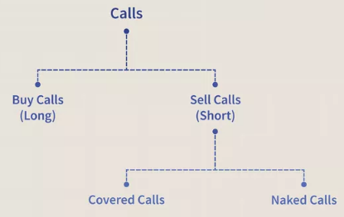
Call (Bullish, Going Up)
Buy Call
Sell Call
Put(Bearish, Going Down)
Buy Put
Sell Put
Book: Options Trading How to turn every Friday into Payday using weekly options

Slide 7
Call Put Call => Bullish (going up)
Buy Call Buy Put Put => Bearish (going down)
Sell Call Sell Put
Buy Call
X = 10$ Market Sentiment Bullish 1Month Premium 50$ 1 Buy Call Option After 2 weeks X = 15$
(15 – 10) x (1 x 100) – Premium ie 5 x 100 – 50$ ie 500$ - 50 $ = 450$
If the above is 10 contract instead of 1 contract.
(15 – 10) x ( 10 x 100) – (10 x premium) = 5000 – 500 = 4500$
__________________________________________________________________________________________________
Buy Call
X = 6$ Market Sentiment Bullish 1Month Premium 50$ 1 Buy Call Option After 2 weeks 10$
(10 – 6) x (1 x 100) - 50 = 350$
__________________________________________________________________________________________________
Buy Call
X = 6$ Market Sentiment Bullish 1Month Premium 50$ 1 Buy Call Option After 2 weeks 10$
(10 – 6) x (1 x 100) - 50 = 350$
Buying a call: I have the right to buy a security at a predetermined price.
Selling a call: I must deliver the security at a predetermined price to the option buyer if they exercise the option.
Buying a put: I have the right to sell a security at a predetermined price.
Selling a put: I must buy the security at a predetermined price from the option buyer if they exercise the option.
Book: Options Trading How to turn every Friday into Payday using weekly options

Slide 8
Step 1: Select a stock
Step 2: We buy a long-dated put option that expires in approximately 120 days and past the next earnings announcement. This is our sleep-at-night insurance.
Step 3: We sell a short-dated put that expires the following week. That premium is instantly credited to your account.
Step 4: Manage, rinse, and repeat.
Time decay plays a key role in Options
Long-dated insurance puts have slow decay because there is so much time before they expire. It is usually slow until the option has less than 30 days to expire—then it speeds up.
The short-dated puts we sell for weekly income decay fast—in seven days, since we want to keep all the options premium, the faster the time decays, the better.
… at a predetermined price
Buying a call: I have the right to buy a security …
Selling a call: I must deliver/sell/give the security … to the option buyer if they exercise the option.
Buying a put: I have the right to sell a security … (Insurance)
Selling a put: I must buy the security … from the option buyer if they exercise the option.
Book: Options Trading How to turn every Friday into Payday using weekly options

Slide 9
SELLING OPTIONS LIKE ICE CREAM?
An ice cream shops that buy a 5-gallon tub for, say, $50. Each tub has 100 scoops, and each of those scoops sells for $3 So, they pay $50 and collect $300!
Our long-dated put (Buy Put serves as insurance) is the tub of ice cream that lasts for 120 days;
each scoop is the weekly put we sell.
Let’s use Charles Schwab (SCHW) as an example:
SCHW is trading at $74.00
We buy a $70 put expiring in 120 days and past the next earnings date for $4.20
We sell next week’s at the money 74 put and collect $1.28
We have a tub of ice cream with 16 weekly scoops and the potential to collect $1.28!
If you had 1 contract (100 shares), you would pay $420 for the insurance and collect $2048.
If you had 5 contracts (500 shares), you would pay $2,100 for the insurance and collect $10,240.
If you had 10 contracts (1,000 shares), you would pay $4,200 for the insurance and collect $20,480; this is $1,280 a week.
Buying a call: You have the right to buy a security at a predetermined price.
Selling a call: You must deliver the security at a predetermined price to the option buyer if they exercise the option.
Buying a put: You have the right to sell a security at a predetermined price.
Selling a put: You must buy the security at a predetermined price from the option buyer if they exercise the option.
Book: Options Trading How to turn every Friday into Payday using weekly options

Slide 10
Risk Percentages
Keep each trade at no more than 5% of total portfolio, and most are at 3%.
That means there is never a position that is going to tank my account!
In the example above, we have a $4.00 spread between the $74 short put we sold and the $70 long put we bought. The maximum exposure is $4.00, less the premium you took in that week of $1.28. If the market tanks, your risk is $2.72 per share.
1 contract (100 shares) is $272
5 contracts (500 shares) is $1,360
10 contracts (1000 shares) is $2,720
Account sizes and risk are near 3% (These came out to be 2.7%)
$10,000 – 1 contract is $272 – 2.7%
$30,000 – 3 contracts is $816 – 2.7%
$50,000 – 5 contracts is $1,360 – 2.7%
If SCHW suddenly drops, the short put you sold is worth more because it is solidly “in the money”—meaning you sold a 74 put and now the stock is trading at $71. At the same time, your long-term insurance has risen in value to offset and keep your risk contained.
If you were to exit the trade, buying to close your short put and selling to close your long insurance put, the difference is the risk (plus or minus a little on some fees and timing differences).
Buying a call: You have the right to buy a security at a predetermined price.
Selling a call: You must deliver the security at a predetermined price to the option buyer if they exercise the option.
Buying a put: You have the right to sell a security at a predetermined price.
Selling a put: You must buy the security at a predetermined price from the option buyer if they exercise the option.
Book: Options Trading How to turn every Friday into Payday using weekly options

Slide 11
My Basic Tools
Moving averages—I use the 100, 50, and 20—just to keep track. Look at this over a 3-month time frame because we are selling premiums between earnings statements. Think of any KaChing as a 3-month trade.
Price Action and Volume—just seeing the daily buying and selling. If the stock moves up to a resistance level, it may pull back a little as traders take profits. If I saw that trend, I would sell slightly out of the money, collect a little less premium, and allow for the move. If there is a down day on low volume and no news, it is just some profit-taking.
On the other hand, after that little profit taking pull back, if green buying volume comes in, I may take a few contracts and sell an in-the-money put — in this case, maybe the $75 or even $76 to collect a big premium and watch the stock move up.
Keltner Channels or Bollinger Bands: All trading platforms have these tools to determine the level of volatility and price trend. Look at charts over a few periods—1 year, 6 months, or 90 days—and you can see that as the stock moves up to the upper band, it may pull back historically for some profit-taking before moving back up. You can see historically what happens when the stock is in the lower band. How many times did buyers come in, and it moved up, or did it break through and set a new low?
Buying a call: You have the right to buy a security at a predetermined price.
Selling a call: You must deliver the security at a predetermined price to the option buyer if they exercise the option.
Buying a put: You have the right to sell a security at a predetermined price.
Selling a put: You must buy the security at a predetermined price from the option buyer if they exercise the option.
Book: Options Trading How to turn every Friday into Payday using weekly options

Slide 12
Good Stock Parameters
Stock must be trading at $20 or higher.
Avoid stocks over $400—this is personal.
Avoid Apple. Apple is the most widely owned stock in the universe. When Apple goes down, large hedge funds must liquidate because their holdings may exceed 5% of their fund.
Avoid Chinese stocks
Avoid ETFs, as for the most part, they do not have enough premium
It must show an up or sideways, consolidation pattern, meaning it is digesting and coiling for the next move. Look over a 3-month period since these are really 3-month trades.
Buying a call: You have the right to buy a security at a predetermined price.
Selling a call: You must deliver the security at a predetermined price to the option buyer if they exercise the option.
Buying a put: You have the right to sell a security at a predetermined price.
Selling a put: You must buy the security at a predetermined price from the option buyer if they exercise the option.
Book: Options Trading How to turn every Friday into Payday using weekly options

Slide 13
Buy Call (also called as Long Call).
The profit increases as the market rises.
The break-even point will be the options strike price plus the premium paid for the option.
Max Profit: Unlimited (as the stock price Rises)
Max Loss: Premium Price ( Limited to Net Premium paid)
Upside Profit at Expiration: Stock’s Price - Strike Price – Premium Paid
When to Use: Bullish (When we expect a rise in the price of the stock.
Buy Put (also called as Long Put).
The profit increases as the market falls.
The break-even point will be the options strike price minus the premium paid for the option.
Max Profit: Unlimited (as the stock price falls)
Max Loss: Premium Price ( Limited to Net Premium paid)
Downside Profit at Expiration: Strike Price - Stroke Price – Premium Paid
When to Use: Bearish (When we expect a drop in the price of the stock.
When the stock is in Downtrend. When we get a breakdown at double top or Head & Shoulder Pattern
Buying a call: You have the right to buy a security at a predetermined price.
Selling a call: You must deliver the security at a predetermined price to the option buyer if they exercise the option.
Buying a put: You have the right to sell a security at a predetermined price.
Selling a put: You must buy the security at a predetermined price from the option buyer if they exercise the option.
Book: Options Trading How to turn every Friday into Payday using weekly options

Slide 14
Sell Call (also called as Long Call).
The profit increases as the market rises.
The break-even point will be the options strike price plus the premium paid for the option.
Max Profit: Unlimited (as the stock price Rises)
Max Loss: Premium Price ( Limited to Net Premium paid)
Upside Profit at Expiration: Stock’s Price - Strike Price – Premium Paid
When to Use: Bullish (When we expect a rise in the price of the stock.
Sell Put (also called as Long Put).
The profit increases as the market falls.
The break-even point will be the options strike price minus the premium paid for the option.
Max Profit: Unlimited (as the stock price falls)
Max Loss: Premium Price ( Limited to Net Premium paid)
Downside Profit at Expiration: Strike Price - Stroke Price – Premium Paid
When to Use: Bearish (When we expect a drop in the price of the stock.
When the stock is in Downtrend. When we get a breakdown at double top or Head & Shoulder Pattern
Buying a call: You have the right to buy a security at a predetermined price.
Selling a call: You must deliver the security at a predetermined price to the option buyer if they exercise the option.
Buying a put: You have the right to sell a security at a predetermined price.
Selling a put: You must buy the security at a predetermined price from the option buyer if they exercise the option.
Book: Options Trading How to turn every Friday into Payday using weekly options

Slide 15
Call Put Call => Bullish (going up)
Buy Call Buy Put Put => Bearish (going down)
Sell Call Sell Put
Buy Call
X = 10$ Market Sentiment Bullish 1Month Premium 50$ 1 Buy Call Option After 2 weeks X = 15$
(15 – 10) x (1 x 100) – Premium ie 5 x 100 – 50$ ie 500$ - 50 $ = 450$
If the above is 10 contract instead of 1 contract.
(15 – 10) x ( 10 x 100) – (10 x premium) = 5000 – 500 = 4500$
__________________________________________________________________________________________________
Buy Call
X = 6$ Market Sentiment Bullish 1Month Premium 50$ 1 Buy Call Option After 2 weeks 10$
(10 – 6) x (1 x 100) - 50 = 350$
__________________________________________________________________________________________________
Buy Call
X = 6$ Market Sentiment Bullish 1Month Premium 50$ 1 Buy Call Option After 2 weeks 10$
(10 – 6) x (1 x 100) - 50 = 350$
Buying a call: You have the right to buy a security at a predetermined price.
Selling a call: You must deliver the security at a predetermined price to the option buyer if they exercise the option.
Buying a put: You have the right to sell a security at a predetermined price.
Selling a put: You must buy the security at a predetermined price from the option buyer if they exercise the option.
Book: Options Trading How to turn every Friday into Payday using weekly options

Slide 16
Step 1: Select a stock
Step 2: We buy a long-dated put option that expires in approximately 120 days and past the next earnings announcement. This is our sleep-at-night insurance.
Step 3: We sell a short-dated put that expires the following week. That premium is instantly credited to your account.
Step 4: Manage, rinse, and repeat.
Time decay plays a key role in Options
Long-dated insurance puts have slow decay because there is so much time before they expire. It is usually slow until the option has less than 30 days to expire—then it speeds up.
The short-dated puts we sell for weekly income decay fast—in seven days, since we want to keep all the options premium, the faster the time decays, the better.
Buying a call: You have the right to buy a security at a predetermined price.
Selling a call: You must deliver the security at a predetermined price to the option buyer if they exercise the option.
Buying a put: You have the right to sell a security at a predetermined price.
Selling a put: You must buy the security at a predetermined price from the option buyer if they exercise the option.
Book: Options Trading How to turn every Friday into Payday using weekly options

Slide 17
SELLING OPTIONS LIKE ICE CREAM?
An ice cream shops that buy a 5-gallon tub for, say, $50. Each tub has 100 scoops, and each of those scoops sells for $3 So, they pay $50 and collect $300!
Our long-dated put is the tub of ice cream that lasts for 120 days; each scoop is the weekly put we sell.
Let’s use Charles Schwab (SCHW) as an example:
SCHW is trading at $74.00
We buy a $70 put expiring in 120 days and past the next earnings date for $4.20
We sell next week’s at the money 74 put and collect $1.28
We have a tub of ice cream with 16 weekly scoops and the potential to collect $1.28!
If you had 1 contract (100 shares), you would pay $420 for the insurance and collect $2048.
If you had 5 contracts (500 shares), you would pay $2,100 for the insurance and collect $10,240.
If you had 10 contracts (1,000 shares), you would pay $4,200 for the insurance and collect $20,480; this is $1,280 a week.
Buying a call: You have the right to buy a security at a predetermined price.
Selling a call: You must deliver the security at a predetermined price to the option buyer if they exercise the option.
Buying a put: You have the right to sell a security at a predetermined price.
Selling a put: You must buy the security at a predetermined price from the option buyer if they exercise the option.
Book: Options Trading How to turn every Friday into Payday using weekly options

Slide 18
Risk Percentages
Keep each trade at no more than 5% of total portfolio, and most are at 3%.
That means there is never a position that is going to tank my account!
In the example above, we have a $4.00 spread between the $74 short put we sold and the $70 long put we bought. The maximum exposure is $4.00, less the premium you took in that week of $1.28. If the market tanks, your risk is $2.72 per share.
1 contract (100 shares) is $272
5 contracts (500 shares) is $1,360
10 contracts (1000 shares) is $2,720
Account sizes and risk are near 3% (These came out to be 2.7%)
$10,000 – 1 contract is $272 – 2.7%
$30,000 – 3 contracts is $816 – 2.7%
$50,000 – 5 contracts is $1,360 – 2.7%
If SCHW suddenly drops, the short put you sold is worth more because it is solidly “in the money”—meaning you sold a 74 put and now the stock is trading at $71. At the same time, your long-term insurance has risen in value to offset and keep your risk contained.
If you were to exit the trade, buying to close your short put and selling to close your long insurance put, the difference is the risk (plus or minus a little on some fees and timing differences).
Buying a call: You have the right to buy a security at a predetermined price.
Selling a call: You must deliver the security at a predetermined price to the option buyer if they exercise the option.
Buying a put: You have the right to sell a security at a predetermined price.
Selling a put: You must buy the security at a predetermined price from the option buyer if they exercise the option.
Book: Options Trading How to turn every Friday into Payday using weekly options

Slide 19
My Basic Tools
Moving averages—I use the 100, 50, and 20—just to keep track. Look at this over a 3-month time frame because we are selling premiums between earnings statements. Think of any KaChing as a 3-month trade.
Price Action and Volume—just seeing the daily buying and selling. If the stock moves up to a resistance level, it may pull back a little as traders take profits. If I saw that trend, I would sell slightly out of the money, collect a little less premium, and allow for the move. If there is a down day on low volume and no news, it is just some profit-taking.
On the other hand, after that little profit taking pull back, if green buying volume comes in, I may take a few contracts and sell an in-the-money put — in this case, maybe the $75 or even $76 to collect a big premium and watch the stock move up.
Keltner Channels or Bollinger Bands: All trading platforms have these tools to determine the level of volatility and price trend. Look at charts over a few periods—1 year, 6 months, or 90 days—and you can see that as the stock moves up to the upper band, it may pull back historically for some profit-taking before moving back up. You can see historically what happens when the stock is in the lower band. How many times did buyers come in, and it moved up, or did it break through and set a new low?
Buying a call: You have the right to buy a security at a predetermined price.
Selling a call: You must deliver the security at a predetermined price to the option buyer if they exercise the option.
Buying a put: You have the right to sell a security at a predetermined price.
Selling a put: You must buy the security at a predetermined price from the option buyer if they exercise the option.
Book: Options Trading How to turn every Friday into Payday using weekly options

Slide 20
Good Stock Parameters
Stock must be trading at $20 or higher.
Avoid stocks over $400—this is personal.
Avoid Apple. Apple is the most widely owned stock in the universe. When Apple goes down, large hedge funds must liquidate because their holdings may exceed 5% of their fund.
Avoid Chinese stocks
Avoid ETFs, as for the most part, they do not have enough premium
It must show an up or sideways, consolidation pattern, meaning it is digesting and coiling for the next move. Look over a 3-month period since these are really 3-month trades.
Buying a call: You have the right to buy a security at a predetermined price.
Selling a call: You must deliver the security at a predetermined price to the option buyer if they exercise the option.
Buying a put: You have the right to sell a security at a predetermined price.
Selling a put: You must buy the security at a predetermined price from the option buyer if they exercise the option.
Book: Options Trading How to turn every Friday into Payday using weekly options

Slide 21
Buy Call (also called as Long Call).
The profit increases as the market rises.
The break-even point will be the options strike price plus the premium paid for the option.
Max Profit: Unlimited (as the stock price Rises)
Max Loss: Premium Price ( Limited to Net Premium paid)
Upside Profit at Expiration: Stock’s Price - Strike Price – Premium Paid
When to Use: Bullish (When we expect a rise in the price of the stock.
Buy Put (also called as Long Put).
The profit increases as the market falls.
The break-even point will be the options strike price minus the premium paid for the option.
Max Profit: Unlimited (as the stock price falls)
Max Loss: Premium Price ( Limited to Net Premium paid)
Downside Profit at Expiration: Strike Price - Stroke Price – Premium Paid
When to Use: Bearish (When we expect a drop in the price of the stock.
When the stock is in Downtrend. When we get a breakdown at double top or Head & Shoulder Pattern
Buying a call: You have the right to buy a security at a predetermined price.
Selling a call: You must deliver the security at a predetermined price to the option buyer if they exercise the option.
Buying a put: You have the right to sell a security at a predetermined price.
Selling a put: You must buy the security at a predetermined price from the option buyer if they exercise the option.
Book: Options Trading How to turn every Friday into Payday using weekly options

Slide 22
Sell Call (also called as Long Call).
The profit increases as the market rises.
The break-even point will be the options strike price plus the premium paid for the option.
Max Profit: Unlimited (as the stock price Rises)
Max Loss: Premium Price ( Limited to Net Premium paid)
Upside Profit at Expiration: Stock’s Price - Strike Price – Premium Paid
When to Use: Bullish (When we expect a rise in the price of the stock.
Sell Put (also called as Long Put).
The profit increases as the market falls.
The break-even point will be the options strike price minus the premium paid for the option.
Max Profit: Unlimited (as the stock price falls)
Max Loss: Premium Price ( Limited to Net Premium paid)
Downside Profit at Expiration: Strike Price - Stroke Price – Premium Paid
When to Use: Bearish (When we expect a drop in the price of the stock.
When the stock is in Downtrend. When we get a breakdown at double top or Head & Shoulder Pattern
Buying a call: You have the right to buy a security at a predetermined price.
Selling a call: You must deliver the security at a predetermined price to the option buyer if they exercise the option.
Buying a put: You have the right to sell a security at a predetermined price.
Selling a put: You must buy the security at a predetermined price from the option buyer if they exercise the option.
Book: Options Trading How to turn every Friday into Payday using weekly options

