Slide 1
Bottom-Up Parsing
Exersices

Slide 2
Exercise 4.5.1
For the grammar
S --> 0 S 1 | 0 1
indicate the handle in each of the following right-sentential forms:
a) 000111
b) 00S11
Answer:
a) 01
b) 0S1

Slide 3
Exercise 4.5.2
For the grammar
S --> SS+ | SS* | a
indicate the handle in each of the following right-sentential forms:
a) SSS+a*+
b) SS+a*a+
c) aaa*a++
Answer:
a) SS+
b) SS+
c) a

Slide 4
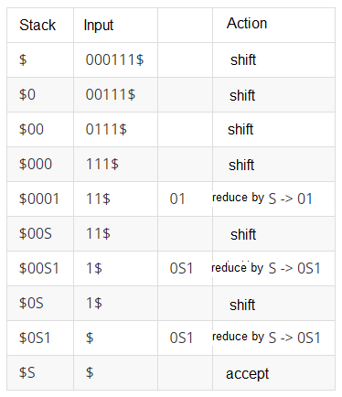
Exercise 4.5.3
Give bottom-up parses for the following input strings and grammars:
The input 000111 according to the grammar of Exercise 4.5.1.
Answer →

Slide 5
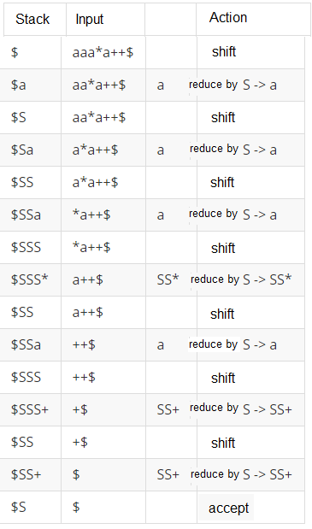
Exercise 4.5.3.b
Give bottom-up parses for the following input strings and grammars:
The input aaa*a++ according to the grammar of Exercise 4.5.2.
Answer →

Slide 6
Example
Give bottom-up parses for the following input strings and grammars:
The input id+id*id according to the following grammar:
E → E+T | T
T → T*F | F
F → (E) | id
Answer → next slide

Slide 7
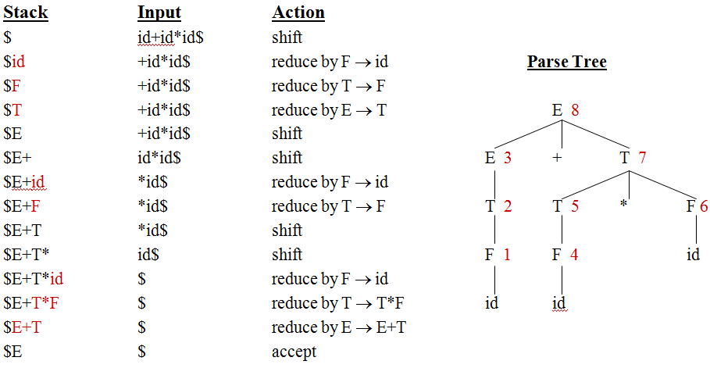
Example: (Answer)

Slide 8
Exercise 4.6.1
Construct the SLR sets of items for the following grammar. Compute the GOTO function for these sets of items. Show the parsing table for this grammar.
S --> 0 S 1 | 0 1
S --> SS+ | SS* | a
S -> S (S) S | ε
Answer →

Slide 9
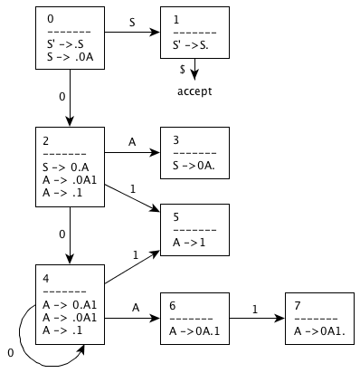
Exercise 4.6.1.a Answer
0) S' -> S
S -> 0 A
A -> 0 A 1
A -> 1
I₀ = {S' -> .S , S -> .0 A}
GOTO(I₀, S) = {S' -> S . } = I₁
GOTO(I₀, 0) = {S -> 0. A, A -> . 0 A 1 , A -> . 1 } = I₂
GOTO(I₂, A) = {S -> 0 A. } = I₃
GOTO(I₂, 0) = {A -> 0. A 1, A -> . 0 A 1 , A -> . 1 } = I₄
GOTO(I₂, 1) = {A -> 1. } = I₅
GOTO(I₄, A) = {A -> 0 A. 1} = I₆
GOTO(I₄, 0) = {A -> 0. A 1 , A -> . 0 A 1 , A -> . 1 } = I₄
GOTO(I₄, 1) = {A -> 1. } = I₅
GOTO(I₆, 1) = {A -> 0A1. } = I₇

Slide 10
Exercise 4.6.1.a Answer(cont.)
Follow(S) = { $ }
Follow(A) = {1, $ }
 | ACTION |  |  | GOTO
I | 0 | 1 | $ | S | A
0 | S 2 |  |  | 1
1 |  |  | accept
2 | S4 | S5 |  |  | 3
3 |  |  | R {S -> 0 A }
4 | S4 | S5 |  |  | 6
5 |  | R {A -> 1} | R {A -> 1}
6 |  | S7
7 |  | R {A -> 0 A 1} | R {A -> 0 A 1}

Slide 11
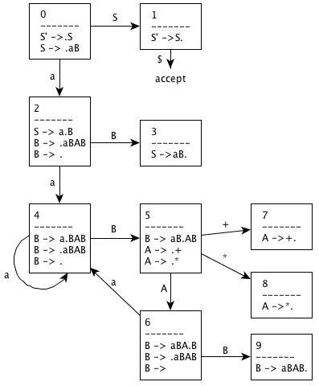
Exercise 4.6.1.b Answer
S - > SSA | a
A -> + | *
0) S’-> S
S -> aB
2,3) B-> SAB| ε //B->aBAB
4,5) A -> + | *
I₀ = { S’ -> .S, S -> .aB}
GOTO(I₀, S) = {S’ -> S.} =I₁
GOTO(I₀, a) = {S -> a.B, B-> .aBAB , B->.} =I₂
GOTO(I₂, B) = {S -> aB.} =I₃
GOTO(I₂, a) = {B-> a.BAB , B-> .aBAB , B->.} =I₄
GOTO(I₄, B) = {B-> aB.AB , A -> .+ | .*} =I₅
GOTO(I₄, a) = I₄
GOTO(I₅, A) = {B-> aBA.B, B-> .aBAB , B->.} =I₆
GOTO(I₅, +) = {A -> +. } =I₇
GOTO(I₅, *) = {A -> *. } =I₈
GOTO(I₆, B) = {B-> aBAB.} =I₉
GOTO(I₆, a) = I₄

Slide 12
Exercise 4.6.1.b Answer (cont.)
Follow (S) = {$}
Follow (A) = {$, a}
Follow(B) = {$, + ,*}
 | ACTION |  |  |  | GOTO
I | a | + | * | $ | S | A | B
0 | S2 |  |  |  | 1
1 |  |  | accept
2 | S4 | R{B-> ε} | R{B-> ε} | R{B-> ε} |  |  | 3
3 |  |  |  | R{S -> aB}
4 | S4 | R{B-> ε} | R{B-> ε} | R{B-> ε} |  |  | 5
5 |  | S7 | S8 |  |  | 6
6 | S4 | R{B-> ε} | R{B-> ε} | R{B-> ε} |  |  | 9
7 | R{A -> +} |  |  | R{A -> +}
8 | R{A -> *} |  |  | R{A -> *}
9 |  | R{B->aBAB} | R{B->aBAB} | R{B->aBAB}

Slide 13
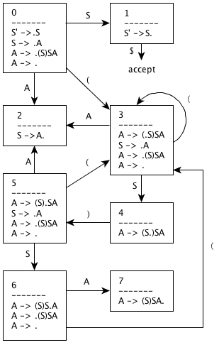
Exercise 4.6.1.c Answer
S’ --> S
S --> A
3,4) A --> (S) S A | ε
I₀ = { S’ -> .S, S -> .A , A -> .(S) S A , A - > .}
GOTO(I₀ , S ) = {S’ --> S. } = I₁
GOTO(I₀, A ) = {S -> A.} = I₂
GOTO(I₀, ( ) = {A -> (.S) S A , S -> .A , A -> .(S) S A , A - > .} = I₃
GOTO(I₃, S ) = {A -> (S.) S A } = I₄
GOTO(I₃, A ) = I₂
GOTO(I₃, ( ) = I₃
GOTO(I₄, ) ) = {A -> (S). S A, S -> .A , A -> .(S) S A , A - > . } = I₅
GOTO(I₅, S ) = {A -> (S) S .A, A -> (.S) S A , S -> .A , A -> .(S) S A , A - > . } = I₆
GOTO(I₅, A ) = I₂
GOTO(I₅, ( ) = I₃
GOTO(I₆, A ) = {A -> (S) S A. , S -> A.} = I₇
GOTO(I₆, S ) = I₄
GOTO(I₆, ( ) = I₃

Slide 14
Exercise 4.6.1.c Answer (cont.)
Follow (A) = Follow (S) = { $, ) }
 | ACTION |  |  | GOTO
I | ( | ) | $ | S | A
0 | S3 |  |  | 1 | 2
1 |  |  | accept
2 |  | R {S --> A} | R {S --> A}
3 | S3 | R {A --> ε} | R {A --> ε} | 4 | 2
4 |  | S5
5 | S3 | R {A --> ε} | R {A --> ε} | 6 | 2
6 | S3 | R {A --> ε} | R {A --> ε} |  | 7
7 |  | R {A --> (S) S A} | R {A --> (S) S A}

Slide 15
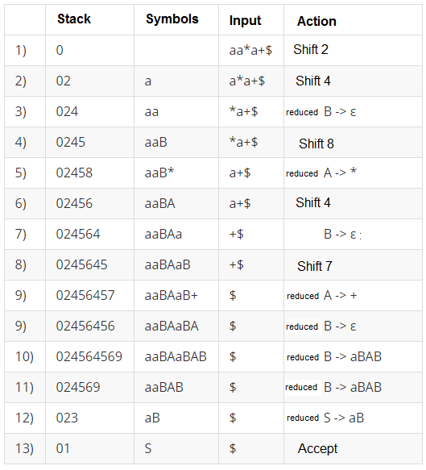
Exercise 4.6.3
Show the actions of your parsing table from Exercise 4.6.1.b on the input aa * a+.
Answer →

Slide 16
Example 1
Construct the SLR sets of items for the following grammar. Compute the GOTO function for these sets of items. Show the parsing table for this grammar.
1) E → E+T
2) E → T
3) T → T*F
4) T → F
5) F → (E)
6) F → id
Answer →

Slide 17
Example 1 Answer
0) E’ --> E
I₀ ={ E’ → .E, E → .E+T, E → .T,
T → .T*F, T → .F,
F → .(E), F → .id }
goto(I₀,E) = { E’ → E., E → E.+T } = I₁
goto(I₀,T) = { E → T., T → T.*F } = I₂
goto(I₀,F) = {T → F. } = I₃
goto(I₀,() = { F → (.E), E → .E+T, E → .T, T → .T*F, T → .F, F → .(E), F → .id } = I₄
goto(I₀,id) = { F → id. } = I₅
goto(I₁,+) = {E → E+.T , T → .T*F, T → .F, F → .(E), F → .id } = I₆
goto(I₂,*) = {T → T*.F , F → .(E), F → .id } = I₇
goto(I₄,E) = {F → (E.), E → E.+T } = I₈
goto(I₄,T) = I₂
goto(I₄,F) = I₃
goto(I₄,id) = I₅
goto(I₆,T) = {E → E+ T., T → T.*F } = I₉
goto(I₆,F) = I₃
goto(I₆,( ) = I₄
goto(I₆,id) = I₅
goto(I₇,F) = {T → T*F. } = I₁₀
goto(I₇,() = I₄
goto(I₇,id) = I₅
goto(I₈,)) = {F → (E). } = I₁₁
goto(I₈,+) = I₆
goto(I₉,+) = I₇

Slide 18
Example 1 Answer (cont.)
I₀:
E’ → .E
E →.E+T
E →.T
T →.T*F
T →.F
F →.(E)
F →.d
E’ → E.
E →E.+T
E →T.
T →T.*F
T →F.
F → (.E)
E →.E+T
E →.T
T →.T*F
T →.F
F →.(E)
F →.d
F →d.
E →E+.T
T →.T*F
T →.F
F →.(E)
F →.d
T →T*.F
F →.(E)
F →.d
F →(E.)
E →E.+T
I₉:
E →E+T.
T →T.*F
T →T*F.
F →(E).
*
7
T
E
I₁:
+
I₆:
F
3
(
4
d
T
I₂:
5
*
F
I₃:
I₇:
F
(
I₁₀:
I₄:
(
E
4
d
5
T
I₈:
)
I₁₁:
2
+
F
3
6
(
d
I₅:
4
d
5

Slide 19
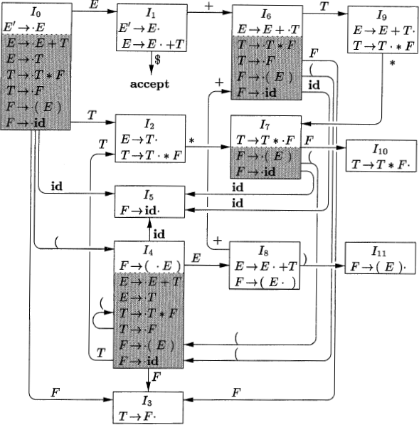
Example 1 Answer (cont.)

Slide 20
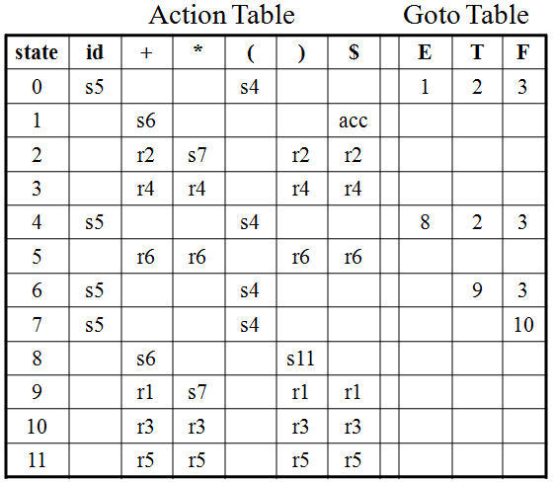
Example 1 Answer (cont.)

Slide 21
Example 2
Show the actions of your parsing table from Example 1 on the input id * id + id.
Answer →

Slide 22
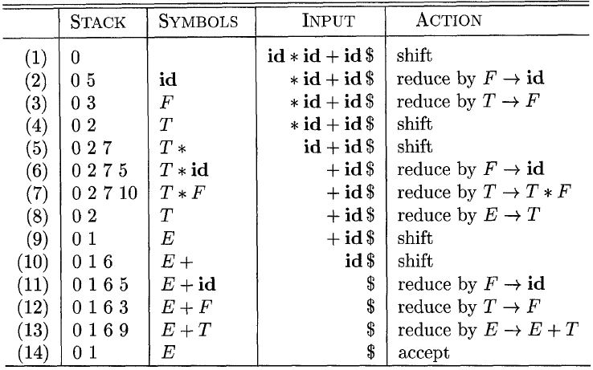
Example 2 Answer

