Slide 1
BRICS PERFORMANCE INDICATOR ANALYSIS
PRESENTED BY: Uha Ratna Sudha Achanti, Prem Kumar Jami

Slide 2


CONTENT
01
02
03
04
05
06
OVERVIEW OF THE PROJECT
ECONOMIC INDICATORS
ENVIRONMENT INDICATORS
HEALTH INDICATORS
PUBLIC SECTOR INDICATORS
COMPARISONS & CORRELATIONS

Slide 3



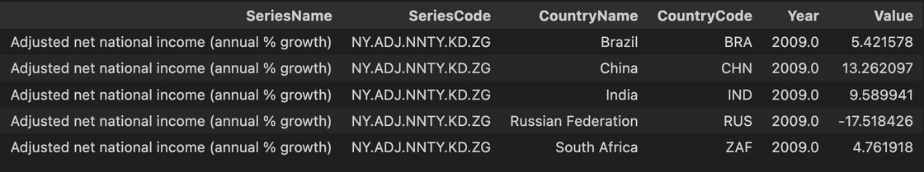
OVERVIEW
What is BRICS?
Why we chose this for our project What is in the data
How we split the project up

Slide 4
This Project is to visualize, compare, and understand the development of emerging economies
related to Economic, Education and Environment, Health and Poverty and Private Sector for BRICS countries. We will be standardizing and updating the insightful data from the World Bank, it allows
for better analysis and insights into each country’s economy.
Countries that are being Analysed as part of this analysis are
Brazil
Russia
India
China
South Africa
Years that are being Considered are
2009 - 2019

Slide 5
How We Split the Project
Data Collection: Gathered and cleaned World Bank data for consistency.
Economic Indicators: Analyzed GDP, income growth, and agriculture's role.
Education & Environment: Studied urbanization, rural trends, and employment shifts.
Health & Poverty: Examined healthcare spending, life expectancy, and child mortality.
Private Sector: Reviewed trade, exports, and tourism metrics.
Correlation Analysis: Explored relationships like healthcare vs. mortality.

Slide 6
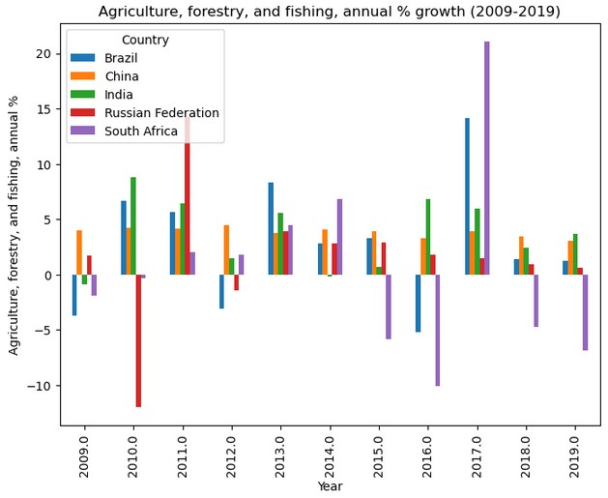

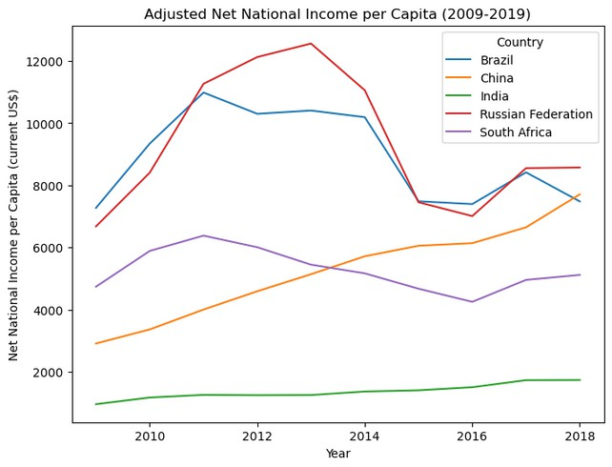


ECONOMIC INDICATORS
When looking at the variety of economic indicators we decided to look further into:
Adjusted net national income ( annual % growth) Adjusted net national income per capita
Agriculture, forestry, and f ishing value added National savings
GDP ( constant 2010 US$)
What our expectations were
What we found in the data

Slide 7
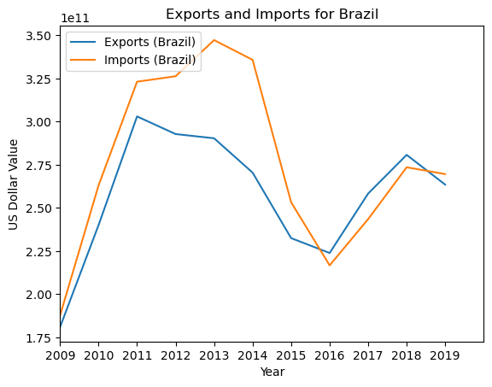
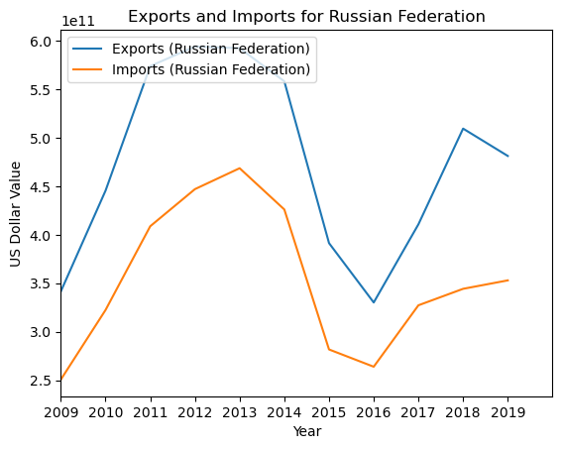
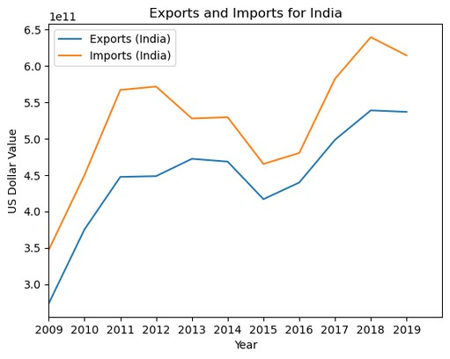
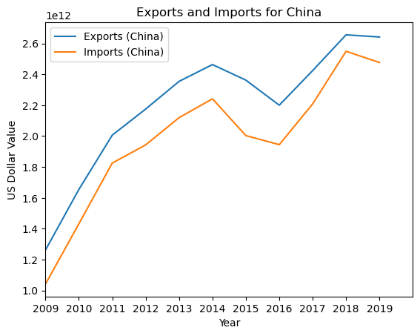
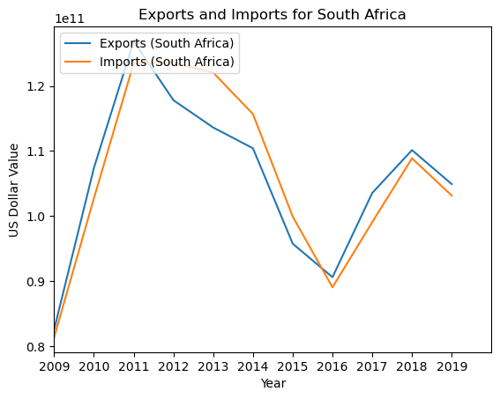

COMPARISONS & CORRELATIONS
Imports vs exports

Slide 8
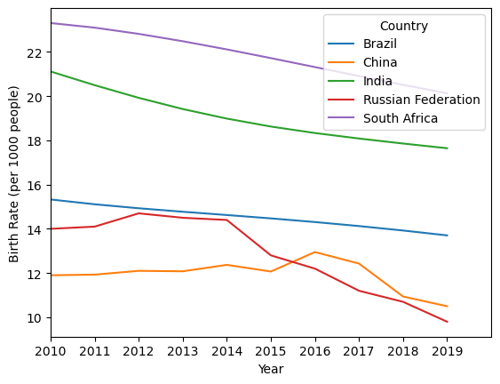

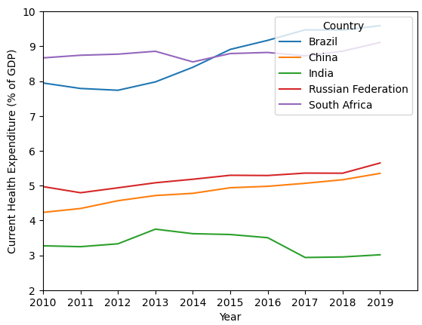
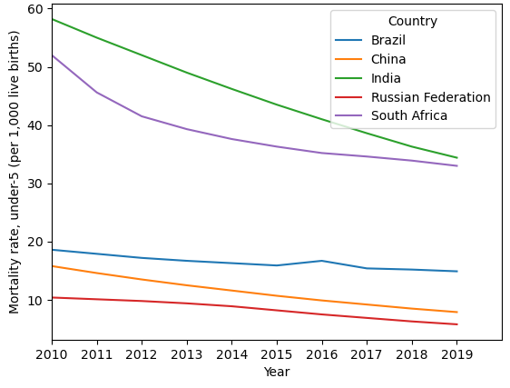
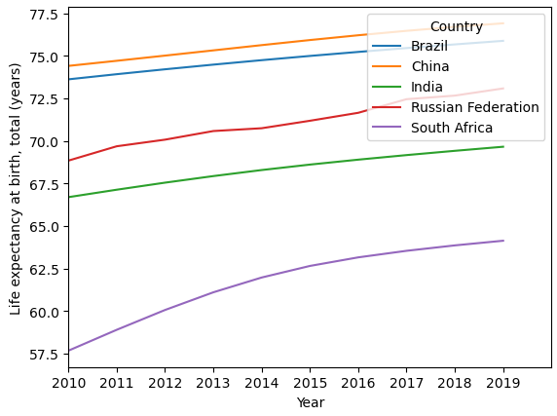

HEALTH INDICATORS
Indicators looked at for health Birth rate ( per 1000 people) Life expectancy ( in years)
Mortality Rate Age under 5
Current Health Expenditure (% of GDP)

Slide 9
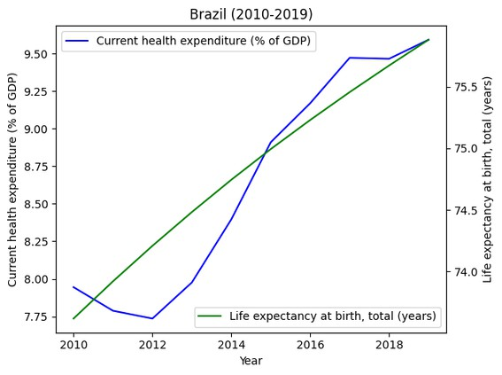
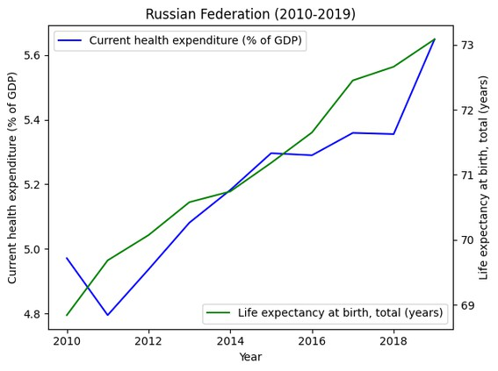
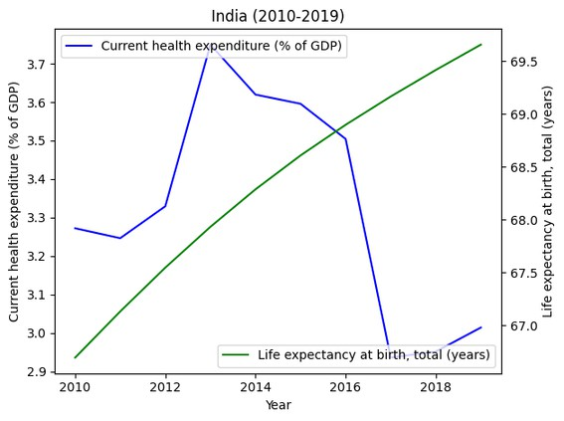
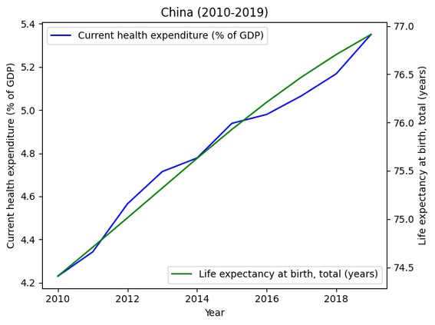
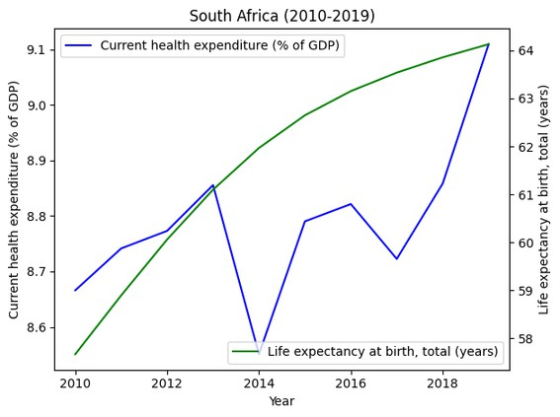
COMPARISONS & CORRELATIONS
Current heath expenditure vs Life expectancy

Slide 10
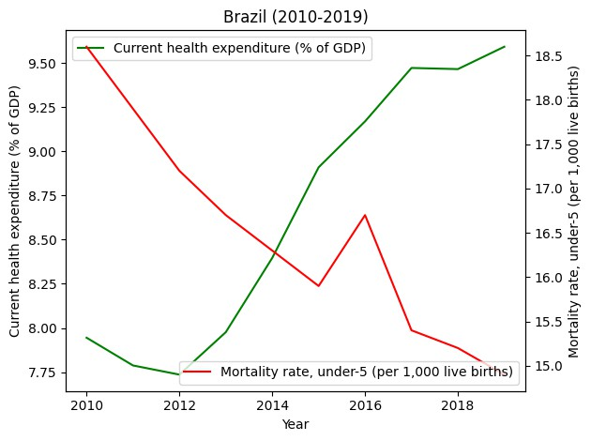
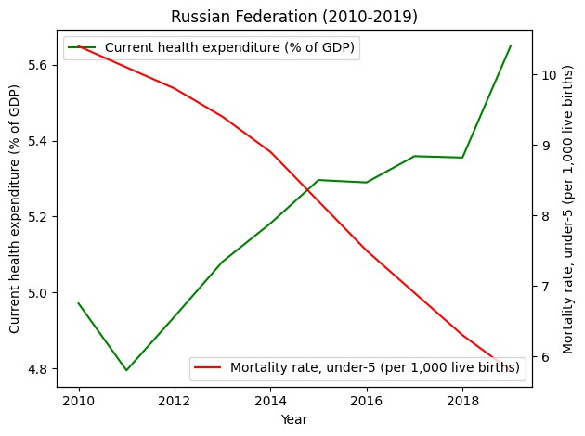
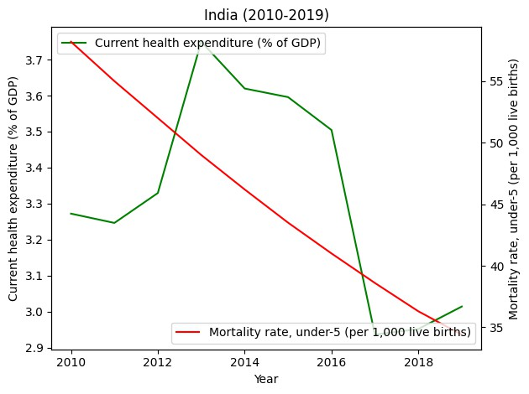
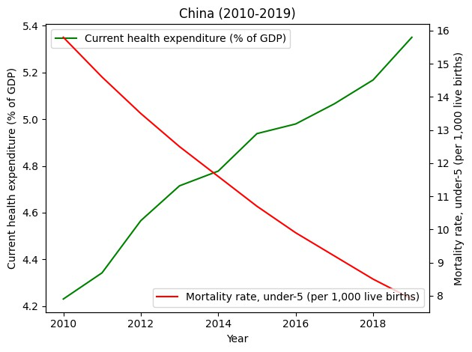
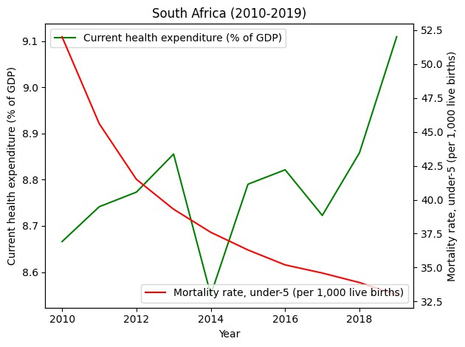
COMPARISONS & CORRELATIONS
Current heath expenditure vs Mortality rate (under-5)

Slide 11
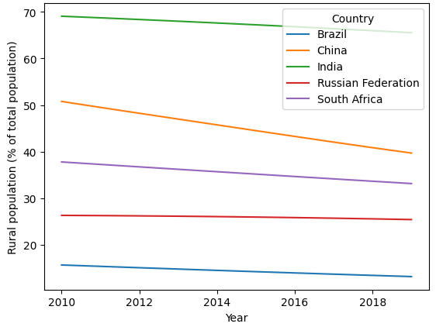
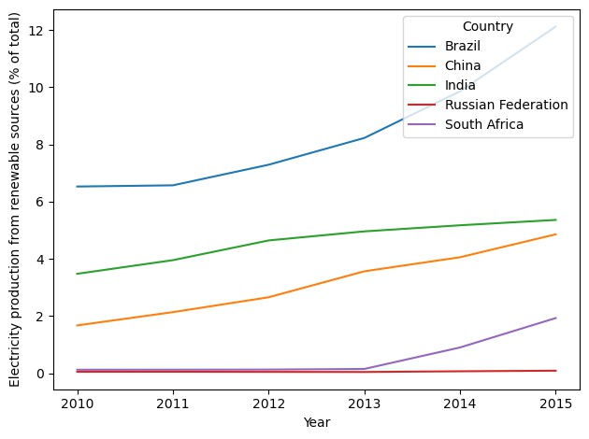
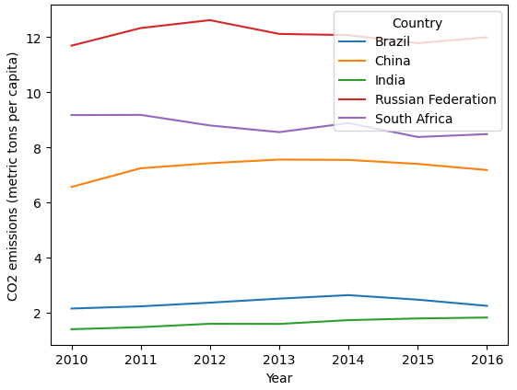
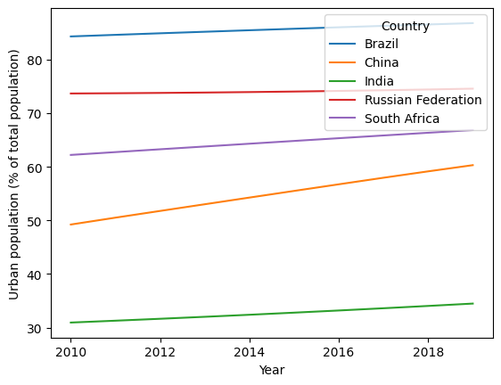
ENVIRONMENT INDICATORS
Education & Environment Indicators looked at:
Rural & Urban population (% of total population) CO2 emissions ( metric tons per capita)
Electricity production from renewable sources (% of total)

Slide 12
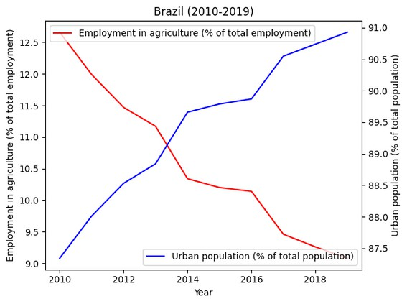
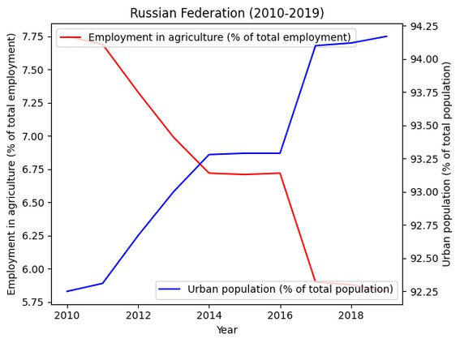
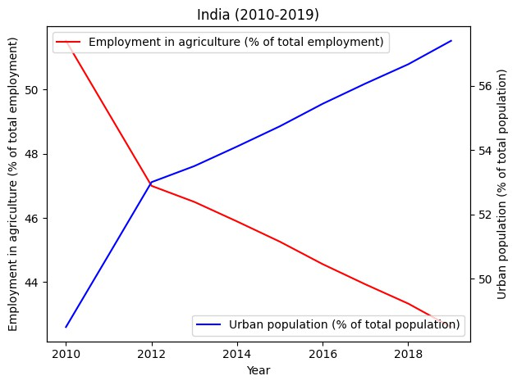
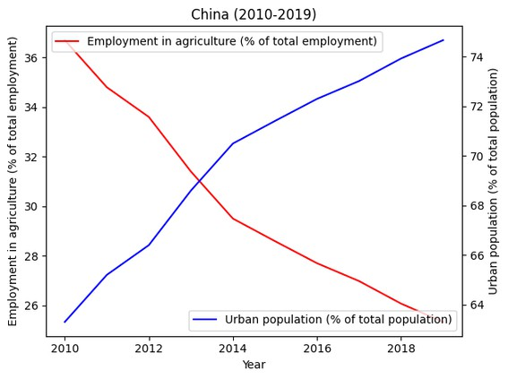
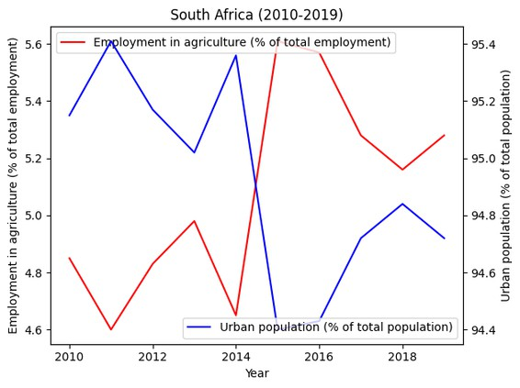
COMPARISONS & CORRELATIONS
Employment in agriculture vs Urban population

Slide 13
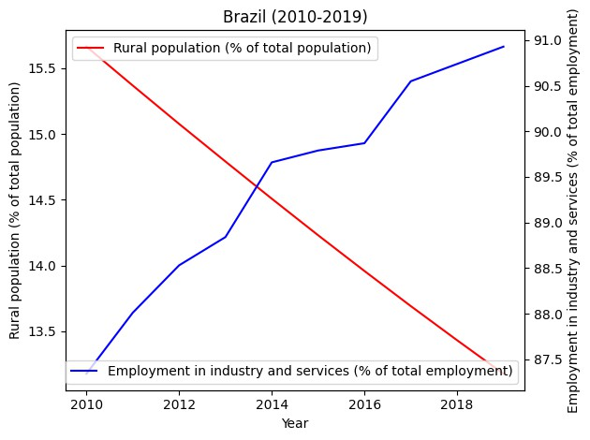
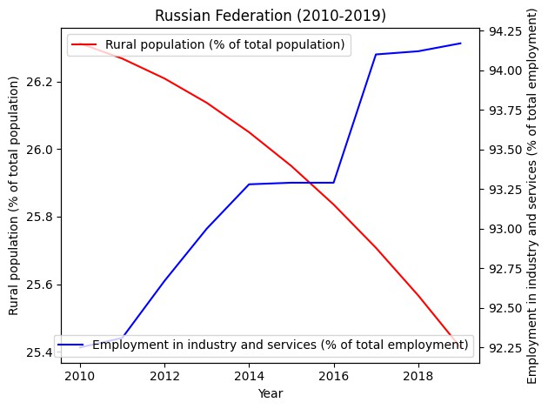
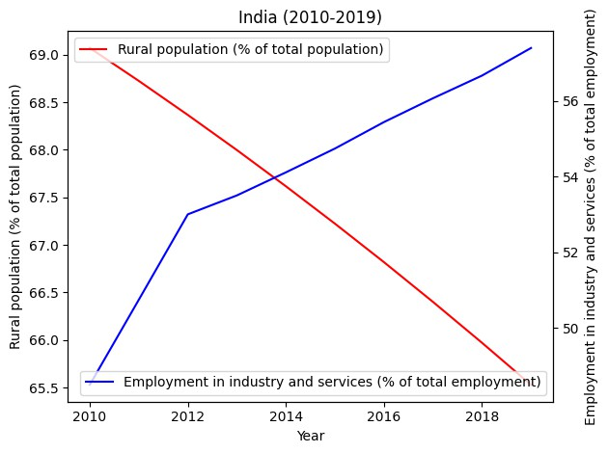
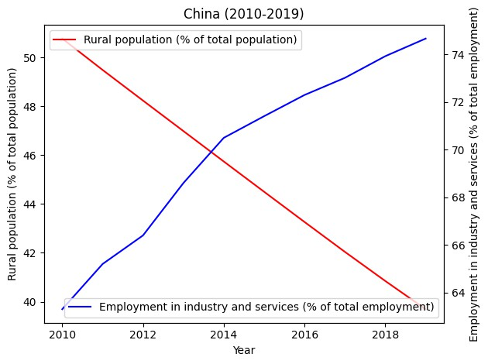
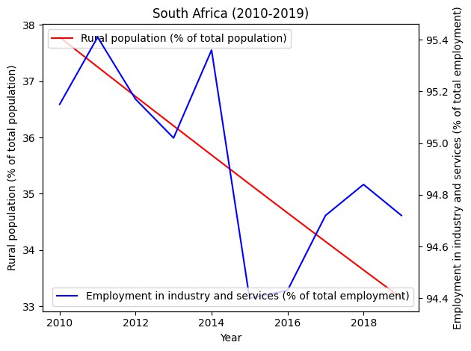
COMPARISONS & CORRELATIONS
Rural population vs Employment in industry and services

Slide 14
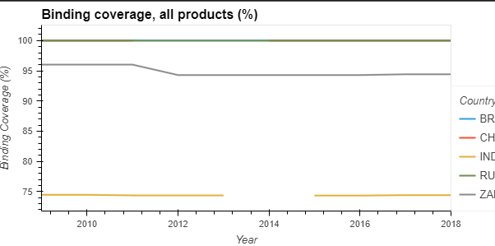
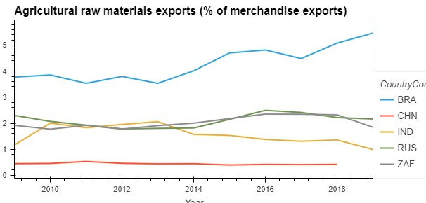
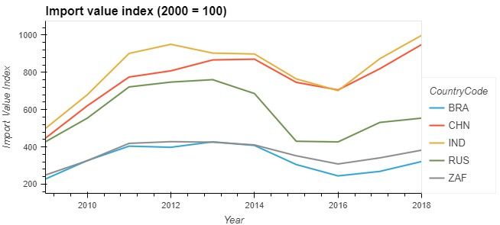
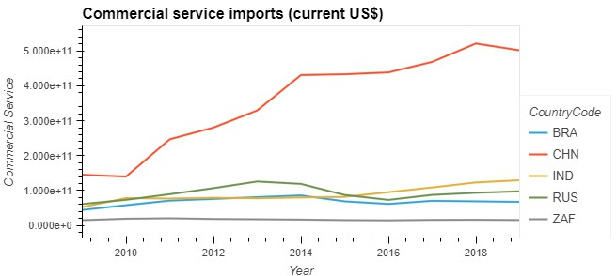

PUBLIC SECTOR INDICATORS
Indicators looked at for Private Sector:
Agricultural raw material export (% of merchandise exports) Binding coverage, all products (%)
Commercial service imports (current US$) Import value index (2000 = 100)

Slide 15

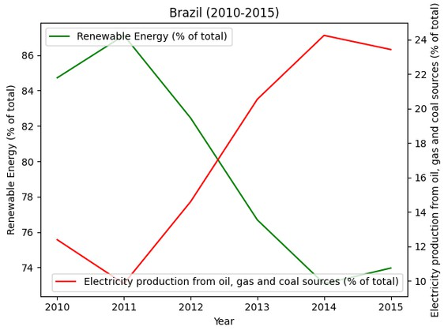
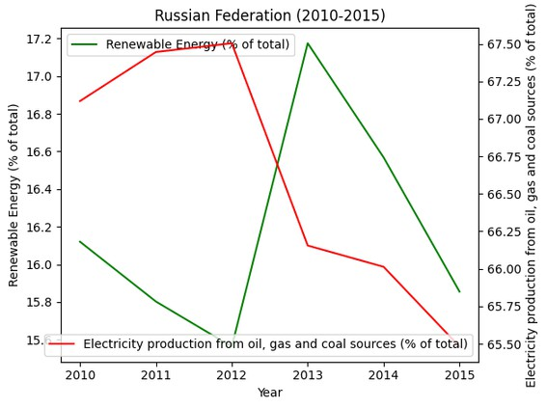
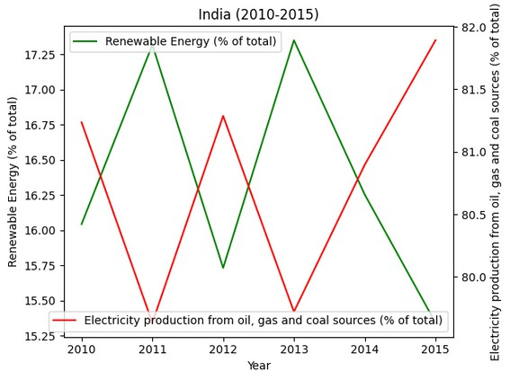
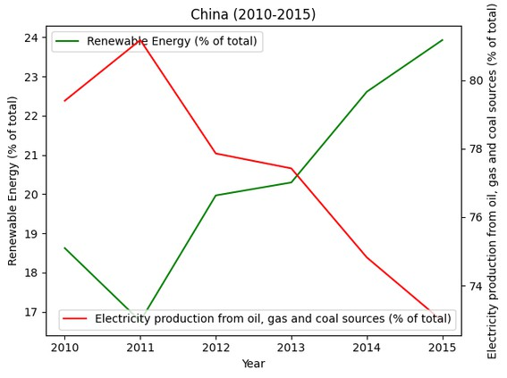
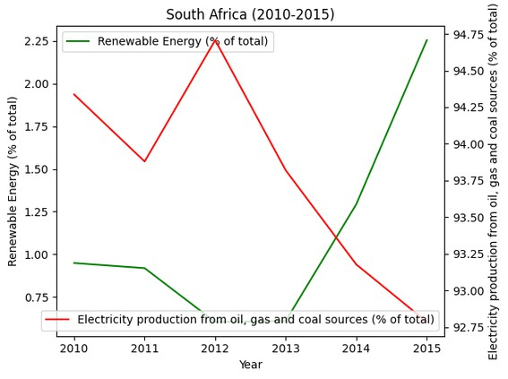
COMPARISONS & CORRELATIONS
Renewable energy vs Energy from fossil fuels

Slide 16
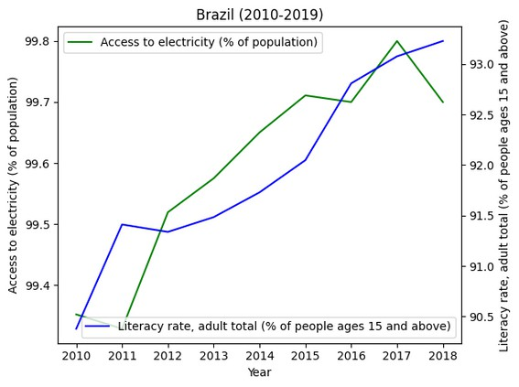
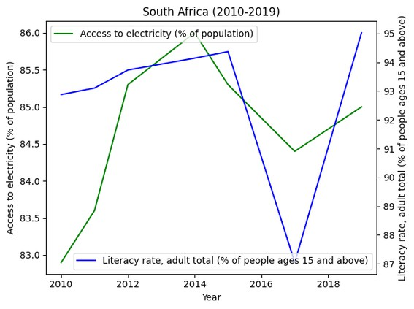
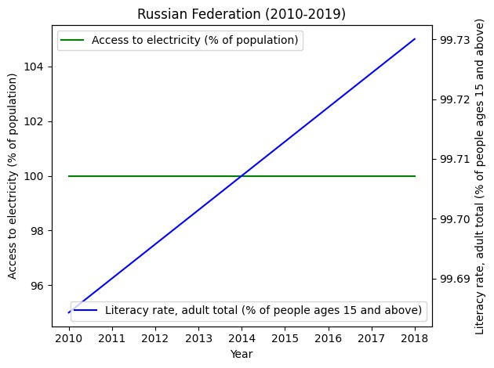
COMPARISONS & CORRELATIONS
Access to Electricity vs Literacy Rate

Slide 17


Thank You

