Slide 1
Classification of Accident Severity A Metrics Based Approach
Pg.1

Slide 2
Introduction
Road safety is a primary concern for drivers since traffic accidents can be fatal.
Without data, drivers rely on their intuitive perception of the environment to determine the level of cautiousness when they drive, which can be inaccurate at times.
For example, drivers may underestimate the danger of speeding on a wet road even after the rain has stopped, or overestimate the risks of driving with light fog.
Pg.2

Slide 3
Introduction
Aim: Classify severity of traffic accidents using relevant features
Therefore, it is important to educate drivers with correct road safety knowledge that is backed-up by empirical evidence, to boost driving safety and confidence.
A multi-class model that classifies accidents of various degrees of severity according to different road conditions can inform drivers of the relevant risks so that they can adjust their level of cautiousness when driving.
Pg.3

Slide 4
Data
Shared dataset: Seattle city collisions
A multi-class model can be used to classify the various degrees of severity. The features used to classify would be variables such as road condition, light condition, weather, speeding (or not), and the lane the driver is in.
For example, consider a driver who is driving under 'wet', 'dark, streetlights on', 'not speeding', and on a particular lane.
Pg.4

Slide 5
Data
A trained model, when assuming that an accident does occur, can classify the severity of the accident. This would provide the driver with the 'worst-case scenario', rather than a probabilistic estimate of an accident occurring. This can still have the effect of inducing an appropriate level of cautiousness in the driver.
The features I will be using for classification are: Speeding, whether accident due to inattention, and whether driver under substance influence. Initially, other features were included, but there were too many categories which resulted in non-convergence of models.
Pg.5

Slide 6
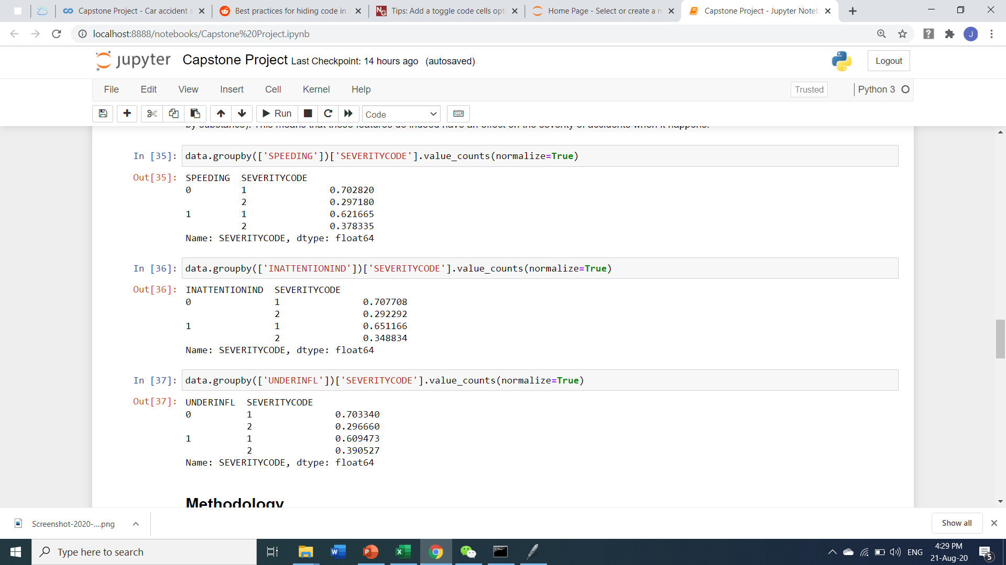
Data
In the following tables, we can see that the proportion of level 2 severity is higher when any of the three cases is true (speeding, inattentive, or influenced by substance). This means that these features do indeed have an effect on the severity of accidents when it happens.
Pg.6

Slide 7
Methodology
I take a metric-based approach in selecting the best classification algorithm to generate insights.
The three candidate models are: KNN, Decision Tree, and Logistic Regression.
The two metrics I rely on for model selection are “accuracy score” and “F1-score”.
Pg.7

Slide 8
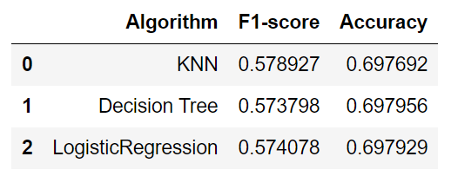
Methodology
We can see that the three models have about the same performance as measured by the two metrices.
Thus, I will choose the logistic regression model since it can give probability estimates.
Probability estimates will be more informative to drivers instead of pure categorization.
Pg.8

Slide 9
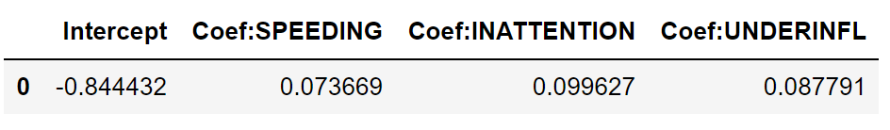
Results
Since the coefficients are positive, those three features has an effect of increasing accident severity.
The model provide empirical evidence against driving behaviours such as speeding, inattention, and substance-use driving.
Pg.9

Slide 10
END
Pg.10

