Slide 1
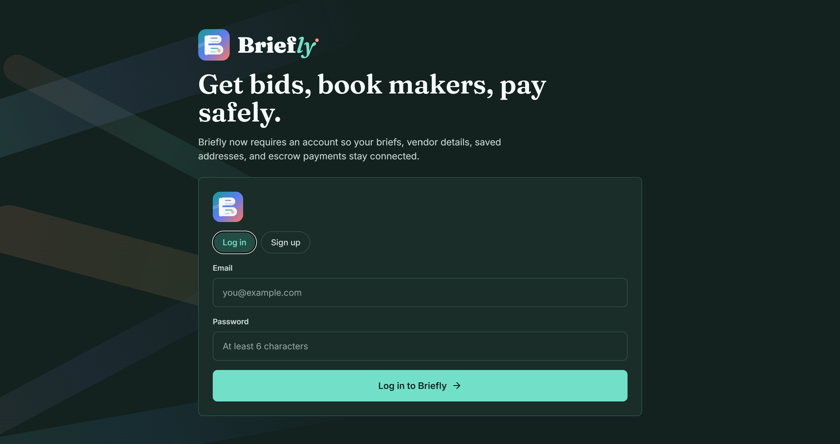
Briefly
01 / 15
THE SPECIFICATION INTERNET
Commerce should begin with human intent.
Not product catalogues. Briefly transforms what people want into standardized manufacturing specifications.
Transforming human intent into standardized manufacturing specifications.

Slide 2
Briefly
02 / 15
THE HIDDEN PROBLEM
Commerce begins with products. People do not.
Customers
Manufacturers
● Cannot find exactly what they need
● Compromise on design or functionality
● Contact multiple manufacturers
● Repeatedly explain requirements
● Wait days for quotations
● Receive vague enquiries
● Spend hours clarifying requirements
● Educate customers on materials and constraints
● Prepare quotations that never convert
The real bottleneck is not manufacturing. It is translating human intent into something manufacturers can actually build.

Slide 3
Briefly
03 / 15
THE PIVOT
We thought we were solving the wrong problem.
Initial assumption
What manufacturers told us
Find manufacturers
→
Marketplace MVP
✓ Customers do not know what manufacturers need
✓ Clarification wastes time
✓ Budgets and materials are misunderstood
✓ Standardized specs reduce quotation effort
5 interviews
→
Real bottleneck
"It turns an ambiguous design conversation into a deterministic procurement transaction."
Teck Soon Furniture

Slide 4
Briefly
04 / 15
INTRODUCING THE SPECIFICATION INTERNET
We remove ambiguity before manufacturing begins.
Instead of
We propose
Customer
Customer intent
↓
↓
Search products
AI specification copilot
↓
↓
Compromise
Specification packet
↓
↓
Purchase
Multiple manufacturers
We do not replace manufacturers. We help customers arrive with quote-ready requirements.

Slide 5
Briefly
05 / 15
THE AI SPECIFICATION COPILOT
From a sentence to a manufacturable packet.
Customer intent
"I need a walnut study desk under my staircase."
Funding step change
AI clarifies
AI generates
Current MVP
Next phase
✓ Dimensions
✓ Budget
✓ Materials
✓ Doorway access
✓ Cable management
✓ Child-safe needs
● Material recommendations
● Cost estimate
● Lead time estimate
● Manufacturability checks
● Simple 3D preview
● Specification packet
✓ Requirement collection
✓ Manufacturer discovery
✓ Quotation workflow
● AI clarification engine
● Specification packet
● Material recommendation
● Cost estimation
● 3D preview

Slide 6
Briefly
06 / 15
OUR MVP
Build. Validate. Improve.
Current MVP
Why we started here
✓ Browse custom furniture
✓ Submit requirements
✓ Receive quotations
✓ Compare manufacturers
✓ Place order
● Validate the workflow first
● Learn from real users
● Avoid unnecessary features
● Prove demand before scaling
Validate first. Build second. Scale third.

Slide 7
Briefly
07 / 15
BUILT. TESTED. PIVOTED.
We challenged our assumptions.
Problem
→
Marketplace MVP
→
Survey
→
Manufacturer interviews
→
Specification Internet
User feedback
Product improvement
Strategic result
Customers struggle to explain requirements
AI clarification workflow
Less vague demand
Manufacturers ask repetitive questions
Specification packet
Faster quotation
Specifications are inconsistent
Universal structured format
Comparable bids
MVP too broad
Focus on custom wooden furniture
Sharper validation

Slide 8
Briefly
08 / 15
MARKET VALIDATION
Validated by customers and manufacturers.
Customer validation
Manufacturer validation
● XX respondents
● XX% could not find exactly what they wanted
● XX% compromised or gave up
● XX% found the AI workflow valuable
● XX waitlist signups
✓ 5/5 reported missing specifications
✓ 5/5 spend significant time clarifying
✓ 5/5 said standardized specs reduce effort
✓ 4/5 interested in piloting
"If your AI can tell customers their budget does not match their material choice before they talk to me, you save me 80% of my nightly headaches."
WD Custom Woodcraft

Slide 9
Briefly
09 / 15
WHY EXISTING SOLUTIONS FALL SHORT
Existing platforms help people find products. We help people define what they need.
Existing solutions
The Specification Internet
Starting point
Products
Human intent
Workflow
Search and compromise
AI clarification
Specifications
Manual
Standardized
Quotations
One manufacturer
Competitive bidding
Innovation
Marketplace
Specification engine

Slide 10
Briefly
10 / 15
MARKET OPPORTUNITY
A focused wedge into custom manufacturing.
Phase 1
Phase 2
Phase 3
Singapore custom wooden furniture
● Wardrobes
● Kitchen cabinets
● Office furniture
● Retail displays
● Commercial fit-out
● Renovation
● Custom manufacturing
TAM
SAM
SOM
Global custom manufacturing
Singapore custom furniture
500 users, 100 specs, 30 projects
Long-term vision: a universal specification layer connecting customers and manufacturers worldwide.

Slide 11
Briefly
11 / 15
BUSINESS MODEL
Manufacturers pay when we create real business.
Today: marketplace commission
Future: manufacturer SaaS
Small commission on successfully completed projects.
● AI quotation assistant
● Specification management
● Workflow automation
Enterprise API
Premium AI tools
Integrate the Specification Engine into manufacturing software.
● Advanced design refinement
● Specification history
● Enhanced 3D previews

Slide 12
Briefly
12 / 15
ROADMAP
From MVP to public beta.
Already achieved
0-3 months
4-6 months
7-9 months
10-12 months
Marketplace MVP, survey, interviews, pivot
AI clarification engine
Spec packet and material recommendation
Pilot with 5-10 manufacturers
Public beta launch
500
100
30
5-10
users
specifications
completed projects
manufacturer partners

Slide 13



Briefly
13 / 15
ABOUT US
Meet the team building Briefly.
CEO
CFO
CTO
Mohamed Sirajudeen Bin Mohamed Rabik
Thanis Senthilkumas
Sherwin Rufus
Siraj
Thanis
Sherwin
Leads product direction, customer discovery, and the overall Briefly vision.
Owns finance, business modelling, and validation of the commercial strategy.
Drives engineering, technical execution, and the AI specification roadmap.

Slide 14
Briefly
14 / 15
WHY WE ARE THE RIGHT TEAM
We started with a marketplace. Evidence changed the product.
Technical
Business
Design
● Full-stack development
● AI integration
● Product engineering
● Customer discovery
● Validation
● Partnerships
● UX/UI
● Prototyping
● User experience
Instead of defending our original idea, we changed it. Evidence of execution: working MVP, customer survey, manufacturer interviews, product pivot, AI roadmap, live demo.

Slide 15
Briefly
15 / 15
THE FUTURE OF COMMERCE
Products built exactly as needed.
Today
Tomorrow
Products
Human intent
↓
↓
Customers compromise
AI spec copilot
↓
Standardized specification
↓
Manufacturers
The internet standardized how information moves. Manufacturing needs a standardized specification layer so products begin with human intent, not product catalogues.
We are not building a better marketplace. We are building the missing layer between imagination and manufacturing.

