Slide 1
FAR
To advance use “→” or “Enter”
The Freshman Advising Resource
A Web-based Advising Tool
All rights reserved 1999-2016

Slide 2
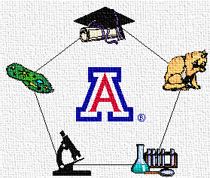
FAR: Uwe Hilgert, Ph.D.
Uwe Hilgert, Ph.D.
BIO5 Institute
University of Arizona
(Veterinary Science and Microbiology Advisor, 1996-2000)
Contact: hilgert /at\ uwe-hilgert.net

Slide 3
FAR: Foundation For Student Success
New Student Success
Advising lays the foundation for new students’ success
Advising is crucial for transition from high school or 2-year college.
Quality of first meaningful personal contacts with members of educational institution are instrumental for student retention and graduation (NACADA).
Academic advisors often are the first institutional officials with whom students spend quality time – and who they will continue to meet during their education.

Slide 4
FAR: The Problem
The reality, however, looks bleak:
The first contacts between Freshmen and advisors are often limited and not conducive to building meaningful relationships nor providing a sound basis beyond hastily putting together a first-semester schedule.

Slide 5
FAR: Limitations Without FAR
Because:
Freshmen often meet with their advisors in groups of 5-20 students.
Limited opportunities for immediate individual follow due to rushed summer orientation events.
Meeting time used for explaining the system and to help students put schedule together.
Time too short to work with students through the frustrating experience of not being able to enroll for courses they envisioned they would take.
No time for starting to build relationships.

Slide 6
FAR: Concept
FAR delegates the repetitive aspects of first-semester scheduling to the Web.

Slide 7
FAR: Benefits
FAR
Improves advising efficiency.
Increases advising accuracy.
Frees time for personal interactions.
Replaces scheduling with advising.
Fosters student bonding.

Slide 8
FAR: Class Scheduling
Components of Course Scheduling
Degree/Major Requirements
Academic Preparedness
Personal Preparedness
Course availability
Course coordination

Slide 9
FAR: Individualized
FAR empowers each student to compose a schedule in accordance with her/his
current program requirements,
preparation as determined by entrance tests,
personal sense of readiness.

Slide 10
FAR
Individual
Flexible
On-line
Interactive
Up-to-date
Comprehensive

Slide 11
FAR: What Is It?
FAR Structure
Branched Web-pages
Multi-leveled
Decision-dependent navigation

Slide 12
FAR: 1 - Selecting Major
FAR Level 1: Major
FAR: Select (click) your major:
ANTH
EXSS
MICR
SPAN
Start

Slide 13
FAR: 2 - Selecting Math Test Results
FAR Level 2: Math Test Results
FAR: Click on your MATH result:
Pre-Algebra
Algebra
Calculus
Previously selected: MICR Major

Slide 14
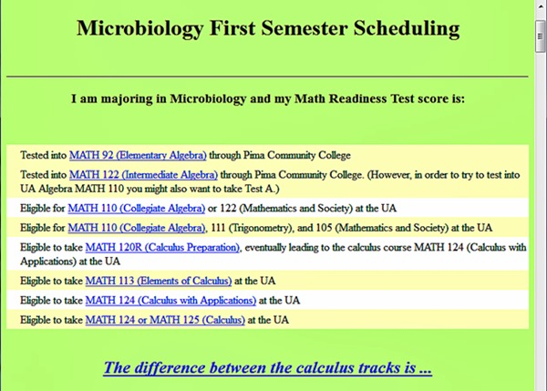
FAR: 2 - Selecting Math Test Results
FAR Level 2: Math Test Results
Previously selected: MICR Major

Slide 15
FAR: 3 - Selecting Desired Load
FAR Level 3: Desired Load
FAR: Click on your preference:
Calculus + Bio + Chem
Calculus + one of (Bio, Chem)
Calculus, no lab science
Bio + Chem, no Calculus
Bio or Chem, no Calculus
Previously selected:
1) MICR Major
2) Calculus eligible

Slide 16
FAR: 4 – Compose Appropriate Schedule
FAR Level 4: A list of courses for the first fall:
FAR: Compose schedule from:
Calculus (4 credits)
General Education (3 credits)
Communications (3 credits)
Foreign Languages (3 credits)
Previously selected:
1) MICR Major
2) Calculus eligible
3) Calculus, no lab science

Slide 17
FAR: From Clueless To Scheduled
FAR
***
From “Clueless” to “Scheduled”
in less than 30 min.
***

Slide 18
FAR: Outcomes
FAR Success: FAR has exceeded all expectations:
Using FAR students quickly and efficiently create accurate and optimal course lists.
Students have their schedule ready when they meet their advisor.
FAR-assisted scheduling 90% appropriate.
FAR minimizes time necessary for scheduling.
FAR frees time for developmental advising and relationship-building.
FAR fosters student bonding.

Slide 19
FAR: Advantages
Advantages of using FAR
FAR frees advisor’s time to talk about course of study, preparedness, and goals, and to tend to questions,
FAR supports less experienced advisors,
FAR minimizes waiting and advising time for students, AND...

Slide 20
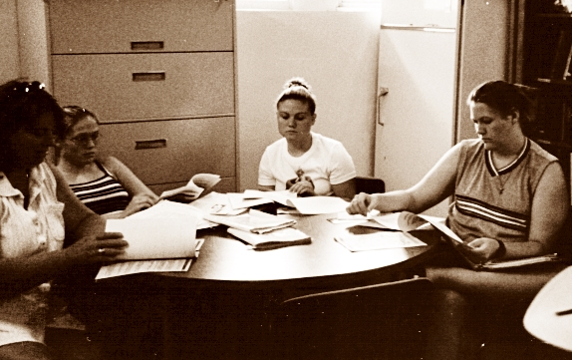
FAR: Before FAR
Without FAR
Students wait to talk to an advisor

Slide 21
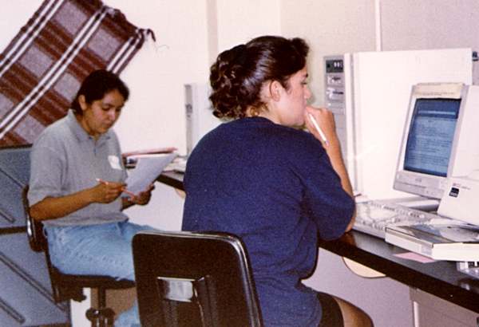
FAR: With FAR
With FAR
Students work on their schedules, then see advisor

Slide 22
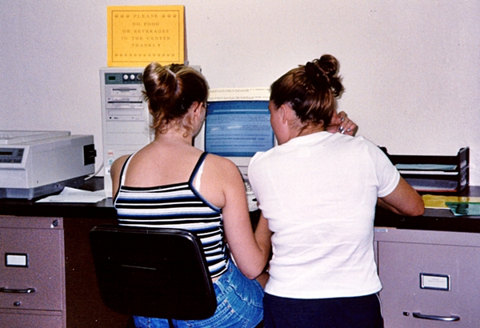
FAR: SURPRISE!
Unexpected benefit of using FAR
Indeed, students connect through FAR

Slide 23
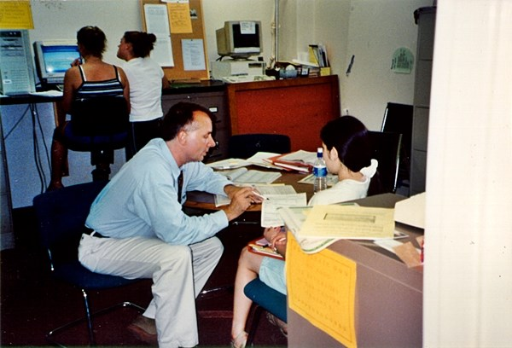
FAR: Quality Time
FAR frees advising time to talk about important issues

Slide 24
FAR: Summary
Summary
FAR
Delegates repetitive scheduling aspects to IT;
Frees advising time to focus on other important concerns;
Allows advisor to spend quality time with student;
Fosters group work among students;
Supports student bonding.

Slide 25
FAR
Use it!
Contact hilgert /at\ uwe-hilgert.net
All rights reserved 1999-2016

