Slide 1
Simulation of Forest Management under Climate Change
Paper 3
Notes:
https://www.researchgate.net/publication/51997305_Use_of_Brooks-Corey_Parameters_to_Improve_Estimates_of_Saturated_Conductivity_from_Effective_Porosity

Slide 2
Possible titles
Linking forest management and climate change with a dynamic forest growth model: Warming above 1.5° C would increase the risk of long-term changes in ecosystem functions
Long-term effects of disturbance on the growth and yield of a Neotropic forest: Warming above 1.5° C would increase the risk of long-term changes in ecosystem functions
Predicting the effects of disturbance on the growth and yield of a Neotropic forest: Linking forest management and climate change in a dynamic forest model
Long-term effects of disturbance on the growth and yield of a Neotropic forest: Linking forest management and climate change in a dynamic forest model

Slide 3
research questions
How do biomass dynamics of disturbed or undisturbed forests change under climate change (temperature, precipitation)?
What is the long-term impact of different rotation cycles, minimum stem diameter at breast height of cutting thresholds and climate change on ecosystem functions and properties (biomass, timber versus non-timber volumes, yield)?
What are the effects of climate factors on forest growth?

Slide 4
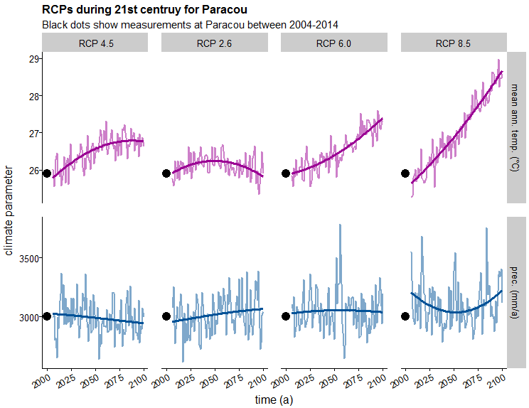

Slide 5
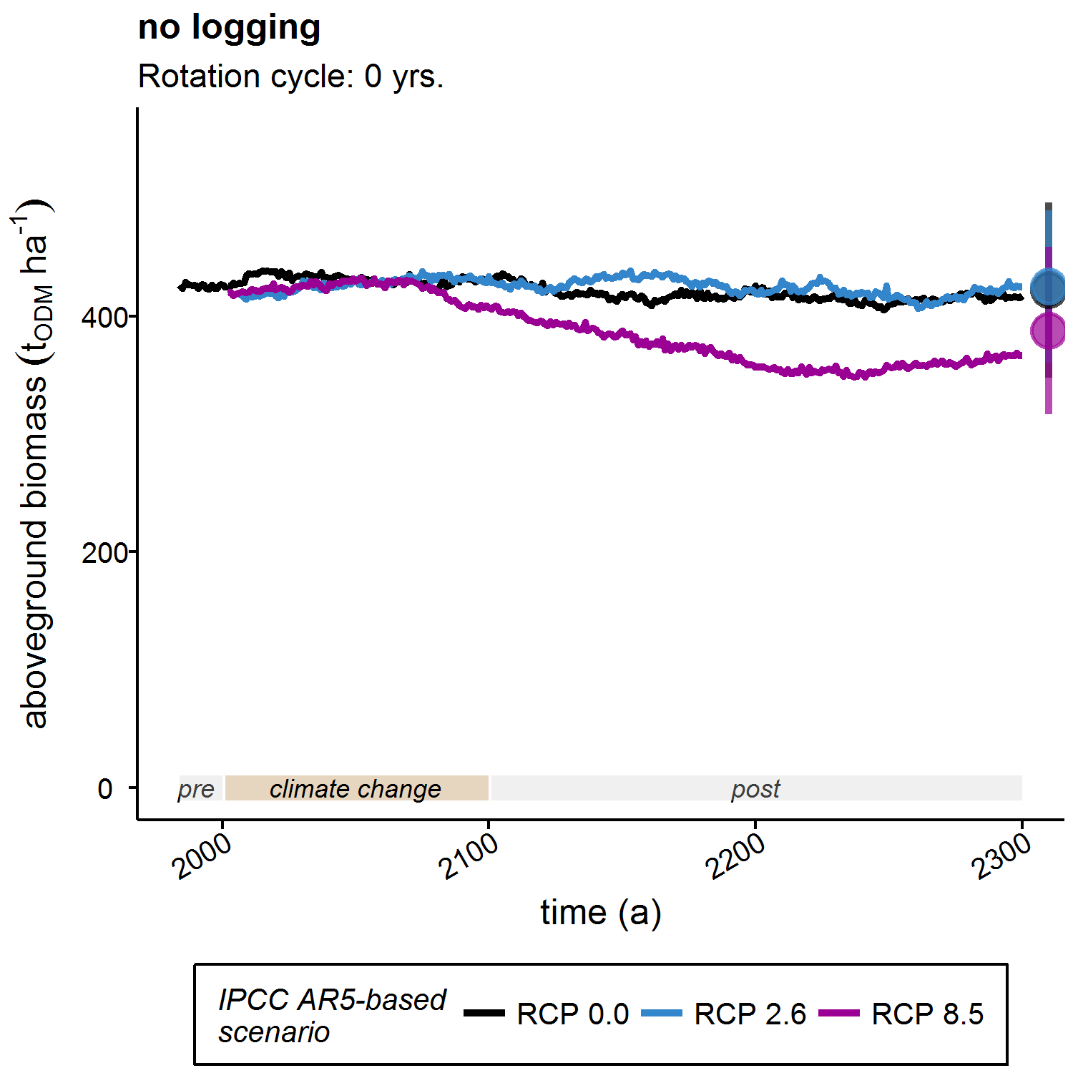

Slide 6
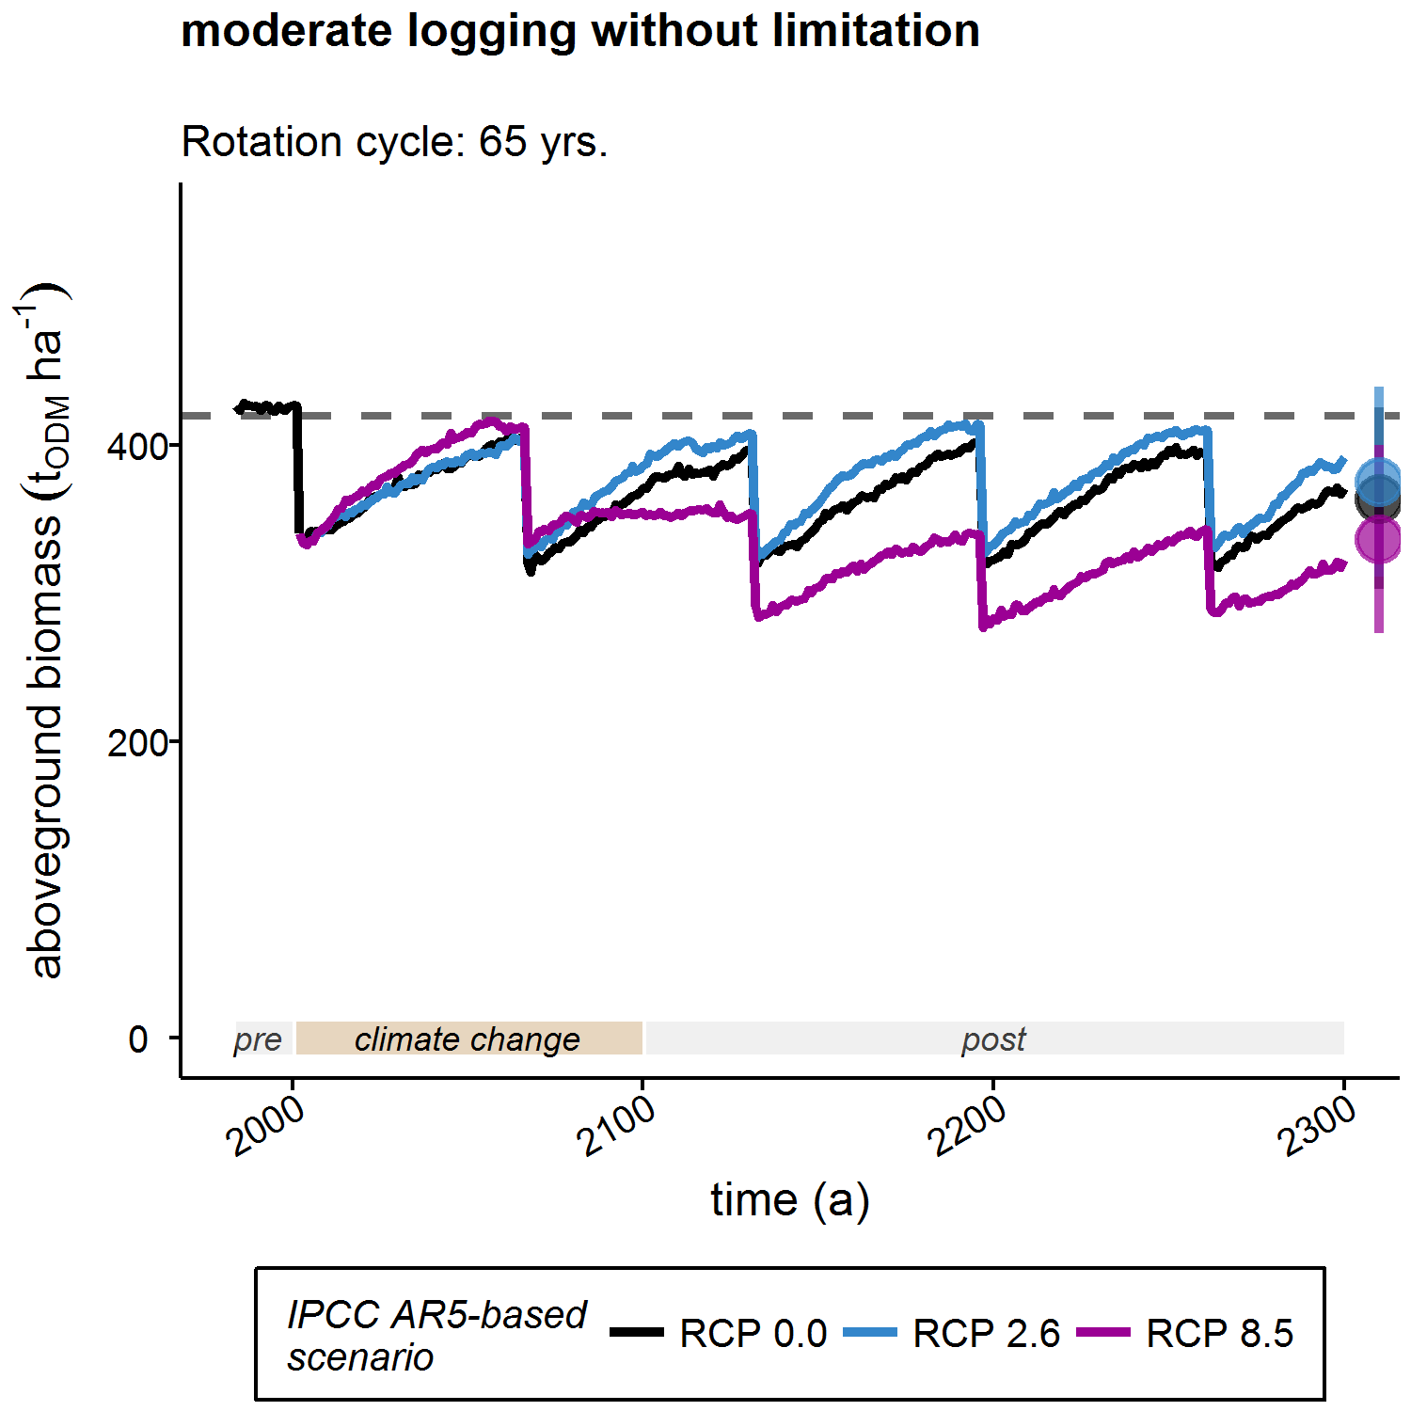
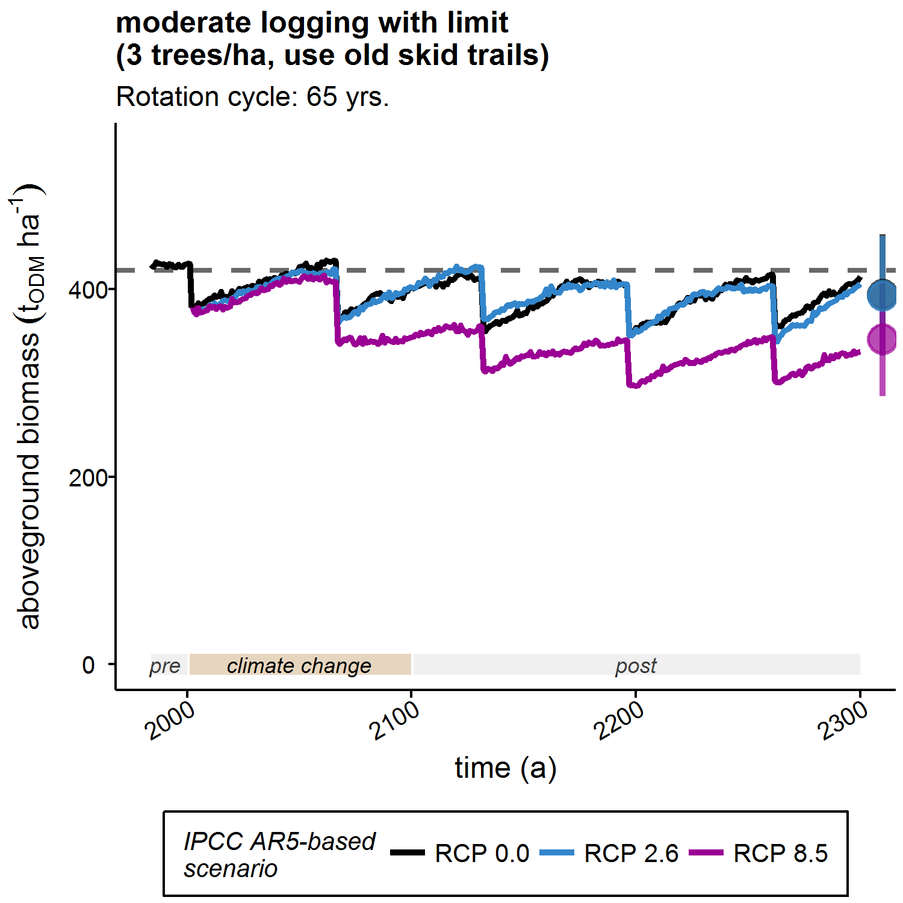

Slide 7
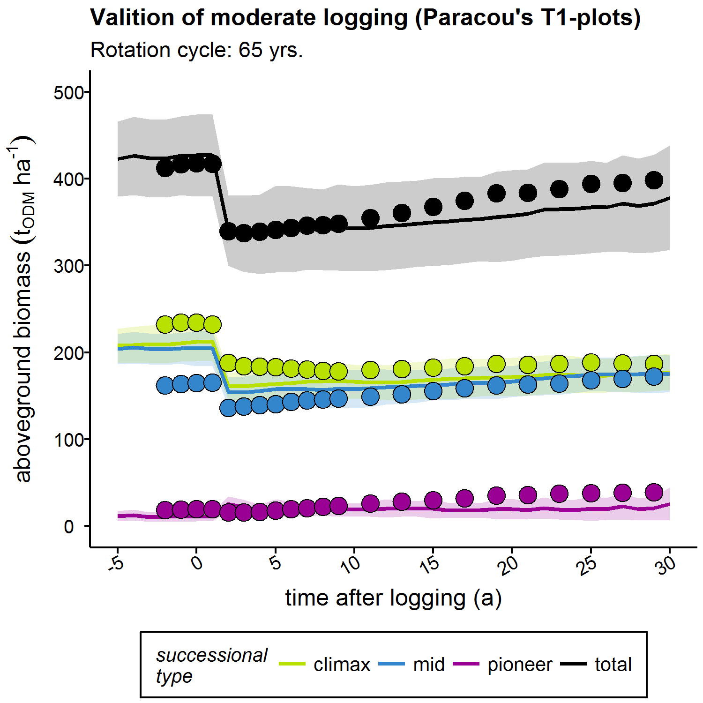

Slide 8
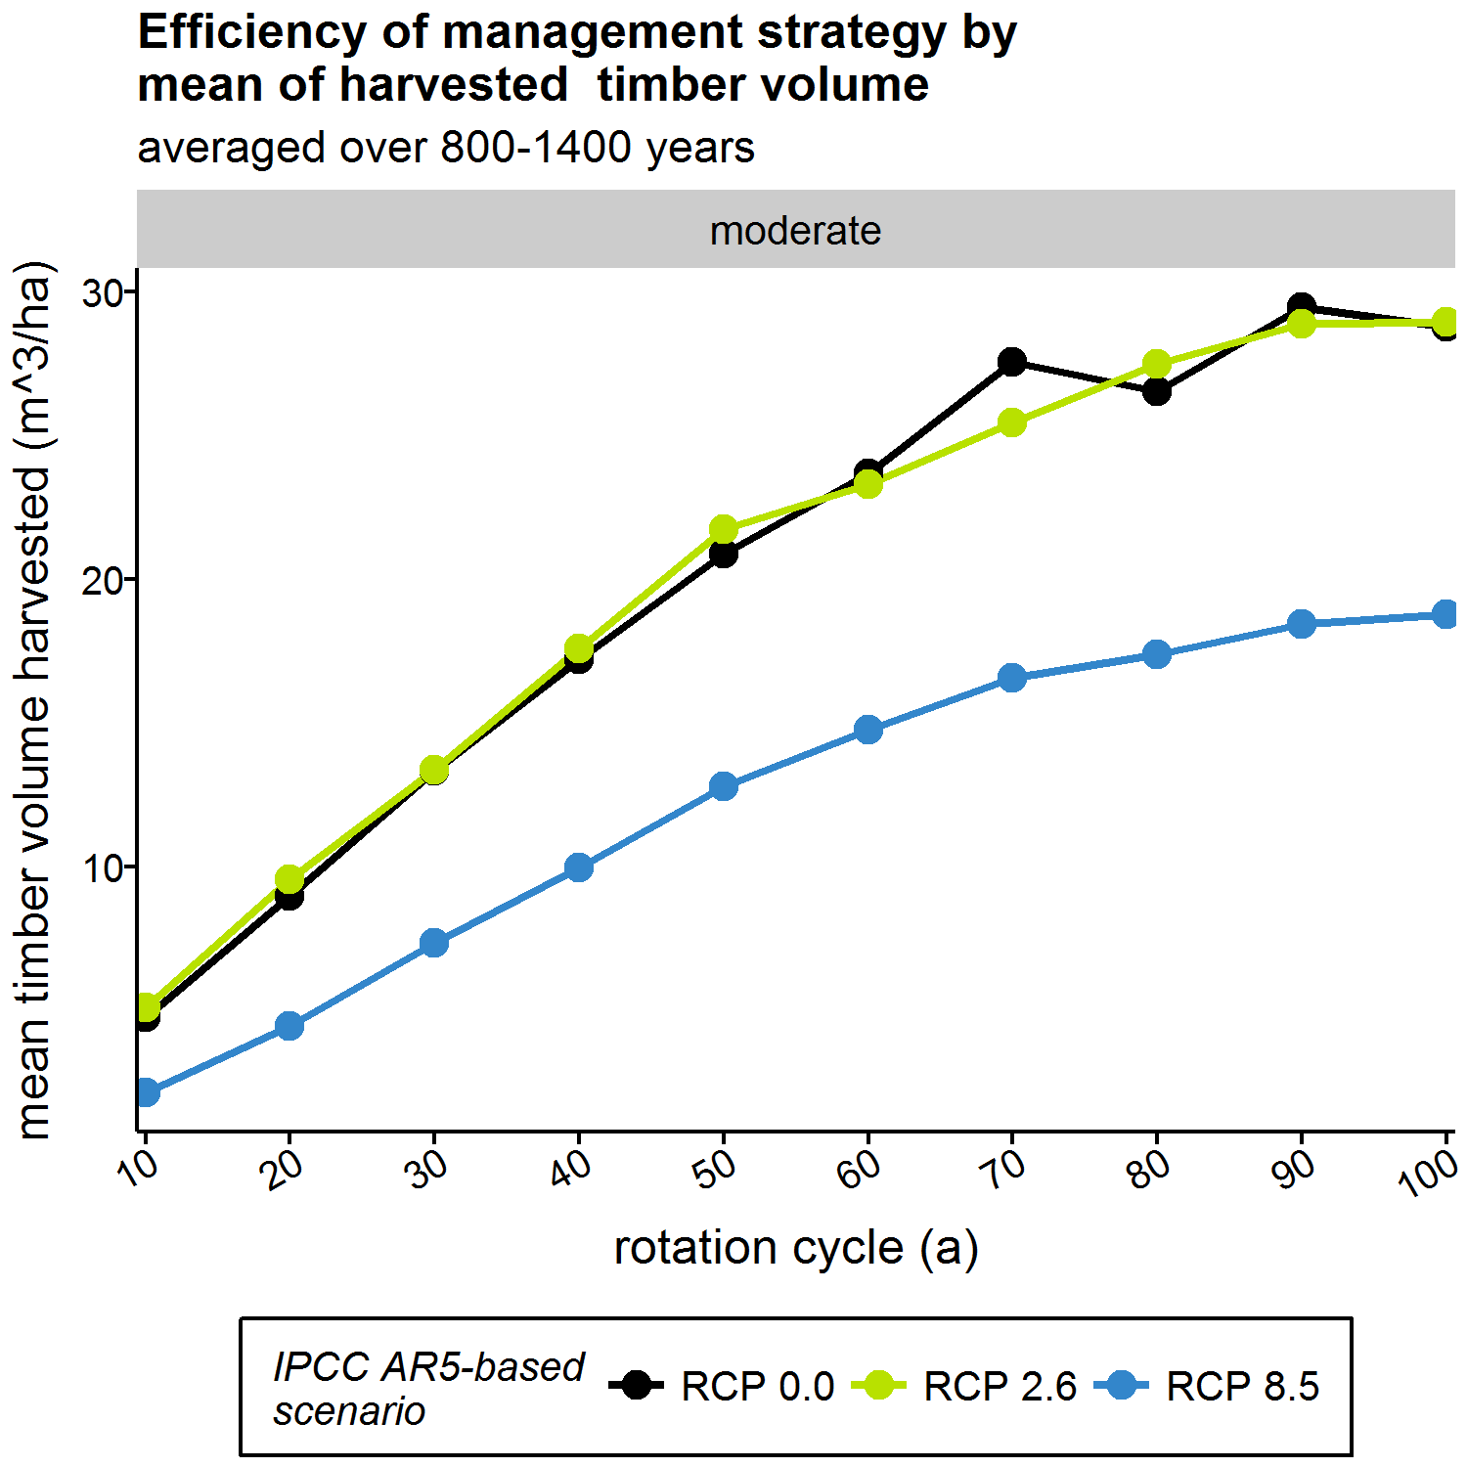
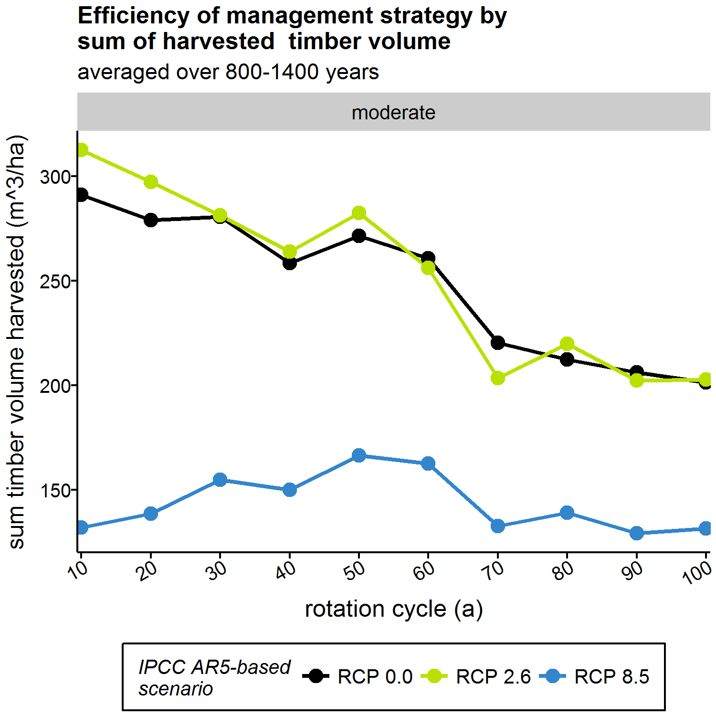
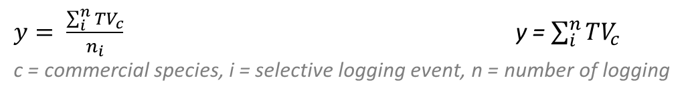
Use always new skid trails, no limitation (all harvestable trees are yielded),
Averages of time after climate change (new equilibrium)
$y= \frac{\sum_{i}^{n}{{TV}_{c}}}{n_{i}}$ y = $\sum_{i}^{n}{{TV}_{c}}$
c = commercial species, i = selective logging event, n = number of logging

Slide 9
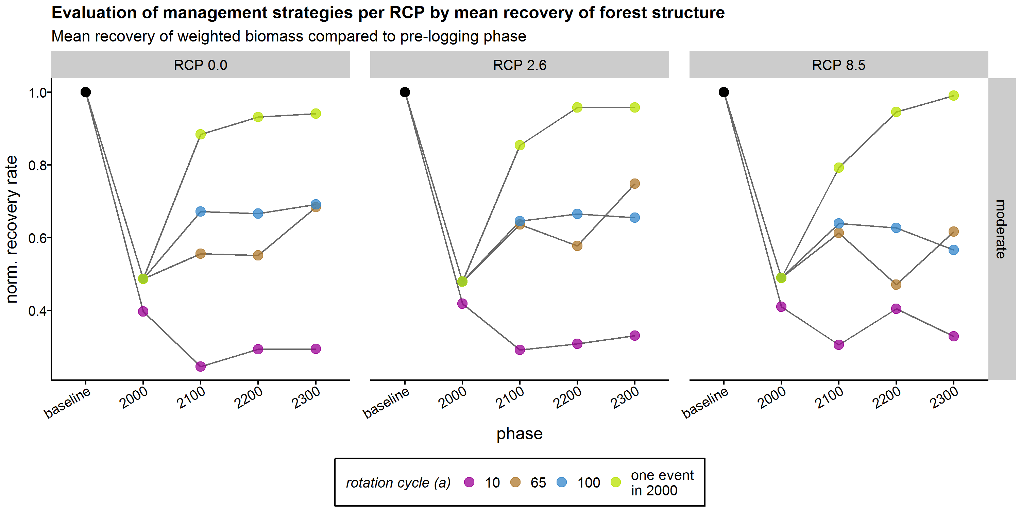

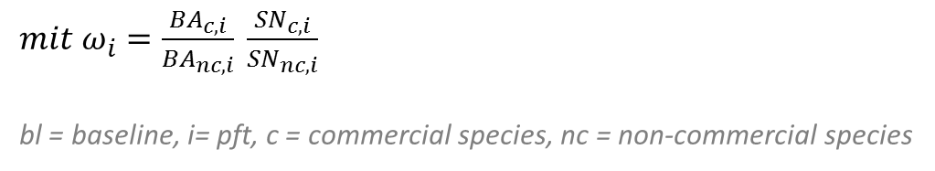
Work on progress only!
y $=\frac{AGB ω_{i}}{{AGB}_{bl} ω_{bl,i}}$
$mit ω_{i}=\frac{{BA}_{c,i}}{{BA}_{nc,i}} \frac{{SN}_{c,i}}{{SN}_{nc,i}}$
bl = baseline, i= pft, c = commercial species, nc = non-commercial species

Slide 10
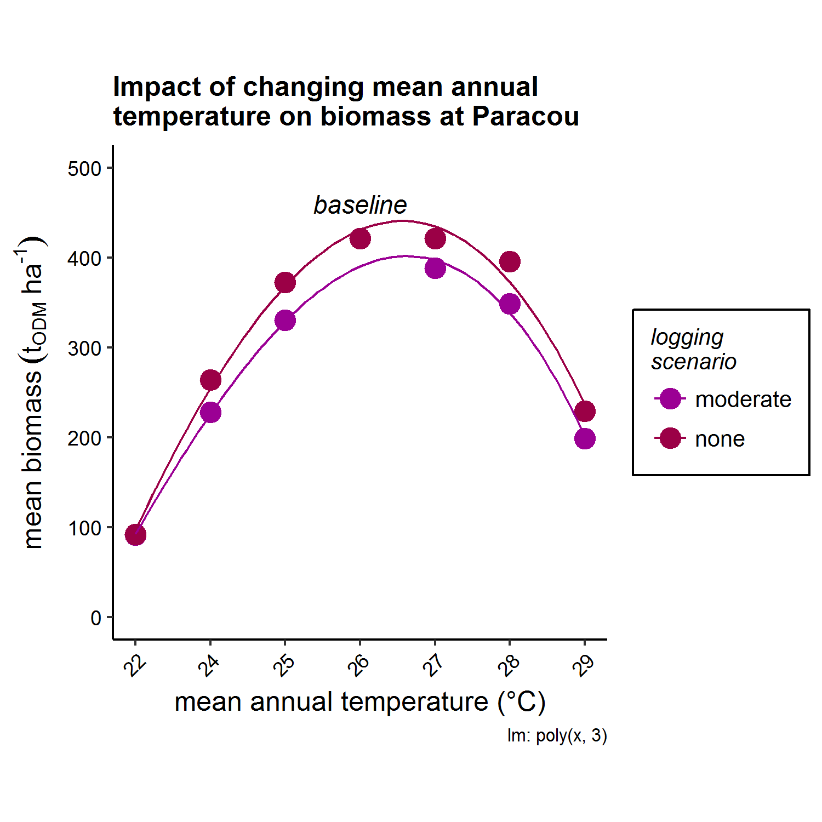
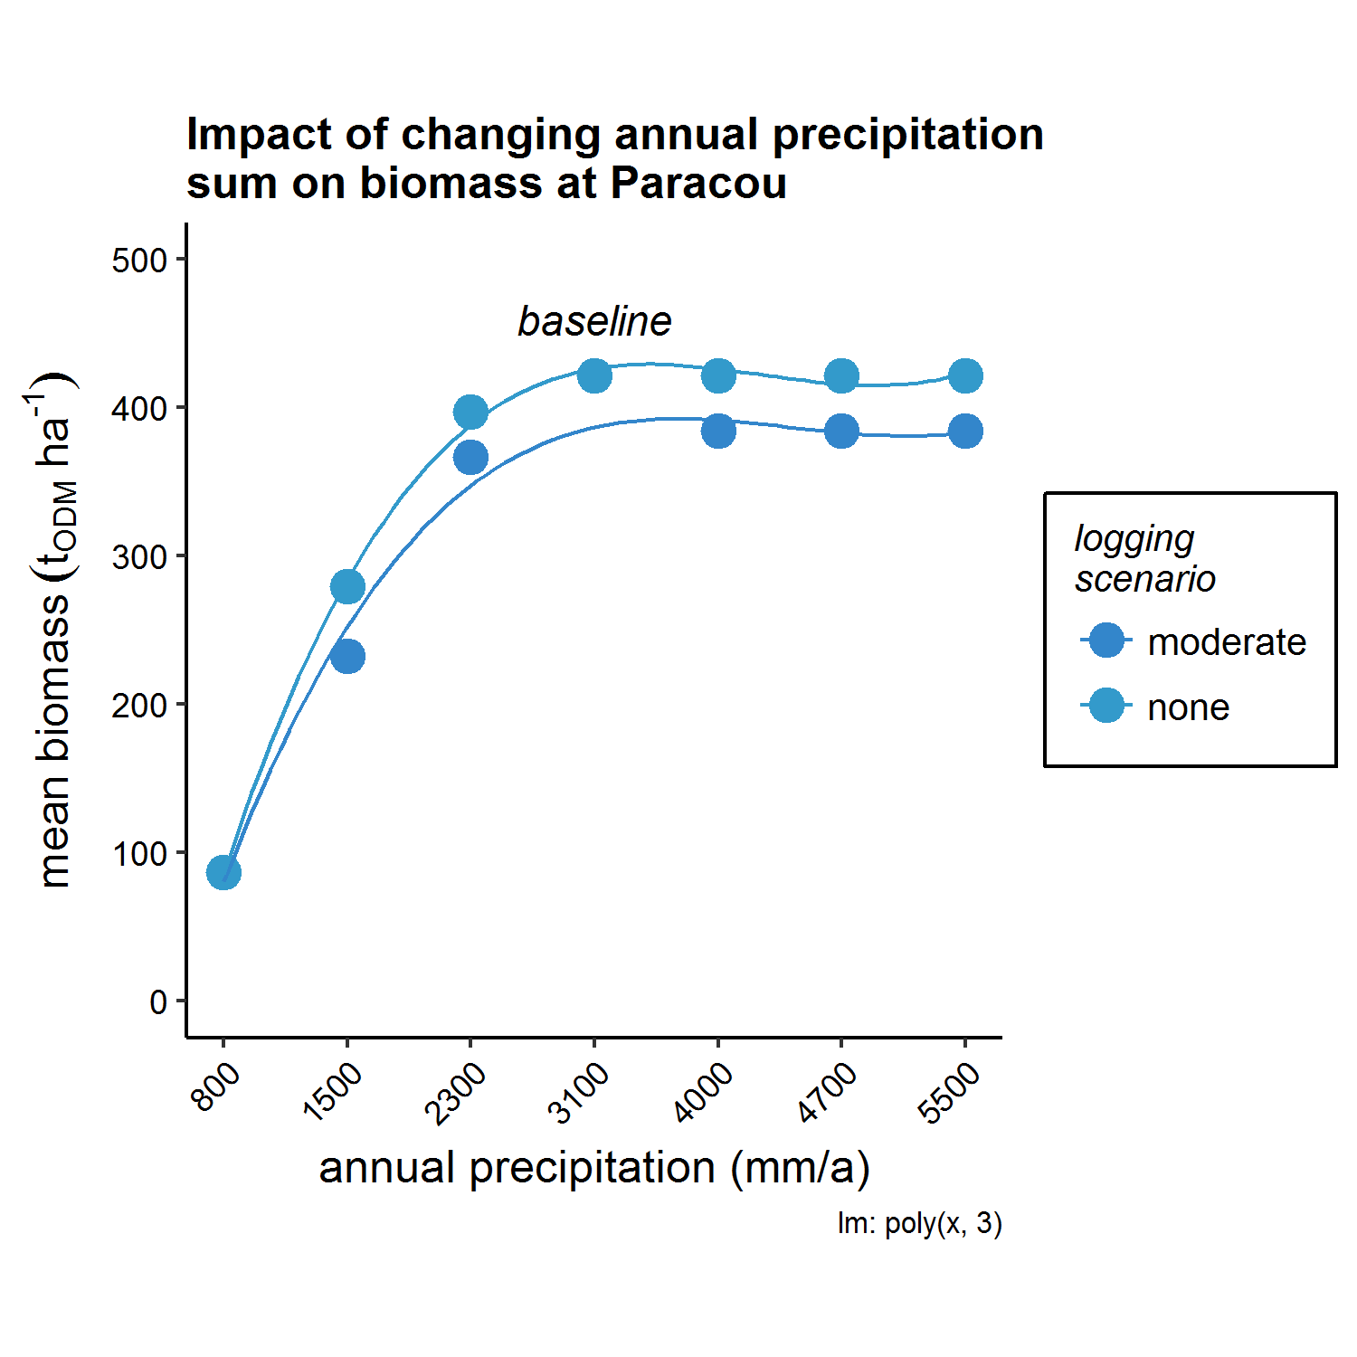

Slide 11
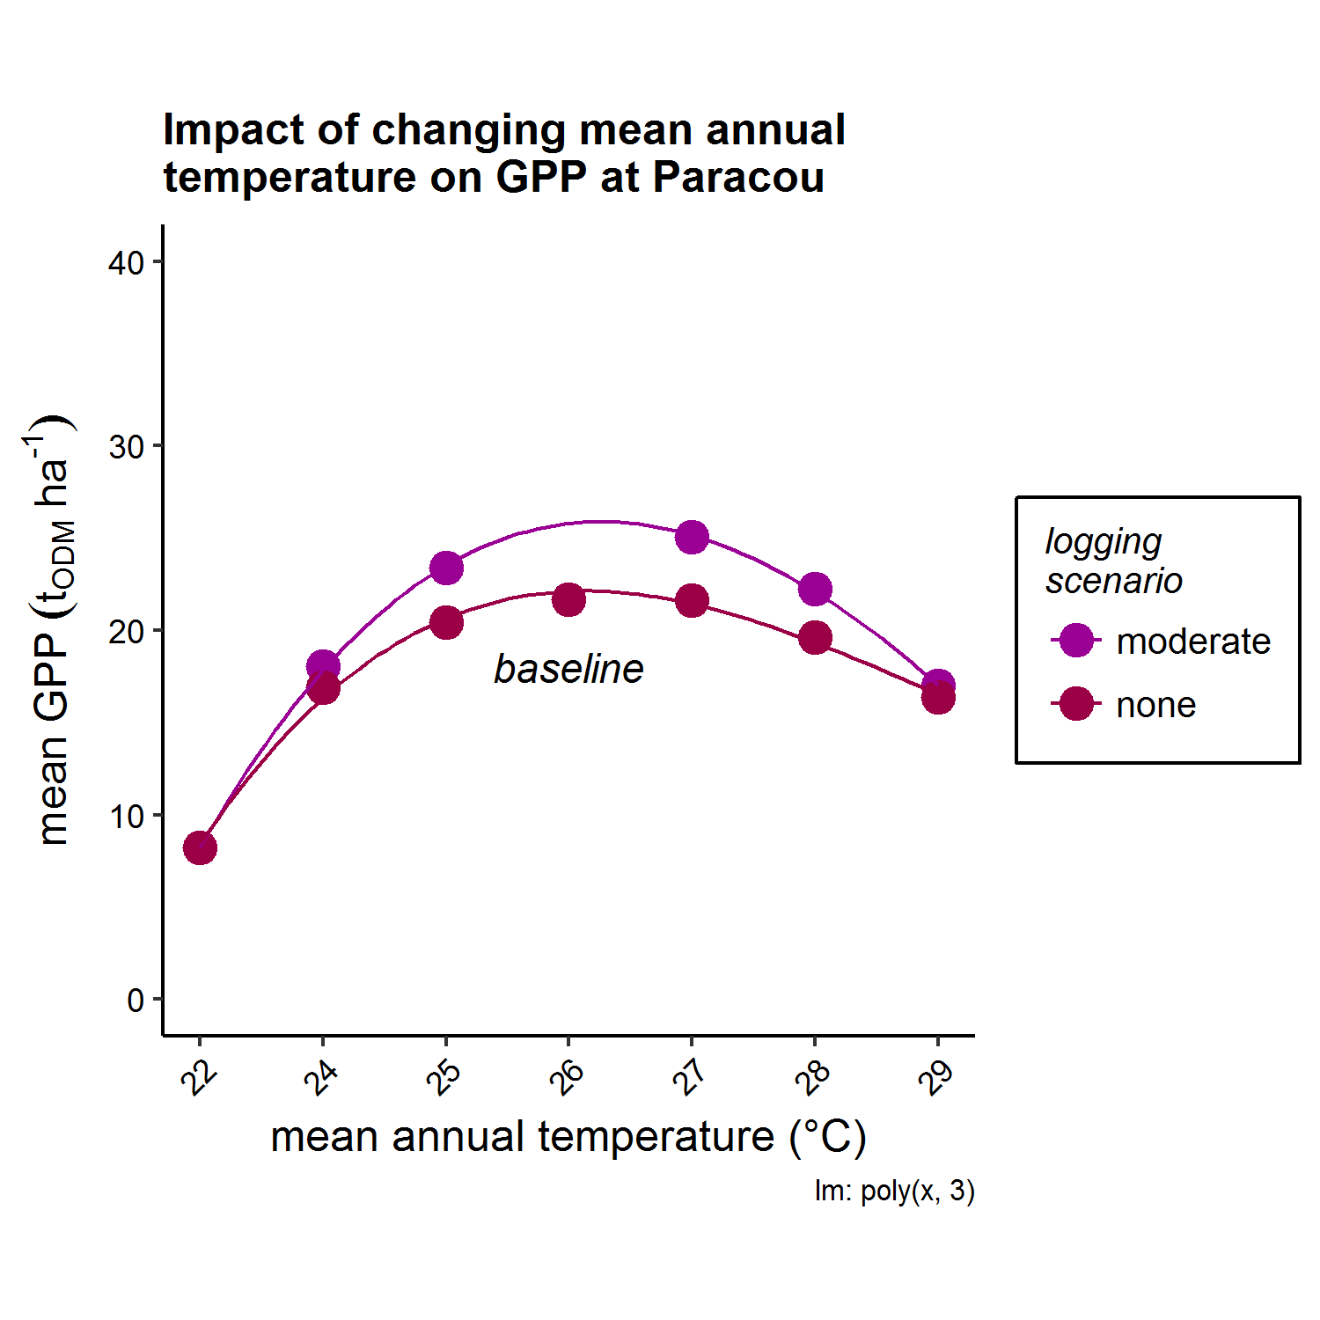
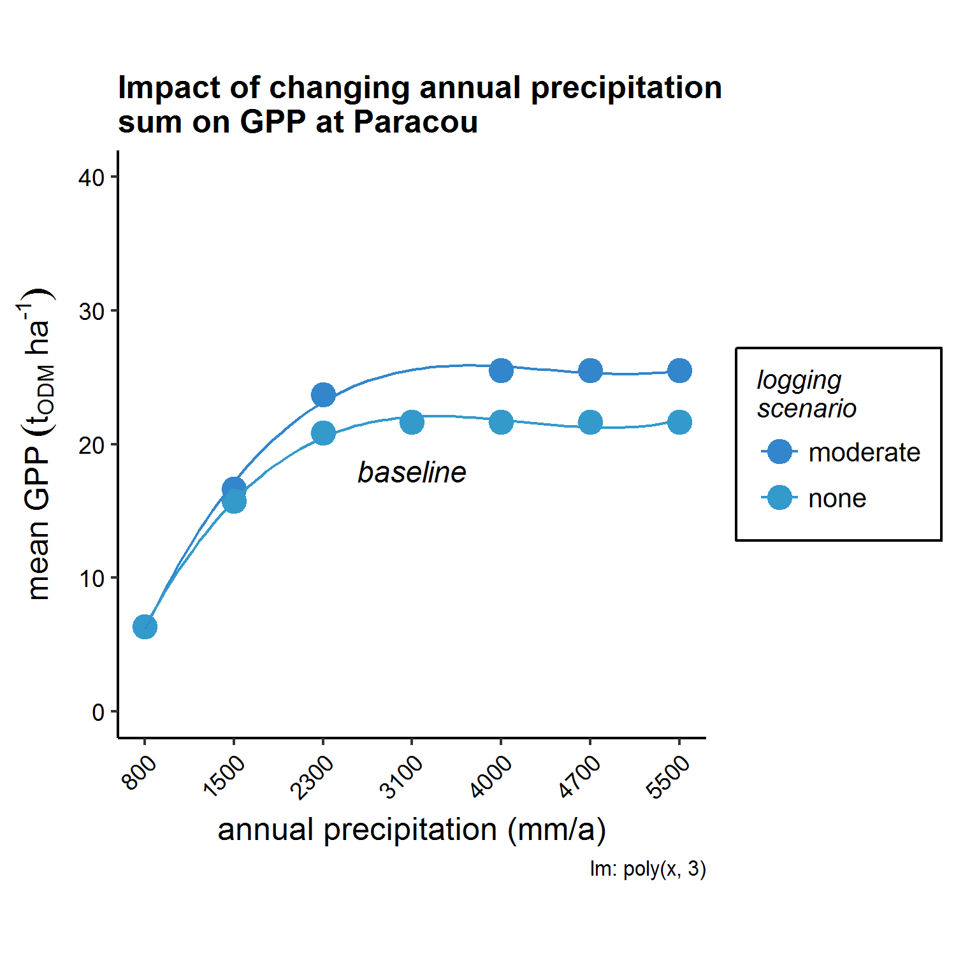

Slide 12
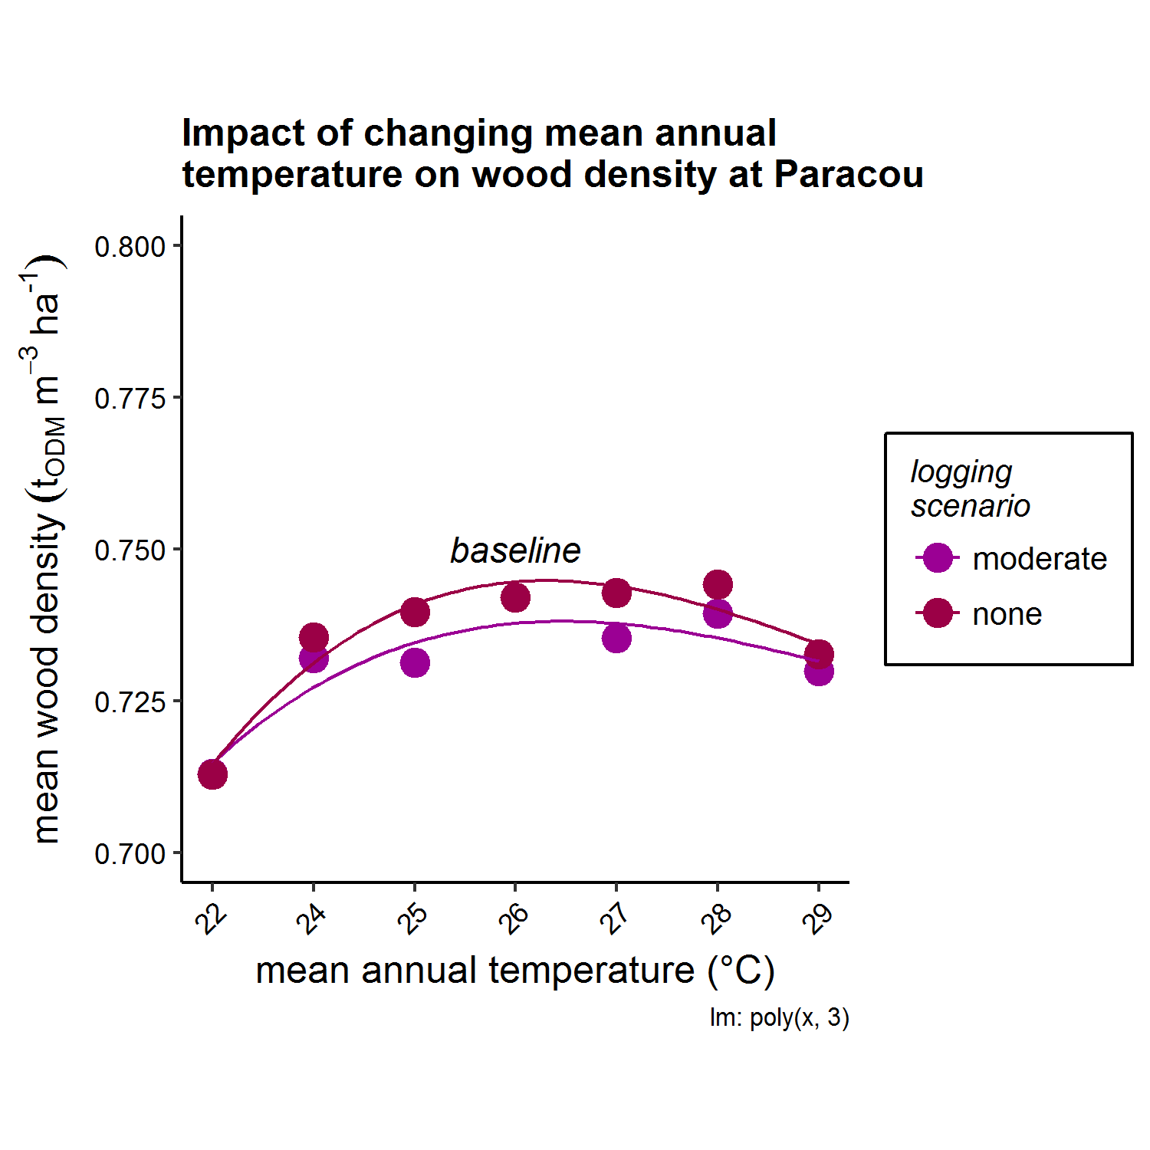
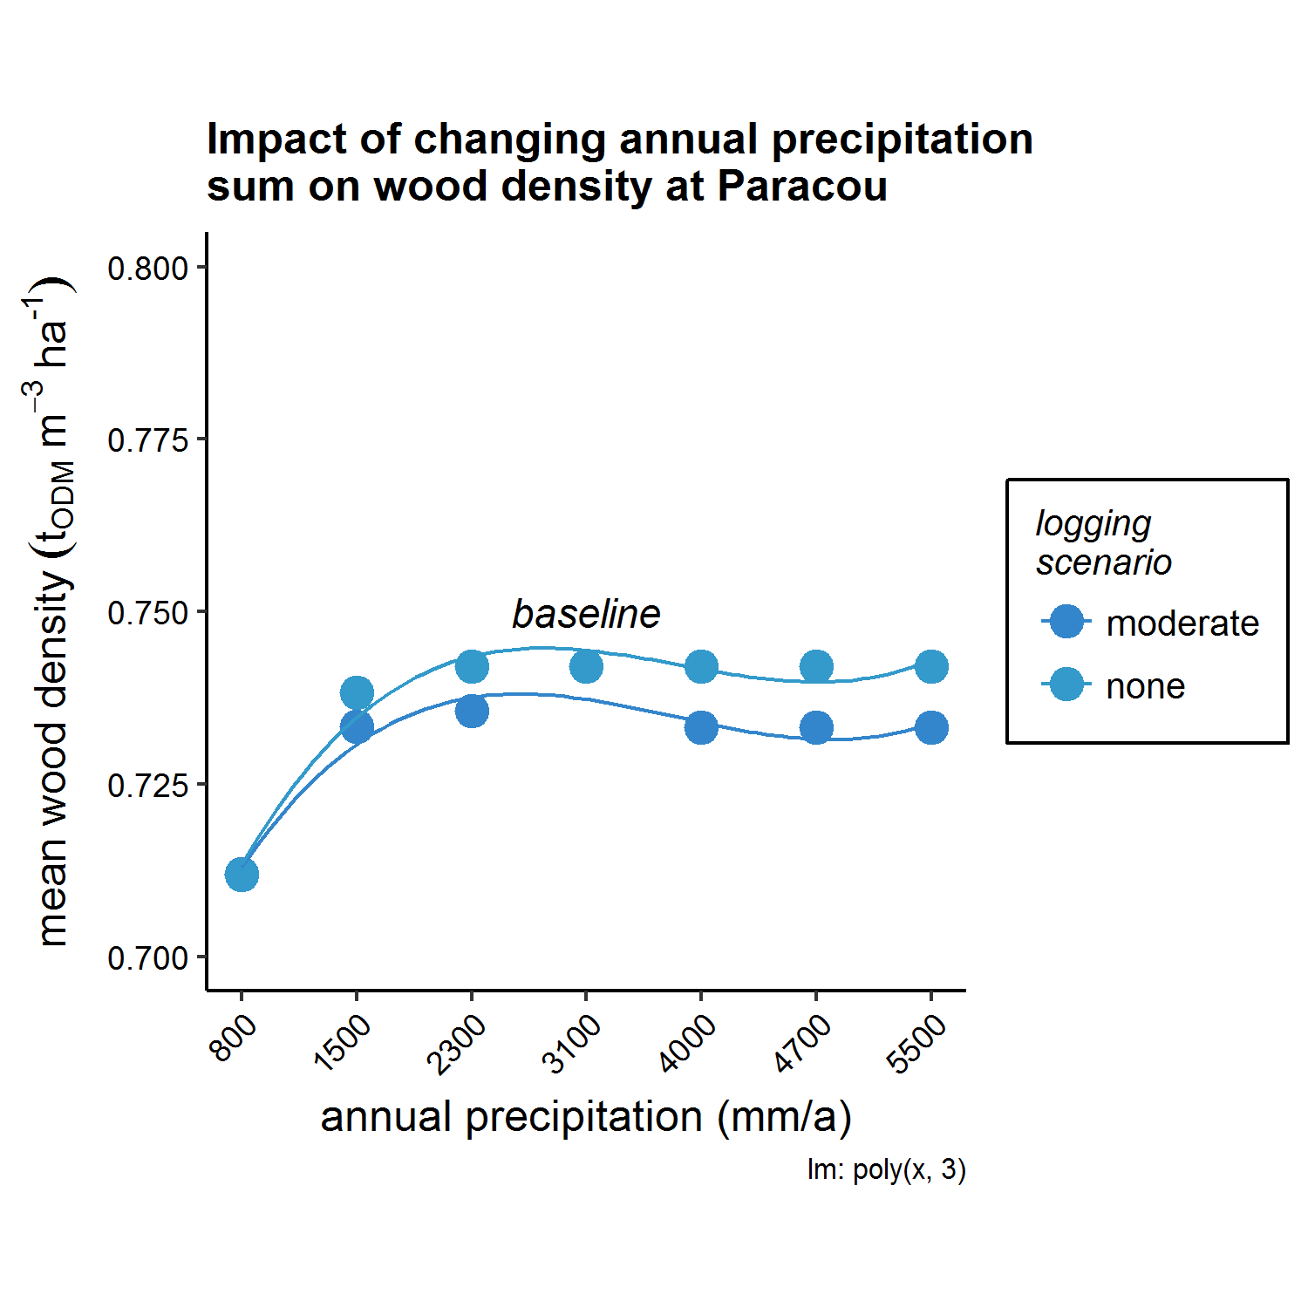

Slide 13
Appendix & out takes

Slide 14
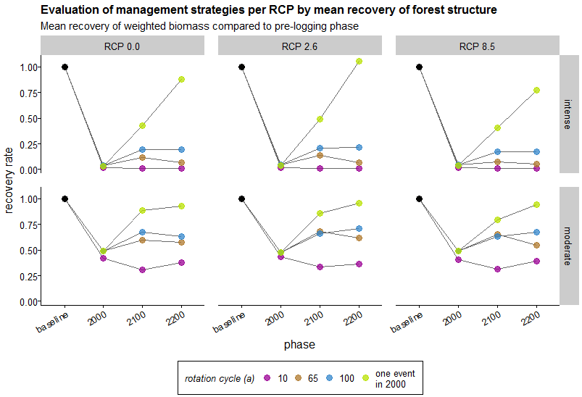

Old figure!!!
$$y=TV ∗ ω$$
$ω=$ Pcom / Pnon = (BVcom/SNcom) / (BVnon/SNnon)

Slide 15
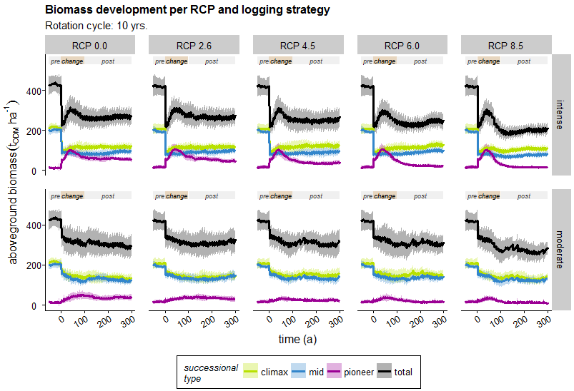

Slide 16
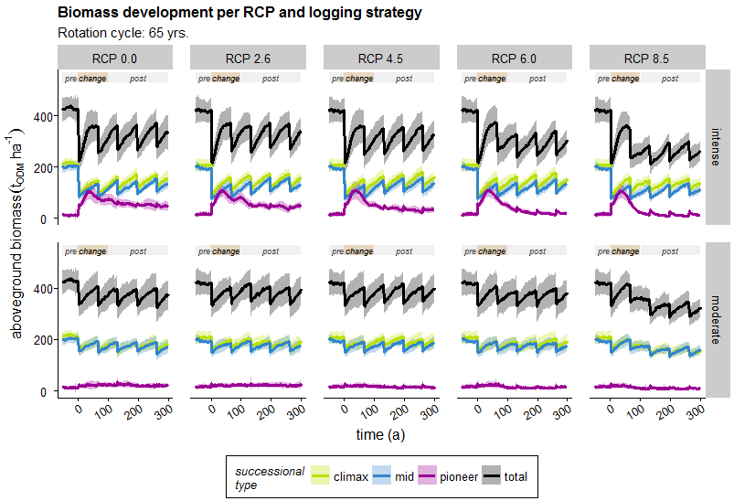

Slide 17
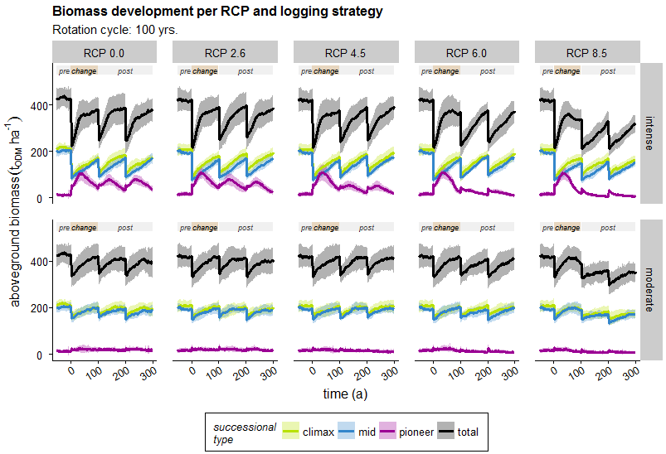

Slide 18
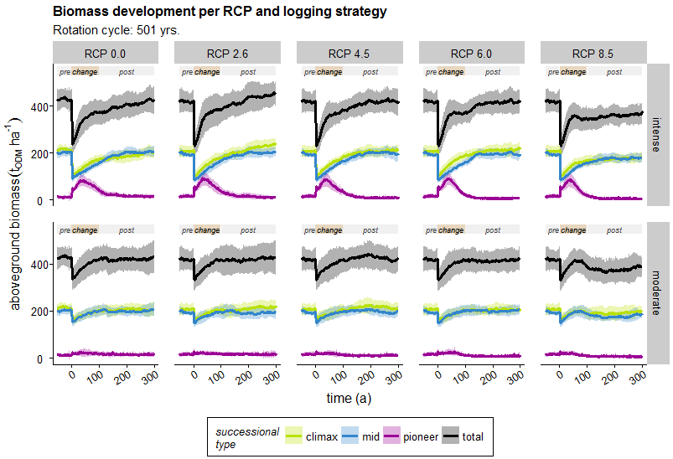

Slide 19
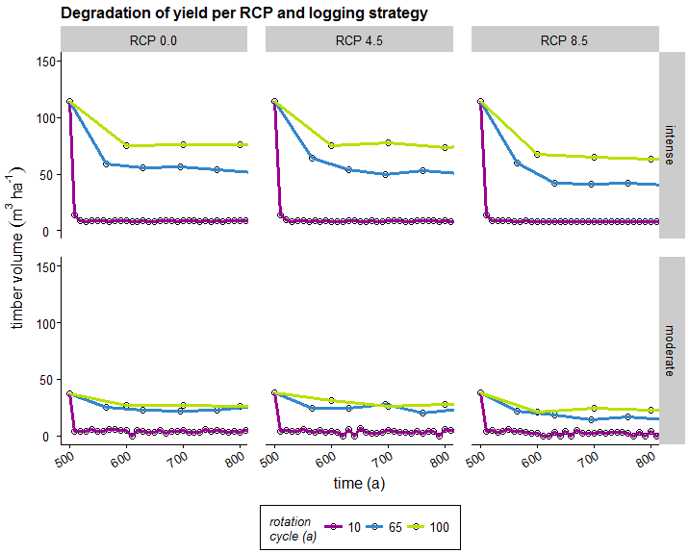

Slide 20
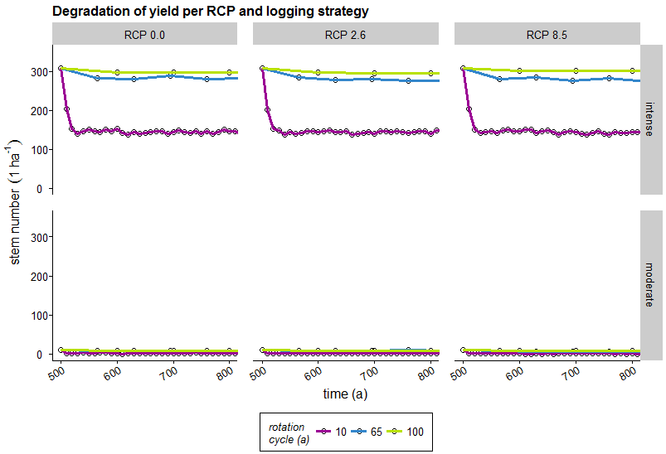

Slide 21
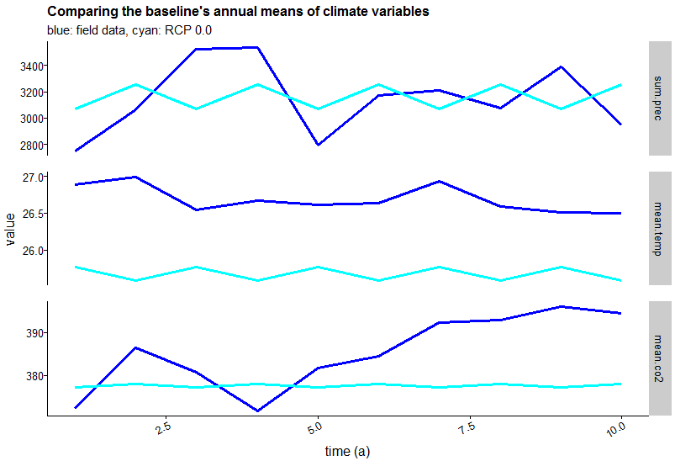

Slide 22
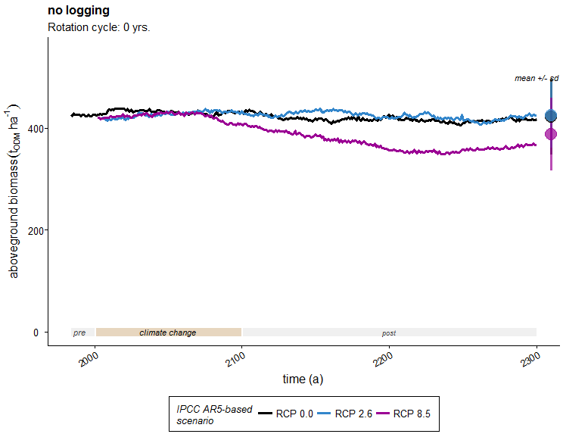

Slide 23
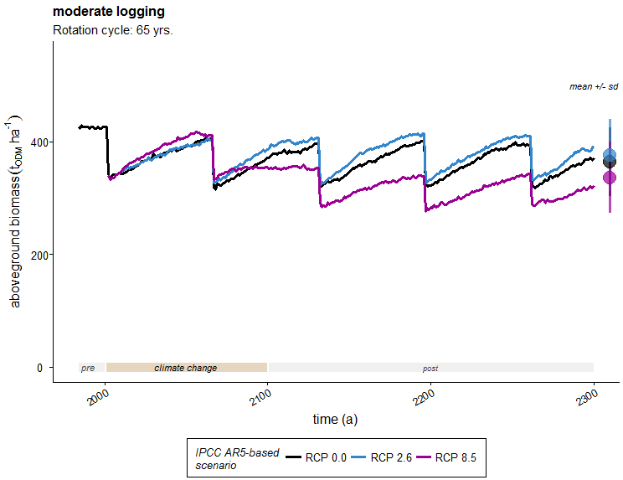

Slide 24
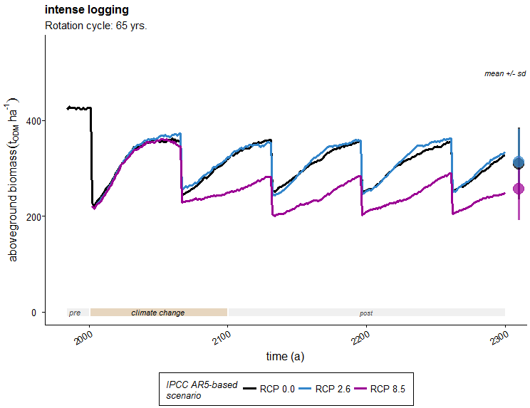

Slide 25
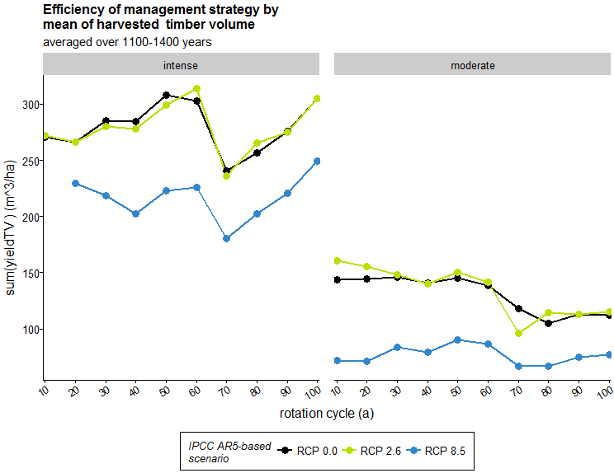

Slide 26
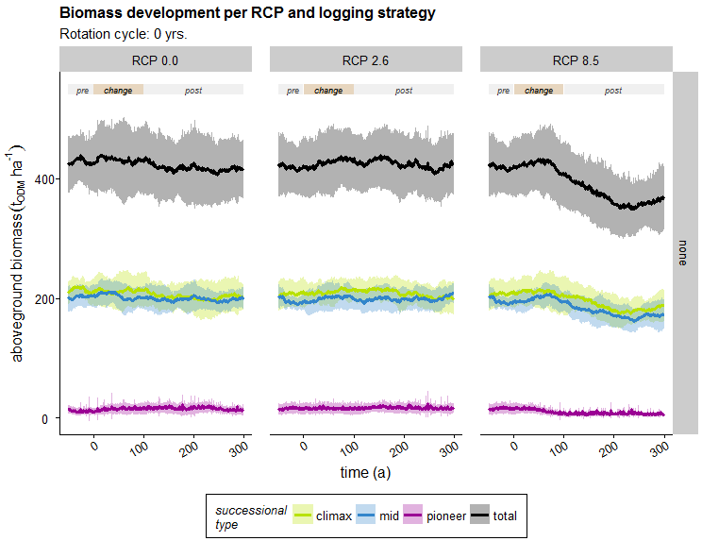

Slide 27
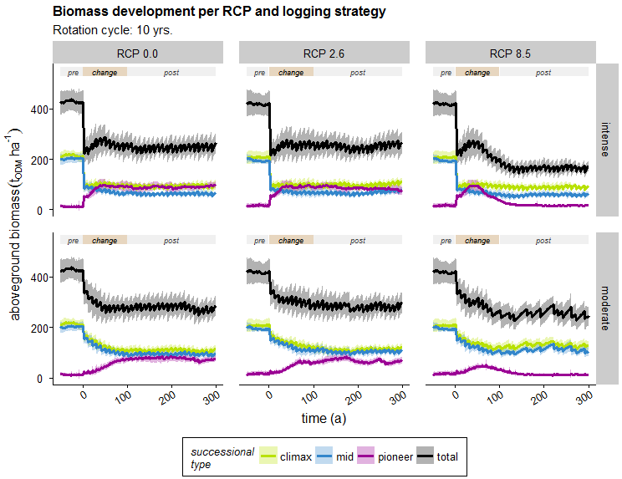

Slide 28
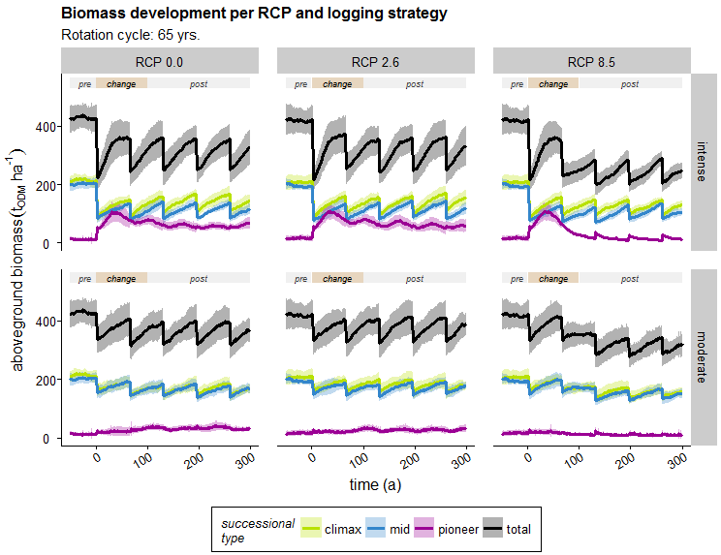

Slide 29
