Slide 1

Original Article Safety and Efficacy of the BNT162b2 mRNA Covid-19 Vaccine
Fernando P. Polack, M.D., Stephen J. Thomas, M.D., Nicholas Kitchin, M.D., Judith Absalon, M.D., Alejandra Gurtman, M.D., Stephen Lockhart, D.M., John L. Perez, M.D., Gonzalo Pérez Marc, M.D., Edson D. Moreira, M.D., Cristiano Zerbini, M.D., Ruth Bailey, B.Sc., Kena A. Swanson, Ph.D., Satrajit Roychoudhury, Ph.D., Kenneth Koury, Ph.D., Ping Li, Ph.D., Warren V. Kalina, Ph.D., David Cooper, Ph.D., Robert W. Frenck, Jr., M.D., Laura L. Hammitt, M.D., Özlem Türeci, M.D., Haylene Nell, M.D., Axel Schaefer, M.D., Serhat Ünal, M.D., Dina B. Tresnan, D.V.M., Ph.D., Susan Mather, M.D., Philip R. Dormitzer, M.D., Ph.D., Uğur Şahin, M.D., Kathrin U. Jansen, Ph.D., William C. Gruber, M.D., for the C4591001 Clinical Trial Group
N Engl J Med
Volume 383(27):2603-2615
December 31, 2020

Slide 2
Study Overview
A vaccine containing an RNA molecule encoding the SARS-CoV-2 spike protein was tested in a trial in which two injections were given 3 weeks apart.
After the second injection, Covid-19 developed in 162 patients receiving placebo, with a median follow-up of 2 months, and in 8 patients receiving the vaccine.
Side effects were mainly mild-to-moderate injection-site pain and swelling.

Slide 3
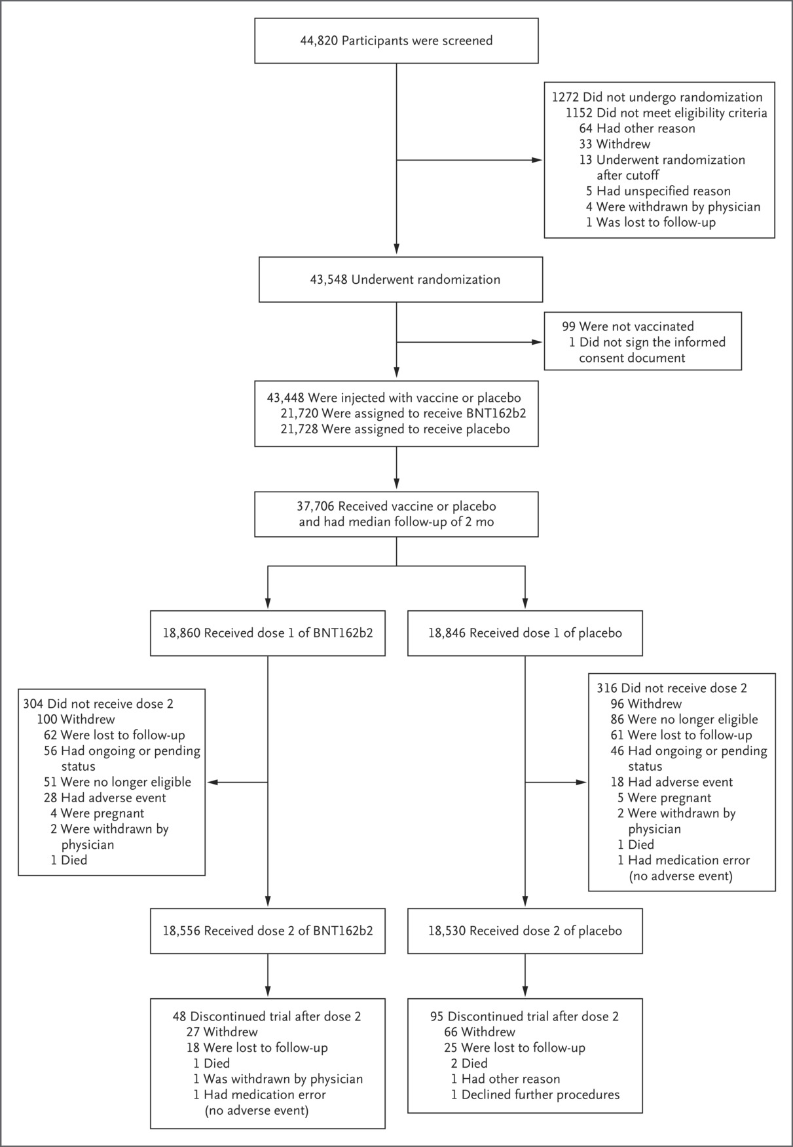
Enrollment and Randomization.
Polack FP et al. N Engl J Med 2020;383:2603-2615
Notes:
Figure 1 Enrollment and Randomization. The diagram represents all enrolled participants through November 14, 2020. The safety subset (those with a median of 2 months of follow-up, in accordance with application requirements for Emergency Use Authorization) is based on an October 9, 2020, data cut-off date. The further procedures that one participant in the placebo group declined after dose 2 (lower right corner of the diagram) were those involving collection of blood and nasal swab samples.

Slide 4
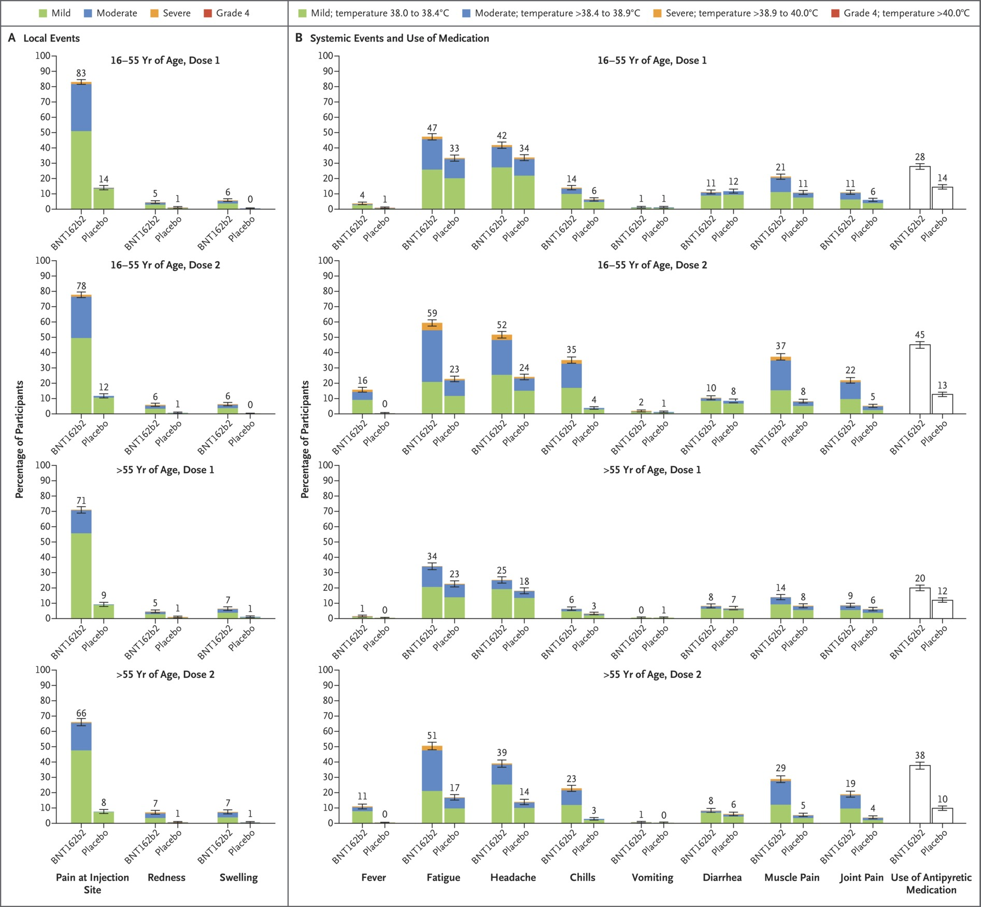
Local and Systemic Reactions Reported within 7 Days after Injection of BNT162b2 or Placebo, According to Age Group.
Polack FP et al. N Engl J Med 2020;383:2603-2615
Notes:
Figure 2 Local and Systemic Reactions Reported within 7 Days after Injection of BNT162b2 or Placebo, According to Age Group. Data on local and systemic reactions and use of medication were collected with electronic diaries from participants in the reactogenicity subset (8,183 participants) for 7 days after each vaccination. Solicited injection-site (local) reactions are shown in Panel A. Pain at the injection site was assessed according to the following scale: mild, does not interfere with activity; moderate, interferes with activity; severe, prevents daily activity; and grade 4, emergency department visit or hospitalization. Redness and swelling were measured according to the following scale: mild, 2.0 to 5.0 cm in diameter; moderate, >5.0 to 10.0 cm in diameter; severe, >10.0 cm in diameter; and grade 4, necrosis or exfoliative dermatitis (for redness) and necrosis (for swelling). Systemic events and medication use are shown in Panel B. Fever categories are designated in the key; medication use was not graded. Additional scales were as follows: fatigue, headache, chills, new or worsened muscle pain, new or worsened joint pain (mild: does not interfere with activity; moderate: some interference with activity; or severe: prevents daily activity), vomiting (mild: 1 to 2 times in 24 hours; moderate: >2 times in 24 hours; or severe: requires intravenous hydration), and diarrhea (mild: 2 to 3 loose stools in 24 hours; moderate: 4 to 5 loose stools in 24 hours; or severe: 6 or more loose stools in 24 hours); grade 4 for all events indicated an emergency department visit or hospitalization. 𝙸 bars represent 95% confidence intervals, and numbers above the 𝙸 bars are the percentage of participants who reported the specified reaction.

Slide 5
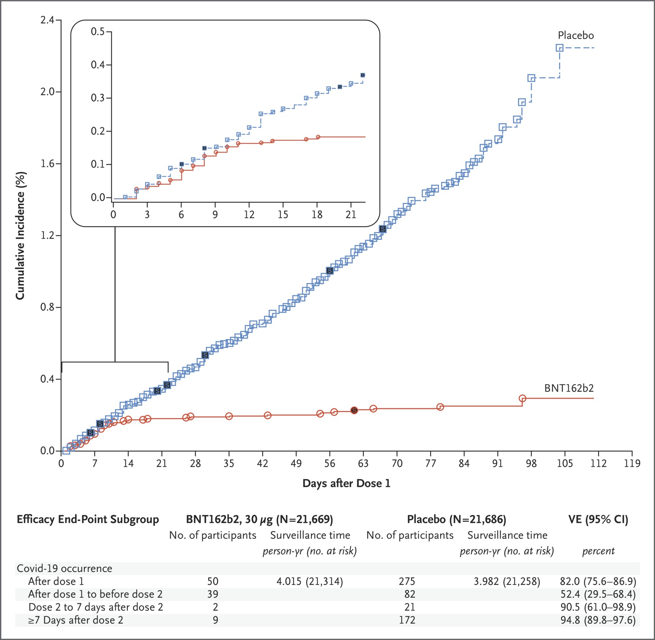
Efficacy of BNT162b2 against Covid-19 after the First Dose.
Polack FP et al. N Engl J Med 2020;383:2603-2615
Notes:
Figure 3 Efficacy of BNT162b2 against Covid-19 after the First Dose. Shown is the cumulative incidence of Covid-19 after the first dose (modified intention-to-treat population). Each symbol represents Covid-19 cases starting on a given day; filled symbols represent severe Covid-19 cases. Some symbols represent more than one case, owing to overlapping dates. The inset shows the same data on an enlarged y axis, through 21 days. Surveillance time is the total time in 1000 person-years for the given end point across all participants within each group at risk for the end point. The time period for Covid-19 case accrual is from the first dose to the end of the surveillance period. The confidence interval (CI) for vaccine efficacy (VE) is derived according to the Clopper–Pearson method.

Slide 6
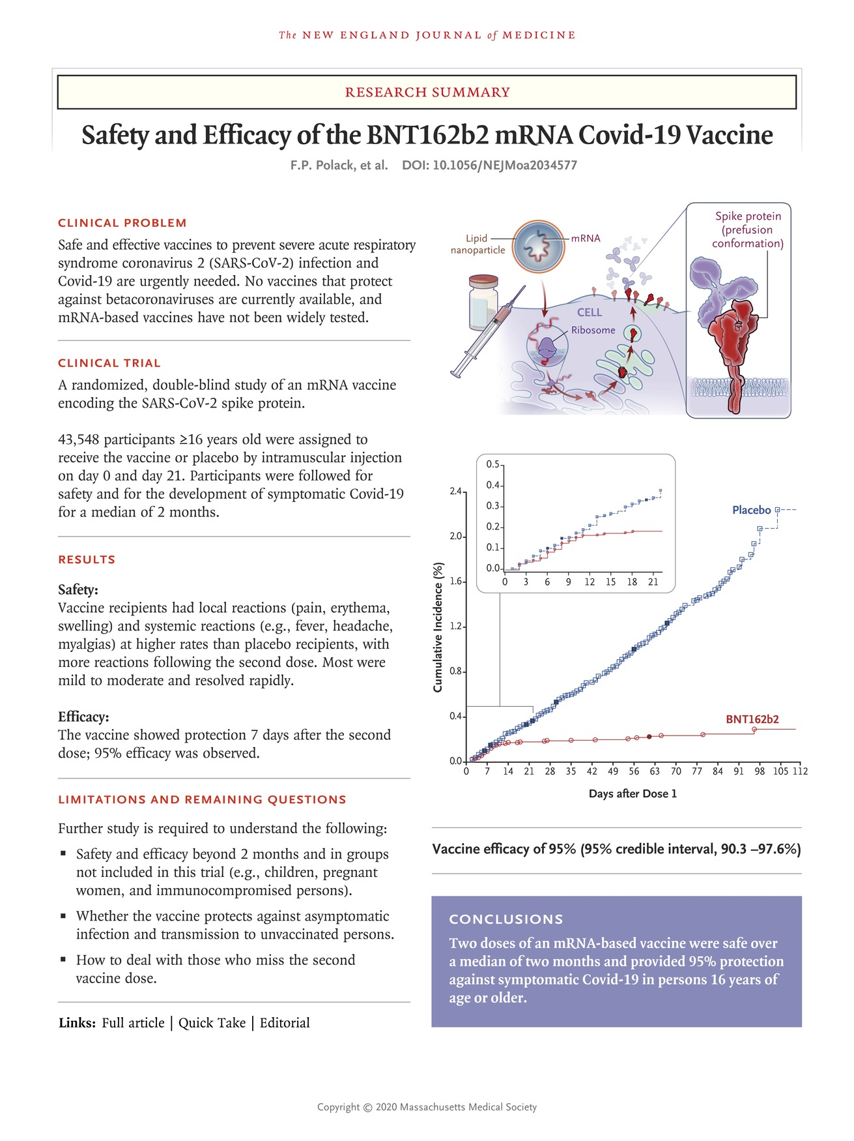
Polack FP et al. N Engl J Med 2020;383:2603-2615
Notes:
Download a PDF of the Research Summary.

Slide 7
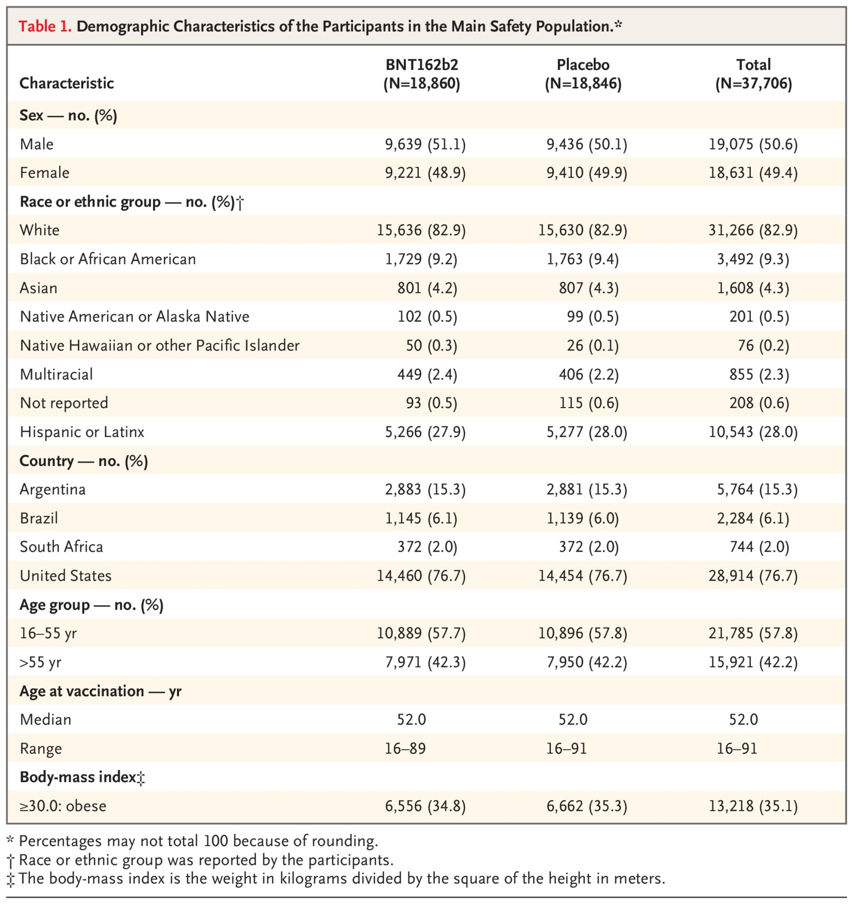
Demographic Characteristics of the Participants in the Main Safety Population.
Polack FP et al. N Engl J Med 2020;383:2603-2615
Notes:
Table 1 Demographic Characteristics of the Participants in the Main Safety Population.

Slide 8
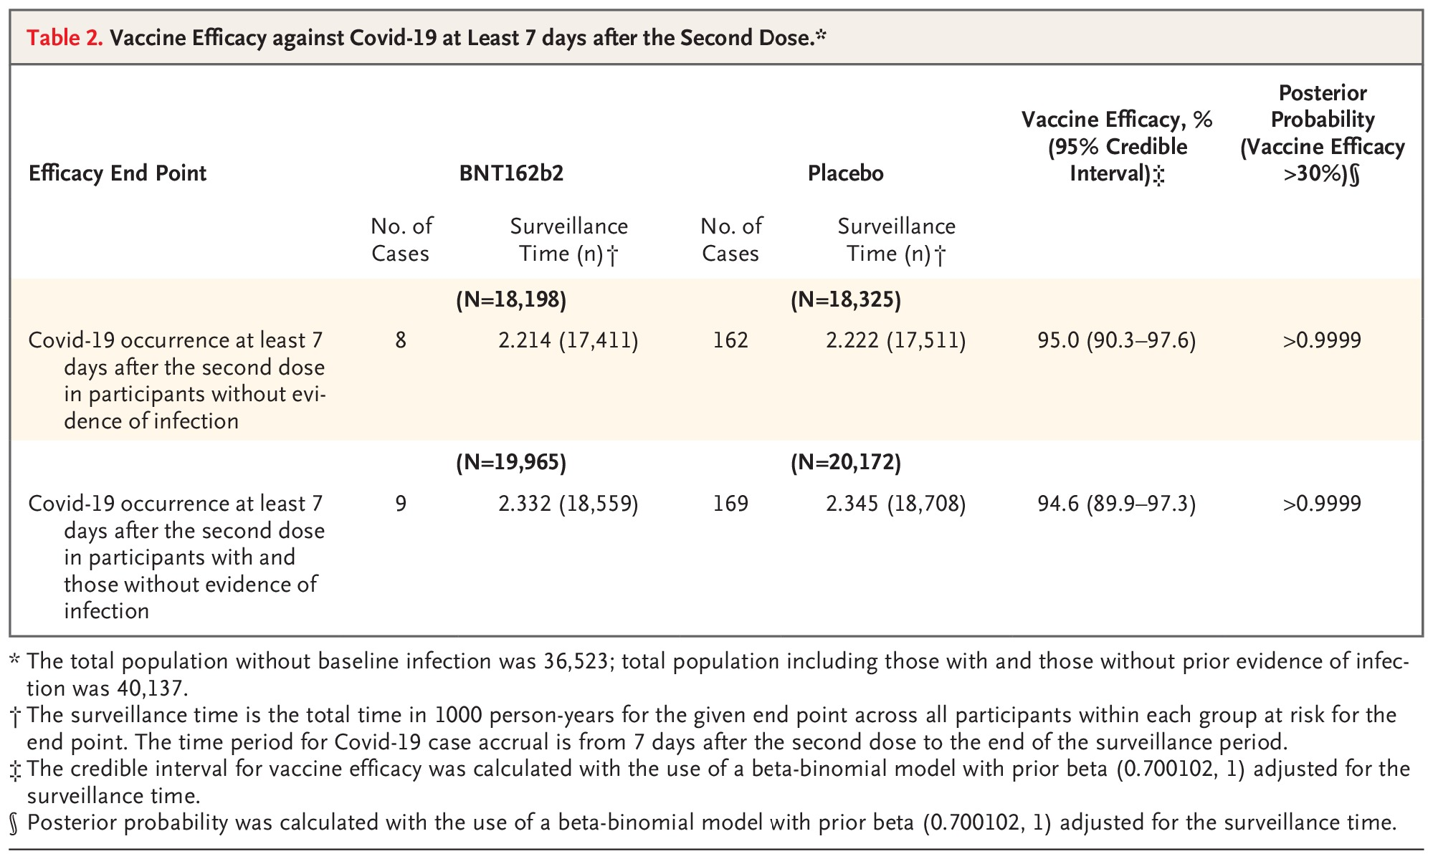
Vaccine Efficacy against Covid-19 at Least 7 days after the Second Dose.
Polack FP et al. N Engl J Med 2020;383:2603-2615
Notes:
Table 2 Vaccine Efficacy against Covid-19 at Least 7 days after the Second Dose.

Slide 9
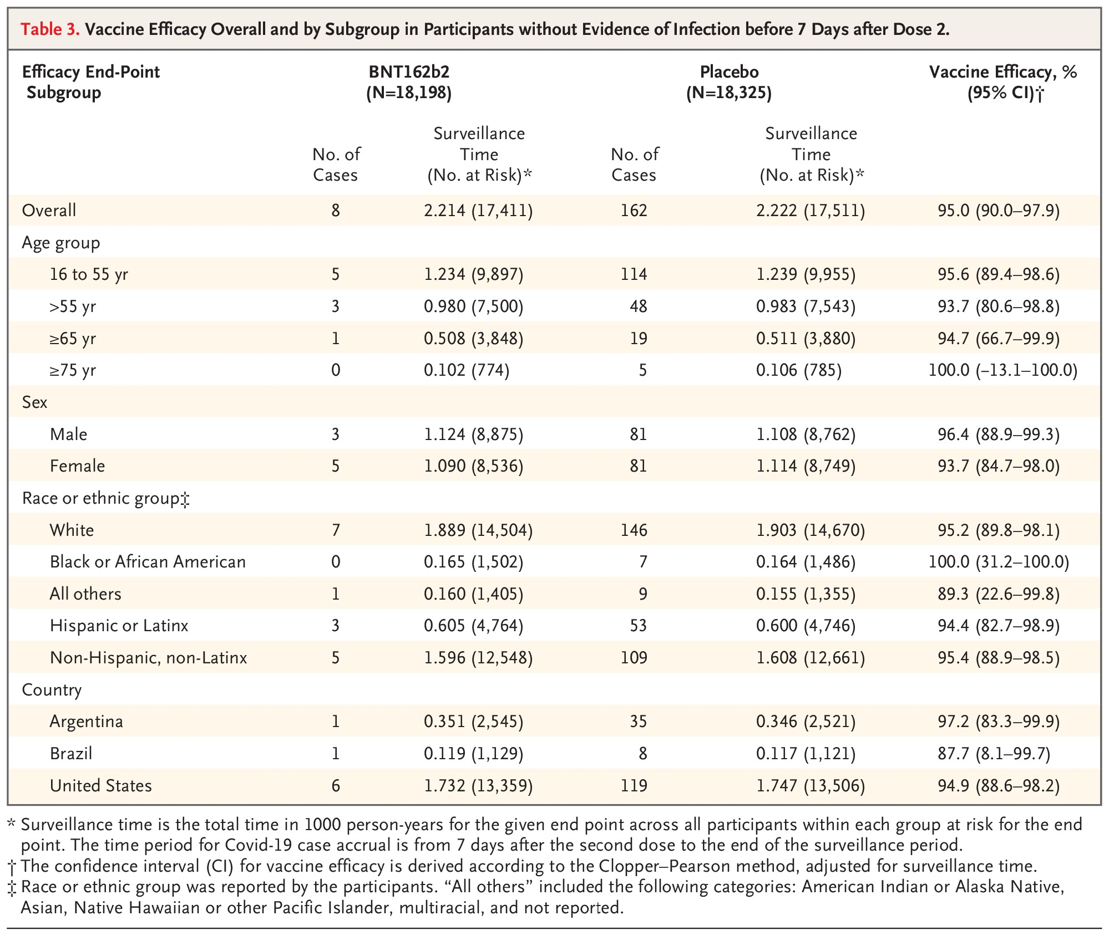
Vaccine Efficacy Overall and by Subgroup in Participants without Evidence of Infection before 7 Days after Dose 2.
Polack FP et al. N Engl J Med 2020;383:2603-2615
Notes:
Table 3 Vaccine Efficacy Overall and by Subgroup in Participants without Evidence of Infection before 7 Days after Dose 2.

Slide 10
Conclusions
A two-dose regimen of BNT162b2 conferred 95% protection against Covid-19 in persons 16 years of age or older.
Safety over a median of 2 months was similar to that of other viral vaccines.

