Slide 1
Process modeling day 1 slides
Renata Diaz

Slide 2
Sections
Theory and motivation of process modeling
An example: Hubbell’s neutral theory
Exercise 1: Playing neutral games
Exercise 2: Coding up neutral theory in R
Exercise 3: Exploring parameter changes in neutral theory
Inferring parameters from results using neutral theory

Slide 3
Theory and motivation of process modeling

Slide 4
Theory and motivation of process modeling
What do we mean by process modeling, anyway?
What are the applications of process modeling for ecological and evolutionary dynamics?
What are the limitations of a process modeling approach?

Slide 5
What do we mean by process modeling, anyway?
Have you ever worked with or encountered a process model?
Notes:
Option here to slot in responses from class survey

Slide 6
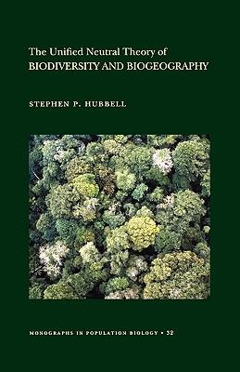

What do we mean by process modeling, anyway?
Process models are games…
Scenarios play out according to rules
Outcomes depend on the rules + chance

Slide 7


What do we mean by process modeling, anyway?
Games may be simple or complex
(Even simple games can be complex!)
Not necessarily deterministic
Not necessarily solvable analytically

Slide 8
What are the applications of process models for eco-evo?
Nearly unlimited flexibility for exploring processes involving…
stochasticity
large temporal/spatial scales
context dependence
feedbacks
multiple levels of organization
complexity

Slide 9
What are the applications of process models for eco-evo?
Use case: hypothesis exploration
How would I expect X to affect Y?

Slide 10
What are the applications of process models for eco-evo?
Use case: null models
How would I expect my system to look,
at random?

Slide 11
What are the applications of process models for eco-evo?
Use case: large swaths of time or space
How will this system look in 1000 years,
under different scenarios?

Slide 12
What are the applications of process models for eco-evo?
Use case: explaining empirical data
What generative processes are (not) consistent with empirical observations?

Slide 13
What are the applications of process models for eco-evo?
Can you think of an application for a process model in your area of interest?

Slide 14
What are the limitations of a process modeling approach?

Slide 15
What are the limitations of a process modeling approach?
read the rules!!!
computationally expensive
pattern != process
“model identifiability”

Slide 16
An example: Hubbell’s Neutral Theory
How do we fit UNTB into a process model framework?
What are the rules and outcomes of UNTB?
Let’s play the game!

Slide 17



How do we fit UNTB into a process model framework?
Entities: Ecological communities made of individuals
Individuals die, give birth, immigrate, and speciate according to rules
Model outcomes are semi-deterministic

Slide 18
What are the rules and outcomes of neutral theory?

Slide 19
What are the rules and outcomes of neutral theory?
Playing field
Process
Outcomes

Slide 20








The playing field
Metacommunity
All-time species list
Local community

Slide 21
The process
Metacommunity
Each time step, an individual from the local community dies.
All-time species list
Local community

Slide 22
The process
Metacommunity
Each time step, an individual from the local community dies.
They are replaced via either a local birth or immigration from the metacommunity.
All-time species list
Local community

Slide 23
The process
Metacommunity
Each time step, an individual from the local community dies.
They are replaced via either a local birth or immigration from the metacommunity.
Sometimes, a speciation event occurs and a new species is added.
All-time species list
Local community

Slide 24
The process
Metacommunity
Each time step, an individual from the local community dies.
They are replaced via either a local birth or immigration from the metacommunity.
Sometimes, a speciation event occurs and a new species is added.
All-time species list
This repeats.
Local community

Slide 25
The parameters
Metacommunity
Jm: The number of individuals in the metacommunity
Sm: The number of species in the metacommunity
J: The number of individuals in the local community
All-time species list
m: The probability that an immigration event occurs
v: The probability that a speciation event occurs
Local community

Slide 26

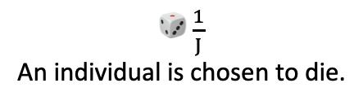
The process
Metacommunity (size = Jm)
🎲 $\frac{1}{J}$ An individual is chosen to die.
All-time species list
Local community (size = J)

Slide 27

The process
Metacommunity (size = Jm)
🎲 $\frac{1}{J}$ An individual is chosen to die.
All-time species list
Local community (size = J)

Slide 28

The process
Metacommunity (size = Jm)
🎲 $\frac{1}{J}$ An individual is chosen to die.
🎲 A birth or immigration event occurs
All-time species list
Local community (size = J)

Slide 29
The process
Metacommunity (size = Jm)
🎲 $\frac{1}{J}$ An individual is chosen to die.
🎲 A birth or immigration event occurs
If birth, a parent is chosen 🎲 from the local community.
All-time species list
Local community (size = J)

Slide 30
The process
Metacommunity (size = Jm)
🎲 $\frac{1}{J}$ An individual is chosen to die.
🎲 A birth or immigration event occurs
If birth, a parent is chosen 🎲 from the local community.
If immigration, a parent is chosen 🎲 from the meta community.
All-time species list
Local community

Slide 31

The process
Metacommunity (size = Jm)
🎲 $\frac{1}{J}$ An individual is chosen to die.
🎲 A birth or immigration event occurs
If birth, a parent is chosen 🎲 from the local community.
If immigration, a parent is chosen 🎲 from the meta community.
All-time species list
🎲 Sometimes, a speciation event occurs.
Local community

Slide 32


The process
Metacommunity (size = Jm)
🎲 $\frac{1}{J}$ An individual is chosen to die.
🎲 A birth or immigration event occurs
If birth, a parent is chosen 🎲 from the local community.
If immigration, a parent is chosen 🎲 from the meta community.
All-time species list
🎲 Sometimes, a speciation event occurs.
Local community
If so, the new offspring is a new species,
and a new species joins the all-time list.

Slide 33
The process
Metacommunity (size = Jm)
🎲 $\frac{1}{J}$ An individual is chosen to die.
🎲 A birth or immigration event occurs
If birth, a parent is chosen 🎲 from the local community.
If immigration, a parent is chosen 🎲 from the meta community.
All-time species list
🎲 Sometimes, a speciation event occurs.
Local community
If not, the new offspring is the same species as its parent.
If so, the new offspring is a new species,
and a new species joins the all-time list.

Slide 34
The process
Metacommunity (size = Jm)
🎲 $\frac{1}{J}$ An individual is chosen to die.
🎲 A birth or immigration event occurs
If birth, a parent is chosen 🎲 from the local community.
If immigration, a parent is chosen 🎲 from the meta community.
All-time species list
The new offspring replaces the dead individual in the local community.
🎲 Sometimes, a speciation event occurs.
Local community (size = J)
If not, the new offspring is the same species as its parent.
If so, the new offspring is a new species,
and a new species joins the all-time list.

Slide 35
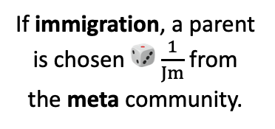
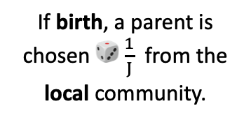
The process
Metacommunity (size = Jm)
🎲 $\frac{1}{J}$ An individual is chosen to die.
🎲 m A birth or immigration event occurs
If birth, a parent is chosen 🎲 $\frac{1}{J}$ from the local community.
If immigration, a parent is chosen 🎲 $\frac{1}{Jm}$ from the meta community.
Time goes on.
All-time species list
The new offspring replaces the dead individual in the local community.
🎲 v Sometimes, a speciation event occurs.
Local community (size = J)
If not, the new offspring is the same species as its parent.
If so, the new offspring is a new species,
and a new species joins the all-time list.

Slide 36
The process
Metacommunity (size = Jm)
🎲 $\frac{1}{J}$ An individual is chosen to die.
🎲 m A birth or immigration event occurs
If birth, a parent is chosen 🎲 $\frac{1}{J}$ from the local community.
If immigration, a parent is chosen 🎲 $\frac{1}{Jm}$ from the meta community.
Time goes on.
All-time species list
The new offspring replaces the dead individual in the local community.
🎲 v Sometimes, a speciation event occurs.
Local community (size = J)
If not, the new offspring is the same species as its parent.
If so, the new offspring is a new species,
and a new species joins the all-time list.

Slide 37
The process
Metacommunity
🎲 An individual is chosen to die.
🎲 A birth or immigration event occurs
If birth, a parent species is chosen 🎲 from the local community.
If immigration, a parent species is chosen 🎲 from the meta community.
Time goes on.
All-time species list
The new offspring replaces the dead individual in the local community.
🎲 Sometimes, a speciation event occurs.
Local community
If so, the new offspring is a new species,
and a new species joins the all-time list.
If not, the new offspring is the same species as its parent.

Slide 38
The outcomes
Local community (size = J)

Slide 39
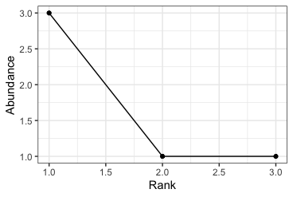
The outcomes
Local community (size = J)

Slide 40
The outcomes
Local community (size = J)
Q | Hill number
0 | 3
1 | 2.58
2 | 2.27

Slide 41
Coffee break. (Then, we’ll play!)

Slide 42
Break to play neutral games. (Not on a computer.)

Slide 43
How did that go?

Slide 44
How did that go? How could we make this more efficient?

Slide 45


How did that go? How could we make this more efficient?

Slide 46
Break to code up UNTB in R.

Slide 47
The process
Metacommunity (size = Jm)
🎲 $\frac{1}{J}$ An individual is chosen to die.
🎲 m A birth or immigration event occurs
If birth, a parent is chosen 🎲 $\frac{1}{J}$ from the local community.
If immigration, a parent is chosen 🎲 $\frac{1}{Jm}$ from the meta community.
Time goes on.
All-time species list
The new offspring replaces the dead individual in the local community.
🎲 v Sometimes, a speciation event occurs.
Local community (size = J)
If not, the new offspring is the same species as its parent.
If so, the new offspring is a new species,
and a new species joins the all-time list.

Slide 48
Break to explore UNTB parameter settings in R.

Slide 49
How did that go?

Slide 50
Inferring parameters from results in UNTB

Slide 51
Inferring parameters from results in UNTB
What do we mean by inferring parameters from outcomes?
How do we approach this for UNTB?
What are the challenges we run into?

Slide 52
What do we mean by inferring parameters from outcomes?
Assuming the processes in a model accurately describe the processes that generated some data***…
*** This is a big assumption!

Slide 53
What do we mean by inferring parameters from outcomes?
Assuming the processes in a model accurately describe the processes that generated some data***… …we can use our knowledge of the model to guess the parameter settings that generated a specific outcome.
*** This is a big assumption!

Slide 54
What do we mean by inferring parameters from outcomes?
Assuming the processes in a model accurately describe the processes that generated some data***… …we can use our knowledge of the model to guess the parameter settings that generated a specific outcome.
This is the backbone of likelihood-free inference (coming up soon!)
*** This is a big assumption!

Slide 55


The (general) model structure
Input parameters (m, v, J, Jm, Sm)
Outcome variables
(hill0, hill1, hill2)
Run simulations over a wide range of parameter settings.
produce

Slide 56
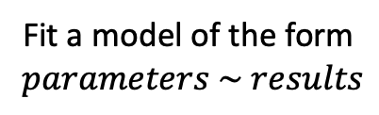
The (general) model structure
Input parameters (m, nu, J, Jm, Sm)
Outcome variables
(hill0, hill1, hill2)
Run simulations over a wide range of parameter settings.
produce
Outcome variables
(hill0, hill1, hill2)
Input parameters (m, nu, J, Jm, Sm)
Fit a model of the form
$$parameters \sim results$$
predict

Slide 57
The (general) model structure
Input parameters (m, nu, J, Jm, Sm)
Outcome variables
(hill0, hill1, hill2)
Run simulations over a wide range of parameter settings.
produce
Outcome variables
(hill0, hill1, hill2)
Input parameters (m, nu, J, Jm, Sm)
Fit a model of the form
$$parameters \sim results$$
predict
Use this model to estimate the parameter values that produced observed outcomes
Focal outcome variables
(hill0 = …, hill1 = …, …)
Generating parameters
(m = …, nu = …, …)
estimate

Slide 58
An example: predicting M and Nu from UNTB

Slide 59
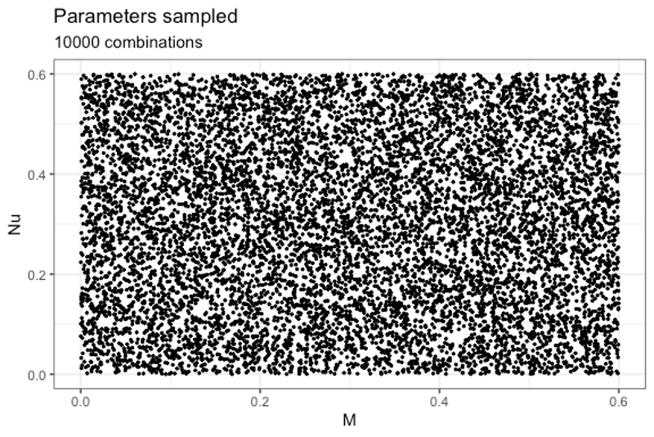
Run simulations over a range of parameters
Constant parameters
Parameter Value 1 Jm 10000 2 Sm 1000 3 J 1000 4 Timesteps 1000

Slide 60
Collect results
Jm Sm J timesteps Nu M hill0 hill1 hill2 1 10000 1000 1000 1000 0.52 0.36 449 41.95 4.02 2 10000 1000 1000 1000 0.18 0.50 298 23.92 3.31 3 10000 1000 1000 1000 0.52 0.15 379 25.86 3.15 4 10000 1000 1000 1000 0.39 0.59 408 41.43 4.22 5 10000 1000 1000 1000 0.02 0.31 163 6.36 1.82 6 10000 1000 1000 1000 0.31 0.18 290 14.82 2.48
Parameters
Outcomes

Slide 61
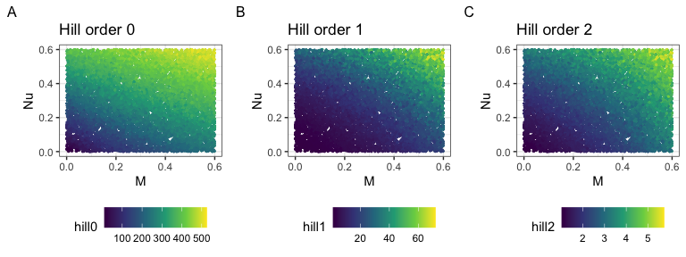
Visualize Hill numbers vs. M, Nu

Slide 62
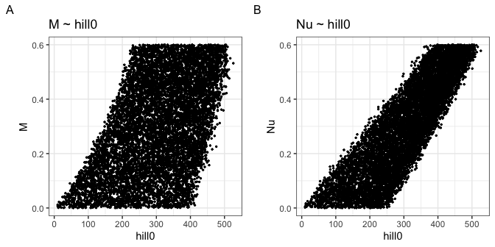
Relating outcomes to parameters

Slide 63
Train a model
m_rf_model <- randomForest(M ~ hill0 + hill1 + hill2, data = all_hills)

Slide 64
Train a model
m_rf_model
Call: randomForest(formula = M ~ hill0 + hill1 + hill2, data = all_hills) Type of random forest: regression Number of trees: 500 No. of variables tried at each split: 1 Mean of squared residuals: 0.003975154 % Var explained: 86.76

Slide 65
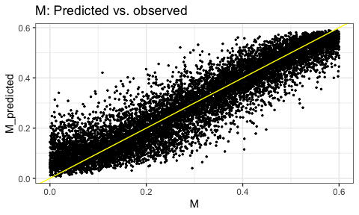
Explore model accuracy

Slide 66
Train a model
nu_rf_model <- randomForest(Nu ~ hill0 + hill1 + hill2, data = all_hills)

Slide 67
Train a model
nu_rf_model
Call: randomForest(formula = Nu ~ hill0 + hill1 + hill2, data = all_hills) Type of random forest: regression Number of trees: 500 No. of variables tried at each split: 1 Mean of squared residuals: 0.001456496 % Var explained: 95.09

Slide 68
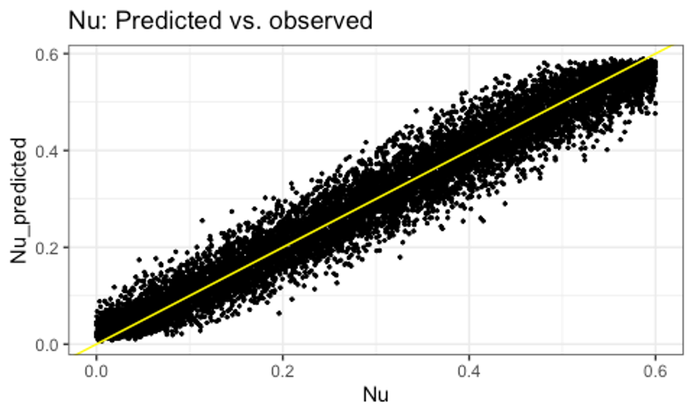
Explore model accuracy

Slide 69
Apply model to new (simulated) data
new_M <- runif(1, 0, 0.6) new_Nu <- runif(1, 0, 0.6) new_sim <- untb(Jm = 10000, Sm = 1000, J = 1000,
m = new_M, nu = new_Nu, niter = 1000) new_hills <- untb_hill(new_sim) predicted_M <- predict(m_rf_model, newdata = new_hills)
predicted_Nu <- predict(nu_rf_model, newdata = new_hills)

Slide 70
Apply model to new (simulated) data
new_M
0.3258534
predicted_M
0.2825361
new_Nu
0.4382455
predicted_Nu
0.3794579

Slide 71
Apply model to new (simulated) data
new_M
0.3258534
predicted_M
0.2825361
new_Nu
0.4382455
predicted_Nu
0.3794579
Estimation is good but not perfect!

Slide 72
Challenges to estimation

Slide 73
How could we improve?

Slide 74
How could we improve?
Different parameters, different rules
More data dimensions
Stay tuned!!!

Slide 75
Recap
In principle, we can use process models to infer the parameters that generate observed data
This is complicated by:
Out-of-sample prediction
Model identifiability
Model run time
The underlying validity of the process model

Slide 76
Looking ahead…
Flexible, scalable, multidimensional, and generally much mess-ier and more powerful models!

Slide 78
Course websites
Days 1-2: https://role-model.github.io/multidim-biodiv-data/
Days 3-4 (this workshop): https://role-model.github.io/process-models-workshop
Materials developed by Renata Diaz, Isaac Overcast, Andy Rominger, Connor French, Jacob Idec, and Rilquer Mascarenhas. Lectures recorded by Renata Diaz.
The development of these materials was supported by NSF awards DBI-2208901 to Renata Diaz and DBI-2104147 to the other authors.

