Slide 1
Untitled

Slide 2
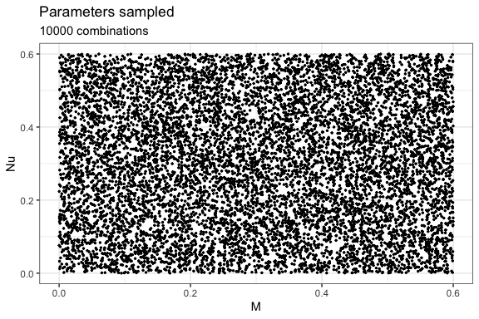
Run neutral simulations over a range of parameters

Slide 3
Parameter Value 1 Jm 10000 2 Sm 1000 3 J 1000 4 Timesteps 1000

Slide 4
Collect results
Jm Sm J timesteps Nu M hill0 hill1 hill2 1 10000 1000 1000 1000 0.52 0.36 449 41.95 4.02 2 10000 1000 1000 1000 0.18 0.50 298 23.92 3.31 3 10000 1000 1000 1000 0.52 0.15 379 25.86 3.15 4 10000 1000 1000 1000 0.39 0.59 408 41.43 4.22 5 10000 1000 1000 1000 0.02 0.31 163 6.36 1.82 6 10000 1000 1000 1000 0.31 0.18 290 14.82 2.48

Slide 5
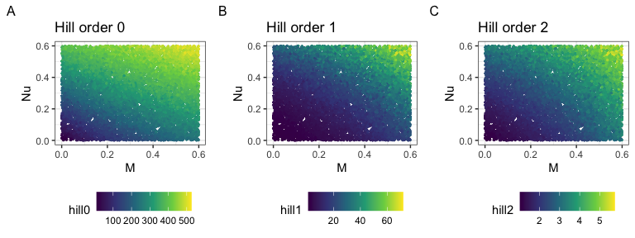
Visualize results

Slide 6
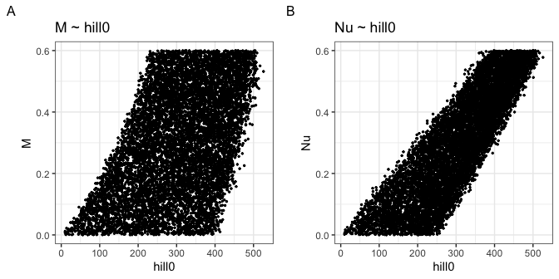
Relating outcomes to parameters

Slide 7
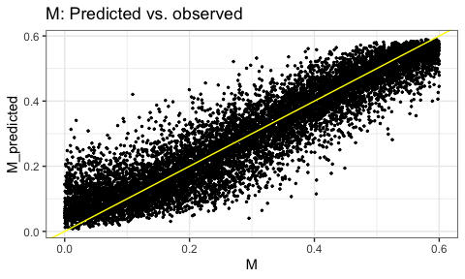
m_rf_model <- randomForest(M ~ hill0 + hill1 + hill2, data = all_hills) m_rf_model
Call: randomForest(formula = M ~ hill0 + hill1 + hill2, data = all_hills) Type of random forest: regression Number of trees: 500 No. of variables tried at each split: 1 Mean of squared residuals: 0.003975154 % Var explained: 86.76
nu_rf_model <- randomForest(Nu ~ hill0 + hill1 + hill2, data = all_hills) nu_rf_model
Call: randomForest(formula = Nu ~ hill0 + hill1 + hill2, data = all_hills) Type of random forest: regression Number of trees: 500 No. of variables tried at each split: 1 Mean of squared residuals: 0.001456496 % Var explained: 95.09

Slide 8
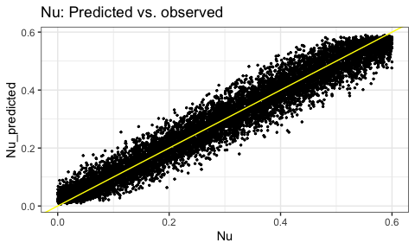

Slide 9
Run a new simulation
new_M <- runif(1, 0, 0.6) new_Nu <- runif(1, 0, 0.6) new_sim <- untb(Jm = 10000, Sm = 1000, J = 1000, m =new_M, nu = new_Nu, niter = 1000) new_hills <- untb_hill(new_sim) predicted_M <- predict(m_rf_model, newdata = new_hills) predicted_Nu <- predict(nu_rf_model, newdata = new_hills) predicted_M
1 0.0919171
new_M
[1] 0.02805322
predicted_Nu
1 0.3794579
new_Nu
[1] 0.4382455

