Slide 1
User flow
Julian Klimczyk,
Bradley Malecki,
Colleen Cheung
MDST 3350 0202

Slide 2
What is it?
Also known as a blueprint, journey, narrative or map, a user flow is a deliverable that demonstrates the step-by-step elements required to allow the user and the business to accomplish their objectives. That means a much clearer vision of the effort it will take to complete the job. (Weissman)
User flows are simple diagrams that illustrate the steps involved in achieving a goal. These flows can be an in-app experience, a cross-application experience or even a cross-device experience (Koht)

Slide 3
Why do we need them?
The problem with sitemaps, wireframes and page layouts is that they don't address the users' needs. Instead, they just create a visual architecture for what pages will look like. User flows, on the other hand, allow us to address users' needs before we begin the visual designs process, which should help us create better product (Koht)

Slide 4
Different types of User Flows

Slide 5
1) In-App user Flow
An e-commerce checkout flow is a basic example where a user wants to purchase a product but is required to add their address, billing and payment information before they can complete their purchase. You've probably experienced this hundreds of times.(Koht)

Slide 6
2) Cross-Application User Flow
User flows don't have to be designed within your own website or app, it can be part of a larger flow. You can create user flows around ad units. For example, a banner ad that leads to a landing page where you want to collect email subscriptions. This flow would use a third party website, your own website, an email signup form and, most likely, a confirmation email. (Koht)

Slide 7
3) Cross-Device User Flow
Sometimes you need users to pick up another device in order to accomplish their goal. These are tricky situations and need be handled with care. For example, sometimes an application requires you to confirm your phone number by sending you a text message with a code that you have to confirm.(Koht)

Slide 8
What about a site flow? What’s the difference?

Slide 9
What about a site flow? What’s the difference?
A site flow is like looking at a map of the territory. The map shows you a bird’s eye-view of everything, and gives you a general direction of where you can go (Anthony)
A user flow is like looking at directions from point A to point B. You can see which routes to take, where to turn and the miles it takes to get there. (Anthony)

Slide 10
What about a site flow? What’s the difference? (Continued)
Having a site flow to guide them prevents wrong or missing links. (Anthony)
User flows also help developers understand how the system interacts with user behavior. The system needs to respond to the user when they make errors and do actions(Anthony)

Slide 11
How do I make use of a User Flow?

Slide 12
How do I make use of a user flow?
You should clearly understand your users’ behaviors, needs and goals — what drives them and what they are trying to accomplish (Weissman)

Slide 13
What is it like for an online shopper?

Slide 14
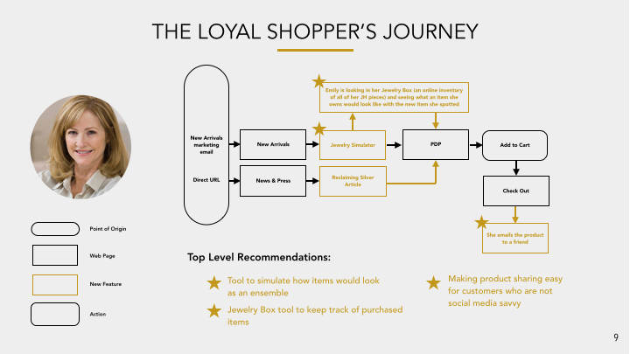
What is it like for an online shopper?

Slide 15
What about the log-ins and errors to logging in?

Slide 16
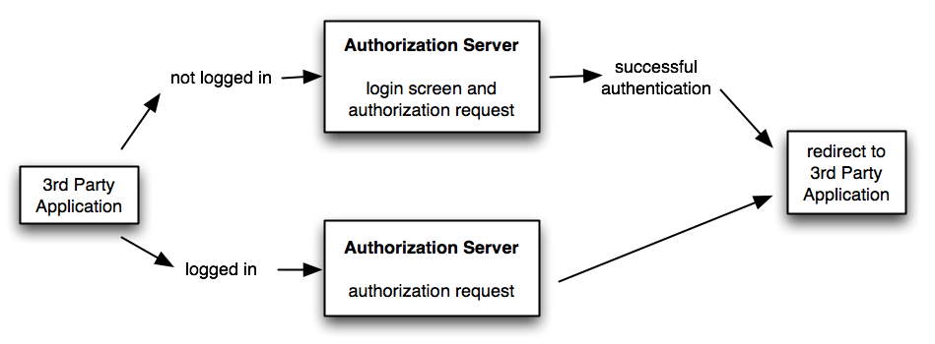
What about the log-ins and errors to logging in?

Slide 17
Do you have an example?

Slide 18
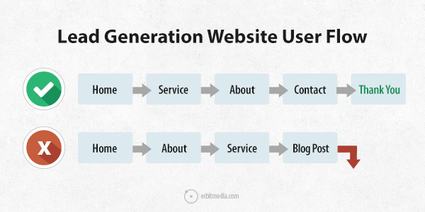
Julian’s website
https://uhm-julian.github.io/UserFlow/

Slide 19
What is my homework or task for this week?

Slide 20
Bibliography/ Works Cited
Anthony. “Site Flows vs. User Flows: When to Use Which”. July 29, 2015. Retrieved from
http://uxmovement.com/wireframes/site-flows-vs-user-flows-when-to-use-which/
Crestodina , Andy. “User Flow: Find the Top Path Through Your Website”. n.d. Retrieved from
https://www.orbitmedia.com/blog/user-flow-google-analytics/
Koht, John. “Create Meaningful User Experiences by Solving Real User Needs”. May 02, 2015. Retrieved from
https://www.kohactive.com/blog/improve-your-ux-with-user-flows/
n.a.“Requiring User Login”. n.d. Retrieved from
https://www.oauth.com/oauth2-servers/authorization/requiring-user-login/
Vander, Hagar. “John Hardy”. 2016. Retrieved from
http://www.hvander.com/john-hardy/
Weissman, Ari. “User Flows in UX Design: What Clients Need to Know”. March 24, 2015. Retrieved from
http://www.effectiveui.com/blog/2015/03/24/user-flows-ux-design-clients-need-know/

