Slide 1
Prosper Loan Project Data visualization
Uyen hoang

Slide 2
Data overview
This data set contains 113,937 loans with 81 variables on each loan, including loan amount, borrower rate (or interest rate), current loan status, borrower income, and many others. Information in data will be used to analyzed and visualized.

Slide 3
Question 1: How is loans distribution differently base on locations, time, employment status, and credit scores, income range?

Slide 4
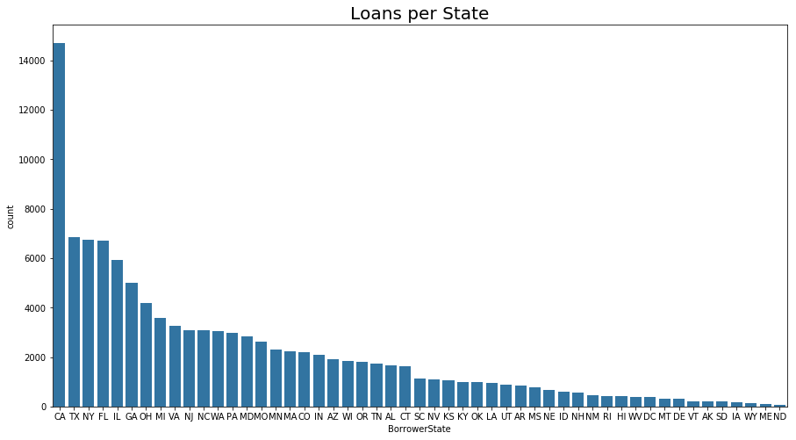
CA have highest numbers of loans while North Dakota has the fewest number of loans. A key consideration is population; it could be a factor that cause the differences.

Slide 5
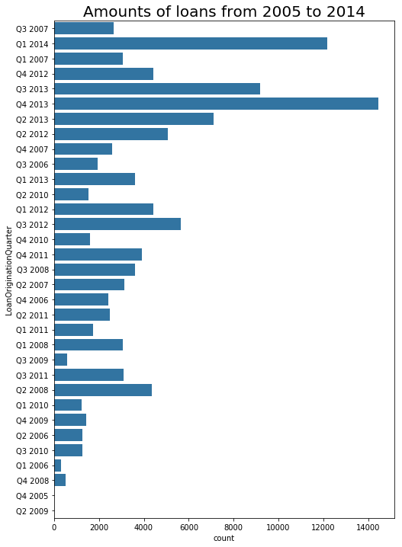
The largest number of loans are in the fourth quarter of 2013. The time that have the least number of loans are in second quarter of 2009 and fourth quarter of 2005.

Slide 6
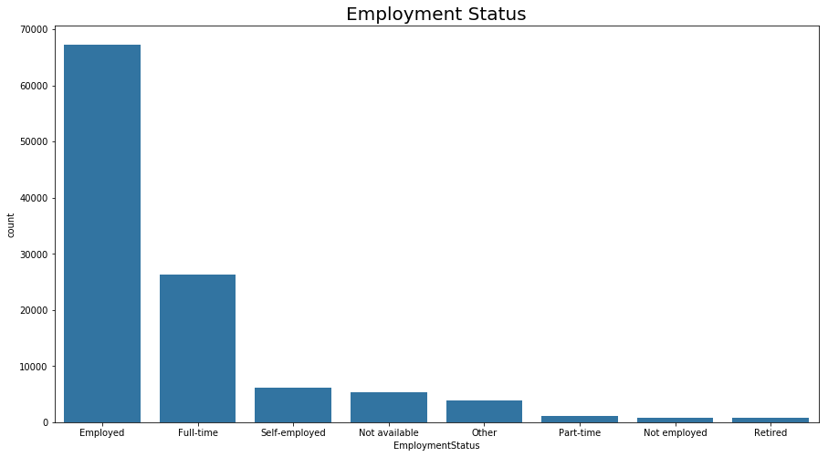
Most people are Employed, the fewest loans belong to retired group

Slide 7
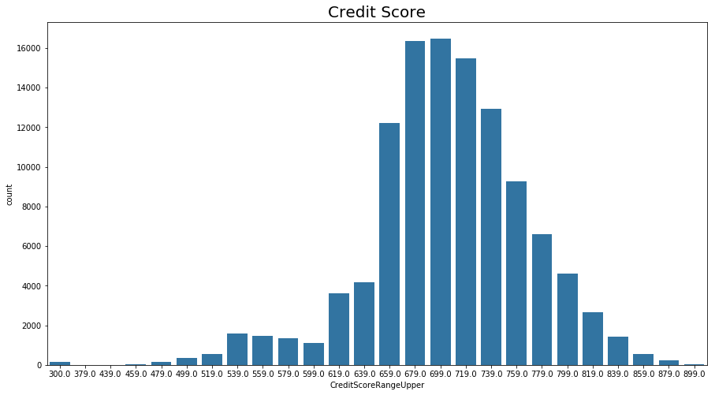
- The most common credit score is 699.0

Slide 8
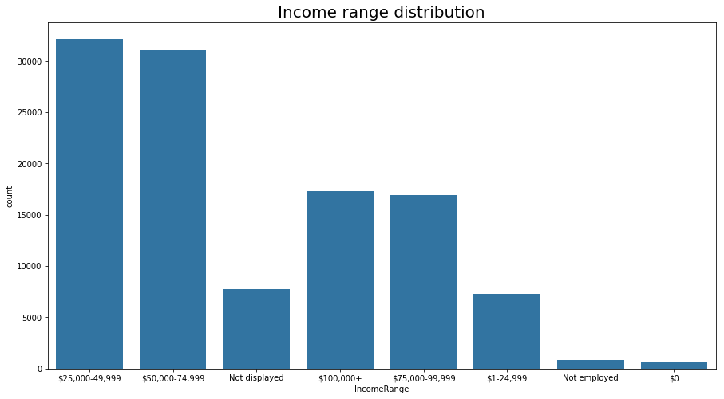
Most loan holders has the income rage between 25,000 to 49,999

Slide 9
Question 2: Is it true that borrower who has higher income more likely to have better credit score?

Slide 10
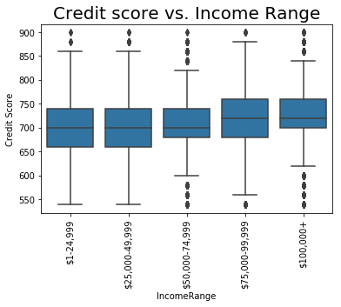
- Plot shows that member with higher income tends to have higher credit score.

Slide 11
Question 3: What is the relationship between borrowers’ employment status and weather they are a home owner?

Slide 12
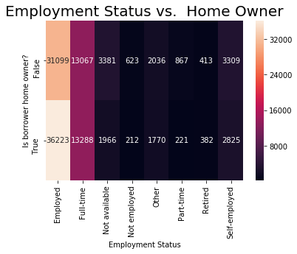
- Plot showed people that employed and work full-time has mores loan compare to people who is working part-time or retired. When comparing whether or not a person owns a house, employed and fulltime job group that own house has higher number while it's less for non-homeowner groups.

Slide 13
Question 4: What are the differences on Borrower rate when comparing home owner and non-homeowner throughout the years?

Slide 14
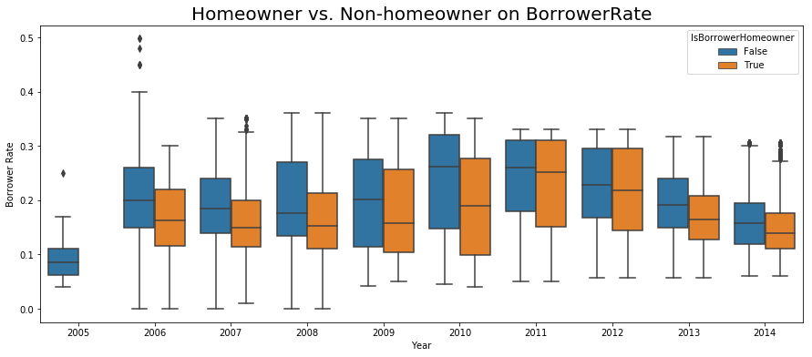
Throughout time, there are some changes on interest rate when comparing Homeowner and Non-homeowner. The interest rate tend to be higher on Non-homeowner vs Homeowner. The borrower rate was highest in 2010, it then started to decrease from there.

