Slide 1
MCA CAPSTONE PROJECT · CHRIST UNIVERSITY
CareerOS
An AI-Powered Career Intelligence Platform
Vaibhav Sahu
Roll No.: 25225026
Aligned with UN SDG 4 (Quality Education) & SDG 8 (Decent Work and Economic Growth)

Slide 2
INTRODUCTION
Objectives & SDG Alignment
1
Unify resume analysis, skill-gap identification, learning guidance, mock interviews, and portfolio evaluation into one AI-driven platform.
4
SDG 4 — Quality Education
Give the AI layer a persistent “Career Memory” so guidance improves with repeated use instead of resetting each session.
Personalized learning roadmaps close each student's specific skill gaps, improving access to relevant resources.
2
3
Provide role-based dashboards for Student, Recruiter, Placement Officer, Faculty, and Admin.
8
SDG 8 — Decent Work & Economic Growth
4
Produce an explainable Career Readiness Score, not a black-box number.
Better resume quality, interview readiness, and skill-role fit improve employability outcomes and recruiter matching.
CareerOS — Project Presentation
2

Slide 3
ANALYSIS
Existing System & Its Limitations
Students today stitch together resume builders, generic ATS checkers, standalone interview-prep apps, MOOC platforms, and manual certificate/GitHub tracking — none of which talk to each other.
1
Fragmentation
No single tool spans resume, skills, interviews, and portfolio — overall readiness is never visible in one place.
2
No Memory
Generic AI chat tools forget everything between sessions; guidance never compounds.
3
Generic Scoring
One-size-fits-all resume/ATS scoring ignores the student's actual target role.
4
Manual Reporting
Placement cells track readiness in spreadsheets that don't scale and go stale fast.
5
No Explainability
Existing AI resume tools return a score with no auditable breakdown of what drove it.
CareerOS — Project Presentation
3

Slide 4
ANALYSIS
Proposed System — A Career Operating System
CareerOS unifies the fragmented tools into one platform, and adds a persistent Career Memory layer so guidance to a student improves as the system learns more about them over time.
1
Resume & ATS
2
Skill Gap & Roadmap
3
AI Career Mentor
Upload, AI parsing, ATS scoring, section feedback
Target-role comparison, sequenced learning path
RAG-grounded, memory-personalized guidance
4
Mock Interview
5
GitHub Portfolio
6
Readiness Score
AI-generated questions, structured feedback
Repository analysis, project recommendations
Composite, explainable employability score
CareerOS — Project Presentation
4

Slide 5
SPECIALIZATION CONCEPTS
What Makes CareerOS Different
Not a thin wrapper around a chatbot — purpose-built, independently explainable AI components.
Career Memory Engine
RAG-Grounded Mentor
Skill Gap Prediction
Persistent, vector-backed student context that compounds over time
AI Mentor responses retrieved from the student's own history, not generic
Target-role skill vector vs. parsed-resume vector, with a generated roadmap
Readiness Score
GitHub Portfolio Analyzer
Adaptive Recommendations
Composite, explainable score with a visible factor breakdown
Repository language mix, activity, and complexity signals
Project and resource suggestions driven by the live skill gap
CareerOS — Project Presentation
5

Slide 6
REQUIREMENTS
Functional & Non-Functional Requirements
Functional (by module)
Non-Functional
Authentication & User Management (RBAC)
Career Profile & Resume (upload, parse, ATS)
Skill Gap & Learning Roadmap
AI Career Mentor & Career Memory
Mock Interview
GitHub Portfolio & Readiness Score
Recruiter (job posting, search, AI ranking)
Placement Cell & Faculty analytics
Admin (users, AI-service health, logs)
Performance: <500ms standard APIs; AI responses start streaming within 5s
Security: HTTPS, hashed credentials, server-side RBAC on every request
Reliability: graceful degradation if AI service is unavailable
Scalability: independently deployable, containerized services
Usability: first resume analysis completed within a 10-minute session
Maintainability & Portability: modular layers, Docker-deployable to any cloud
CareerOS — Project Presentation
6

Slide 7
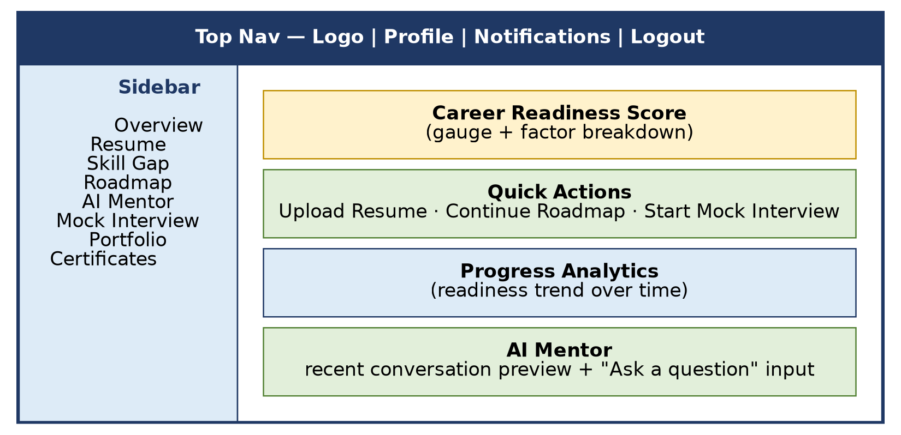
DESIGN
UI Design — Role-Based Dashboards
Every role lands on a dashboard through the same shell:
Shared top nav + role-specific sidebar
Explainable AI scores — never a bare number
Quick-action cards for the most common task
Progressive disclosure: summaries link to detail screens
Responsive: sidebar collapses on tablet widths
Figure: Student Dashboard wireframe layout
CareerOS — Project Presentation
7

Slide 8
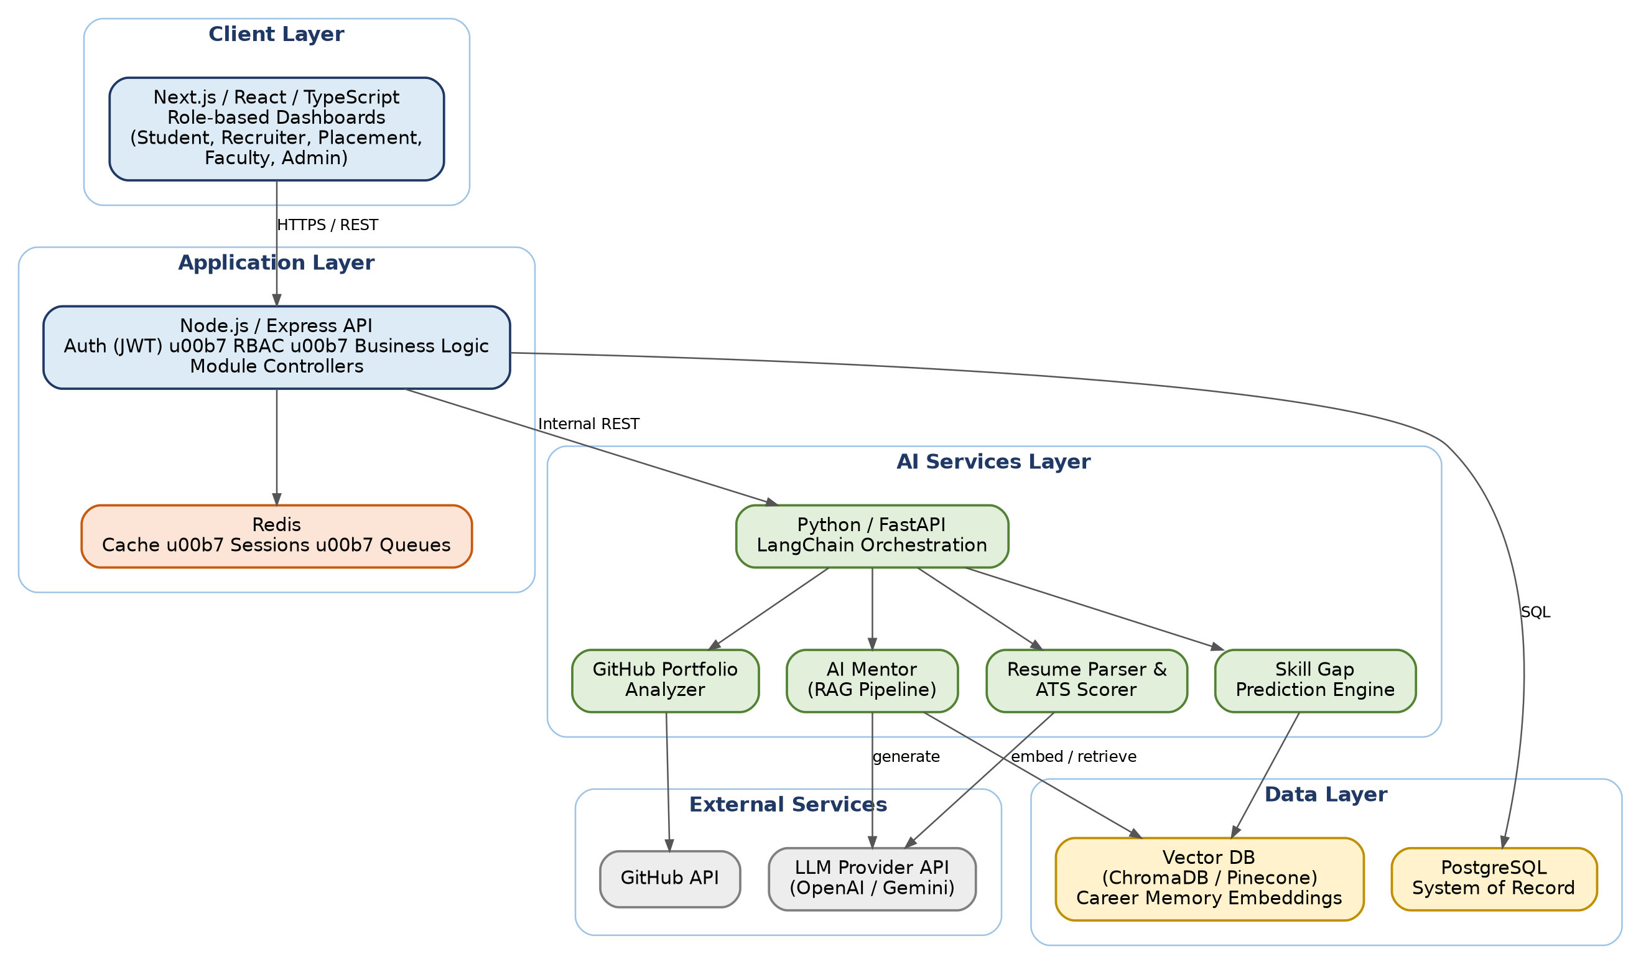
DESIGN
System Architecture
CareerOS — Project Presentation
8

Slide 9
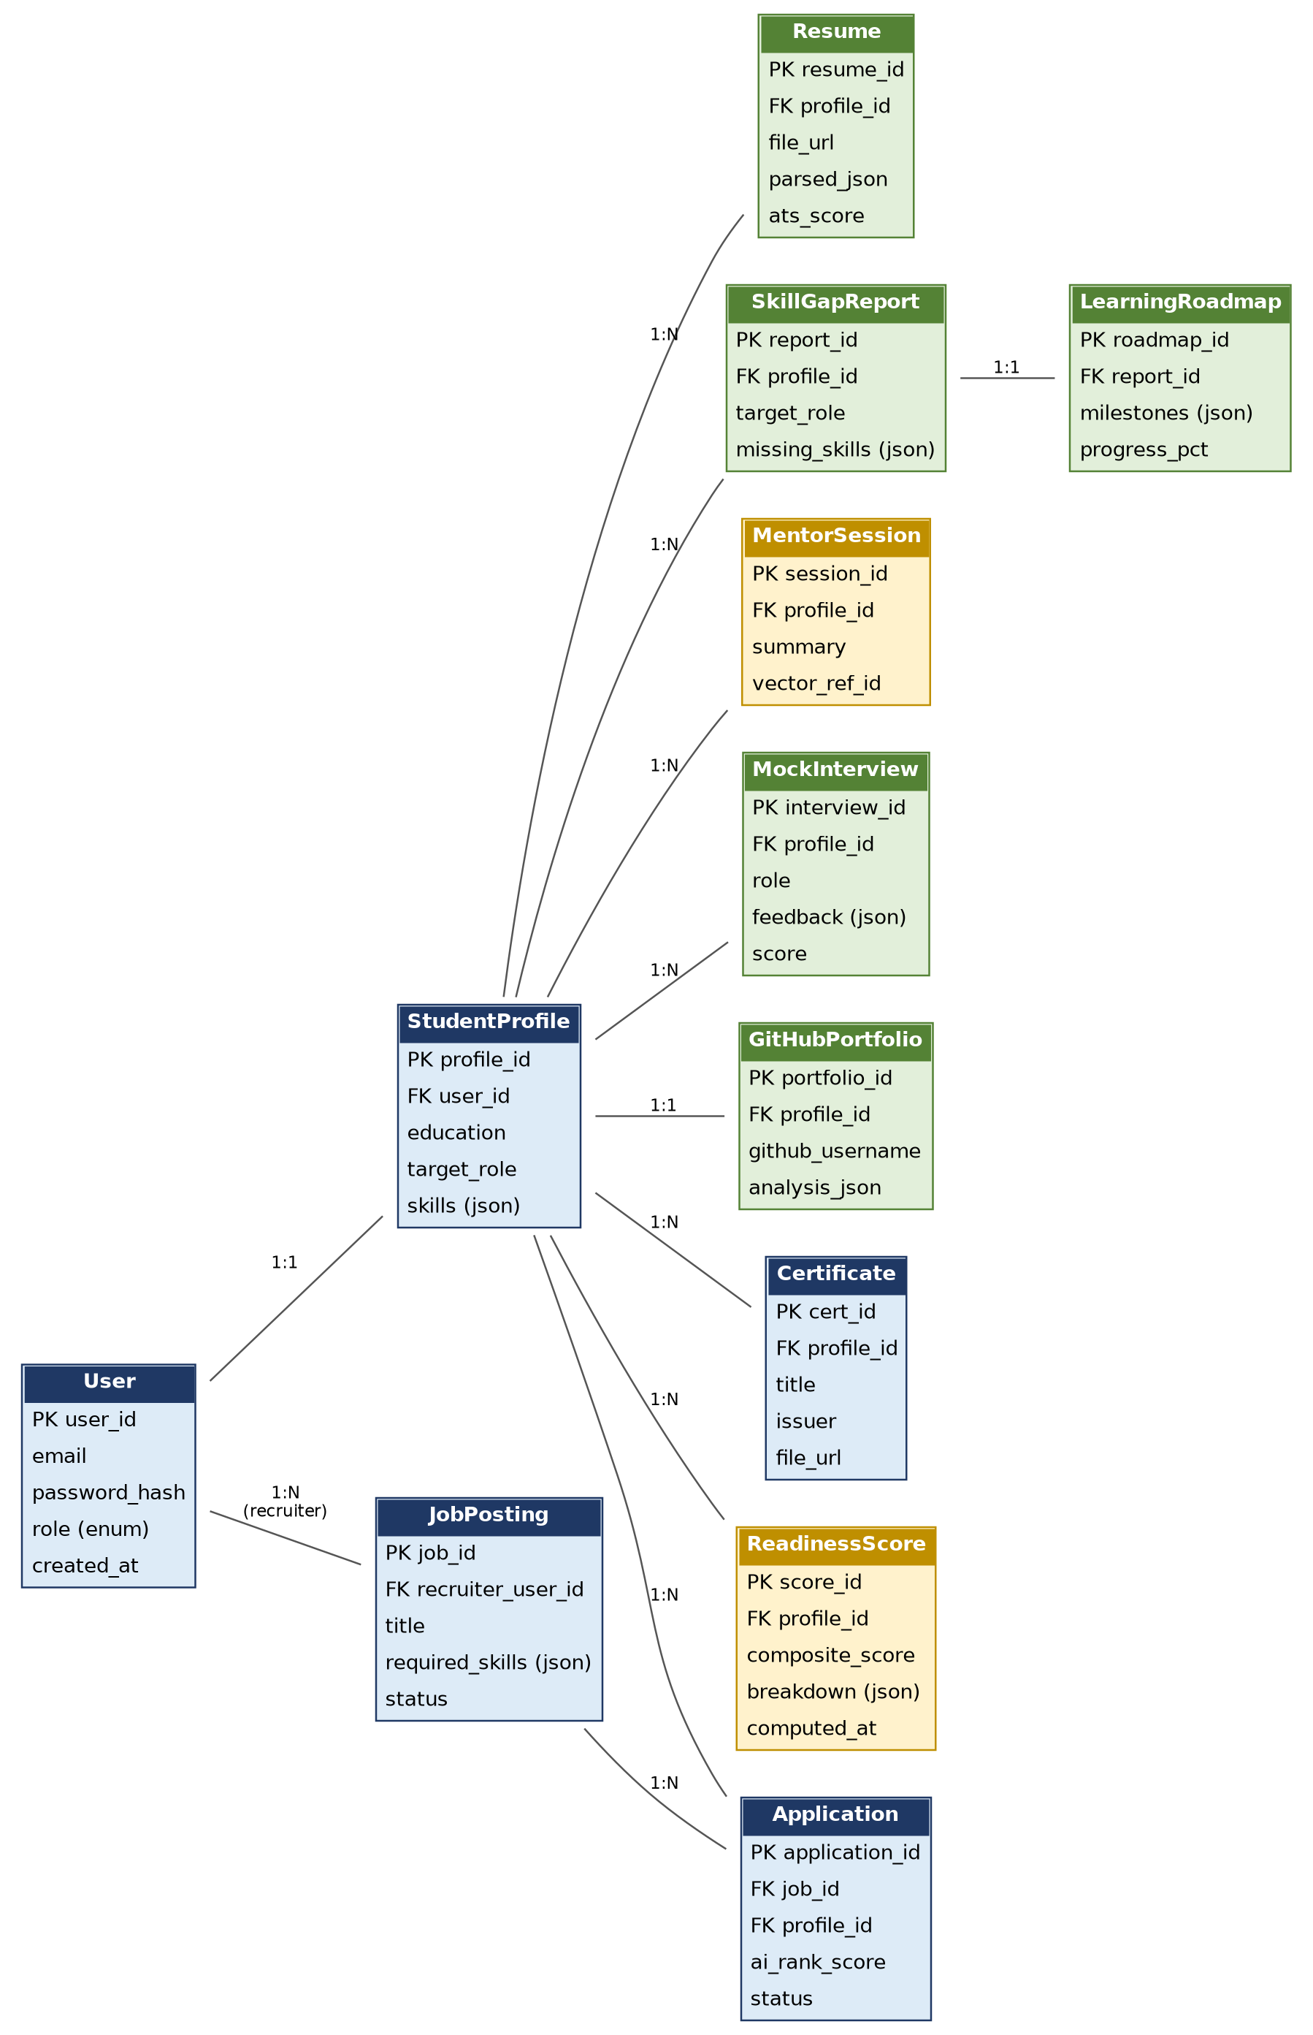
DESIGN
Database Design — Core Entities
Design notes:
PostgreSQL is the single system of record; JSON columns hold AI-derived structured content
StudentProfile anchors resume, skill-gap, mentor, interview, portfolio, certificate, and readiness records
MentorSession stores only a summary + vector reference — full embeddings live in the vector DB
JobPosting / Application support the Recruiter flow; AI writes the rank score
Redis (not shown) handles sessions, caching, and background job queues
Figure: Entity-Relationship diagram
CareerOS — Project Presentation
9

Slide 10
DESIGN
Core Algorithms
Skill Gap
Analysis
Parsed resume
skills
→
Compare to
target role
→
Identify
gaps
→
Generate
roadmap
Readiness
Score
ATS +
skills +
interview +
portfolio
→
Apply
weights
→
Weighted
composite
→
Explainable
breakdown
AI Mentor
(RAG)
Embed
query
→
Retrieve
Career Memory
→
Assemble
prompt
→
LLM
response
→
Update
memory
Full flowcharts for each algorithm are provided in the companion Design Document.
CareerOS — Project Presentation
10

Slide 11
OUTCOMES
Expected Outcomes
✓
Working MVP: profile → resume analysis → skill gap → roadmap → mentor → mock interview → readiness score
✓
Working Recruiter flow: job posting → candidate search → AI-assisted ranking
✓
Placement Officer view: cohort-level readiness and skill-gap analytics
✓
Deployed, containerized system accessible via a public URL for demo and viva
✓
Complete documentation: Synopsis, SRS, Design Document, Presentation, testing report, user manual
✓
GitHub repository with weekly commit history evidencing iterative development
CareerOS — Project Presentation
11

Slide 12
Thank You
Questions & Viva Discussion
GitHub Repository
github.com/uhoh-vaibhav/CareerOS
Vaibhav Sahu · Roll No. 25225026 · Christ University

