Slide 1


UHUCHAIN
CAR CONEPT
KNOW WHAT YOU OWN

Slide 2


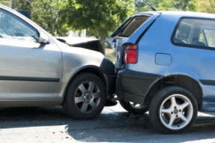
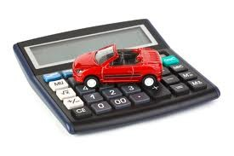


UHUCHAIN Car
What if there were a distributed single source of truth where
all insurance companies could share all information about
Cars
Policies
Claims
to optimize
Policy price calculation
Fraud Detection
Market Analysis
?
UHUCHAIN

Slide 3
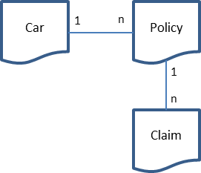


UHUCHAIN Car
Here is the answer ……
permissioned
distributed
Ledger
full data privacy
… since no
customer
data
shared
Insurance
Insurance
Record
Record
Smart Contracts
Smart Contracts
Distributed Ledger
Consensus
Consensus
Distributed Ledger
Consensus
Record
Smart Contracts
Insurance
Distributed Ledger

Slide 4
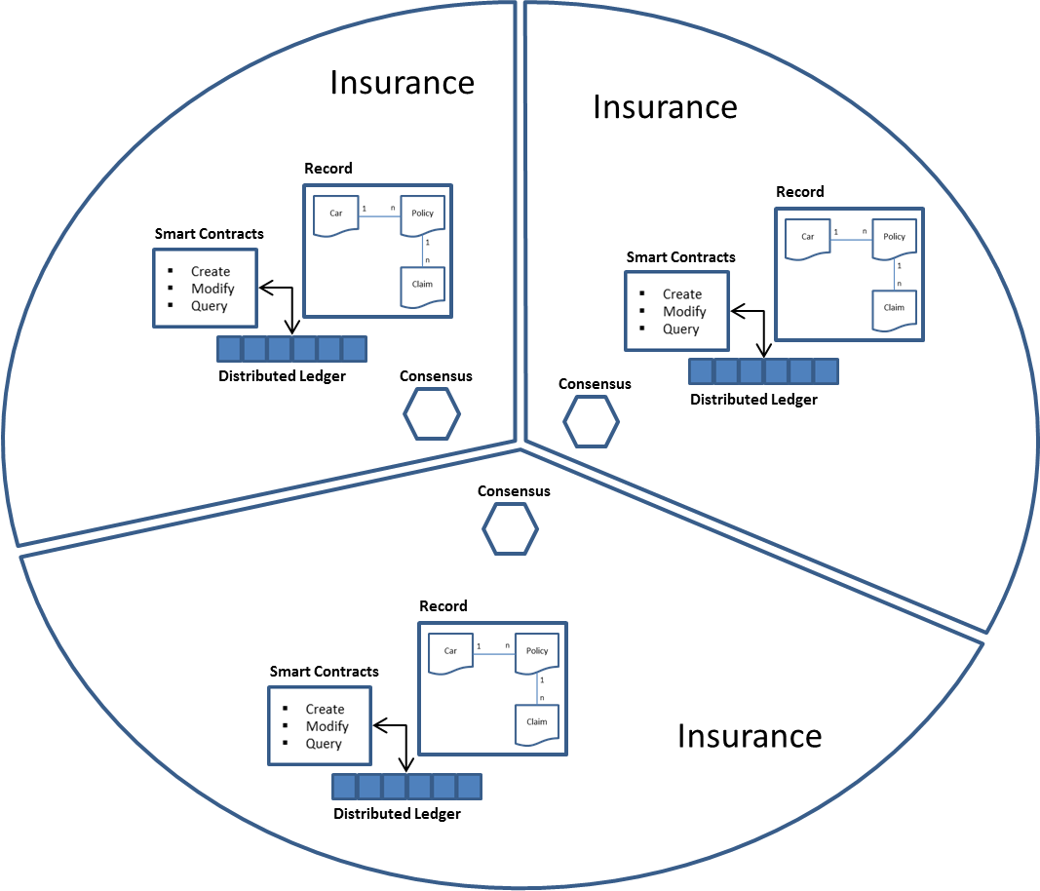
UHUCHAIN Car
Ledger does not hold any customer data
Customer is represented by a unified identifier
Insurance A reads car history data form ledger
In car‘s history each policy contains
The insurers data (let say Insurance B)
Customer’s unified id provided by the insurer
If Insurance A is interested in customer data, it must use the customer unified id provided by Insurance B to ask Insurance B to provide customer data.
Car Chain will not provide any interface to access systems outside the network since these systems may not be available form each peer being part of the network.

Slide 5
UHUCHAIN Car
Guidewire
Car Chain
SDK
Java
Car Chain
API
Car Chain
Record
MSG Life
Smart Contracts
SAP
Insurance
Distributed Ledger
Consensus
Car Chain provides a JAVA SDK and a Standard API to allow existing insurance systems to interface with ledger.

Slide 6
UHUCHAIN Car
Guidewire
Car Chain
carExists(aCar)
addCar(aCar)
queryCarHistory(aCar)
openPolicy(aPolicy)
closePolicy(aPolicy)
createClaim(aClaim)
…
Record
Smart Contracts
Distributed Ledger
Consensus
JAVA SDK and Car Chain API may be used from operational systems such as Guide Wire to access the ledger by invoking smart contract transactions.

Slide 7
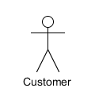
UHUCHAIN Car
Insurance
Custmer Portal
Car Chain
Record
queryCarHistory(aCar)
Smart Contracts
queryCarHistory(aCar)
Distributed Ledger
Consensus
Insurance companies may also expose ledger information to their customers who are interested in buying a car. Customers may request information about a car before buying it.

Slide 8
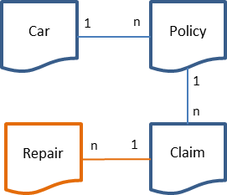
UHUCHAIN Car
Record
Smart Contracts
Distributed Ledger
Car Service Station
Consensus
In future releases network can be expanded by taking in car service stations which can add repair records to each claim. This will add value to car’s history.

Slide 9

UHUCHAIN Car
Insurance
Record
Policy Management
Customer requests a new policy for a car
Insurance checks ledger if that car exists
If car exists, its history can be read and considered for policy calculation
If not, car can be added to the ledger
After customer has concluded contract policy can be added to ledger
Smart Contracts
Consensus
Distributed Ledger
New policy can be added if either no other policy exists or an existing policy has been closed by the insurance company created it
New policy can only be created for a car which is not deactivated.
Insurance company must be able to
Open policy
Close policy
Change policy
Query policy
for a certain car.
UHUCHAIN

Slide 10
UHUCHAIN Car
Insurance
Record
Claims Management
Customer reports a claim
Insurance adds claim to ledger by attaching it to the corresponding policy
Insurance may update claim during fulfillment
Smart Contracts
Consensus
Distributed Ledger
Insurance company must be able to
Open claim
Close claim
Change claim
Query claim
for a certain policy.
New claim can only be added to an open policy
New claim can only be added by the insurance which has created the policy

Slide 11
UHUCHAIN Car
Insurance
Record
Car Management
Car’s attributes may change over its lifecycle
Insurance may update cars existing on the ledger
Smart Contracts
Consensus
Distributed Ledger
A car exists only once in the ledger identified by VIN
A car can be deactivated if there is no open policy assigned to it only
A car can have only one open policy
Insurance company must be able to
Create car
Modify car
Deactivate car
Query car

