Slide 1
Agentic AI in Practice
Lessons from Real-World Use and Evaluation Barrie Robison • AI4RA / RCDS

Slide 2
Context
Connected agent tools to secure on-prem models
Built multiple internal AI applications
Observed real team reactions
Evaluated repo-scale agent collaboration
Early institutional exposure to agentic AI in practice

Slide 3
Immediate Reality
Shadow AI applications are already emerging
Rapid experimentation outside governance
Fear and uncertainty across technical teams
Institutional structures lag the technology

Slide 4
Core Institutional Principle
Make the right thing easy, and the wrong thing difficult
Provide approved stacks, secure deployment paths, reusable patterns, doc standards
Innovation scales within compliance when the environment is designed well

Slide 5
Jobs Are Changing, Not Disappearing
AI doesn’t change WHY roles exist
It changes WHAT people do and HOW they do it
Applies across dev, research admin, and IT/OIT

Slide 6
The Demand Misconception
Fear assumes demand stays constant while productivity rises
More likely: app cost ↓, dev speed ↑, experimentation ↑, demand ↑
Result: more work — different work

Slide 7
AI as a Mission Force Multiplier
Frame AI as amplifying mission outcomes
Research productivity, administrative capacity, innovation throughput
Institutional intelligence and faster iteration loops

Slide 8
Do Not Automate Broken Workflows
Don’t ask: “How can we make this workflow faster?”
Ask: “Why does this workflow exist, and how should it work?”
Agentic AI rewards redesign over optimization

Slide 9
Greenfield vs Brownfield AI
Greenfield: AI-native systems, clean APIs, high autonomy
Brownfield: legacy integration, adapters/RPA, high friction
Most universities operate in brownfield reality

Slide 10
Start Small, Then Expand
Begin with a small ecosystem and trusted stack
Establish safe patterns and governance
Demonstrate value, then scale outward

Slide 11
The Agent Orchestrator Role
Systems thinker with broad generalist understanding
Decomposes processes and explains workflows clearly
Bridges domain experts, infrastructure, and agents

Slide 12
Guidelines for Agents, Not Just Humans
Preferred stacks by project type
Security, deployment, documentation patterns
Data access conventions and reusable primitives
Guidelines should guide agents as much as people

Slide 13
Repo Lesson: Multi-Agent Coordination
Define scope boundaries and conflict prevention
Create a skill registry and output contracts
Establish escalation and handoff protocols
Single-agent assumptions break quickly

Slide 14
Repo Lesson: Explicit Agent Rules
Separate background context from normative MUST rules
Naming conventions, checks before commit, terminology, branching
Rules reduce drift across agents and collaborators

Slide 15
Repo Lesson: Preserve Architectural Intent
Capture “why” via Architecture Decision Records (ADRs)
Prevents accidental “fixes” of intentional patterns
Enables consistent evolution and onboarding for agents/humans

Slide 16
Market Implication: SaaS Pressure
As custom tool creation accelerates, SaaS value shifts
Vendors must improve dramatically or reduce prices
Institutions gain leverage in contract negotiations

Slide 17
Most People Are Thinking Too Small
This isn’t just automation — it’s capability expansion
Solution proliferation and rapid experimentation
Research amplification effects are enormous

Slide 18
Strategic Takeaways
AI is a force multiplier, not a job replacer
Demand for tools will increase
Redesign workflows; don’t automate broken ones
Agent orchestration is a new institutional role
Start small and scale safely

Slide 19
Institutional Question
Not: “Should we adopt AI?”
But: “How do we design an institution where agents safely amplify our mission?”

Slide 20
Closing
Agentic AI changes who builds tools, how they’re built, and how many exist
Treat this as research and mission amplification infrastructure

Slide 21
APPENDIX
Development Activity Report
February 1–19, 2026 • Agentic Development with Claude Code • Prepared by Luke Sheneman

Slide 22
APPENDIX: KEY METRICS AT A GLANCE
248
Total Commits
142,095
Net New Lines of Code
878
Unique Files Modified
7
Active Repositories
48
Pull Requests
90
Issues Tracked
19 calendar days • 3 contributors • ~13 commits/day • ~7,500 net lines/day
Spanning ML/AI, full-stack web, DevOps, and research tools

Slide 23
Appendix: Repository Summary
7 Repositories • 142,095 Lines • 19 Days
VERASUnlimited • mindrouter2 • proposalforge • skillbag • dissertation • CerealPestAID • WildVE

Slide 24
10–15x
Productivity Multiplier
Estimated manual: 6–9 months • Actual: 19 days, 2–3 contributors with agentic AI

Slide 25
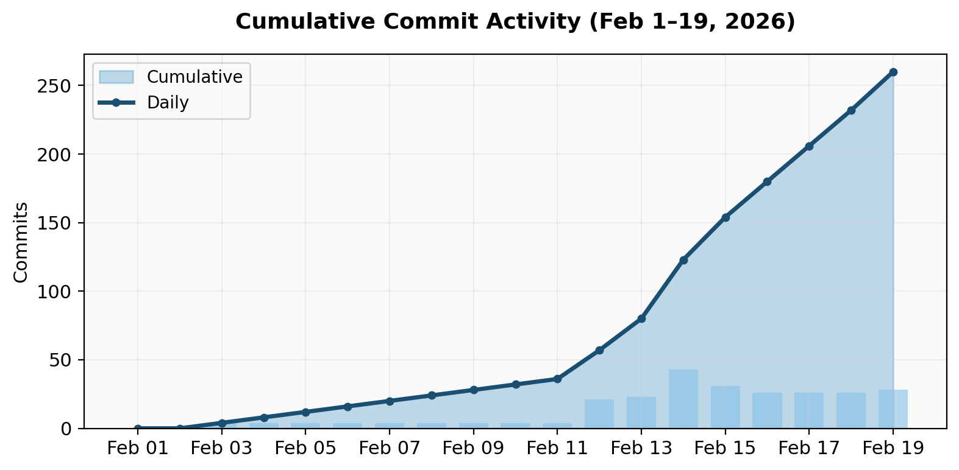

Slide 26
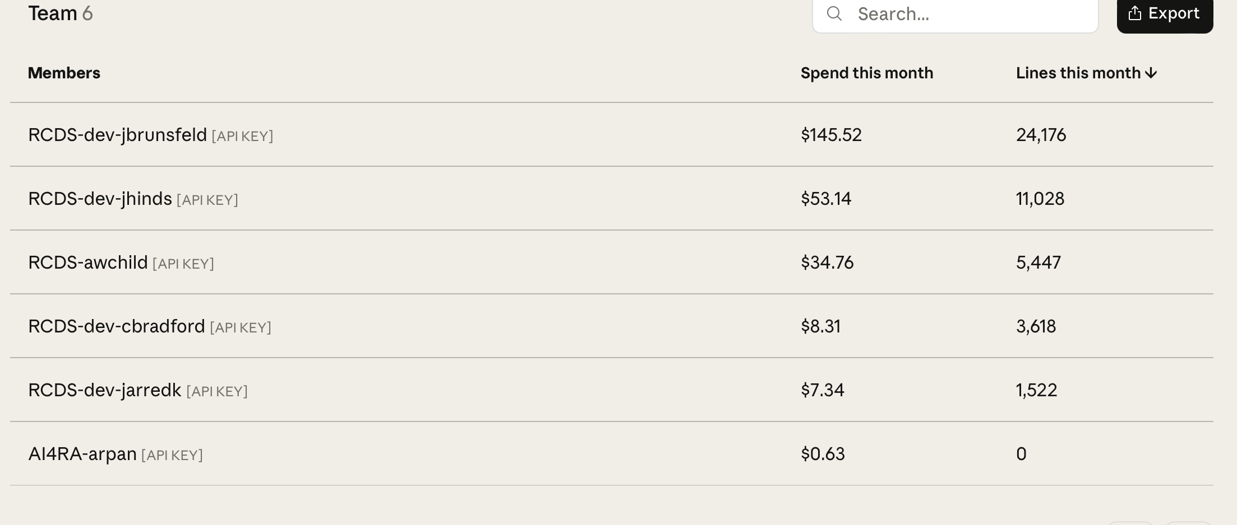

Slide 27
Appendix: Per-Project Effort Estimates
Repository | Days Active | Net New Lines | Low Estimate @ 150 lines/day | High Estimate @ 100 lines/day | Multiplier
VERASUnlimited | 6 | 81,344 | 542 days (24.7 mo) | 813 days (37.0 mo) | 90-136x
mindrouter2 | 17 | 27,132 | 181 days (8.2 mo) | 271 days (12.3 mo) | 11-16x
proposalforge | 1 | 17,163 | 114 days (5.2 mo) | 172 days (7.8 mo) | 114-172x
skillbag | 3 | 7,833 | 52 days (2.4 mo) | 78 days (3.5 mo) | 17-26x
dissertation | 1 | 5,107 | 34 days (1.5 mo) | 51 days (2.3 mo) | 34-51x
CerealPestAID | 1 | 1,984 | 13 days (0.6 mo) | 20 days (0.9 mo) | 13-20x
WildVE | 3 | 1,532 | 10 days (0.5 mo) | 15 days (0.7 mo) | 3-5x
TOTALS | 19* | 142,095 | 947 days (3.6 yr) | 1,421 days (5.4 yr) | 50-75x
*Total reporting period. Days Active = first commit to last commit (inclusive). Multiplier = Low/High estimate ÷ Days Active. Working days at 22/month.

