Slide 1
Introduction to Django Framework
Dibuat oleh User Inspired
http://ui.co.id

Slide 2
What

Slide 3
The Web framework for perfectionists with deadline

Slide 4
Fitur-fitur Utama

Slide 5
Dokumentasi Lengkap
http://docs.djangoproject.com

Slide 6
Object Relational Mapper
>>> post_list = Post.objects.all()
>>> post = Post.objects.get(id=1)
>>> post.delete()
>>> post = Post.objects.latest('id')
>>> post.title = 'hello world 12'
>>> post.save()

Slide 7
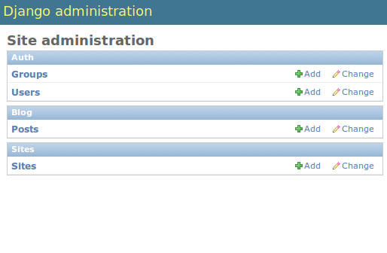
Automatic admin interface

Slide 8
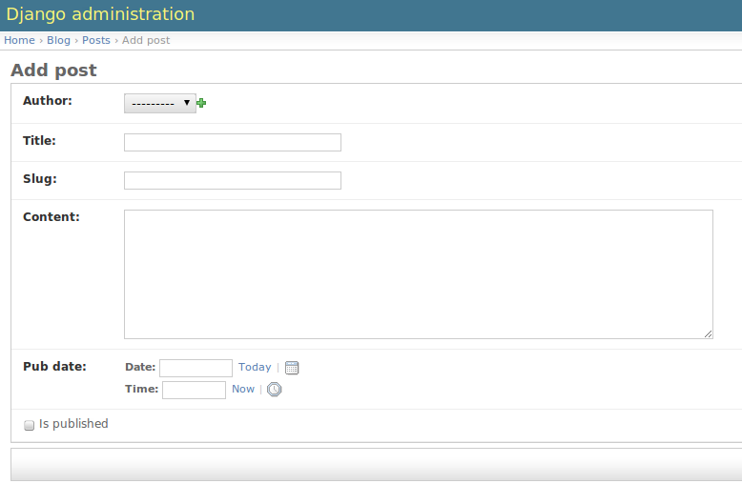

Slide 9
Design URL Elegan
URL berbasis Regex
from django.conf.urls.defaults import *
from django.contrib import admin
admin.autodiscover()
urlpatterns = patterns('',
url(r'^$', 'views.index', name="index"),
url(r'^home/$', 'market.views.home', name='home'),
(r'^fbapp/', include('fbapp.urls')),
(r'^accounts/', include('userena.urls')),
(r'^admin/(.*)', admin.site.root),
)

Slide 10
Mekanisme Cache

Slide 11
Internationalization

Slide 12
Django Main Components
(Model, View, Template)

Slide 13
Model

Slide 14
models.py
Model data dapat dibuat dalam Python
ORM, Tak perlu mengenal SQL
Sanitasi data secara otomatis (mencegah SQL injection)
Kompatibel dengan database populer:
  MySQL, PostgreSQL, sqlite
  Oracle, SQL Server
Tempatkan business logic di Model

Slide 15
Contoh Model
from django.contrib.auth.models import User
from django.db import models
class Post(models.Model):
""" Model post"""
author = models.ForeignKey(User)
title = models.CharField(max_length=255)
slug = models.SlugField(max_length=255)
content = models.TextField()
pub_date = models.DateTimeField()
is_published = models.BooleanField(default=False)
def __unicode__(self):
return self.title

Slide 16
Views

Slide 17
Views
Menerima HTTP request dari URL resolver
Retrieve objects, forms
Memilih template untuk ditampilkan

Slide 18
views.py
from django.views.generic.simple import direct_to_template
def news_archive(request, template="news/detail.html", extra_context = {}):
return direct_to_template(request, template, extra_context)

Slide 19
Template

Slide 20
Template
Untuk front end developer:
  Ditulis dalam HTML, Javascript
By default auto escapes HTML, JS
Fungsionalitas terbatas by design
Tidak menganjurkan business logic di template
Beberapa fungsionalitas yang built in:
  http://docs.djangoproject.com/en/dev/ref/templates/builtins

Slide 21
Template
<!DOCTYPE html PUBLIC "-//W3C//DTD XHTML 1.0 Transitional//EN"
"http://www.w3.org/TR/xhtml1/DTD/xhtml1-transitional.dtd">
<html xmlns="http://www.w3.org/1999/xhtml" xml:lang="en" lang="en">
<head>
<link rel="stylesheet" href="style.css" />
<title>{% block title %}My amazing site{% endblock %}</title>
</head>
<body>
<div id="sidebar">
{% block sidebar %}
<ul>
<li><a href="/">Home</a></li>
<li><a href="/blog/">Blog</a></li>
</ul>
{% endblock %}
</div>
<div id="content">
{% block content %}{% endblock %}
</div>
</body>
</html>

Slide 22
{% extends "base.html" %}
{% block title %}{{ section.title }}{% endblock %}
{% block content %}
<h1>{{ section.title }}</h1>
{% for story in story_list %}
<h2>
<a href="{{ story.get_absolute_url }}">
{{ story.headline|upper }}
</a>
</h2>
<p>{{ story.tease|truncatewords:"100" }}</p>
{% endfor %}
{% endblock %}

Slide 23
How

Slide 24
Your Project
Buat django project baru
  django-admin startproject hello
Edit settings.py
Sebuah project terdiri dari beberapa “app”
Buat aplikasi django app
  ./manage.py startapp blog
Run syncdb
  ./manage.py syncdb

Slide 25
Help?

Slide 26
Django Resources
id-python mailing list
www.djangoproject.com
www.django.or.id (sebentar lagi)

Slide 27
Questions

