Slide 1
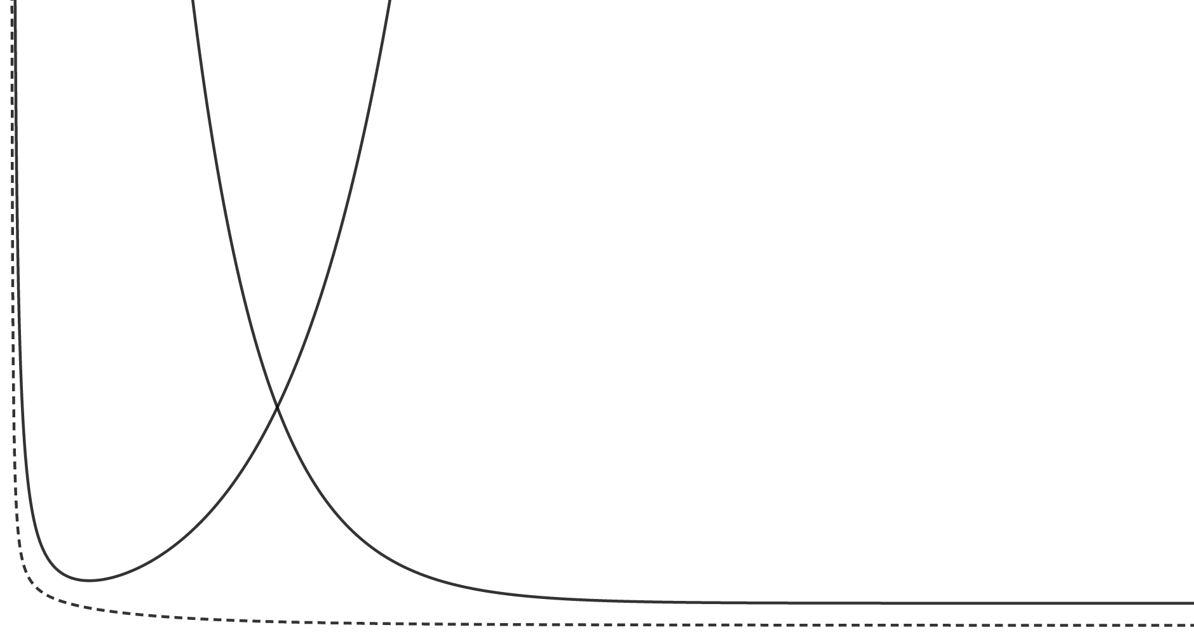
Risk
under-parameterized
over-parameterized
„classical“ regime
„modern“ regime
Test risk
Train risk
interpolation threshold
Capacity of F

