Slide 1
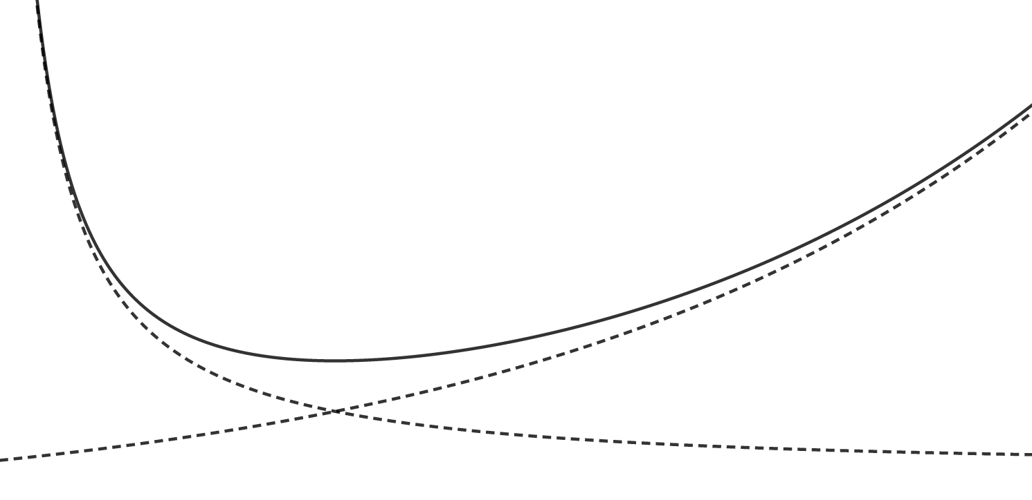
Loss
Risk Bound
Capacity term
Empirical Risk
Optimal model
Capacity of F

