Slide 1
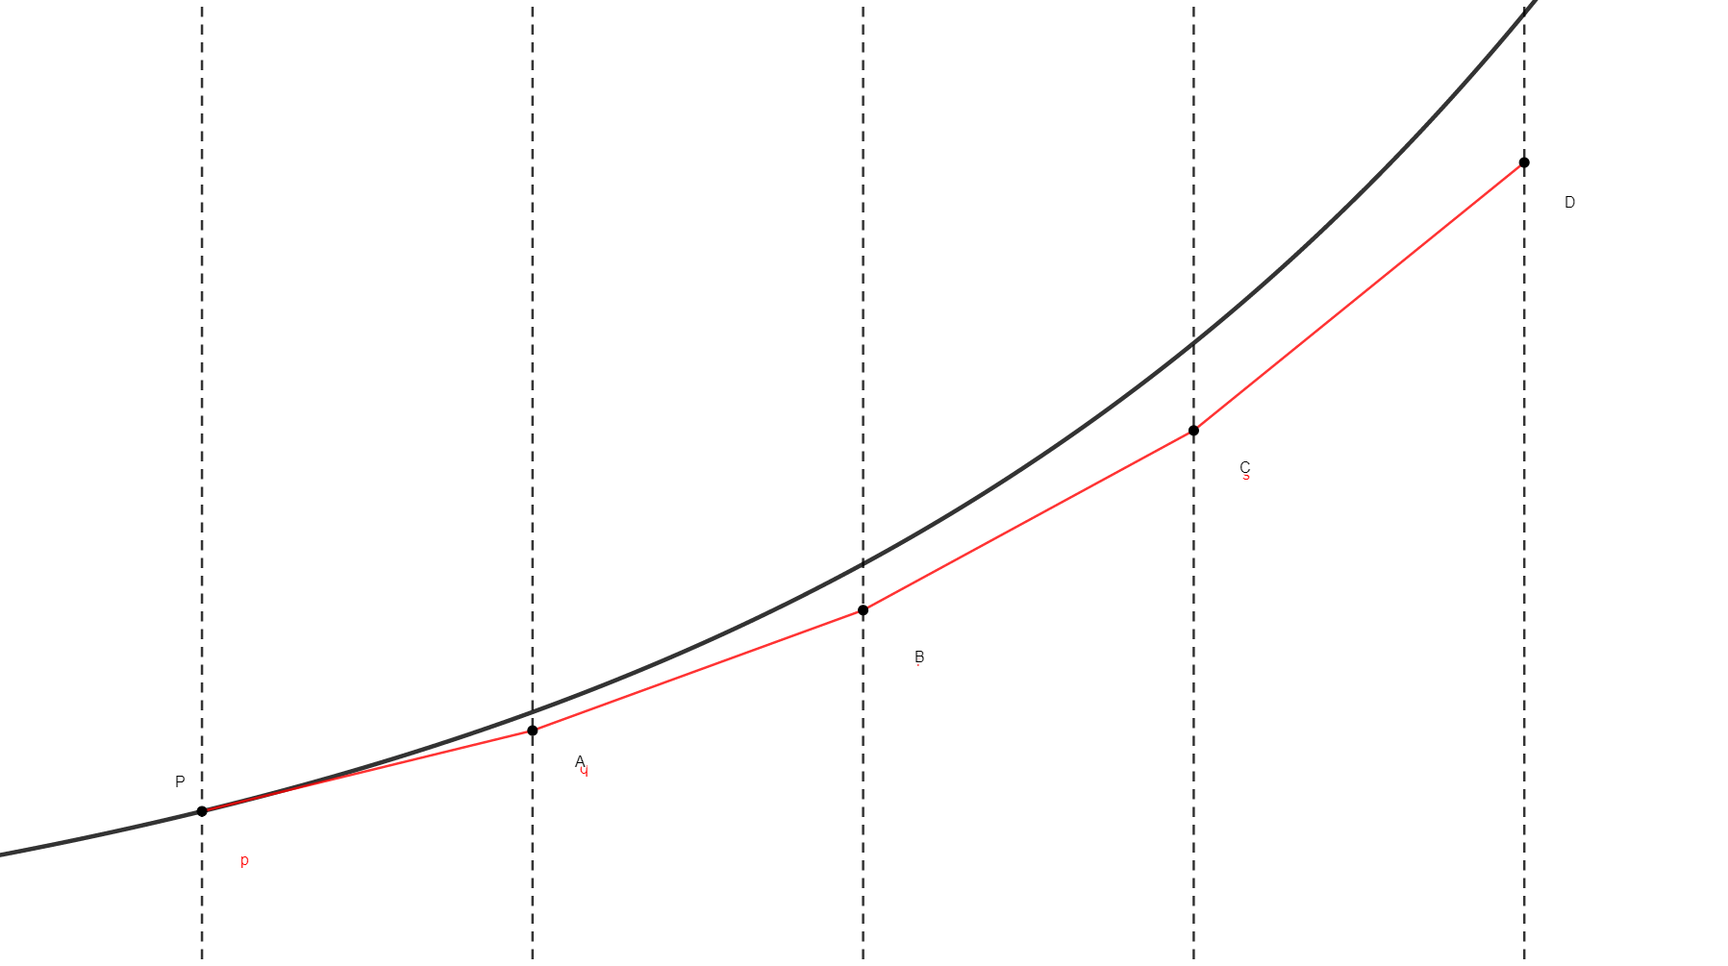
















y
$$y\left(t\right)$$
$$y_{4}$$
$$y_{3}$$
$$y_{2}$$
gradient
$$f\left(t_{0},y\left(t_{0}\right)\right)$$
$$y_{1}$$
$$y_{0}$$
$$η_{0}$$
$$η_{1}$$
$$η_{2}$$
$$η_{3}$$
$$t_{0}$$
$$t_{1}$$
$$t_{2}$$
$$t_{3}$$
$$t_{4}$$
t

