Slide 1
Uncertainty-Aware Hallucination Detection and Clarifying-Question Policy for LLMs
Final Presentation NLP Project
Jakob Josef Maisch 2025-82942

Slide 2
Motivation
LLMs tend to hallucinate and give wrong answers or an answer where no answer should be possible [1]
Model‘s uncertainty in the output can be helpful in hallucination detection [1,2]
Consequences from detecting a hallucination are not always clear [3,4]
Goal: Show that model uncertainty signals can drive a useful policy by directly linking them with user interaction (answer vs. clarify vs. abstain)

Slide 3
Dataset and Setup
Dataset: FEVER v1.0 [5] consisting of claims classified as SUPPORTS, REFUTES, NOT ENOUGH INFO
Using provided split train gives 311 431 samples
LLM: FLAN-T5-(base/large) [6] (250 – 800 Mio. params decoder-encoder Transformer finetuned on a mixture of tasks) and GPT2 [7] (124 Mio. params decoder Transformer)
Data Split: 70% train / 15% validation / 15% test (in total 100 000 samples)
Policy Model: Ridge Regression, Neural Network, Gradient Boosted Tree

Slide 4
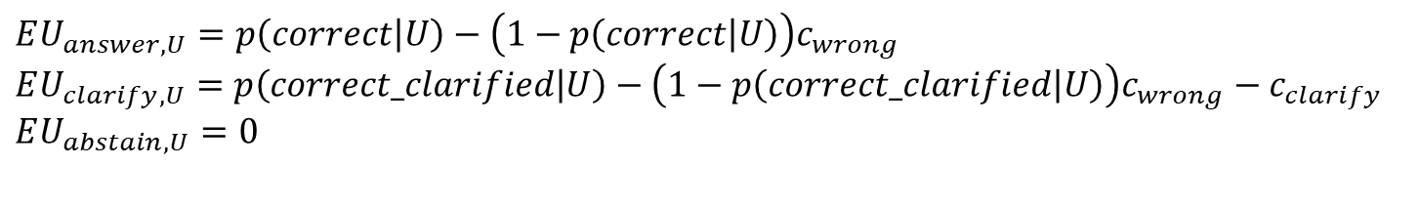
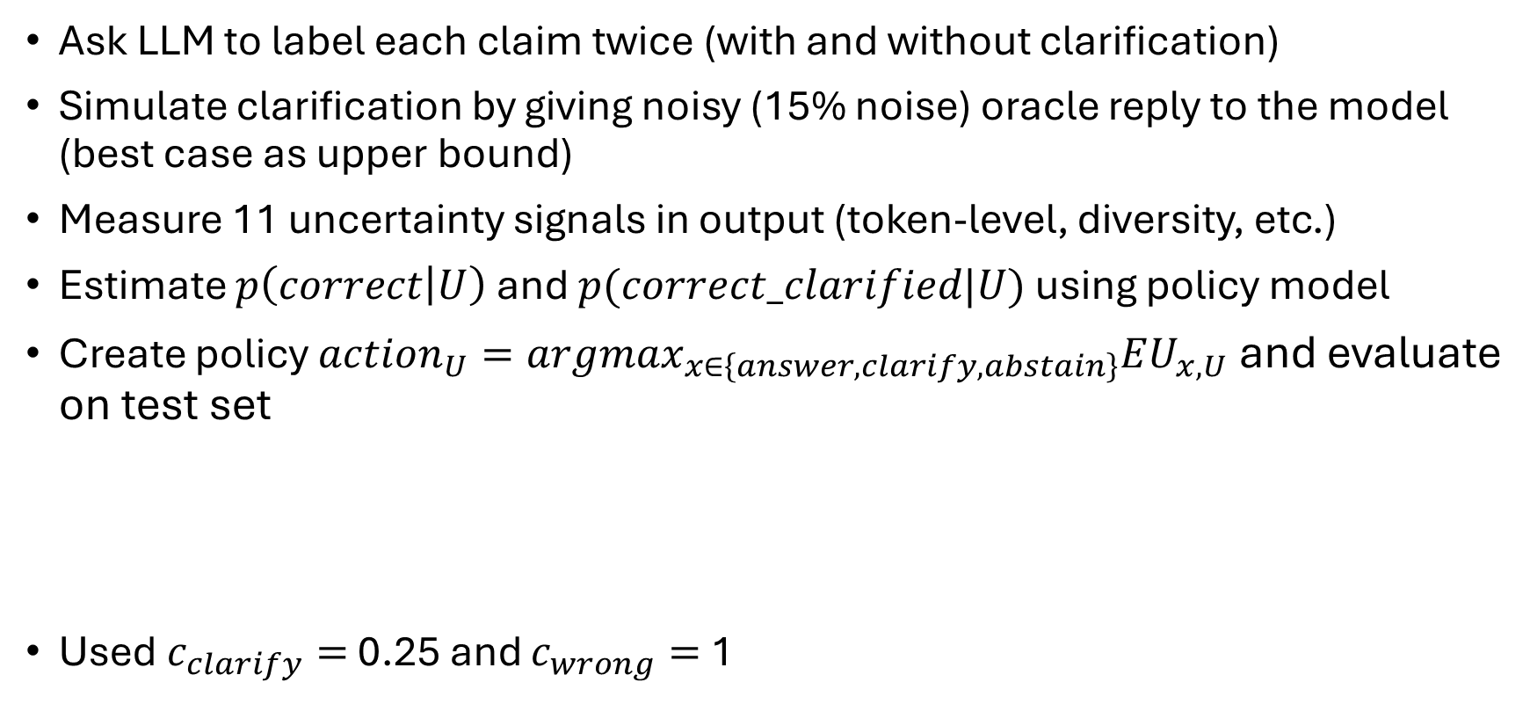
Method
Ask LLM to label each claim twice (with and without clarification)
Simulate clarification by giving noisy (15% noise) oracle reply to the model (best case as upper bound)
Measure 11 uncertainty signals in output (token-level, diversity, etc.)
Estimate $p\left(correct | U\right)$ and $p(correct_clarified|U)$ using policy model
Create policy $action_{U}=argmax_{x∈\left\{answer,clarify,abstain\right\}}EU_{x,U}$ and evaluate on test set
Used $c_{clarify}=$ 0.25 and $c_{wrong}=$ 1
$$EU_{answer,U}=p\left(correct | U\right)−\left(1−p\left(correct | U\right)\right)c_{wrong}$$
$$EU_{clarify,U}=p\left(correct_clarified | U\right)−\left(1−p\left(correct_clarified | U\right)\right)c_{wrong}−c_{clarify}$$
$$EU_{abstain,U}=0$$

Slide 5
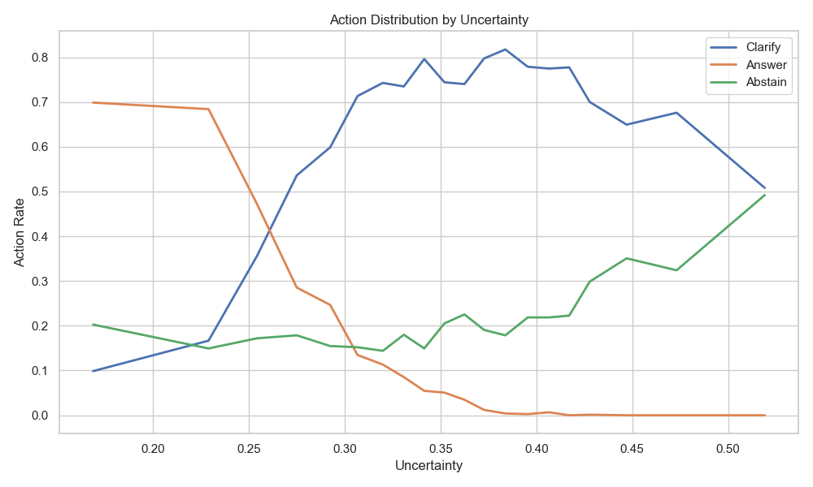
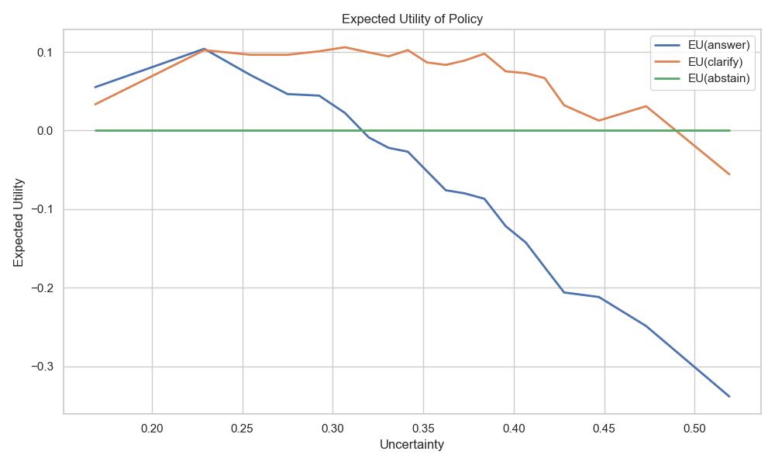
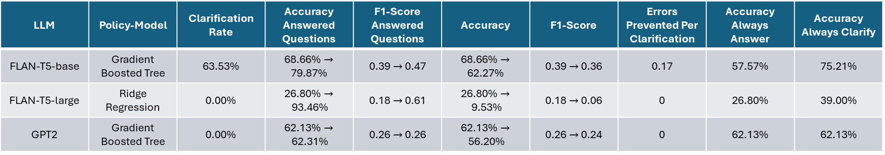
Results
LLM | Policy-Model | Clarification Rate | Accuracy Answered Questions | F1-Score Answered Questions | Accuracy | F1-Score | Errors Prevented Per Clarification | Accuracy Always Answer | Accuracy Always Clarify
FLAN-T5-base | Gradient Boosted Tree | 63.53% | 68.66% $→$ 79.87% | 0.39 $→$0.47 | 68.66% $→$ 62.27% | 0.39$→$0.36 | 0.17 | 57.57% | 75.21%
FLAN-T5-large | Ridge Regression | 0.00% | 26.80% $→$93.46% | 0.18 $→$0.61 | 26.80% $→$9.53% | 0.18 $→$0.06 | 0 | 26.80% | 39.00%
GPT2 | Gradient Boosted Tree | 0.00% | 62.13% $→$62.31% | 0.26 $→$0.26 | 62.13% $→$56.20% | 0.26 $→$0.24 | 0 | 62.13% | 62.13%
* Uncertainty in figures is the mean of the rescaled uncertainty features
** Value changes in the table represent the comparison to random clarifications with the same clarification rate
*** All Figures based on FLAN-T5-base

Slide 6
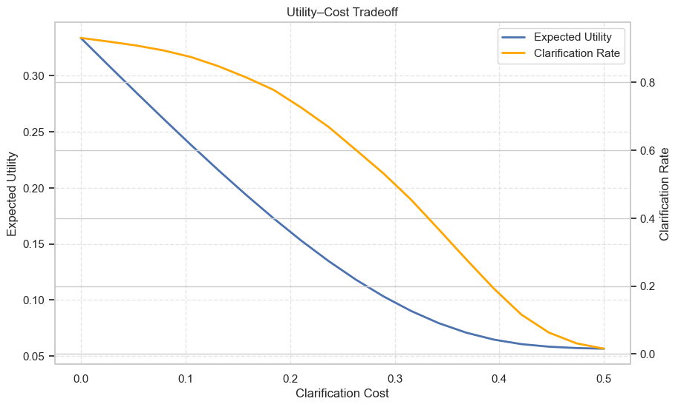
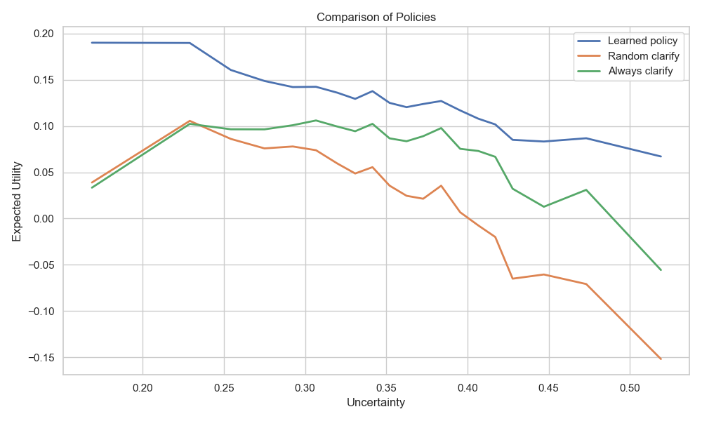
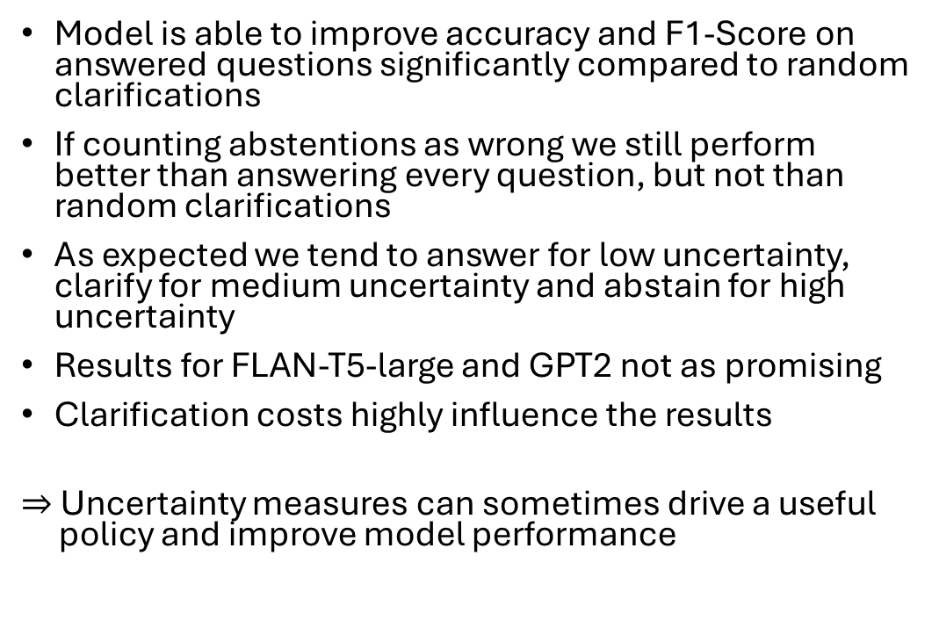
Results
Model is able to improve accuracy and F1-Score on answered questions significantly compared to random clarifications
If counting abstentions as wrong we still perform better than answering every question, but not than random clarifications
As expected we tend to answer for low uncertainty, clarify for medium uncertainty and abstain for high uncertainty
Results for FLAN-T5-large and GPT2 not as promising
Clarification costs highly influence the results
$⇒$ Uncertainty measures can sometimes drive a useful
policy and improve model performance
* All Figures based on FLAN-T5-base

Slide 7
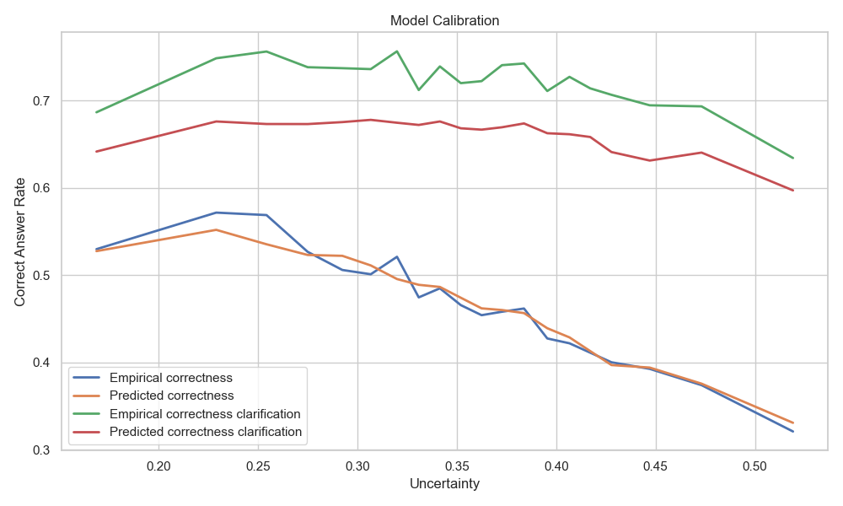
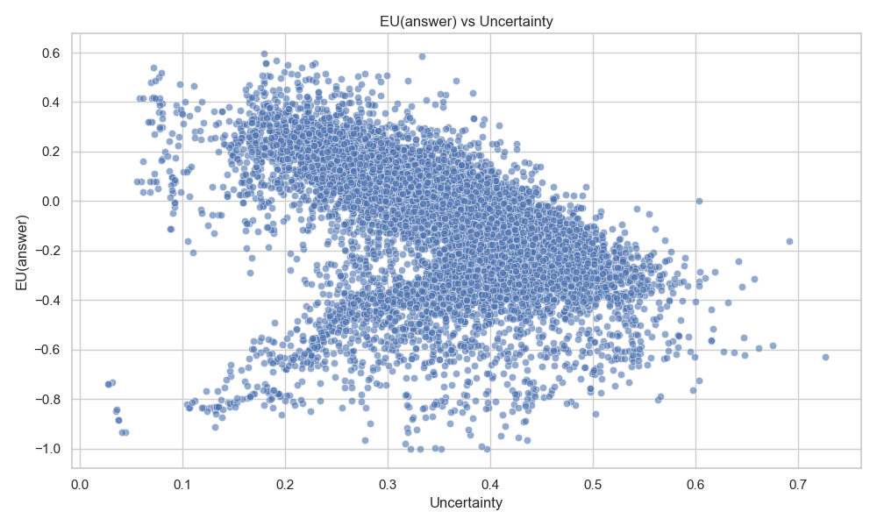
Further Thoughts
Performance might not be better for bigger models
Predicted correctness of a clarification is not well calibrated to the empirical correctness
Some samples have a small uncertainty, but tend to be wrongly answered (overconfidence)
Analyze more models and variations to clarify whether results for FLAN-T5-base or FLAN-T5-large/GPT2 are outliers
* All Figures based on FLAN-T5-base

Slide 8
Bibliography
Lei Huang et al., A Survey on Hallucination in Large Language Models: Principles, Taxonomy, Challenges, and Open Questions, ACM Transactions on Information Systems 43, 1-55, 2024
Sebastian Farquhar et al., Detecting hallucinations in large language models using semantic entropy, Nature 630, 625–630, 2024
Ji Xin et al., The Art of Abstention: Selective Prediction and Error Regularization for Natural Language Processing, 2021
Chinmaya Andukuri et al., STaR-GATE: Teaching Language Models to Ask Clarifying Questions, 2024
James Thorne et al., FEVER: a Large-scale Dataset for Fact Extraction and VERification, 2018
Hyung Won Chung et al., Scaling Instruction-Finetuned Language Models, 2022
Alec Redford et al., Language Models are Unsupervised Multitask Learners, 2019

