Slide 1
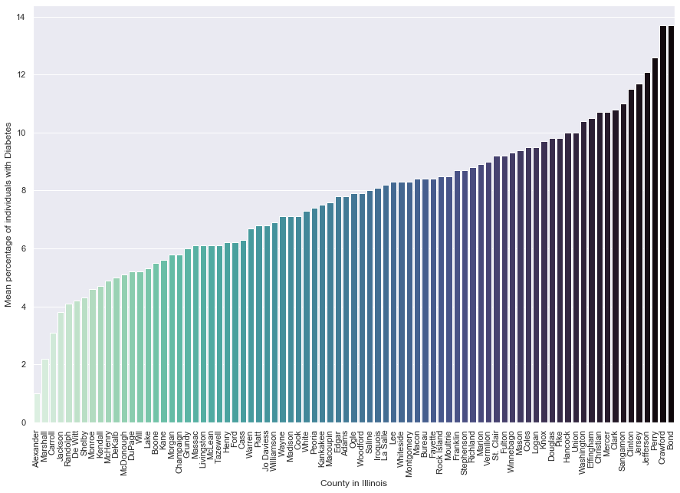
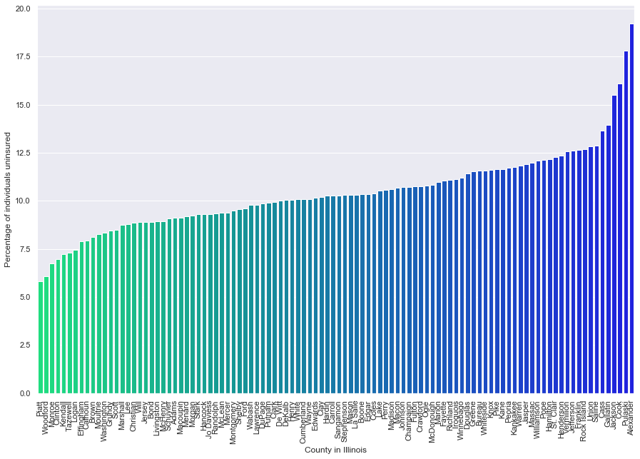
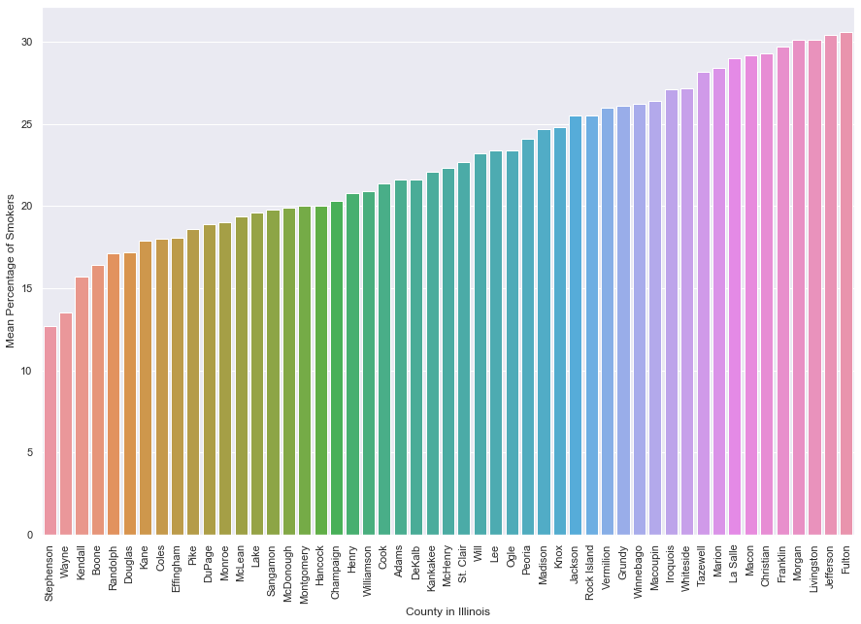
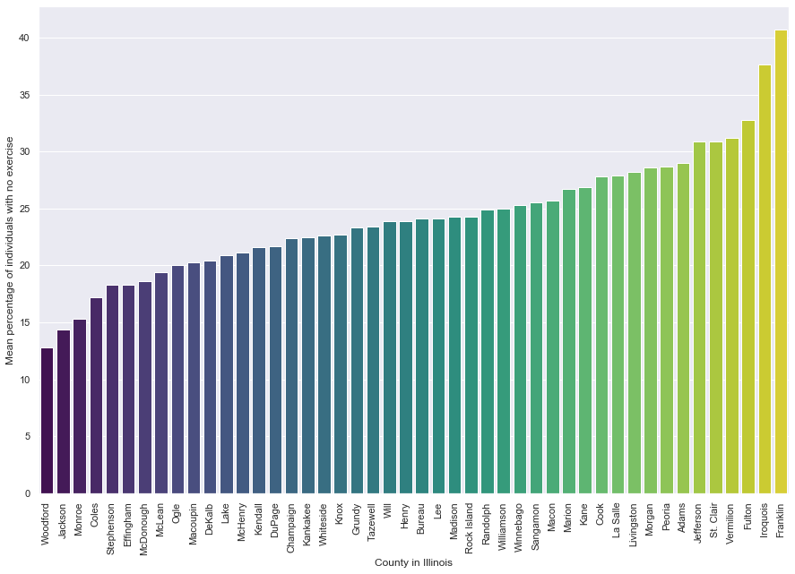
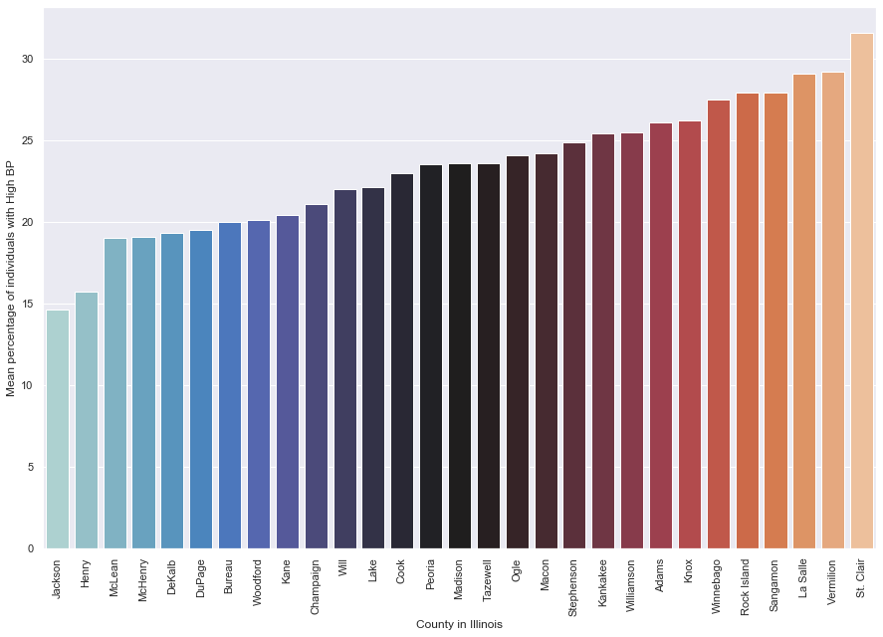
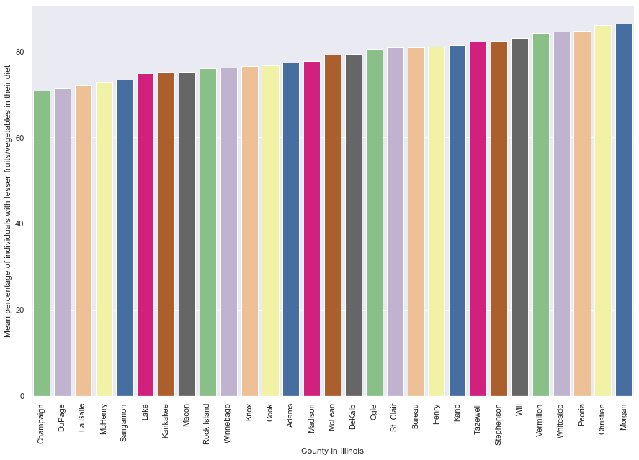
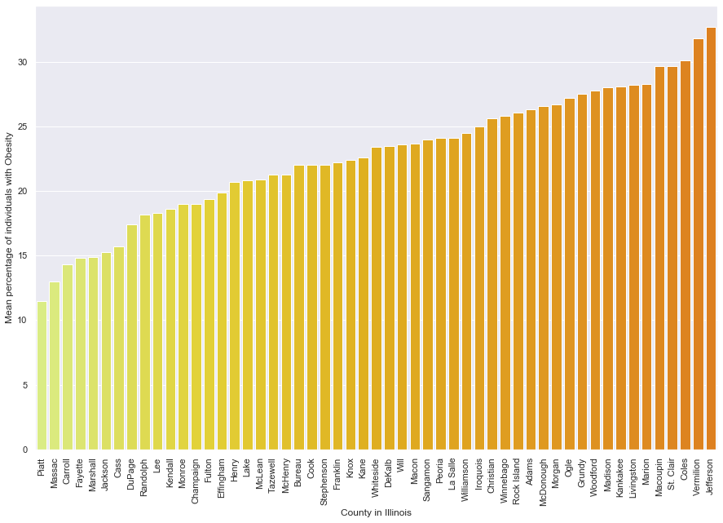
Health Status Indicators – Illinois Data

Slide 2
Main Takeaway from Illinois Data EDA
According to the plots of smokers, unhealthy diets, no exercise, diabetes, high BP etc sorted by increasing order; Counties like Jackson and Du Page appear have healthier habits among the population while counties like Jefferson and Morgan lie on the unhealthier side of almost every chart with higher number of individuals indulging in poor habits. Cook, Knox and Madison appear to lie on the middle range.
As expected, the counties with fewer physicians per 100k population appear to have more uninsured individuals in that County with 2 outliers, Jackson and Cook.
The number of healthcare staff per population in a County could reveal more about the health of the individuals and total deaths, which is why that was chosen as a factor for modelling an unsupervised clustering algorithm.
Another important aspect of a healthy population is to focus on lowering the infant mortality rate. A pipeline of ML models and optimization would be required to efficiently understand the indirect factors affecting it.

Slide 3
Modelling on Illinois County Data

Slide 4
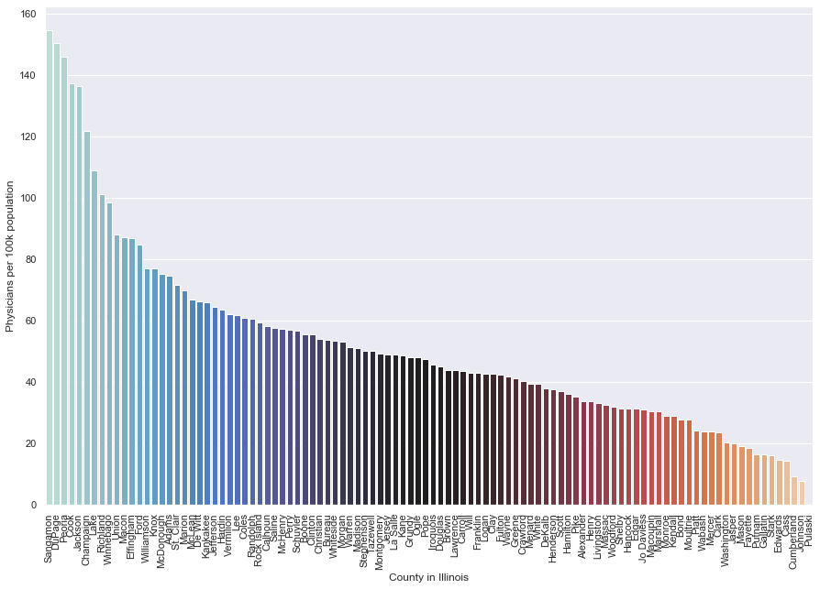
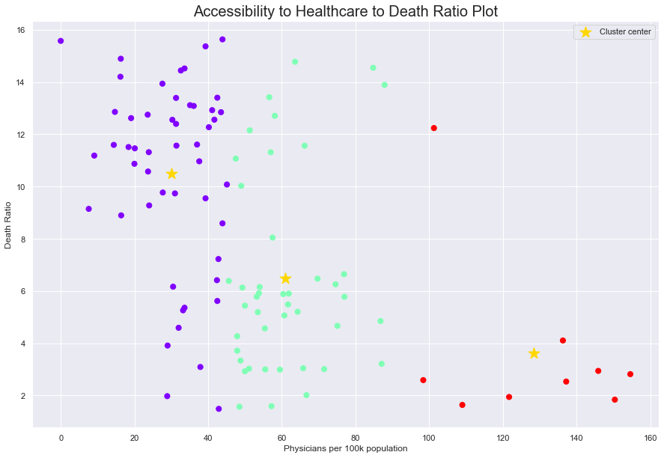
Unsupervised Clustering
Taking the number of deaths from the Demographics data and comparing it to the number of physicians per 100k in the County data of Illinois, we arrive at the conclusion that the high death rate is due to lack of medical staff. Hence healthcare agencies need to focus on staffing the counties listed on the higher end of death rates.
The clustering algorithm has clustered the data with plenty of outliers, indicating that lack of medical staffing is not the only reason for a high or low death rate.
A robust ensemble model will be more accurate in predicting the leading factors affecting death rate.

Slide 5
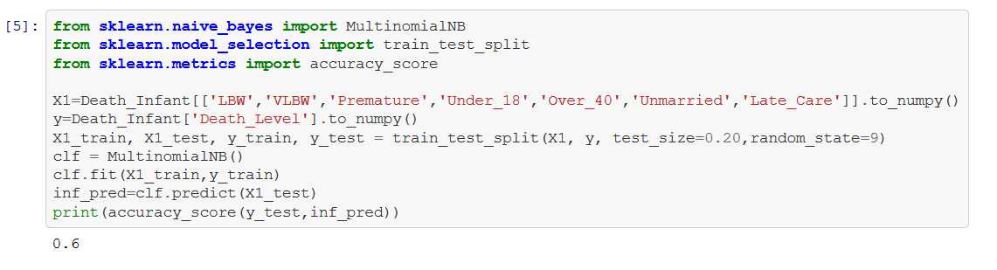
Infant Mortality Prediction
The pipeline consists of 3 steps :
Clustering regions by low and high Infant mortality.
Running a Naïve Bayes Classifier to fit the data with features as shown to the Death Level and evaluating the model based on accuracy score given by the ratio of correct classifications.
Using Backward Elimination iterations to eliminate features with lesser influence to improve accuracy of classifications.
Initial accuracy with Illinois Data

Slide 6
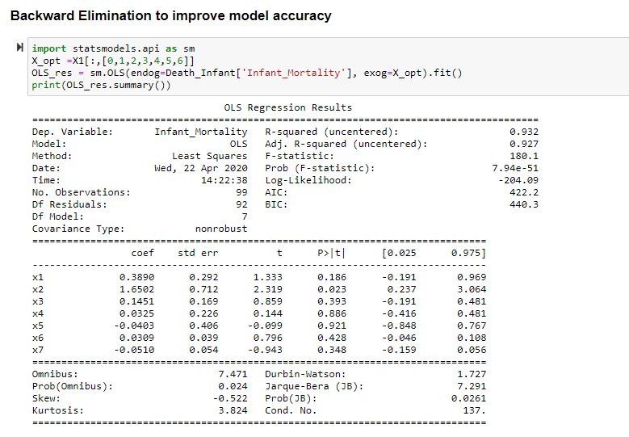
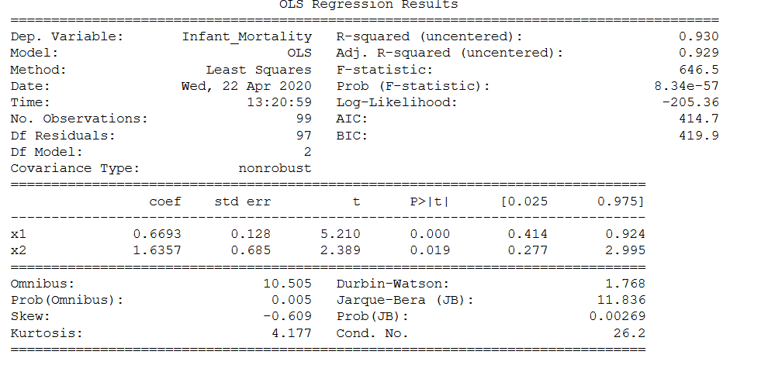
The significance level is taken as 0.05. It appears that only the features Low Birth Weight and Very Low Birth Weight have an effect on the infant mortality for counties in Illinois after 5 iterations. This will change from State to State. Hence it is important to run this on different States to see which features have most impact which is a useful insight to healthcare agencies.
Low Birth Weight in turn could be a result of poor prenatal care for pregnant women or food insecurity amongst the population which results in malnutrition in mothers.

Slide 7
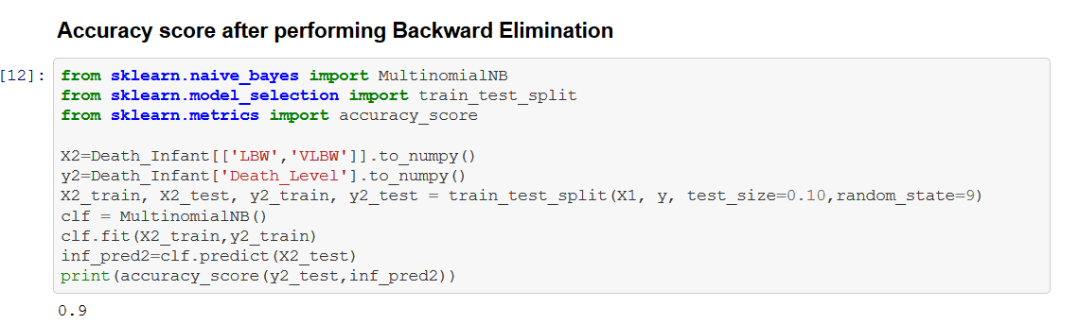
The redundant features eliminated through backward elimination varies for each state.
Although, such a large increase in accuracy for this model is superficial. Since there is a high bias in this model, the accuracy can vary a great deal.
In order to make the model more robust, we require more data. But since unavailable data can’t be helped in this case (We cannot survey for more data) we will resort to making our predictions based on world data and with a different model such as random forest.

Slide 8
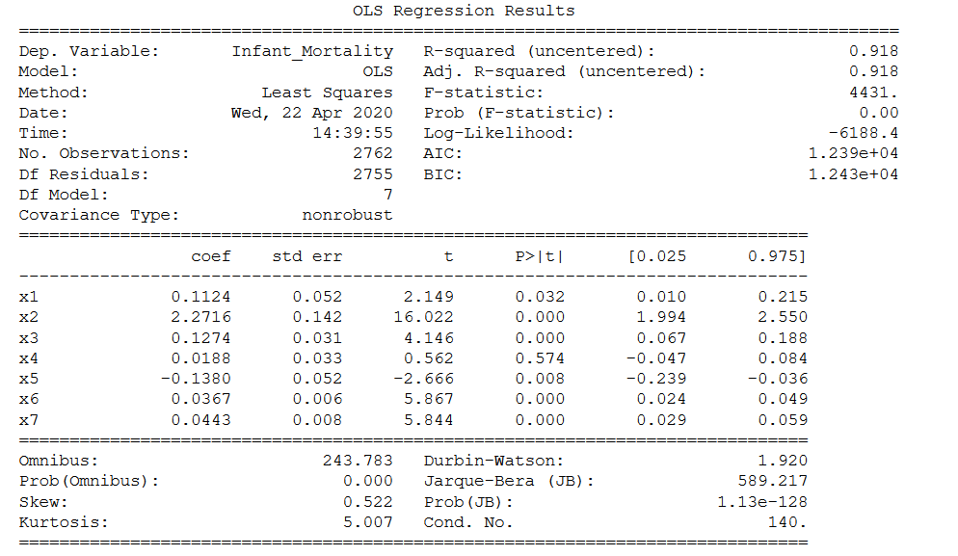
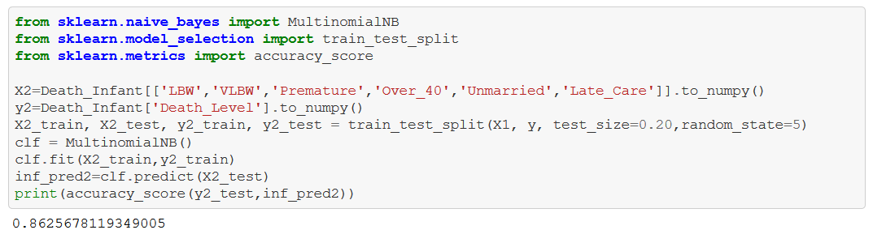
Backward Elimination and Accuracy on World Data
In the world data, all factors satisfy the significance level except for pregnancies under 18. This makes sense, although it is unethical for an age of under 18, a lower age plays a role in producing a healthy offspring hence it does not affect the classifications. And there is lower bias in the model even though the accuracy is lower than the one with only Illinois data.

