Slide 1
Cyber Security:
Data Encryption
Dan Sullivan
Notes:
This LESSON TEMPLATE provides a high-level standard approach to delivering a lesson experience.
It DOES identify the major steps each lesson should have. Students need to see, feel, hear, or touch these steps. They need to be real.
It DOES NOT dictate the use of PPTs, or a slide for every step.
MAIN TOPIC: should be an Action Verb statement, such as “Configure and Test a VPN” or “Build a Bubble Sort”

Slide 2
What We’ll Learn
Compare different levels of-- and approaches to-- encryption
  Case study - Review hybrid approach to online transaction
Describe and demonstrate three levels of encryption (using code)
  Simple
  Hash and SHA
  Public/Private Key
Notes:
Break the main lesson objective down into four to six Action Verb statements.
For our VPN example, these might be:
Identify key design elements (to meet user needs, security, and other policy requirements)
Select the right VPN tools, and verify they are correctly installed
Configure both ends of the VPN
Test the VPN’s basic operation
Attempt penetration / security / error testing of the new VPN
Enable users (or classes of users) to use the VPN

Slide 3

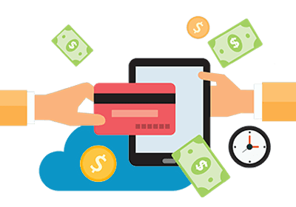

How do Business and Industry Use It?
  Data encryption can be used as a measured response for mitigating information security risks
  Different approaches should be used for different risk levels
    (according to Asset Value, Vulnerability and Threat level)
  Information risk should be considered separately for data…:
    At Rest, In Transit, & In Use
(Information) Security is relative, not absolute. Balance risk mitigation and acceptance
Notes:
Make real world connections that relate what we’re about to teach and learn to realistic, everyday uses.
For a single Main Topic, there might be one, three or more “key features” that you can make examples of. Take one or more of them and illustrate in terms of outcome: what does the business gain (over its competitors, or against its adversaries) by doing this?
Lead a quick discussion, with an example such as:
Loops and Conditional statements: “Smart Home” products you can control with your smartphone (but keep burglars from controlling for you)
Infinite loops: machines are always waiting for us – or others – to do something. That’s a “wait until called” loop.
Why?
Simplifies the design AND makes the user interface easier to understand.
Conveys “always watching over you”, always protecting, always monitoring.
This directly relates to the customer’s perception of the value of this service.
Other examples: how would YOU quickly link the “what the code or the system does” to the value the users and the company derive from it?
Digital Signatures: verify that the update you’re downloading from Microsoft is really from Microsoft, and is what they say it is
Increases users’ trust in the update itself and the update process
Presentation Layer Deserialization: “compare 5 products” in online shopping means fetch five products’ worth of data, arrange in a table, send to the client row by row, value by value, to display in shopper-friendly form.
PS: Isn’t this table a two-dimensional array, with rows and columns? You have been online shopping before, haven’t you?
Pivot tables (enrichment topic): MOST business users extract data from databases into tools like Power BI, Tableau, or Excel… but it’s useful to understand how they work underneath, in SQL
Etc.

Slide 4
How We’ll Learn This
Explain
  Present concepts and applications associated with cyber-security
  Where does Encryption fit?
Demonstrate
  Present and Discuss Case-Study, highlight different approaches
Engage, explore, and familiarize
  Discuss and Develop Code for Simple Cipher algorithm
Students demonstrate their understanding
  Discuss and Implement solution for more advanced en-/decryption
Review, wrap-up, and follow-up
Notes:
Break your lesson plan down into its discrete chunks, by name
THESE STEPS ARE IMPORTANT. They engage the students with both doing what you’re teaching them and thinking about it along the way.
NOTE: maybe each Outcome maps to specific steps. Maybe they don’t. You need to cover each outcome in at least one of the steps.
Extra steps – that don’t map to an Outcome, but that add enrichment, fun, what have you – are encouraged and welcome!

Slide 5
Step By Step…
1. What is Data Security?
  1.1 Identify and Assess Security Risk
Notes:
THIS IS THE MEAT AND POTATOES.
Add your lesson content here. ADD SLIDES or other resources here as you need them.

Slide 6
Information Security … à go-go
(a mini lesson)
18 weeks of cyber-security stuffed into 3 slides and 5 minutes or less…

Slide 7
Discussion: A Measured Response
  The total cost investment for protecting an asset shouldn’t significantly exceed the value of the asset.
    Teenager’s diary? Concealed under pillow/mattress?
    Bicycle? Padlock and cable? Locked garage?
    Passport & spending cash? Hotel room safe?
    …
A System may be made more secure, but never entirely secure

Slide 8
Discussion: Prioritized Importance
  Assets may include:
    Personal Privacy
      Medical, Financial, Social, … other
    Corporate
      Intellectual Property, Human Resource data, Business Plans, …
    National Security
  Further classification by level of:
    Confidentiality
    Sensitivity
    Value
    Criticality

Slide 9
Discussion: Identify Security Threats and Risk
  Threats to information security systems include interception, interruption, modification, and fabrication
  Protecting Data:
    At Rest
      Physical security (Locks? Redundancy? Backups? UPSs?
      Restricted access (User- and role-based access? Multi-part authentication?)
      Encryption (function? Symmetric key? Asymmetric key?)
    In Transit
      End-to-end encryption (SSL? VPN?)
      Alternative trans-media (RF? Copper? Fiber-optic)
    In Use
      Processing (dedicated server? Protected workstations?)
      End-points (user awareness? social engineering?)
How does unauthorized access occur? … The easiest way

Slide 10
Discussion: Encryption
  Encryption can be used to protect data in storage and transit by obscuring it from unintentional interception
  Categories of encryption include:
    (Keyless) Functional algorithms
      No key is required, applies a one-way algorithm to the subject data
    Symmetric Key
      Secret key algorithm. Requires both producer and consumer share keys
    Asymmetric Key
      Public key/Private key. Used to protect content as well as authenticate point of origin
Notes:
Encryption includes:
Keyless functions (including Hashes)

Slide 11
Step By Step…
1. What is Data Security?
  1.1 Identify and Assess Security Risk
  1.2 Case Study: Implementing an online payment system
Notes:
THIS IS THE MEAT AND POTATOES.
Add your lesson content here. ADD SLIDES or other resources here as you need them.

Slide 12
Online Payment System – User Stories
As a customer,
I want to submit secure online payments,
So that I can complete transactions quickly and efficiently
As a business owner,
I need to provide a simple and secure online payment system
So that I can remain competitive
As a business accountant,
I need to securely process online payments
So that the customer’s and business’ interests are not at risk

Slide 13
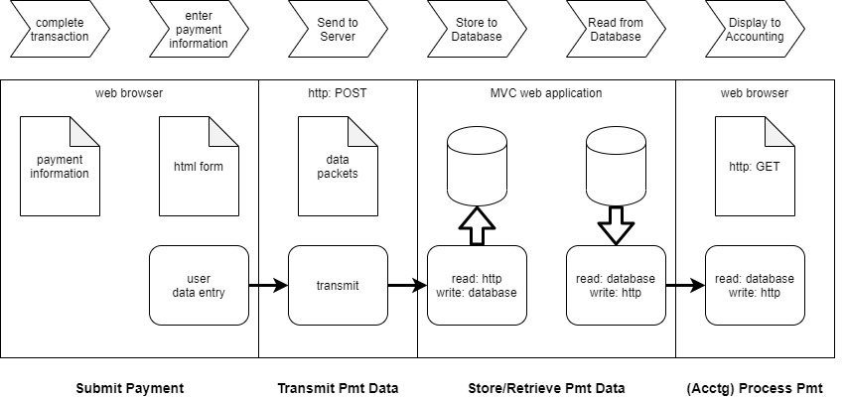
Online Payment System – Data Flow Concept
Question: How many security vulnerabilities can you identify?

Slide 14

Question: Can we make the transaction 100% secure?

Slide 15
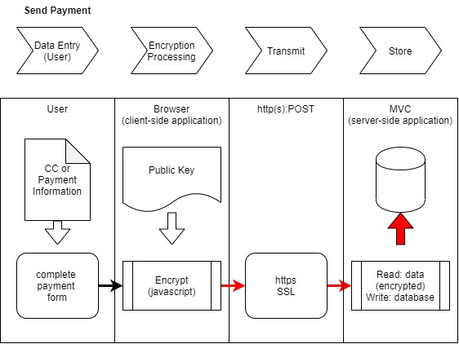
Submit Online Payments - Solution
Transmit payment data over encrypted (SSL) connection (https)
Encrypt data (client-side*) prior to
  writing to database
  Transmitting (https)
  server processing
  * Browser javascript processing with public key encryption

Slide 16
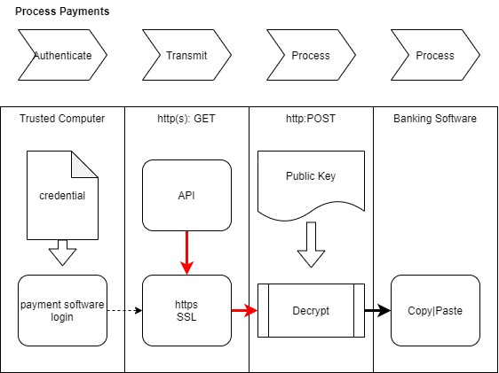
Online Payment System – Solution Part 2
Payment data remains encrypted for all server side handling and processing
Provide offline application to decrypt data using private key on trusted computer
Protect private key from unauthorized use
  controlling limited installation
  and authenticating authorized user

Slide 17
Online Payment System – End-to-End test

Slide 18
Step By Step…
1. What is Data Security?
  1.1 Identify and Assess Security Risk
  1.2 Case Study: Implementing an online payment system
2. Encrypting & Decrypting Data
  2.1 Substitution
Notes:
THIS IS THE MEAT AND POTATOES.
Add your lesson content here. ADD SLIDES or other resources here as you need them.

Slide 19


Caesar Cipher
Also known as a shift- or substitution- cipher, each character of the plain text is replaced with another from a known function f(x)
This Wikipedia example illustrates a “left rotation of three places”
Exercise 1: Write a method to implement a shift encryption for a given integer number of digits
Question: Will this method decrypt your message using the negative value of the same parameter?

Slide 20
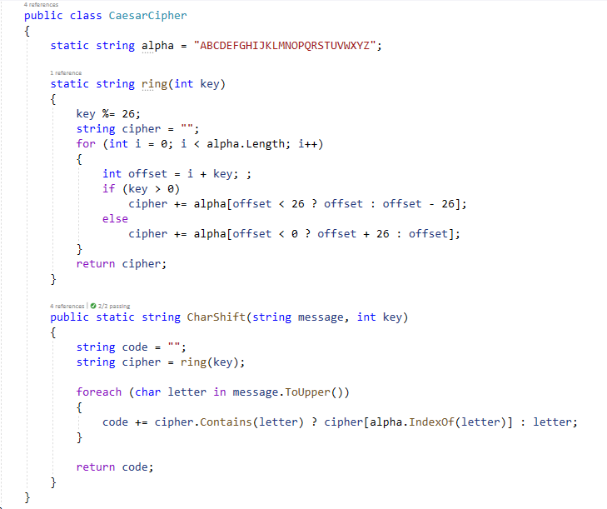
sample solution

Slide 21
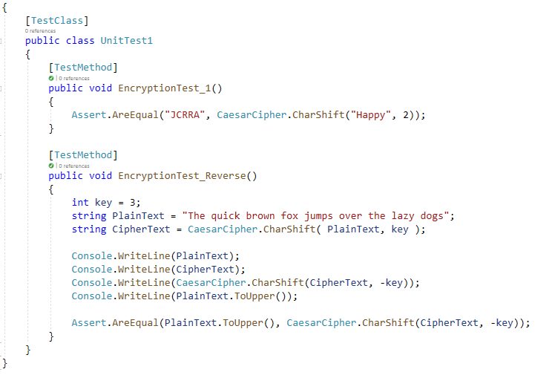
sample unit test

Slide 22
Step By Step…
1. What is Data Security?
  1.1 Identify and Assess Security Risk
  1.2 Case Study: Implementing an online payment system
2. Encrypting & Decrypting Data
  2.1 Substitution cipher
  2.2 Hash functions
Notes:
THIS IS THE MEAT AND POTATOES.
Add your lesson content here. ADD SLIDES or other resources here as you need them.

Slide 24
Step By Step…
1. What is Data Security?
  1.1 Identify and Assess Security Risk
  1.2 Case Study: Implementing an online payment system
2. Encrypting & Decrypting Data
  2.1 Substitution cipher
  2.2 Hash functions
  2.3 Assymetric ( Public key / Private key ) encryption
Notes:
THIS IS THE MEAT AND POTATOES.
Add your lesson content here. ADD SLIDES or other resources here as you need them.

Slide 25
What We’ve Just Learned
Remember
Understand
Apply
Analyze
Evaluate
Create
There are varying degrees of encryption
How much is considered secure?
Consider cost/risk for a given encryption level
Implement the end-to-end system
Factor maintenance, training and UI/UX in solution
Rinse and repeat
Notes:
This step focuses the students on what they’ve just done. It cements the lesson-specific learning outcomes back into their minds, in the immediate context of the activity they’ve just completed.
ACTIVE POLL of the class: Instructor walks each outcome and gets the class to acknowledge it was covered.
“Did we cover Objective 1? Clear? Understood? “
“Did we cover Objective 2? …”
This makes it a lot harder for those who were present to say (to themselves) “we never covered that.” It might, might encourage some of the students to realize that they need to do more homework on that outcome!
By confirming coverage and time / activity spent on outcomes, you also protect yourself as instructor and the program by setting the stage for the next step: follow-through and wrap-up

Slide 26
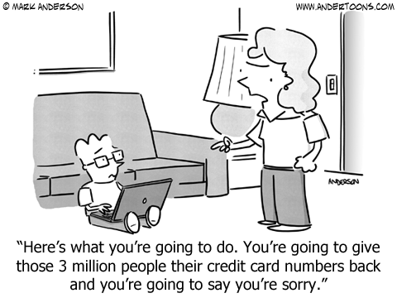

Slide 27
Terminal Learning Objective(s)
  Enabling Learning Objective(s)
TLO1: Describe levels and approaches to encryption solutions
  ELO1.1: Identify Asset, Threat, and Vulnerability classification
  ELO1.2: Discuss Case Study to identify risk and response
TLO2: Identify and compare three encryption levels
  ELO2.1: Describe simple function execution algorithms
    Ex 1. Implement simple “Caesar cipher” algorithm
  ELO2.2: Describe Hash and SHA
    Ex 2. Apply third-party encryption methods to code
  ELO2.3: Public/Private Key
    End-to-end demonstration
Notes:
Terminal Learning Objectives
and corresponding
Enabling Objectives (NOT Electric Light Orchestra!)

Slide 28
Follow-On: Homework, Exercises, Labs…
  Homework assignments
  Labs
  Exercises
  Class Project steps or activities
Notes:
Instructor specifies follow-on activities that will reinforce this learning.
Yes, these details are in the syllabus and in the Canvas lesson plan. ANCHOR them in the students’ minds, in the context of what they’ve just done.
Then: Declare victory and move on!

